Slide 1
Spelling Y4
Mastering spellings: building of the foundations of phonics
Autumn 1
Week 4
(Duplicate of Year 3 summer 2 week 4)

Slide 2
Year 4 - Autumn 1
Week 4 - Monday

Slide 3
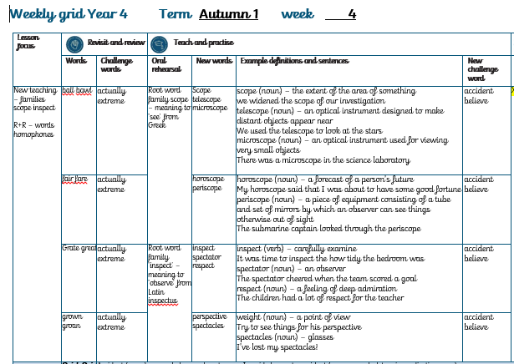

Slide 4
Let’s Revisit and Review…

Slide 5
Do you remember this challenge word?

Slide 6

Definition – in fact or really
actually
ADVERB

Slide 7
I didn’t actually see her – I just heard her voice.
________

Slide 8
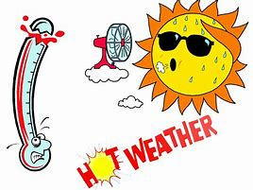
Definition – very great
extreme
ADJECTIVE

Slide 9
The weather forecast was for extreme heat.
_______

Slide 10
Homophones

Slide 11
Homophones
Words which sound the same but have different spellings, meanings or origins

Slide 12
ball

Slide 13
bawl

Slide 14
Let’s Teach and Practise

Slide 15
Root word family: scope meaning to ‘see’ from Greek

Slide 16

scope

Slide 17

telescope

Slide 18
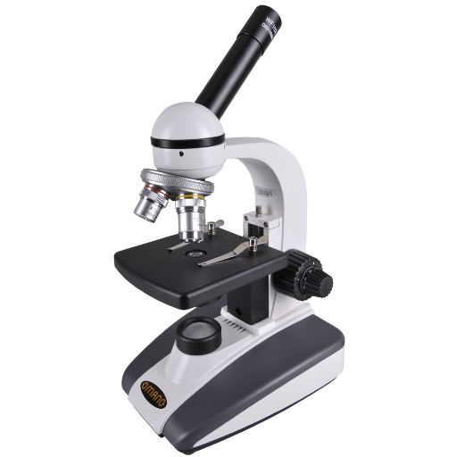
microscope

Slide 19
Definition - the extent of the area of something
scope
(noun)

Slide 20
Definition - an optical instrument designed to make distant objects appear near
telescope
(noun)

Slide 21
Definition - an optical instrument used for viewing very small objects
microscope
(noun)

Slide 22
We widened the scope of our investigation.
_____

Slide 23
We used the telescope to look at the stars.
_________

Slide 24
There was a microscope in the science laboratory.
__________

Slide 25
New CHALLENGE words.

Slide 26
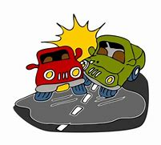
Definition - an unfortunate incident that happens unexpectedly and unintentionally, typically resulting in damage or injury
accident
NOUN

Slide 27
Luckily I avoided having a nasty accident.
________

Slide 28

Definition - accept that (something) is true, especially without proof
believe
VERB

Slide 29
I couldn’t believe my eyes!
_______

Slide 30
Let’s Practise and Apply.

Slide 31
Can you spot the spelling rule words and the challenge words?

Slide 32
The scope of materials to build homes from is large. Actually, stone has been quarried in the UK with over 120 different types of building stone being used for housing. Stone is an excellent building material due to its strength under extreme pressure and is great against wind and water. When you inspect stone homes carefully, you notice the type of stone used is quarried locally. This is due to the difficulty in transporting stone. Respect must be given to the Ancient Egyptians for developing ways to quarry, move and shape huge blocks of stone to create homes.

Slide 33
The scope of materials to build homes from is large. Actually, stone has been quarried in the UK with over 120 different types of building stone being used for housing. Stone is an excellent building material due to its strength under extreme pressure and is great against wind and water. When you inspect stone homes carefully, you notice the type of stone used is quarried locally. This is due to the difficulty in transporting stone. Respect must be given to the Ancient Egyptians for developing ways to quarry, move and shape huge blocks of stone to create homes.

Slide 34
Write this sentence as I dictate it to you.
Notes:
The scope of materials to build homes from is large. Actually, stone has been quarried in the UK with over 120 different types of building stone being used for housing.

Slide 35
The scope of materials to build homes from is large. Actually, stone has been quarried in the UK with over 120 different types of building stone being used for housing.
Did you write it correctly?
Edit your work and make sure you have it correct.
Can you underline the spelling words that we have covered in this session?

Slide 36
Year 4 - Autumn 1
Week 4 - Tuesday

Slide 38
Let’s Revisit and Review…

Slide 39
Do you remember this challenge word?

Slide 40
Definition – in fact or really
actually
ADVERB

Slide 41
I didn’t actually see her – I just heard her voice.
________

Slide 42
Definition – very great
extreme
ADJECTIVE

Slide 43
The weather forecast was for extreme heat.
_______

Slide 44
Homophones

Slide 45
Homophones
Words which sound the same but have different spellings, meanings or origins

Slide 46
fair

Slide 47
fare

Slide 48
Let’s Teach and Practise

Slide 49
Root word family: scope meaning to ‘see’ from Greek

Slide 50
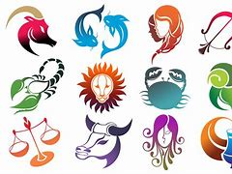
horoscope

Slide 51

periscope

Slide 52
Definition - a forecast of a person’s future
horoscope
(noun)

Slide 53
Definition - a piece of equipment consisting of a tube and set of mirrors by which an observer can see things otherwise out of sight
periscope
(noun)

Slide 54
My horoscope said that I was about to have some good fortune.
_________

Slide 55
The submarine captain looked through the periscope.
_________

Slide 56
New CHALLENGE words.

Slide 57
Definition - an unfortunate incident that happens unexpectedly and unintentionally, typically resulting in damage or injury
accident
NOUN

Slide 58
Luckily I avoided having a nasty accident.
________

Slide 59
Definition - accept that (something) is true, especially without proof
believe
VERB

Slide 60
I couldn’t believe my eyes!
_______

Slide 61
Let’s Practise and Apply.

Slide 62
Can you spot the spelling rule words and the challenge words?

Slide 63
The scope of materials to build homes from is large. Actually, stone has been quarried in the UK with over 120 different types of building stone being used for housing. Stone is an excellent building material due to its strength under extreme pressure and is great against wind and water. When you inspect stone homes carefully, you notice the type of stone used is quarried locally. This is due to the difficulty in transporting stone. Respect must be given to the Ancient Egyptians for developing ways to quarry, move and shape huge blocks of stone to create homes.

Slide 64
The scope of materials to build homes from is large. Actually, stone has been quarried in the UK with over 120 different types of building stone being used for housing. Stone is an excellent building material due to its strength under extreme pressure and is great against wind and water. When you inspect stone homes carefully, you notice the type of stone used is quarried locally. This is due to the difficulty in transporting stone. Respect must be given to the Ancient Egyptians for developing ways to quarry, move and shape huge blocks of stone to create homes.

Slide 65
Write this sentence as I dictate it to you.
Notes:
Stone is an excellent building material due to its strength under extreme pressure.

Slide 66
Stone is an excellent building material due to its strength under extreme pressure .
Did you write it correctly?
Edit your work and make sure you have it correct.
Can you underline the spelling words that we have covered in this session?

Slide 67
Year 4 - Autumn 1
Week 4 - Wednesday

Slide 69
Let’s Revisit and Review…

Slide 70
Do you remember this challenge word?

Slide 71
Definition – in fact or really
actually
ADVERB

Slide 72
I didn’t actually see her – I just heard her voice.
________

Slide 73
Definition – very great
extreme
ADJECTIVE

Slide 74
The weather forecast was for extreme heat.
_______

Slide 75
Homophones

Slide 76
Homophones
Words which sound the same but have different spellings, meanings or origins

Slide 77
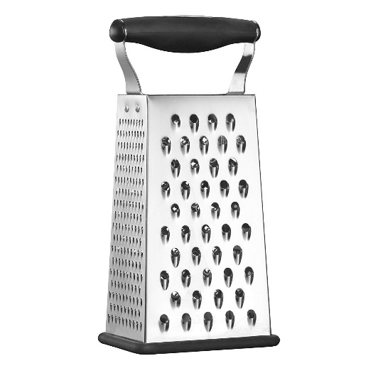
grate

Slide 78
great

Slide 79
Let’s Teach and Practise

Slide 80
Root word family:
‘spect’ meaning to ‘observe’ from Latin inspectus

Slide 81

inspect

Slide 82
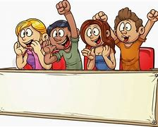
spectator

Slide 83

respect

Slide 84
Definition - carefully examine
inspect
(verb)

Slide 85
Definition - an observer
spectator
(noun)

Slide 86
Definition - a feeling of deep admiration
respect
(noun)

Slide 87
It was time to inspect how tidy the bedroom was.
_______

Slide 88
The spectator cheered when the team scored a goal.
_________

Slide 89
The children had a lot of respect for their teacher.
_______

Slide 90
New CHALLENGE words.

Slide 91
Definition - an unfortunate incident that happens unexpectedly and unintentionally, typically resulting in damage or injury
accident
NOUN

Slide 92
Luckily I avoided having a nasty accident.
________

Slide 93
Definition - accept that (something) is true, especially without proof
believe
VERB

Slide 94
I couldn’t believe my eyes!
_______

Slide 95
Let’s Practise and Apply.

Slide 96
Can you spot the spelling rule words and the challenge words?

Slide 97
The scope of materials to build homes from is large. Actually, stone has been quarried in the UK with over 120 different types of building stone being used for housing. Stone is an excellent building material due to its strength under extreme pressure and is great against wind and water. When you inspect stone homes carefully, you notice the type of stone used is quarried locally. This is due to the difficulty in transporting stone. Respect must be given to the Ancient Egyptians for developing ways to quarry, move and shape huge blocks of stone to create homes.

Slide 98
The scope of materials to build homes from is large. Actually, stone has been quarried in the UK with over 120 different types of building stone being used for housing. Stone is an excellent building material due to its strength under extreme pressure and is great against wind and water. When you inspect stone homes carefully, you notice the type of stone used is quarried locally. This is due to the difficulty in transporting stone. Respect must be given to the Ancient Egyptians for developing ways to quarry, move and shape huge blocks of stone to create homes.

Slide 99
Write this sentence as I dictate it to you.
Notes:
When you inspect stone homes carefully, you notice the type of stone used is quarried locally.

Slide 100
When you inspect stone homes carefully, you notice the type of stone used is quarried locally.
Did you write it correctly?
Edit your work and make sure you have it correct.
Can you underline the spelling words that we have covered in this session?

Slide 101
Year 4 - Autumn 1
Week 4 - Thursday
Notes:
Revisit and review the words from Y3– I say, we say, you say
Ask children to write words only in their spelling book
Words from root word family spect – meaning to ‘see’ from Latin
Children to write the new spelling rule words and challenge words into books when the sentences are shown with the spelling word missing.
Read the extract with the class as choral reading. Practise model of prosody etc.
Ask children to find the spelling words from the session in the text.
Then read allowed the chosen sentence for children to write fully in their books.
Show the extract and ask children to then edit their work to check they were correct in their dictation.

Slide 102
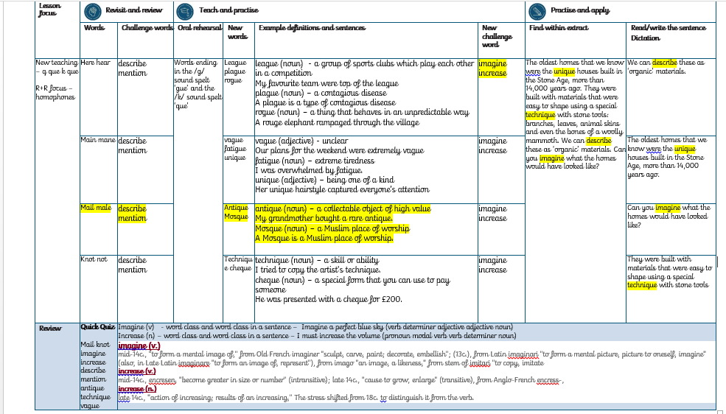

Slide 103
Let’s Revisit and Review…

Slide 104
Do you remember this challenge word?

Slide 105
Definition – in fact or really
actually
ADVERB

Slide 106
I didn’t actually see her – I just heard her voice.
________

Slide 107
Definition – very great
extreme
ADJECTIVE

Slide 108
The weather forecast was for extreme heat.
_______

Slide 109
Homophones

Slide 110
Homophones
Words which sound the same but have different spellings, meanings or origins

Slide 111
grown

Slide 112
groan

Slide 113
Let’s Teach and Practise

Slide 114
Root word family:
‘spect’ meaning to ‘observe’ from Latin inspectus

Slide 115
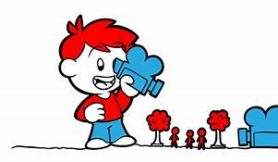
perspective

Slide 116

spectacles

Slide 117
Definition - a point of view
perspective
(noun)

Slide 118
Definition - glasses
spectacles
(noun)

Slide 119
Try to see things from his perspective.
___________

Slide 120
I’ve lost my spectacles!
__________

Slide 121
New CHALLENGE words.

Slide 122
Definition - an unfortunate incident that happens unexpectedly and unintentionally, typically resulting in damage or injury
accident
NOUN

Slide 123
Luckily I avoided having a nasty accident.
________

Slide 124
Definition - accept that (something) is true, especially without proof
believe
VERB

Slide 125
I couldn’t believe my eyes!
_______

Slide 126
Let’s Practise and Apply.

Slide 127
Can you spot the spelling rule words and the challenge words?

Slide 128
The scope of materials to build homes from is large. Actually, stone has been quarried in the UK with over 120 different types of building stone being used for housing. Stone is an excellent building material due to its strength under extreme pressure and is great against wind and water. When you inspect stone homes carefully, you notice the type of stone used is quarried locally. This is due to the difficulty in transporting stone. Respect must be given to the Ancient Egyptians for developing ways to quarry, move and shape huge blocks of stone to create homes.

Slide 129
The scope of materials to build homes from is large. Actually, stone has been quarried in the UK with over 120 different types of building stone being used for housing. Stone is an excellent building material due to its strength under extreme pressure and is great against wind and water. When you inspect stone homes carefully, you notice the type of stone used is quarried locally. This is due to the difficulty in transporting stone. Respect must be given to the Ancient Egyptians for developing ways to quarry, move and shape huge blocks of stone to create homes.

Slide 130
Write this sentence as I dictate it to you.
Notes:
Respect must be given to the Ancient Egyptians for developing ways to quarry, move and shape huge blocks of stone to create homes.

Slide 131
Respect must be given to the Ancient Egyptians for developing ways to quarry, move and shape huge blocks of stone to create homes.
Did you write it correctly?
Edit your work and make sure you have it correct.
Can you underline the spelling words that we have covered in this session?

Slide 132
Year 4 - Autumn 1
Week 4 - Friday
Notes:
Click through the slides for all the R+R words for the week (both the focus and the challenge words)
Click through the slides for all the new learning this week

Slide 133
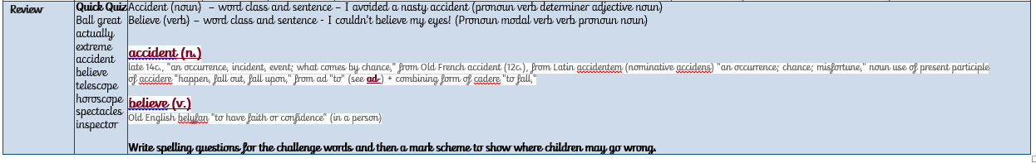

Slide 134
Old challenge words…

Slide 135
actually

Slide 136
extreme

Slide 137
Old spelling rule words… (homophones)

Slide 138
ball

Slide 139
bawl

Slide 140
fair

Slide 141
fare

Slide 142
grate

Slide 143
great

Slide 144
grown

Slide 145
groan

Slide 146
New spelling rule words…

Slide 147
scope

Slide 148
telescope

Slide 149
microscope

Slide 150
horoscope

Slide 151
periscope

Slide 152
inspect

Slide 153
spectator

Slide 154
respect

Slide 155
perspective

Slide 156
spectacles

Slide 157
New challenge words…

Slide 158
accident

Slide 159
believe

Slide 160
Quick Quiz time…
Notes:
Say these words for the quiz:
Ball great actually extreme accident believe telescope horoscope spectacles inspector

Slide 161
Did you get them correct?
Ball
Great
actually
extreme
accident
Edit your work.
Believe
telescope
horoscope
spectacles
inspector

Slide 162
Word class time…

Slide 163
accident
Luckily I avoided having a nasty accident

Slide 164
accident
Luckily I avoided having a nasty accident
Adverb pronoun verb verb determiner adjective noun

Slide 165
accident
Luckily I avoided having a nasty accident
Adverb pronoun verb verb determiner adjective noun

Slide 166
believe
I couldn’t believe my eyes!
Pronoun (modal) verb verb determiner noun

Slide 167
believe
I couldn’t believe my eyes!
Pronoun (modal) verb verb determiner noun

Slide 168
Etymology
The history of a word….

Slide 169
accident (n.)
late 14c., "an occurrence, incident, event; what comes by chance," from Old French accident (12c.)
from Latin accidentem (nominative accidens) "an occurrence; chance; misfortune,"
noun use of present participle of accidere "happen, fall out, fall upon," from ad "to"

Slide 170
believe (v.)
Old English belyfan
"to have faith or confidence" (in a person)

Slide 171
Let’s investigate….
Write a multiple choice quiz for each word with three incorrect spellings and one correct spelling.
Your partner will identify the correct spelling and explain why the others are wrong

Slide 172
For example:
  akcident
  accident
  acident
  acsident

