Slide 1
Spelling Y4
Mastering spellings: building of the foundations of phonics
Autumn 1
Week 5
(Duplicate of Year 3 summer 2 week 5)

Slide 2
Year 4 - Autumn 1
Week 5 - Monday

Slide 3
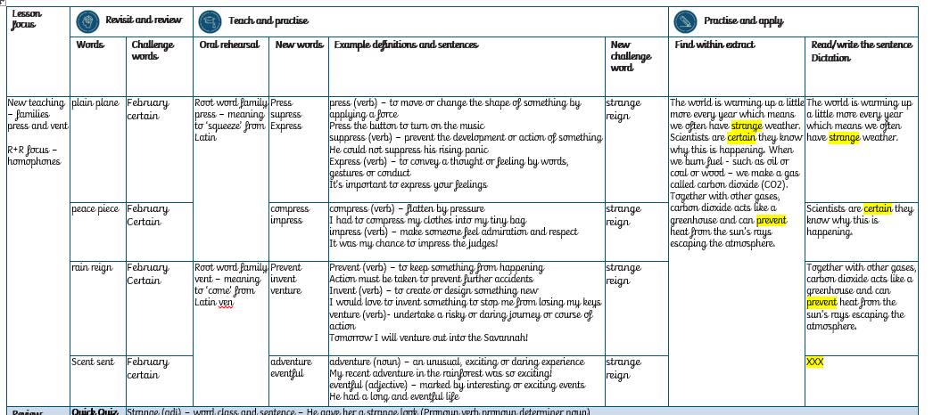

Slide 4
Let’s Revisit and Review…

Slide 5

February
NOUN
Definition - the second month of the year, in the northern hemisphere usually considered the last month of winter

Slide 6
In February the place is busy.
________

Slide 7
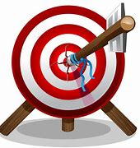
certain
ADJECTIVE
Definition - able to be firmly relied on to happen or be the case

Slide 8
The certain answer was clear.
_______

Slide 9
Homophones

Slide 10
homophones = same sound homo- same phone – sound

Slide 11
homophones

Slide 12
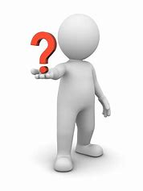
which

Slide 13
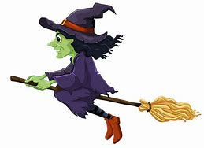
witch

Slide 14
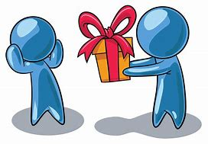
accept

Slide 15

except

Slide 16
Let’s Teach and Practise

Slide 17
Root word family: press meaning to ‘squeeze’ from Latin

Slide 18

press

Slide 19
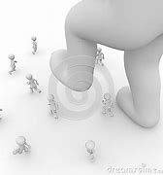
suppress

Slide 20

express

Slide 21
Definition - to move or change the shape of something by applying a force
press
(verb)

Slide 22
Definition -prevent the development or action of something
suppress
(verb)

Slide 23
Definition - to convey a thought or feeling by words, gestures or conduct
express
(verb)

Slide 24
Press the button to turn on the music.
_____

Slide 25
He could not suppress his rising panic.
________

Slide 26
It’s important to express your feelings.
_______

Slide 27
New CHALLENGE words.

Slide 28
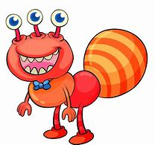
Definition - unusual or surprising; difficult to understand or explain
strange
ADJECTIVE

Slide 29
What a strange sight!
_______

Slide 30

Definition - the period of rule of a monarch
reign
NOUN

Slide 31
Her reign as queen began in 1952.
_____

Slide 32
Let’s Practise and Apply.

Slide 33
Can you spot the spelling rule words and the challenge words?

Slide 34
The world is warming up a little more every year which means we often have strange weather. Scientists are certain they know why this is happening. When we burn fuel - such as oil or coal or wood – we make a gas called carbon dioxide (CO2). Together with other gases, carbon dioxide acts like a greenhouse and can prevent heat from the sun’s rays escaping the atmosphere. Scientists have yet to invent a way to reverse this process.

Slide 35
The world is warming up a little more every year which means we often have strange weather. Scientists are certain they know why this is happening. When we burn fuel - such as oil or coal or wood – we make a gas called carbon dioxide (CO2). Together with other gases, carbon dioxide acts like a greenhouse and can prevent heat from the sun’s rays escaping the atmosphere. Scientists have yet to invent a way to reverse this process.

Slide 36
Write this sentence as I dictate it to you.
Notes:
We often have strange weather.

Slide 37
We often have strange weather.
Did you write it correctly?
Edit your work and make sure you have it correct.
Can you underline the spelling words that we have covered in this session?

Slide 38
Year 4 - Autumn 1
Week 5 - Tuesday

Slide 40
Let’s Revisit and Review…

Slide 41
February
NOUN
Definition - the second month of the year, in the northern hemisphere usually considered the last month of winter

Slide 42
In February the place is busy.
________

Slide 43
certain
ADJECTIVE
Definition - able to be firmly relied on to happen or be the case

Slide 44
The certain answer was clear.
_______

Slide 45
Homophones

Slide 46
homophones = same sound homo- same phone – sound

Slide 47
homophones

Slide 48
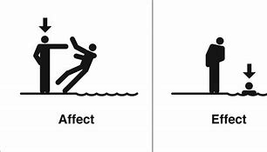
affect

Slide 49
effect

Slide 50
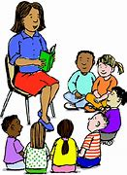
aloud

Slide 51

allowed

Slide 52
Let’s Teach and Practise

Slide 53
Root word family: press meaning to ‘squeeze’ from Latin

Slide 54

compress

Slide 55

impress

Slide 56
Definition - flatten by pressure
compress
(verb)

Slide 57
Definition - make someone feel admiration and respect
impress
(verb)

Slide 58
I had to compress my clothes into my tiny bag.
________

Slide 59
It was my chance to impress the judges!
_______

Slide 60
New CHALLENGE words.

Slide 61
Definition - unusual or surprising; difficult to understand or explain
strange
ADJECTIVE

Slide 62
What a strange sight!
_______

Slide 63
Definition - the period of rule of a monarch
reign
NOUN

Slide 64
Her reign as queen began in 1952.
_____

Slide 65
Let’s Practise and Apply.

Slide 66
Can you spot the spelling rule words and the challenge words?

Slide 67
The world is warming up a little more every year which means we often have strange weather. Scientists are certain they know why this is happening. When we burn fuel - such as oil or coal or wood – we make a gas called carbon dioxide (CO2). Together with other gases, carbon dioxide acts like a greenhouse and can prevent heat from the sun’s rays escaping the atmosphere. Scientists have yet to invent a way to reverse this process.

Slide 68
The world is warming up a little more every year which means we often have strange weather. Scientists are certain they know why this is happening. When we burn fuel - such as oil or coal or wood – we make a gas called carbon dioxide (CO2). Together with other gases, carbon dioxide acts like a greenhouse and can prevent heat from the sun’s rays escaping the atmosphere. Scientists have yet to invent a way to reverse this process.

Slide 69
Write this sentence as I dictate it to you.
Notes:
Scientists are certain they know why this is happening.

Slide 70
Scientists are certain they know why this is happening.
Did you write it correctly?
Edit your work and make sure you have it correct.
Can you underline the spelling words that we have covered in this session?

Slide 71
Year 4 - Autumn 1
Week 5 - Wednesday

Slide 73
Let’s Revisit and Review…

Slide 74
February
NOUN
Definition - the second month of the year, in the northern hemisphere usually considered the last month of winter

Slide 75
In February the place is busy.
________

Slide 76
certain
ADJECTIVE
Definition - able to be firmly relied on to happen or be the case

Slide 77
The certain answer was clear.
_______

Slide 78
Homophones

Slide 79
homophones = same sound homo- same phone – sound

Slide 80
homophones

Slide 81
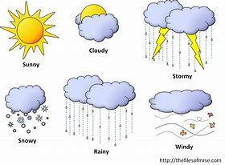
weather

Slide 82
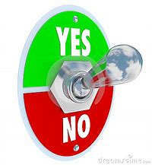
whether

Slide 83
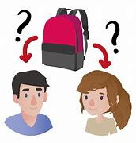
whose

Slide 84
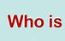
who’s

Slide 85
Let’s Teach and Practise

Slide 86
Root word family: vent meaning to ‘come’ from Latin ‘ven’.

Slide 87

prevent

Slide 88
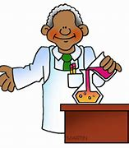
invent

Slide 89
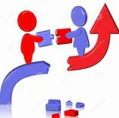
venture

Slide 90
Definition - to keep something from happening
prevent
(verb)

Slide 91
Definition - to create or design something new
invent
(verb)

Slide 92
Definition - to undertake a risky or daring journey or course of action
venture
(verb)

Slide 93
Action must be taken to prevent further accidents.
_______

Slide 94
I would love to invent something to stop me from losing my keys.
______

Slide 95
Tomorrow I will venture out into the Savannah!
_______

Slide 96
New CHALLENGE words.

Slide 97
Definition - unusual or surprising; difficult to understand or explain
strange
ADJECTIVE

Slide 98
What a strange sight!
_______

Slide 99
Definition - the period of rule of a monarch
reign
NOUN

Slide 100
Her reign as queen began in 1952.
_____

Slide 101
Let’s Practise and Apply.

Slide 102
Can you spot the spelling rule words and the challenge words?

Slide 103
The world is warming up a little more every year which means we often have strange weather. Scientists are certain they know why this is happening. When we burn fuel - such as oil or coal or wood – we make a gas called carbon dioxide (CO2). Together with other gases, carbon dioxide acts like a greenhouse and can prevent heat from the sun’s rays escaping the atmosphere. Scientists have yet to invent a way to reverse this process.

Slide 104
The world is warming up a little more every year which means we often have strange weather. Scientists are certain they know why this is happening. When we burn fuel - such as oil or coal or wood – we make a gas called carbon dioxide (CO2). Together with other gases, carbon dioxide acts like a greenhouse and can prevent heat from the sun’s rays escaping the atmosphere. Scientists have yet to invent a way to reverse this process.

Slide 105
Write this sentence as I dictate it to you.
Notes:
Carbon dioxide can prevent heat from escaping the atmosphere.

Slide 106
Carbon dioxide can prevent heat from escaping the atmosphere.
Did you write it correctly?
Edit your work and make sure you have it correct.
Can you underline the spelling words that we have covered in this session?

Slide 107
Year 4 - Autumn 1
Week 5 - Thursday

Slide 109
Let’s Revisit and Review…

Slide 110
February
NOUN
Definition - the second month of the year, in the northern hemisphere usually considered the last month of winter

Slide 111
In February the place is busy.
________

Slide 112
certain
ADJECTIVE
Definition - able to be firmly relied on to happen or be the case

Slide 113
The certain answer was clear.
_______

Slide 114
Homophones

Slide 115
homophones = same sound homo- same phone – sound

Slide 116
homophones

Slide 117
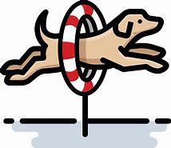
through

Slide 118
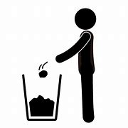
threw

Slide 119
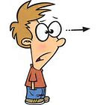
stares

Slide 120
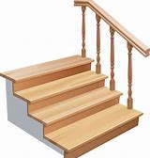
stairs

Slide 121
Let’s Teach and Practise

Slide 122
Root word family: vent meaning to ‘come’ from Latin ‘ven’.

Slide 123
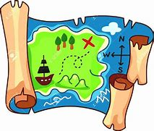
adventure

Slide 124
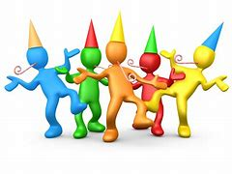
eventful

Slide 125
Definition - an unusual, exciting or daring experience
adventure
(noun)

Slide 126
Definition - marked by interesting or exciting events
eventful
(adjective)

Slide 127
My recent adventure in the rainforest was so exciting!
_________

Slide 128
He had a long and eventful life.
________

Slide 129
New CHALLENGE words.

Slide 130
Definition - unusual or surprising; difficult to understand or explain
strange
ADJECTIVE

Slide 131
What a strange sight!
_______

Slide 132
Definition - the period of rule of a monarch
reign
NOUN

Slide 133
Her reign as queen began in 1952.
_____

Slide 134
Let’s Practise and Apply.

Slide 135
Can you spot the spelling rule words and the challenge words?

Slide 136
The world is warming up a little more every year which means we often have strange weather. Scientists are certain they know why this is happening. When we burn fuel - such as oil or coal or wood – we make a gas called carbon dioxide (CO2). Together with other gases, carbon dioxide acts like a greenhouse and can prevent heat from the sun’s rays escaping the atmosphere. Scientists have yet to invent a way to reverse this process.

Slide 137
The world is warming up a little more every year which means we often have strange weather. Scientists are certain they know why this is happening. When we burn fuel - such as oil or coal or wood – we make a gas called carbon dioxide (CO2). Together with other gases, carbon dioxide acts like a greenhouse and can prevent heat from the sun’s rays escaping the atmosphere. Scientists have yet to invent a way to reverse this process.

Slide 138
Write this sentence as I dictate it to you.
Notes:
Scientists have yet to invent a way to reverse this process.

Slide 139
Scientists have yet to invent a way to reverse this process.
Did you write it correctly?
Edit your work and make sure you have it correct.
Can you underline the spelling words that we have covered in this session?

Slide 140
Year 4 - Autumn 1
Week 5 - Friday
Notes:
Click through the slides for all the R+R words for the week (both the focus and the challenge words)
Click through the slides for all the new learning this week

Slide 141
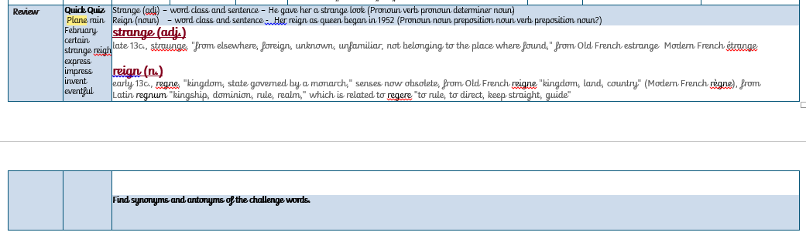

Slide 142
Old challenge words…

Slide 143
February

Slide 144
certain

Slide 145
Old spelling rule words… (homophones)

Slide 146
plane

Slide 147
plain

Slide 148
piece

Slide 149
peace

Slide 150
rain

Slide 151
reign

Slide 152
scent

Slide 153
sent

Slide 154
New spelling rule words…

Slide 155
press

Slide 156
suppress

Slide 157
express

Slide 158
compress

Slide 159
impress

Slide 160
prevent

Slide 161
invent

Slide 162
venture

Slide 163
adventure

Slide 164
eventful

Slide 165
New challenge words…

Slide 166
strange

Slide 167
reign

Slide 168
Quick Quiz time…
Notes:
Say these words for the quiz:
Plane rain February certain strange reigh express impress invent eventful

Slide 169
Did you get them correct?
plane
rain
February
certain
strange
Edit your work.
reign
express
impress
invent
eventful

Slide 170
Word class time…

Slide 171
strange
He gave her a strange look

Slide 172
strange
He gave her a strange look
pronoun verb pronoun determiner adjective noun

Slide 173
strange
He gave her a strange look
pronoun verb pronoun determiner adjective noun

Slide 174
reign
Her reign as queen began in 1952.

Slide 175
reign
Her reign as queen began in 1952.
Pronoun noun preposition noun verb preposition noun (?)

Slide 176
reign
Her reign as queen began in 1952.
Pronoun noun preposition noun verb preposition noun (?)

Slide 177
Etymology
The history of a word….

Slide 178
strange (adj.)
late 13c., straunge, "from elsewhere, foreign, unknown, unfamiliar, not belonging to the place where found," from Old French estrange Modern French étrange

Slide 179
reign (n.)
early 13c., regne, "kingdom, state governed by a monarch," senses now obsolete, from Old French reigne "kingdom, land, country" (Modern French règne), from Latin regnum "kingship, dominion, rule, realm," which is related to regere "to rule, to direct, keep straight, guide"

Slide 180
Let’s investigate….
Find synonyms of the challenge words.

Slide 181
For example:
e.g.
Weird, peculiar,
Rule, lead, govern

