Slide 1
Spelling Y4
Mastering spellings: building on the foundations of phonics
Summer 2
Week 5

Slide 2
Year 4 - Summer 2
Week 5 - Monday

Slide 3
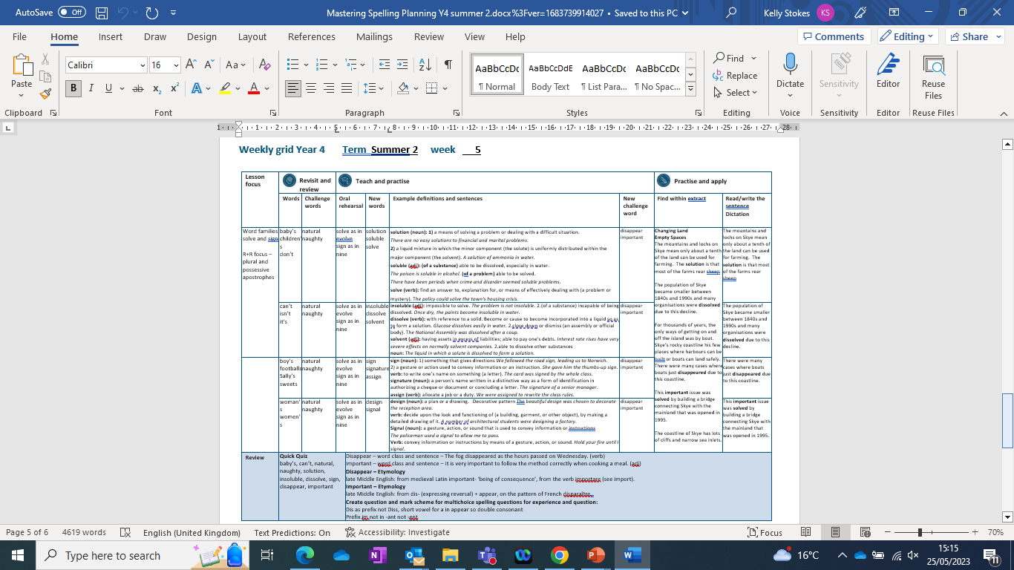

Slide 4
Let’s Revisit and Review…

Slide 5
Do you remember this challenge word?

Slide 6
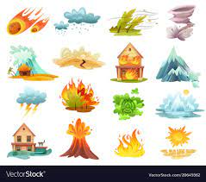
Definition - existing in or derived from nature; not made or caused by humankind.
natural
ADJECTIVE

Slide 7
Sharks have no natural enemies
_______

Slide 8
Do you remember this challenge word?

Slide 9
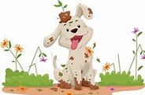
Definition – (especially of a child) badly behaved; disobedient.
naughty
ADJECTIVE

Slide 10
You've been a really naughty puppy.
_______

Slide 11
Plural and possessive apostrophes

Slide 12
a punctuation mark (‘) used to indicate either possession or the omission of letters or figures

Slide 13
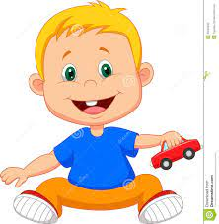
baby’s
baby’s toy car

Slide 14
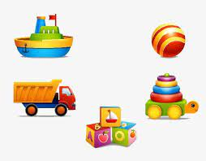
children’s
children’s toys

Slide 15

don’t

Slide 16
Let’s Teach and Practise

Slide 17
Word families – solve and sign

Slide 18
solve
Latin - loosen sign
Latin – mark or token

Slide 19

solve

Slide 20
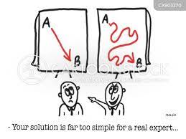
solution

Slide 21
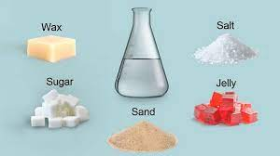
solublen

Slide 22
Definition - a means of solving a problem or dealing with a difficult situation.
solution
NOUN

Slide 23
Definition - find an answer to, explanation for, or means of effectively dealing with (a problem or mystery).
solve
VERB

Slide 24
Definition – (of a substance) able to be dissolved, especially in water.
(of a problem) able to be solved.
soluble
ADJECTIVE

Slide 25
We worked as a team to solve the mystery.
_____

Slide 26
Finally, we have found a solution to this problem.
________

Slide 27
Her experiment showed that salt is soluble in water.
_______

Slide 28
New CHALLENGE words.

Slide 29
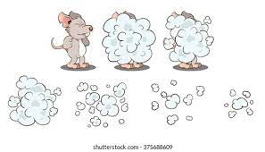
Definition - cease to be visible
disappear
VERB

Slide 30
The small mouse ran to disappear from the cat.
_________

Slide 31

Definition -of great significance or value
important
ADJECTIVE

Slide 32
Sally had a very important meeting to attend at 10 o’clock.
_________

Slide 33
Let’s Practise and Apply.

Slide 34
Can you spot the spelling rule words and the challenge words?

Slide 35
Changing Land
Empty Spaces
The mountains and lochs on Skye mean only about a tenth of the land can be used for farming. The solution is that most of the farms rear sheep
The population of Skye became smaller between 1840s and 1990s and many organisations were dissolved due to this decline.
For thousands of years, the only ways of getting on and off the island was by boat. Skye’s rocky coastline his few places where harbours can be built or boats can land safely. There were many cases where boats just disappeared due to this coastline.
This important issue was solved by building a bridge connecting Skye with the mainland that was opened in 1995.
The coastline of Skye has lots of cliffs and narrow sea inlets.

Slide 36
Changing Land
Empty Spaces
The mountains and lochs on Skye mean only about a tenth of the land can be used for farming. The solution is that most of the farms rear sheep
The population of Skye became smaller between 1840s and 1990s and many organisations were dissolved due to this decline.
For thousands of years, the only ways of getting on and off the island was by boat. Skye’s rocky coastline his few places where harbours can be built or boats can land safely. There were many cases where boats just disappeared due to this coastline.
This important issue was solved by building a bridge connecting Skye with the mainland that was opened in 1995.
The coastline of Skye has lots of cliffs and narrow sea inlets.

Slide 37
Write this sentence as I dictate it to you.
Notes:
The mountains and lochs on Skye mean only about a tenth of the land can be used for farming. The solution is that most of the farms rear sheep.

Slide 38
The mountains and lochs on Skye mean only about a tenth of the land can be used for farming. The solution is that most of the farms rear sheep.
Did you write it correctly?
Edit your work and make sure you have it correct.
Can you underline the spelling word that we have covered in this session?

Slide 39
Year 4 - Summer 2
Week 5 - Tuesday
Notes:
Revisit and review the words from Y2 and challenge words – I say, we say, you say
Ask children to write words only in their spelling book
Introduce the new spelling rule
Children to write the new spelling rule words and challenge words into books when the sentences are shown with the spelling word missing.
Read the extract with the class as choral reading. Practise model of prosody etc.
Ask children to find the spelling words from the session in the text.
Then read allowed the chosen sentence for children to write fully in their books.
Show the extract and ask children to then edit their work to check they were correct in their dictation.

Slide 41
Let’s Revisit and Review…

Slide 42
Do you remember this challenge word?

Slide 43
Definition - existing in or derived from nature; not made or caused by humankind.
natural
ADJECTIVE

Slide 44
Sharks have no natural enemies
_______

Slide 45
Do you remember this challenge word?

Slide 46
Definition – (especially of a child) badly behaved; disobedient.
naughty
ADJECTIVE

Slide 47
You've been a really naughty puppy.
_______

Slide 48
Plural and possessive apostrophes

Slide 49
a punctuation mark (‘) used to indicate either possession or the omission of letters or figures

Slide 50
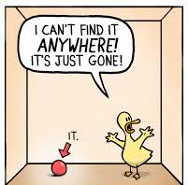
can’t

Slide 51
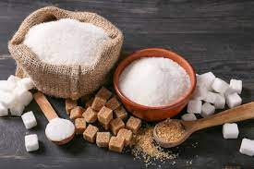
isn’t
Sugar isn’t healthy.

Slide 52
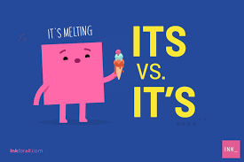
it’s

Slide 53
Let’s Teach and Practise

Slide 54
Word families – solve and sign

Slide 55
solve
Latin - loosen sign
Latin – mark or token

Slide 56
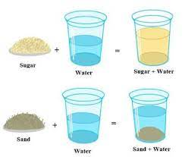
insoluble

Slide 57
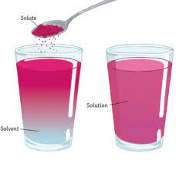
dissolve

Slide 58
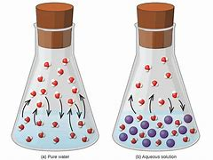
solvent

Slide 59
Definition - (of a substance) incapable of being dissolved.
insoluble
ADJECTIVE

Slide 60
Definition - with reference to a solid becoming or caused to become incorporated into a liquid so as to form a solution
dissolve
VERB

Slide 61
Definition - the liquid in which a solute is dissolved to form a solution
solvent
verb and noun
NOUN

Slide 62
The samples were all insoluble.
_________

Slide 63
The committee was dissolved after a huge dispute.
_________
Notes:
Change sentence from enough to bough sentence

Slide 64
The laboratory had many examples of solvents.
________
Notes:
Change sentence from enough to bough sentence

Slide 65
New CHALLENGE words.

Slide 66
Definition - cease to be visible
disappear
VERB

Slide 67
The small mouse ran to disappear from the cat.
_________

Slide 68
Definition -of great significance or value
important
ADJECTIVE

Slide 69
Sally had a very important meeting to attend at 10 o’clock.
_________

Slide 70
Let’s Practise and Apply.

Slide 71
Can you spot the spelling rule words and the challenge words?

Slide 72
Changing Land
Empty Spaces
The mountains and lochs on Skye mean only about a tenth of the land can be used for farming. The solution is that most of the farms rear sheep
The population of Skye became smaller between 1840s and 1990s and many organisations were dissolved due to this decline.
For thousands of years, the only ways of getting on and off the island was by boat. Skye’s rocky coastline his few places where harbours can be built or boats can land safely. There were many cases where boats just disappeared due to this coastline.
This important issue was solved by building a bridge connecting Skye with the mainland that was opened in 1995.
The coastline of Skye has lots of cliffs and narrow sea inlets.

Slide 73
Changing Land
Empty Spaces
The mountains and lochs on Skye mean only about a tenth of the land can be used for farming. The solution is that most of the farms rear sheep
The population of Skye became smaller between 1840s and 1990s and many organisations were dissolved due to this decline.
For thousands of years, the only ways of getting on and off the island was by boat. Skye’s rocky coastline his few places where harbours can be built or boats can land safely. There were many cases where boats just disappeared due to this coastline.
This important issue was solved by building a bridge connecting Skye with the mainland that was opened in 1995.
The coastline of Skye has lots of cliffs and narrow sea inlets.

Slide 74
Write this sentence as I dictate it to you.
Notes:
The population of Skye became smaller between 1840s and 1990s and many organisations were dissolved due to this decline.

Slide 75
The population of Skye became smaller between 1840s and 1990s and many organisations were dissolved due to this decline.
Did you write it correctly?
Edit your work and make sure you have it correct.
Can you underline the spelling word that we have covered in this session?

Slide 76
Year 4 - Summer 2
Week 5 - Wednesday

Slide 78
Let’s Revisit and Review…

Slide 79
Do you remember this challenge word?

Slide 80
Definition - existing in or derived from nature; not made or caused by humankind.
natural
ADJECTIVE

Slide 81
Sharks have no natural enemies
_______

Slide 82
Do you remember this challenge word?

Slide 83
Definition – (especially of a child) badly behaved; disobedient.
naughty
ADJECTIVE

Slide 84
You've been a really naughty puppy.
_______

Slide 85
Plural and possessive apostrophes

Slide 86
a punctuation mark (‘) used to indicate either possession or the omission of letters or figures

Slide 87
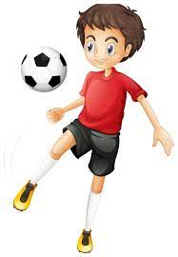
boy’s football

Slide 88
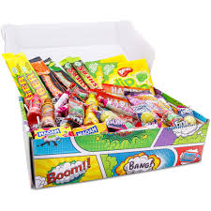
Sally’s sweets

Slide 89
Let’s Teach and Practise

Slide 90
Word families – solve and sign

Slide 91
solve
Latin - loosen sign
Latin – mark or token

Slide 92

sign

Slide 93
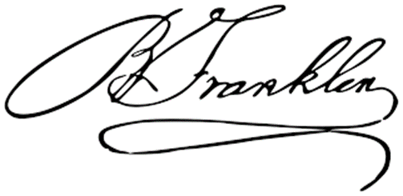
signature
tt

Slide 94
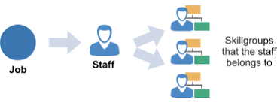
assign

Slide 95
Definition –gesture or action used to convey information or an instruction.
sign
NOUN

Slide 96
Definition - a person's name written in a distinctive way as a form of identification in authorising a cheque or document or concluding a letter.
signature
NOUN

Slide 97
Definition - allocate (a job or duty).
assign
VERB

Slide 98
The sign to give directions to the village hall was missing.
____

Slide 99
Mr Smith’s signature was difficult to read.
_________

Slide 100
Sally was to assign two boys to clear the garden shed.
______

Slide 101
New CHALLENGE words.

Slide 102
Definition - cease to be visible
disappear
VERB

Slide 103
The small mouse ran to disappear from the cat.
_________

Slide 104
Definition -of great significance or value
important
ADJECTIVE

Slide 105
Sally had a very important meeting to attend at 10 o’clock.
_________

Slide 106
Let’s Practise and Apply.

Slide 107
Can you spot the spelling rule words and the challenge words?

Slide 108
Changing Land
Empty Spaces
The mountains and lochs on Skye mean only about a tenth of the land can be used for farming. The solution is that most of the farms rear sheep
The population of Skye became smaller between 1840s and 1990s and many organisations were dissolved due to this decline.
For thousands of years, the only ways of getting on and off the island was by boat. Skye’s rocky coastline his few places where harbours can be built or boats can land safely. There were many cases where boats just disappeared due to this coastline.
This important issue was solved by building a bridge connecting Skye with the mainland that was opened in 1995.
The coastline of Skye has lots of cliffs and narrow sea inlets.

Slide 109
Changing Land
Empty Spaces
The mountains and lochs on Skye mean only about a tenth of the land can be used for farming. The solution is that most of the farms rear sheep
The population of Skye became smaller between 1840s and 1990s and many organisations were dissolved due to this decline.
For thousands of years, the only ways of getting on and off the island was by boat. Skye’s rocky coastline his few places where harbours can be built or boats can land safely. There were many cases where boats just disappeared due to this coastline.
This important issue was solved by building a bridge connecting Skye with the mainland that was opened in 1995.
The coastline of Skye has lots of cliffs and narrow sea inlets.

Slide 110
Write this sentence as I dictate it to you.
Notes:
There were many case where boats just disappeared due to this coastline.

Slide 111
There were many case where boats just disappeared due to this coastline.
Did you write it correctly?
Edit your work and make sure you have it correct.
Can you underline the spelling word that we have covered in this session?

Slide 112
Year 4 - Summer 2
Week 5 - Thursday

Slide 114
Let’s Revisit and Review…

Slide 115
Do you remember this challenge word?

Slide 116
Definition - existing in or derived from nature; not made or caused by humankind.
natural
ADJECTIVE

Slide 117
Sharks have no natural enemies
_______

Slide 118
Do you remember this challenge word?

Slide 119
Definition – (especially of a child) badly behaved; disobedient.
naughty
ADJECTIVE

Slide 120
You've been a really naughty puppy.
_______

Slide 121
Plural and possessive apostrophes

Slide 122
a punctuation mark (‘) used to indicate either possession or the omission of letters or figures

Slide 123

woman’s

Slide 124

women’s

Slide 125
Let’s Teach and Practise

Slide 126
Word families – solve and sign

Slide 127
solve
Latin - loosen sign
Latin – mark or token

Slide 128

design

Slide 129

signal

Slide 130
Definition – (noun) a plan or a drawing
design
NOUN

Slide 131
Definition – a gesture, action or sound that is used to convey information or instructions
signal
NOUN

Slide 132
The beautiful design was chosen to decorate the reception area.
______

Slide 133
The police officer used a signal to allow me to pass.
______

Slide 134
New CHALLENGE words.

Slide 135
Definition - cease to be visible
disappear
VERB

Slide 136
The small mouse ran to disappear from the cat.
_________

Slide 137
Definition -of great significance or value
important
ADJECTIVE

Slide 138
Sally had a very important meeting to attend at 10 o’clock.
_________

Slide 139
Let’s Practise and Apply.

Slide 140
Can you spot the spelling rule words and the challenge words?

Slide 141
Changing Land
Empty Spaces
The mountains and lochs on Skye mean only about a tenth of the land can be used for farming. The solution is that most of the farms rear sheep
The population of Skye became smaller between 1840s and 1990s and many organisations were dissolved due to this decline.
For thousands of years, the only ways of getting on and off the island was by boat. Skye’s rocky coastline his few places where harbours can be built or boats can land safely. There were many cases where boats just disappeared due to this coastline.
This important issue was solved by building a bridge connecting Skye with the mainland that was opened in 1995.
The coastline of Skye has lots of cliffs and narrow sea inlets.

Slide 142
Changing Land
Empty Spaces
The mountains and lochs on Skye mean only about a tenth of the land can be used for farming. The solution is that most of the farms rear sheep
The population of Skye became smaller between 1840s and 1990s and many organisations were dissolved due to this decline.
For thousands of years, the only ways of getting on and off the island was by boat. Skye’s rocky coastline his few places where harbours can be built or boats can land safely. There were many cases where boats just disappeared due to this coastline.
This important issue was solved by building a bridge connecting Skye with the mainland that was opened in 1995.
The coastline of Skye has lots of cliffs and narrow sea inlets.

Slide 143
Write this sentence as I dictate it to you.
Notes:
This important issue was solved by building a bridge connecting Skye with the mainland that was opened in 1995.

Slide 144
This important issue was solved by building a bridge connecting Skye with the mainland that was opened in 1995.
Did you write it correctly?
Edit your work and make sure you have it correct.
Can you underline the spelling word that we have covered in this session?

Slide 145
Year 4 - Summer 2
Week 5 - Friday
Notes:
Click through the slides for all the R+R words for the week (both the focus and the challenge words)
Click through the slides for all the new learning this week

Slide 147
Let’s Revisit and Review…
Notes:
Click through the slides for all the R+R words for the week (both the focus and the challenge words)
Click through the slides for all the new learning this week

Slide 148
Old challenge words…

Slide 149
natural

Slide 150
naughty

Slide 151
Old spelling rule words…

Slide 152
baby’s

Slide 153
children’s

Slide 154
don’t

Slide 155
can’t

Slide 156
isn’t

Slide 157
it’s

Slide 158
boy’s footballs

Slide 159
Sally’s sweets

Slide 160
woman’s

Slide 161
women’s

Slide 162
New spelling rule words…

Slide 163
solution

Slide 164
soluble

Slide 165
solve

Slide 166
insoluble

Slide 167
dissolve

Slide 168
solvent

Slide 169
sign

Slide 170
signature

Slide 171
assign

Slide 172
design

Slide 173
signal

Slide 174
New challenge words…

Slide 175
disappear

Slide 176
important

Slide 177
Quick Quiz time…
Notes:
baby’s, can’t, natural, naughty, solution, insoluble, dissolve, sign, disappear, important

Slide 178
Did you get them correct?
Edit your work.
baby’s, can’t, natural, naughty, solution, insoluble, dissolve, sign, disappear, important
Notes:
Say these words for the quiz
Medal, bored, straight, favourite,
Rough, enough, through, borough, peculiar, occasion

Slide 179
Word class time…

Slide 180
determiner adjective noun verb preposition verb preposition determiner noun
The small mouse ran to disappear from the cat.

Slide 181
Proper noun verb determiner intensifier adjective noun preposition verb preposition noun noun
Sally had a very important meeting to attend at 10 o’clock.

Slide 182
Etymology
The history of a word….

Slide 183
Disappear – Etymology
late Middle English: from medieval Latin important- ‘being of consequence’, from the verb importare (see import).
Important – Etymology
late Middle English: from dis- (expressing reversal) + appear, on the pattern of French disparaître .

Slide 184
Let’s investigate….
Knowledge and experiment?

Slide 185
Words linked to disappear…
vanish
pass from sight
cease to be visible
vanish from sight
recede from view
be lost to view/sight
fade
fade/melt away
withdraw
depart
retire
retreat
go
pass
ebb
wane
dissipate
be dispelled

Slide 186
Words linked to important…
main
chief
principal
key
major
salient
prime
dominant
foremost
supreme
predominant
paramount
overriding
cardinal
crucial
vital
indispensable
critical
essential
significant
urgent
central
fundamental
basic
number-one
of value
valuable
valued
useful
of use
beneficial
necessary
of the essence
of concern
of interest
relevant
pertinent
material
germane

Slide 187
Common errors with disappear and important:
disappear
dis as prefix, not Diss, short vowel for a in appear (double consonant) - disappear
important
Prefix im not in and –ant not –ent - important

