Slide 1
Spelling Y5
Mastering spellings: building on the foundations of phonics
Autumn 1
Week 1
Notes:
These slides are the same as Y2 Summer 2 as this is a revisit and review half term

Slide 2
Year 5 - Autumn 1
Week 1 - Monday

Slide 3
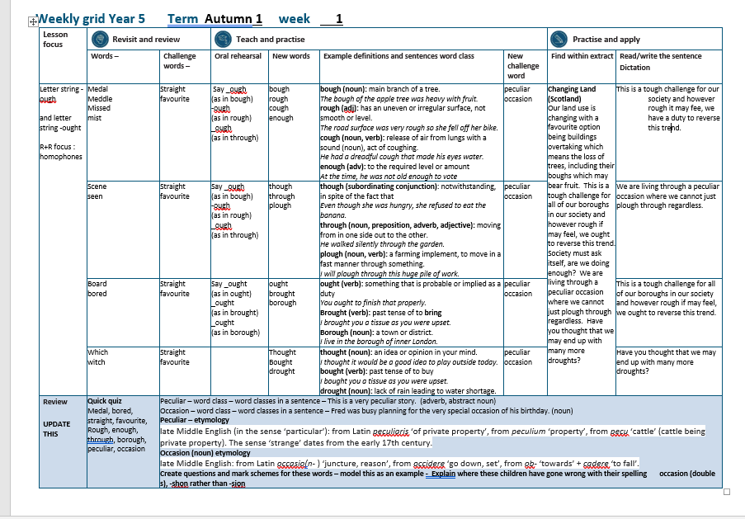

Slide 4
Let’s Revisit and Review…

Slide 5
Do you remember this challenge word?

Slide 6

Definition – extending or moving uniformly in one direction only; without a curve or bend
straight
ADJECTIVE

Slide 7
The road was very straight with no curves or bends.
________

Slide 8
Do you remember this challenge word?

Slide 9

Definition – preferred to all others of the same kind
favourite
ADJECTIVE

Slide 10
This is my favourite colour.
_________

Slide 11
Homophones

Slide 12
Homophone homo = same phone = sound
(from Ancient Greek)

Slide 13
Homophone = a word that has the same sound but has a different meaning

Slide 14

medal

Slide 15
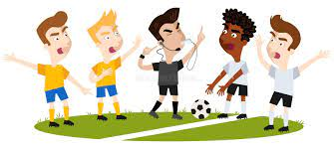
meddle

Slide 16
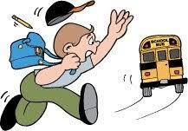
missed

Slide 17
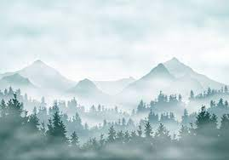
mist

Slide 18
Let’s Teach and Practise

Slide 19
Letter string -ough

Slide 20
-ough

Slide 21
-ough
_ough (as in bough)
-ough (as in rough)
_ough (as in through)

Slide 22

bough

Slide 23
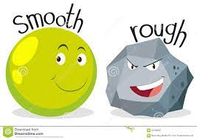
rough n

Slide 24
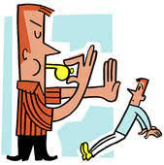
enough

Slide 25

cough

Slide 26
Definition – the branch of a tree
bough
b + ough = bough
NOUN

Slide 27
Definition - has an uneven or irregular surface, not smooth or level.
rough
r + ough = rough
ADJECTIVE

Slide 28
Definition - to the required level or amount
enough
en + ough = enough
ADVERB

Slide 29
Definition - release of air from lungs with a sound (noun), act of coughing.
cough
c + ough = cough
noun
NOUN

Slide 30
He had a dreadful cough that made his eyes water.
_____

Slide 31
The bough of the apple tree was heavy with fruit.
_____

Slide 32
Due to a rough road surface, the cyclist dismounted.
_____

Slide 33
At the time, they were not old enough to vote.
______

Slide 34
New CHALLENGE words.

Slide 35
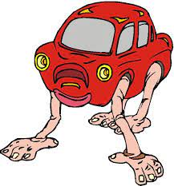
Definition - different to what is normal or expected; strange
peculiar
ADJECTIVE

Slide 36
This is a very peculiar story.
________

Slide 37

Definition – a particular event, or the time at which it takes place
occasion
NOUN

Slide 38
Fred was busy planning for the very special occasion of his birthday.
________

Slide 39
Let’s Practise and Apply.

Slide 40
Can you spot the spelling rule words and the challenge words?

Slide 41
Changing Land (Scotland)
Our land use is changing with a favourite option being buildings overtaking which means the loss of trees, including their boughs which may bear fruit. This is a tough challenge for all of our boroughs in our society and however rough if may feel, we ought to reverse this trend. Society must ask itself, are we doing enough? We are living through a peculiar occasion where we cannot just plough through regardless. Have you thought that we may end up with many more droughts?

Slide 42
Changing Land (Scotland)
Our land use is changing with a favourite option being buildings overtaking which means the loss of trees, including their boughs which may bear fruit. This is a tough challenge for all of our boroughs in our society and however rough if may feel, we ought to reverse this trend. Society must ask itself, are we doing enough? We are living through a peculiar occasion where we cannot just plough through regardless. Have you thought that we may end up with many more droughts?

Slide 43
Write this sentence as I dictate it to you.
Notes:
This is a tough challenge for our society and however rough it may fee, we have a duty to reverse this trend.

Slide 44
This is a tough challenge for our society and however rough it may fee, we have a duty to reverse this trend.
Did you write it correctly?
Edit your work and make sure you have it correct.
Can you underline the spelling word that we have covered in this session?

Slide 45
Year 5 - Autumn 1
Week 1 - Tuesday
Notes:
Revisit and review the words from Y2 and challenge words – I say, we say, you say
Ask children to write words only in their spelling book
Introduce the new spelling rule
Children to write the new spelling rule words and challenge words into books when the sentences are shown with the spelling word missing.
Read the extract with the class as choral reading. Practise model of prosody etc.
Ask children to find the spelling words from the session in the text.
Then read allowed the chosen sentence for children to write fully in their books.
Show the extract and ask children to then edit their work to check they were correct in their dictation.

Slide 46
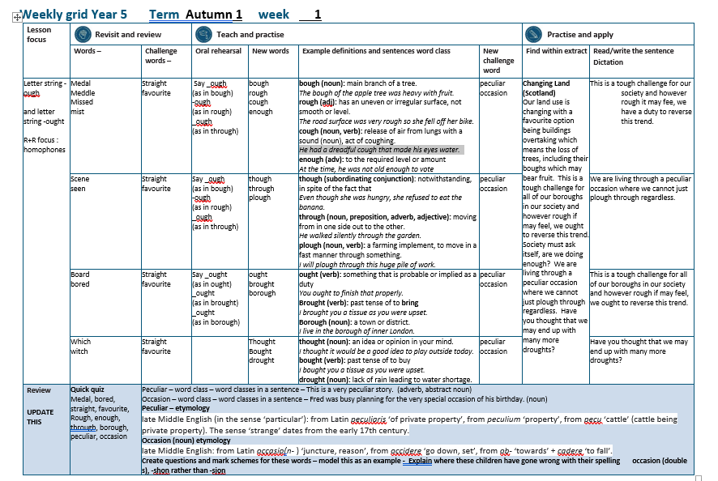

Slide 47
Let’s Revisit and Review…

Slide 48
Do you remember this challenge word?

Slide 49
Definition – extending or moving uniformly in one direction only; without a curve or bend
straight
ADJECTIVE

Slide 50
The road was very straight with no curves or bends.
________

Slide 51
Do you remember this challenge word?

Slide 52
Definition – preferred to all others of the same kind
favourite
ADJECTIVE

Slide 53
This is my favourite colour.
_________

Slide 54
Homophones

Slide 55
Homophone homo = same phone = sound
(from Ancient Greek)

Slide 56
Homophone = a word that has the same sound but has a different meaning

Slide 57
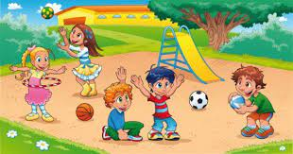
scene

Slide 58

seen

Slide 59
Let’s Teach and Practise

Slide 60
Letter string -ough

Slide 61
-ough

Slide 62
-ough
_ough (as in bough)
-ough (as in rough)
_ough (as in through)

Slide 63

though

Slide 64

through n

Slide 65
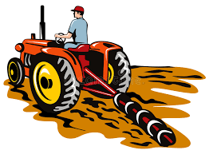
plough

Slide 66
Definition -notwithstanding, in spite of the fact that
though
th + ough = though
CONJUNCTION

Slide 67
thr + ough = through
through
PREPOSITION
Definition -moving in one side and out of the other side of (an opening, channel, or location)

Slide 68
Definition - a farming implement, to move in a fast manner through something
plough
pl + ough = plough
NOUN

Slide 69
Even though she was hungry, she refused to eat the banana.
______

Slide 70
He walked silently through the garden.
______
Notes:
Change sentence from enough to bough sentence

Slide 71
I will a plough for this field.
______

Slide 72
New CHALLENGE words.

Slide 73
Definition - different to what is normal or expected; strange
peculiar
ADJECTIVE

Slide 74
This is a very peculiar story.
________

Slide 75
Definition – a particular event, or the time at which it takes place
occasion
NOUN

Slide 76
Fred was busy planning for the very special occasion of his birthday.
________

Slide 77
Let’s Practise and Apply.

Slide 78
Can you spot the spelling rule words and the challenge words?

Slide 79
Changing Land (Scotland)
Our land use is changing with a favourite option being buildings overtaking which means the loss of trees, including their boughs which may bear fruit. This is a tough challenge for all of our boroughs in our society and however rough if may feel, we ought to reverse this trend. Society must ask itself, are we doing enough? We are living through a peculiar occasion where we cannot just plough through regardless. Have you thought that we may end up with many more droughts?

Slide 80
Changing Land (Scotland)
Our land use is changing with a favourite option being buildings overtaking which means the loss of trees, including their boughs which may bear fruit. This is a tough challenge for all of our boroughs in our society and however rough if may feel, we ought to reverse this trend. Society must ask itself, are we doing enough? We are living through a peculiar occasion where we cannot just plough through regardless. Have you thought that we may end up with many more droughts?
Notes:
Highlight in yellow all the words

Slide 81
Write this sentence as I dictate it to you.
Notes:
We are living through a peculiar occasion where we cannot just plough through regardless.

Slide 82
We are living through a peculiar occasion where we cannot just plough through regardless.
Did you write it correctly?
Edit your work and make sure you have it correct.
Can you underline the spelling word that we have covered in this session?

Slide 83
Year 5 - Autumn 1
Week 1 - Wednesday
Notes:
Revisit and review the words from Y2 and challenge words – I say, we say, you say
Ask children to write words only in their spelling book
Introduce the new spelling rule
Children to write the new spelling rule words and challenge words into books when the sentences are shown with the spelling word missing.
Read the extract with the class as choral reading. Practise model of prosody etc.
Ask children to find the spelling words from the session in the text.
Then read allowed the chosen sentence for children to write fully in their books.
Show the extract and ask children to then edit their work to check they were correct in their dictation.

Slide 85
Let’s Revisit and Review…

Slide 86
Do you remember this challenge word?

Slide 87
Definition – extending or moving uniformly in one direction only; without a curve or bend
straight
ADJECTIVE

Slide 88
The road was very straight with no curves or bends.
________

Slide 89
Do you remember this challenge word?

Slide 90
Definition – preferred to all others of the same kind
favourite
ADJECTIVE

Slide 91
This is my favourite colour.
_________

Slide 92
Homophones

Slide 93
Homophone homo = same phone = sound
(from Ancient Greek)

Slide 94
Homophone = a word that has the same sound but has a different meaning

Slide 95

board

Slide 96
bored

Slide 97
Let’s Teach and Practise

Slide 98
Letter string -ough

Slide 99
-ough

Slide 100
-ough
_ough (as in bough)
-ough (as in rough)
_ough (as in through)

Slide 101

ought

Slide 102

brought n
tt

Slide 103
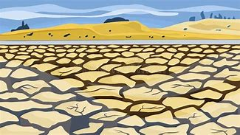
drought

Slide 104
Definition - something that is probable or implied as a duty
ought
VERB

Slide 105
Definition - past tense of to bring
brought
br + ought = brought
VERB

Slide 106
Definition - a prolonged period of abnormally low rainfall, leading to a shortage of water
drought
dr + ought = drought
NOUN

Slide 107
You ought to finish that properly.
_____

Slide 108
I brought you a tissue as you were upset.
_______

Slide 109
There was a drought last summer.
_______

Slide 110
New CHALLENGE words.

Slide 111
Definition - different to what is normal or expected; strange
peculiar
ADJECTIVE

Slide 112
This is a very peculiar story.
________

Slide 113
Definition – a particular event, or the time at which it takes place
occasion
NOUN

Slide 114
Fred was busy planning for the very special occasion of his birthday.
________

Slide 115
Let’s Practise and Apply.

Slide 116
Can you spot the spelling rule words and the challenge words?

Slide 117
Changing Land (Scotland)
Our land use is changing with a favourite option being buildings overtaking which means the loss of trees, including their boughs which may bear fruit. This is a tough challenge for all of our boroughs in our society and however rough if may feel, we ought to reverse this trend. Society must ask itself, are we doing enough? We are living through a peculiar occasion where we cannot just plough through regardless. Have you thought that we may end up with many more droughts?

Slide 118
Changing Land (Scotland)
Our land use is changing with a favourite option being buildings overtaking which means the loss of trees, including their boughs which may bear fruit. This is a tough challenge for all of our boroughs in our society and however rough if may feel, we ought to reverse this trend. Society must ask itself, are we doing enough? We are living through a peculiar occasion where we cannot just plough through regardless. Have you thought that we may end up with many more droughts?
Notes:
Highlight in yellow all the words

Slide 119
Write this sentence as I dictate it to you.
Notes:
This is a tough challenge for all of our boroughs in our society and however rough if may feel, we ought to reverse this trend.

Slide 120
This is a tough challenge for all of our boroughs in our society and however rough if may feel, we ought to reverse this trend.
Did you write it correctly?
Edit your work and make sure you have it correct.
Can you underline the spelling word that we have covered in this session?

Slide 121
Year 5 - Autumn 1
Week 1 - Thursday
Notes:
Revisit and review the words from Y2 and challenge words – I say, we say, you say
Ask children to write words only in their spelling book
Introduce the new spelling rule
Children to write the new spelling rule words and challenge words into books when the sentences are shown with the spelling word missing.
Read the extract with the class as choral reading. Practise model of prosody etc.
Ask children to find the spelling words from the session in the text.
Then read allowed the chosen sentence for children to write fully in their books.
Show the extract and ask children to then edit their work to check they were correct in their dictation.

Slide 123
Let’s Revisit and Review…

Slide 124
Do you remember this challenge word?

Slide 125
Definition – extending or moving uniformly in one direction only; without a curve or bend
straight
ADJECTIVE

Slide 126
The road was very straight with no curves or bends.
________

Slide 127
Do you remember this challenge word?

Slide 128
Definition – preferred to all others of the same kind
favourite
ADJECTIVE

Slide 129
This is my favourite colour.
_________

Slide 130
Homophones

Slide 131
Homophone homo = same phone = sound
(from Ancient Greek)

Slide 132
Homophone = a word that has the same sound but has a different meaning

Slide 133
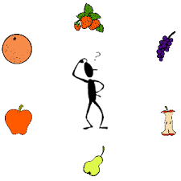
which

Slide 134
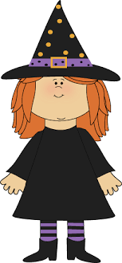
witch

Slide 135
Let’s Teach and Practise

Slide 136
Letter string -ought

Slide 137
-ought

Slide 138
-ought
_ought (as in ought)
-ought (as in brought)
_ought (as in drought)

Slide 139

thought
th

Slide 140
bought n
tt

Slide 141
Definition - an idea or opinion produced by thinking, or occurring suddenly in the mind.
thought
th + ought = thought
NOUN

Slide 142
Definition - past tense of to buy
bought
b + ought = bought
VERB

Slide 143
I thought it would be a good idea to play outside today.
_______

Slide 144
I bought you a tissue from the shop.
______

Slide 145
New CHALLENGE words.

Slide 146
Definition - different to what is normal or expected; strange
peculiar
ADJECTIVE

Slide 147
This is a very peculiar story.
________

Slide 148
Definition – a particular event, or the time at which it takes place
occasion
NOUN

Slide 149
Fred was busy planning for the very special occasion of his birthday.
________

Slide 150
Let’s Practise and Apply.

Slide 151
Can you spot the spelling rule words and the challenge words?

Slide 152
Changing Land (Scotland)
Our land use is changing with a favourite option being buildings overtaking which means the loss of trees, including their boughs which may bear fruit. This is a tough challenge for all of our boroughs in our society and however rough if may feel, we ought to reverse this trend. Society must ask itself, are we doing enough? We are living through a peculiar occasion where we cannot just plough through regardless. Have you thought that we may end up with many more droughts?

Slide 153
Changing Land (Scotland)
Our land use is changing with a favourite option being buildings overtaking which means the loss of trees, including their boughs which may bear fruit. This is a tough challenge for all of our boroughs in our society and however rough if may feel, we ought to reverse this trend. Society must ask itself, are we doing enough? We are living through a peculiar occasion where we cannot just plough through regardless. Have you thought that we may end up with many more droughts?
Notes:
Highlight in yellow all the words

Slide 154
Write this sentence as I dictate it to you.
Notes:
Have you thought that we may end up with many more droughts?

Slide 155
Have you thought that we may end up with many more droughts?
Did you write it correctly?
Edit your work and make sure you have it correct.
Can you underline the spelling word that we have covered in this session?

Slide 156
Year 5 - Autumn 1
Week 1 - Friday
Notes:
Click through the slides for all the R+R words for the week (both the focus and the challenge words)
Click through the slides for all the new learning this week

Slide 157
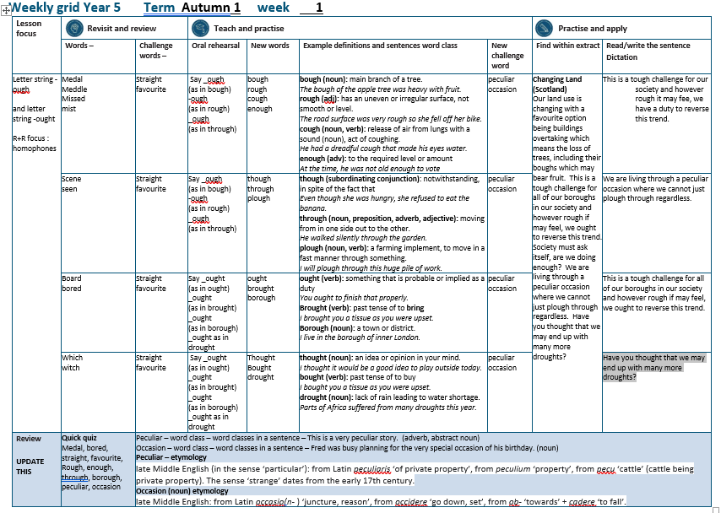

Slide 158
Old challenge words…

Slide 159
straight

Slide 160
favourite

Slide 161
Old spelling rule words…

Slide 162
medal

Slide 163
meddle

Slide 164
missed

Slide 165
mist

Slide 166
scene

Slide 167
seen

Slide 168
board

Slide 169
bored

Slide 170
which

Slide 171
witch

Slide 172
New spelling rule words…

Slide 173
bough

Slide 174
rough

Slide 175
cough

Slide 176
enough

Slide 177
though

Slide 178
through

Slide 179
plough

Slide 180
ought

Slide 181
brought

Slide 182
borough

Slide 183
thought

Slide 184
brought

Slide 185
drought

Slide 186
New challenge words…

Slide 187
peculiar

Slide 188
occasion

Slide 189
Quick Quiz time…
Notes:
Say these words for the quiz
Medal, bored, straight, favourite,
Rough, enough, through, borough, peculiar, occasion

Slide 190
Did you get them correct?
Edit your work.
medal, bored, straight, favourite,
rough, enough, through, borough, peculiar, occasion
Notes:
Say these words for the quiz
Medal, bored, straight, favourite,
Rough, enough, through, borough, peculiar, occasion

Slide 191
Word class time…

Slide 192
This is a very peculiar story
Pronoun verb determiner intensifier adjective
noun
Notes:
Ask for these words to be classed

Slide 193
Fred was busy planning for the very special occasion of his birthday.
Proper noun verb adverb verb determiner intensifier adjective pronoun noun
Notes:
Ask for these words to be classed

Slide 194
Etymology
The history of a word….

Slide 195
Peculiar – etymology
late Middle English (in the sense ‘particular’): from Latin peculiaris ‘of private property’, from peculium ‘property’, from pecu ‘cattle’ (cattle being private property). The sense ‘strange’ dates from the early 17th century.
Occasion (noun) etymology
late Middle English: from Latin occasio(n- ) ‘juncture, reason’, from occidere ‘go down, set’, from ob- ‘towards’ + cadere ‘to fall’.

Slide 196
Let’s investigate….
Can you find words linked to peculiar and occasion?

Slide 197
Words linked to peculiar…
Ensure
strange
unusual
odd
funny
curious
bizarre
weird
uncanny
queer
unexpected
unfamiliar
abnormal
atypical
unaccountable
incongruous
uncommon
irregular
singular
deviant
aberrant
freak
freakish
suspicious
dubious
questionable
eerie
unnatural
outré
anomalous
untypical
different
out of the ordinary
out of the way
exceptional
rare
extraordinary
remarkable
puzzling
mystifying
mysterious
perplexing
baffling

Slide 198
Words linked to occasion…
instance
time
moment
juncture
point
event
happening
occurrence
affair
incident
episode
experience
situation
case
circumstance
reason
cause
call
grounds
justification
need
necessity
requirement
excuse
pretext
stimulus
inducement
provocation
motive

Slide 199
Common errors with peculiar and occasion:
peculier (missing r for er sound, er ending rather than ar)
occasion (double c and double s, shon rather than sion)

