Slide 1
Spelling Y5
Mastering spellings: building on the foundations of phonics
Autumn 1
Week 1
Notes:
These slides are the same as Y2 Summer 2 as this is a revisit and review half term

Slide 2
Year 5 - Autumn 1
Week 3 - Monday

Slide 3
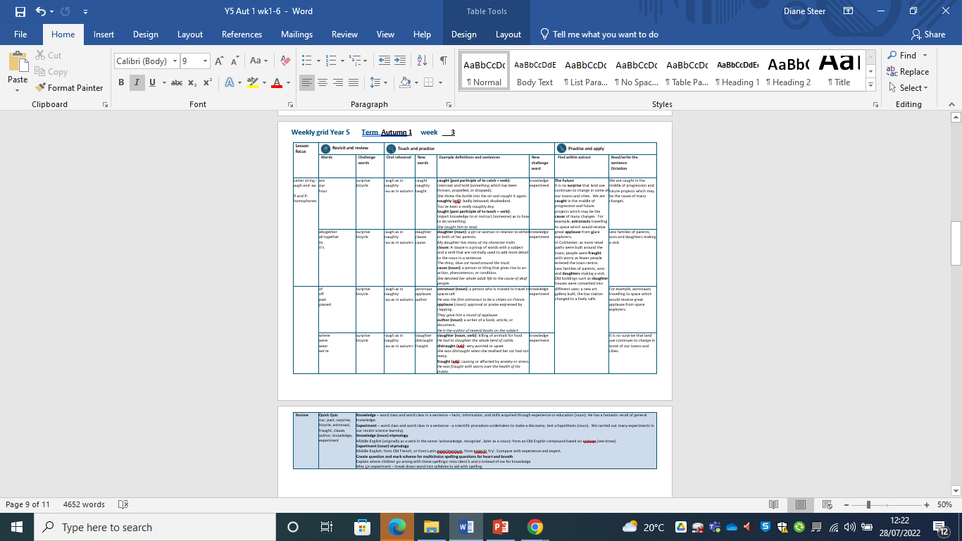

Slide 4
Let’s Revisit and Review…

Slide 5
Do you remember this challenge word?

Slide 6

Definition - an unexpected or astonishing event, fact, etc.
surprise
NOUN

Slide 7
The bus tour was full of surprises.
_________

Slide 8
Do you remember this challenge word?

Slide 9
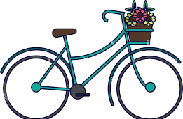
Definition – a vehicle consisting of two wheels held in a frame one behind the other, propelled by pedals and steered with handlebars attached to the front wheel.
bicycle
NOUN

Slide 10
My mum repaired the back tyre on my bicycle.
_______

Slide 11
Homophones

Slide 12
Homophone homo = same phone = sound
(from Ancient Greek)

Slide 13
Homophone a word that has the same sound but has a different meaning

Slide 14

are

Slide 15
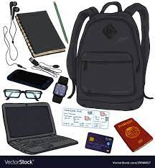
our
our belongings

Slide 16
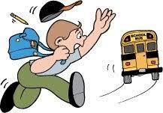
missed

Slide 17

mist

Slide 18
Let’s Teach and Practise

Slide 19
Letter strings –augh and -au

Slide 20
-augh
-au

Slide 21
-augh or (as in naughty)
-au or (as in autumn)

Slide 22

caught

Slide 23
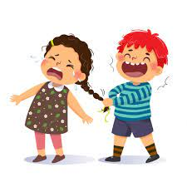
naughty n

Slide 24
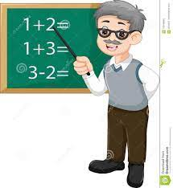
taught

Slide 25
Definition – intercept and hold (something which has been thrown, propelled or dropped).
caught
c + augh + t = caught
VERB

Slide 26
Definition - (especially of a child) badly behaved; disobedient.
naughty
n + augh + ty = naughty
ADJECTIVE

Slide 27
Definition - cause (someone) to learn or understand something by example or experience.
taught
t + augh + t = taught
VERB

Slide 28
She threw the bottle into the air and caught it again.
______

Slide 29
You’ve been a really naughty puppy.
_______

Slide 30
She taught him to read.
______

Slide 31
New CHALLENGE words.

Slide 32

Definition - facts, information, and skills acquired through experience or education; the theoretical or practical understanding of a subject
knowledge
NOUN

Slide 33
He has a fantastic recall of general knowledge.
_________

Slide 34
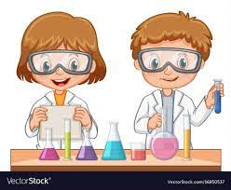
Definition - a scientific procedure undertaken to make a discovery, test a hypothesis, or demonstrate a known fact
experiment
NOUN

Slide 35
We carried out many experiments in our recent science learning.
__________

Slide 36
Let’s Practise and Apply.

Slide 37
Can you spot the spelling rule words and the challenge words?

Slide 38
Changing Land (Scotland)
The Future
It is no surprise that land use continues to change in some of our towns and cities. We are caught in the middle of progression and future projects which may be the cause of many changes. For example, astronauts travelling to space which would receive great applause from s[ace explorers. In Colchester, as more retail parks were built around the town, people were fraught with worry as fewer people entered the town centre. Less families of parents, sons and daughters making a visit. Old buildings such as slaughter houses were converted into different uses: a new art gallery built, the bus station changed to a lively café.

Slide 39
Changing Land (Scotland)
The Future
It is no surprise that land use continues to change in some of our towns and cities. We are caught in the middle of progression and future projects which may be the cause of many changes. For example, astronauts travelling to space which would receive great applause from space explorers.
In Colchester, as more retail parks were built around the town, people were fraught with worry as fewer people entered the town centre. Less families of parents, sons and daughters making a visit. Old buildings such as slaughter houses were converted into different uses: a new art gallery built, the bus station changed to a lively café.

Slide 40
Write this sentence as I dictate it to you.
Notes:
We are caught in the middle of progression and future projects which may be the cause of many changes.

Slide 41
We are caught in the middle of progression and future projects which may be the cause of many changes.
Did you write it correctly?
Edit your work and make sure you have it correct.
Can you underline the spelling word that we have covered in this session?

Slide 42
Year 5 - Autumn 1
Week 3 - Tuesday
Notes:
Revisit and review the words from Y2 and challenge words – I say, we say, you say
Ask children to write words only in their spelling book
Introduce the new spelling rule
Children to write the new spelling rule words and challenge words into books when the sentences are shown with the spelling word missing.
Read the extract with the class as choral reading. Practise model of prosody etc.
Ask children to find the spelling words from the session in the text.
Then read allowed the chosen sentence for children to write fully in their books.
Show the extract and ask children to then edit their work to check they were correct in their dictation.

Slide 43
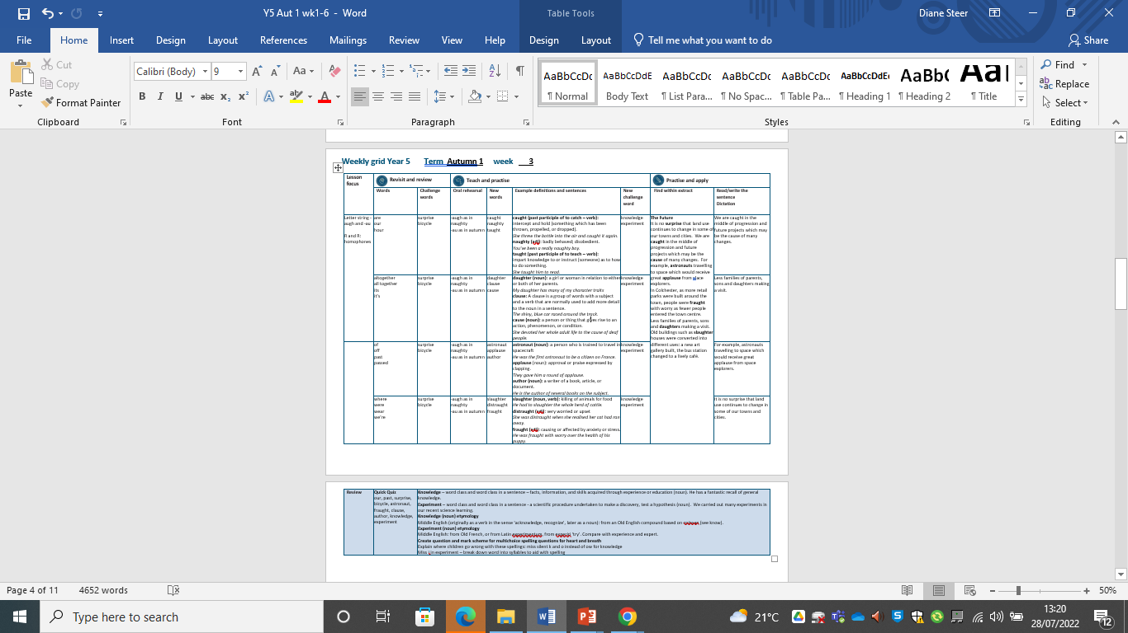

Slide 44
Let’s Revisit and Review…

Slide 45
Do you remember this challenge word?

Slide 46
Definition - an unexpected or astonishing event, fact, etc.
surprise
NOUN

Slide 47
The bus tour was full of surprises.
_________

Slide 48
Do you remember this challenge word?

Slide 49
Definition – a vehicle consisting of two wheels held in a frame one behind the other, propelled by pedals and steered with handlebars attached to the front wheel.
bicycle
NOUN

Slide 50
My mum repaired the back tyre on my bicycle.
_______

Slide 51
Homophones

Slide 52
Homophone homo = same phone = sound
(from Ancient Greek)

Slide 53
Homophone a word that has the same sound but has a different meaning

Slide 54

altogether
complete

Slide 55
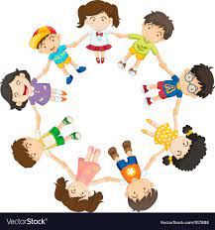
all together
Everyone or everything together

Slide 56
Let’s Teach and Practise

Slide 57
Letter string -ough

Slide 58
-augh and -au

Slide 59
-augh or (as in naughty)
-au or (as in autumn)

Slide 60

daughter

Slide 61
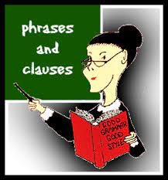
clause n

Slide 62

cause

Slide 63
Definition – a girl or woman in relation to either or both of her parents.
daughter
d + augh + ter = daughter
NOUN

Slide 64
Definition – a clause is a group of words with a subject and a verb that are normally used to add more detail to the noun in a sentence.
clause
cl + au + se = clause
NOUN

Slide 65
Definition – a person or thing that gives rise to an action, phenomenon or condition.
cause
c + au + se = cause
NOUN

Slide 66
My daughter has many of my character traits.
________

Slide 67
A sentence is also known as an independent clause.
______
Notes:
Change sentence from enough to bough sentence

Slide 68
She devoted her whole adult life to the cause of deaf people.
_____
Notes:
Change sentence from enough to bough sentence

Slide 69
New CHALLENGE words.

Slide 70
Definition - facts, information, and skills acquired through experience or education; the theoretical or practical understanding of a subject
knowledge
NOUN

Slide 71
He has a fantastic recall of general knowledge.
_________

Slide 72
Definition - a scientific procedure undertaken to make a discovery, test a hypothesis, or demonstrate a known fact
experiment
NOUN

Slide 73
We carried out many experiments in our recent science learning.
__________

Slide 74
Let’s Practise and Apply.

Slide 75
Can you spot the spelling rule words and the challenge words?

Slide 76
Changing Land (Scotland)
The Future
It is no surprise that land use continues to change in some of our towns and cities. We are caught in the middle of progression and future projects which may be the cause of many changes. For example, astronauts travelling to space which would receive great applause from s[ace explorers. In Colchester, as more retail parks were built around the town, people were fraught with worry as fewer people entered the town centre. Less families of parents, sons and daughters making a visit. Old buildings such as slaughter houses were converted into different uses: a new art gallery built, the bus station changed to a lively café.

Slide 77
Changing Land (Scotland)
The Future
It is no surprise that land use continues to change in some of our towns and cities. We are caught in the middle of progression and future projects which may be the cause of many changes. For example, astronauts travelling to space which would receive great applause from space explorers.
In Colchester, as more retail parks were built around the town, people were fraught with worry as fewer people entered the town centre. Less families of parents, sons and daughters making a visit. Old buildings such as slaughter houses were converted into different uses: a new art gallery built, the bus station changed to a lively café.

Slide 78
Write this sentence as I dictate it to you.
Notes:
Less failies of parents, sons and daughters making a visit.

Slide 79
Less families of parents, sons and daughters making a visit.
Did you write it correctly?
Edit your work and make sure you have it correct.
Can you underline the spelling word that we have covered in this session?

Slide 80
Year 5 - Autumn 1
Week 3 - Wednesday
Notes:
Revisit and review the words from Y2 and challenge words – I say, we say, you say
Ask children to write words only in their spelling book
Introduce the new spelling rule
Children to write the new spelling rule words and challenge words into books when the sentences are shown with the spelling word missing.
Read the extract with the class as choral reading. Practise model of prosody etc.
Ask children to find the spelling words from the session in the text.
Then read allowed the chosen sentence for children to write fully in their books.
Show the extract and ask children to then edit their work to check they were correct in their dictation.

Slide 81


Slide 82
Let’s Revisit and Review…

Slide 83
Do you remember this challenge word?

Slide 84
Definition - an unexpected or astonishing event, fact, etc.
surprise
NOUN

Slide 85
The bus tour was full of surprises.
_________

Slide 86
Do you remember this challenge word?

Slide 87
Definition – a vehicle consisting of two wheels held in a frame one behind the other, propelled by pedals and steered with handlebars attached to the front wheel.
bicycle
NOUN

Slide 88
My mum repaired the back tyre on my bicycle.
_______

Slide 89
Homophones

Slide 90
Homophone homo = same phone = sound
(from Ancient Greek)

Slide 91
Homophone a word that has the same sound but has a different meaning

Slide 92
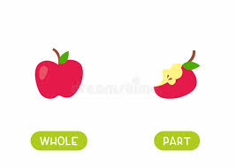
of
of - relationship between part and whole

Slide 93

off

Slide 94

past

Slide 95
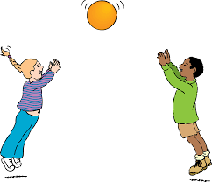
passed

Slide 96
Let’s Teach and Practise

Slide 97
Letter string –augh and -au

Slide 98
-augh
-au

Slide 99
-augh or (as in naughty)
-au or (as in autumn)

Slide 100
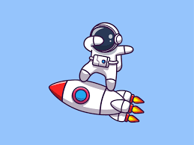
astronaut

Slide 101

applause n
tt

Slide 102
Definition – a person who is trained to travel in spacecraft.
astronaut
astron + au + t = astronaut
NOUN

Slide 103
Definition – approval or praise expressed by clapping.
applause
appl + au + se = applause
NOUN

Slide 104
She was the first astronaut to be a citizen of France.
_________

Slide 105
They gave her a round of applause.
_________

Slide 106
New CHALLENGE words.

Slide 107
Definition - facts, information, and skills acquired through experience or education; the theoretical or practical understanding of a subject
knowledge
NOUN

Slide 108
He has a fantastic recall of general knowledge.
_________

Slide 109
Definition - a scientific procedure undertaken to make a discovery, test a hypothesis, or demonstrate a known fact
experiment
NOUN

Slide 110
We carried out many experiments in our recent science learning.
__________

Slide 111
Let’s Practise and Apply.

Slide 112
Can you spot the spelling rule words and the challenge words?

Slide 113
Changing Land (Scotland)
The Future
It is no surprise that land use continues to change in some of our towns and cities. We are caught in the middle of progression and future projects which may be the cause of many changes. For example, astronauts travelling to space which would receive great applause from s[ace explorers. In Colchester, as more retail parks were built around the town, people were fraught with worry as fewer people entered the town centre. Less families of parents, sons and daughters making a visit. Old buildings such as slaughter houses were converted into different uses: a new art gallery built, the bus station changed to a lively café.

Slide 114
Changing Land (Scotland)
The Future
It is no surprise that land use continues to change in some of our towns and cities. We are caught in the middle of progression and future projects which may be the cause of many changes. For example, astronauts travelling to space which would receive great applause from space explorers.
In Colchester, as more retail parks were built around the town, people were fraught with worry as fewer people entered the town centre. Less families of parents, sons and daughters making a visit. Old buildings such as slaughter houses were converted into different uses: a new art gallery built, the bus station changed to a lively café.

Slide 115
Write this sentence as I dictate it to you.
Notes:
For example, astronauts travelling to space which hwould receive great applause from space explorers.

Slide 116
For example, astronauts travelling to space which would receive great applause from space explorers.
Did you write it correctly?
Edit your work and make sure you have it correct.

Slide 117
Year 5 - Autumn 1
Week 3 - Thursday
Notes:
Revisit and review the words from Y2 and challenge words – I say, we say, you say
Ask children to write words only in their spelling book
Introduce the new spelling rule
Children to write the new spelling rule words and challenge words into books when the sentences are shown with the spelling word missing.
Read the extract with the class as choral reading. Practise model of prosody etc.
Ask children to find the spelling words from the session in the text.
Then read allowed the chosen sentence for children to write fully in their books.
Show the extract and ask children to then edit their work to check they were correct in their dictation.

Slide 118
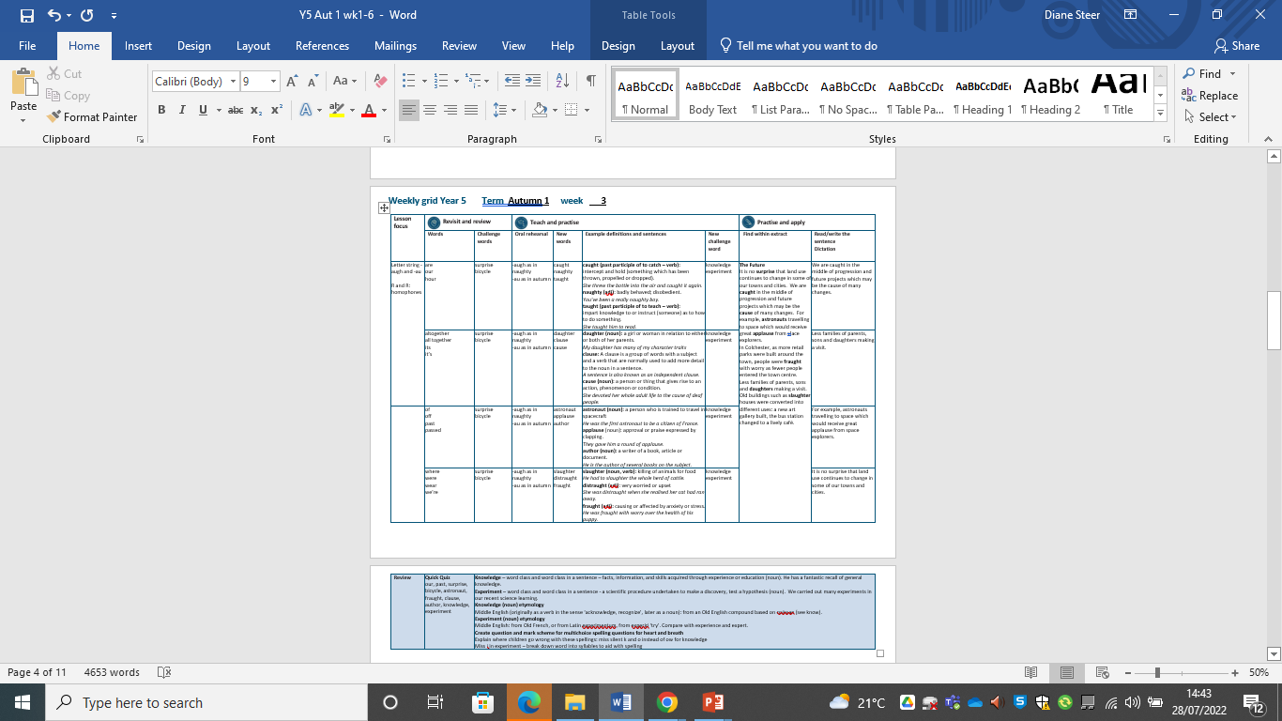

Slide 119
Let’s Revisit and Review…

Slide 120
Do you remember this challenge word?

Slide 121
Definition - an unexpected or astonishing event, fact, etc.
surprise
NOUN

Slide 122
The bus tour was full of surprises.
_________

Slide 123
Do you remember this challenge word?

Slide 124
Definition – a vehicle consisting of two wheels held in a frame one behind the other, propelled by pedals and steered with handlebars attached to the front wheel.
bicycle
NOUN

Slide 125
My mum repaired the back tyre on my bicycle.
_______

Slide 126
Homophones

Slide 127
Homophone homo = same phone = sound
(from Ancient Greek)

Slide 128
Homophone a word that has the same sound but has a different meaning

Slide 129
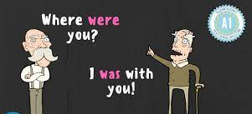
were

Slide 130
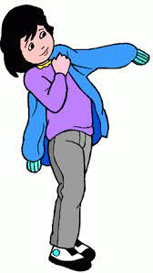
wear

Slide 131
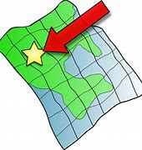
where

Slide 132
Let’s Teach and Practise

Slide 133
Letter strings –augh and -au

Slide 134
-augh
-au

Slide 135
-augh or (as in naughty)
-au or (as in autumn)

Slide 136
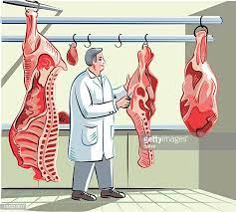
slaughter
th

Slide 137
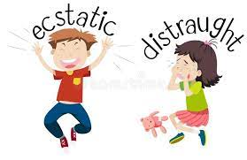
distraught n

Slide 138
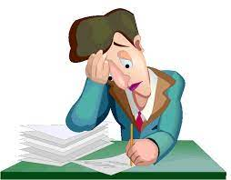
fraught

Slide 139
Definition – killing of animals for food.
slaughter
sl +augh + ter = slaughter
NOUN

Slide 140
Definition – very worried or upset.
distraught
distr + augh + t = distraught
ADJECTIVE

Slide 141
Definition – causing or affected by anxiety or stress.
fraught
fr + aught = fraught
ADJECTIVE

Slide 142
They had to slaughter the whole herd of cattle.
_________

Slide 143
The family was distraught when they realised their cat had ran away.
_________

Slide 144
They were fraught with worry over the health of his puppy.
_______

Slide 145
New CHALLENGE words.

Slide 146
Definition - facts, information, and skills acquired through experience or education; the theoretical or practical understanding of a subject
knowledge
NOUN

Slide 147
He has a fantastic recall of general knowledge.
_________

Slide 148
Definition - a scientific procedure undertaken to make a discovery, test a hypothesis, or demonstrate a known fact
experiment
NOUN

Slide 149
We carried out many experiments in our recent science learning.
__________

Slide 150
Let’s Practise and Apply.

Slide 151
Can you spot the spelling rule words and the challenge words?

Slide 152
Changing Land (Scotland)
The Future
It is no surprise that land use continues to change in some of our towns and cities. We are caught in the middle of progression and future projects which may be the cause of many changes. For example, astronauts travelling to space which would receive great applause from s[ace explorers. In Colchester, as more retail parks were built around the town, people were fraught with worry as fewer people entered the town centre. Less families of parents, sons and daughters making a visit. Old buildings such as slaughter houses were converted into different uses: a new art gallery built, the bus station changed to a lively café.

Slide 153
Changing Land (Scotland)
The Future
It is no surprise that land use continues to change in some of our towns and cities. We are caught in the middle of progression and future projects which may be the cause of many changes. For example, astronauts travelling to space which would receive great applause from space explorers.
In Colchester, as more retail parks were built around the town, people were fraught with worry as fewer people entered the town centre. Less families of parents, sons and daughters making a visit. Old buildings such as slaughter houses were converted into different uses: a new art gallery built, the bus station changed to a lively café.

Slide 154
Write this sentence as I dictate it to you.
Notes:
Have you thought that we may end up with many more droughts?

Slide 155
It is no surprise that land use continues to change in some of our towns and cities.
Did you write it correctly?
Edit your work and make sure you have it correct.
Can you underline the spelling word that we have covered in this session?

Slide 156
Year 5 - Autumn 1
Week 3 - Friday
Notes:
Click through the slides for all the R+R words for the week (both the focus and the challenge words)
Click through the slides for all the new learning this week

Slide 157


Slide 158
Let’s Revisit and Review…
Notes:
Click through the slides for all the R+R words for the week (both the focus and the challenge words)
Click through the slides for all the new learning this week

Slide 159
Old challenge words…

Slide 160
surprise

Slide 161
bicycle

Slide 162
Old spelling rule words…

Slide 163
are

Slide 164
our

Slide 165
hour

Slide 166
altogether

Slide 167
all together

Slide 168
its

Slide 169
it’s

Slide 170
of

Slide 171
off

Slide 172
past

Slide 173
passed

Slide 174
where

Slide 175
were

Slide 176
wear

Slide 177
we’re

Slide 178
New spelling rule words…

Slide 179
caught

Slide 180
naughty

Slide 181
taught

Slide 182
daughter

Slide 183
clause

Slide 184
cause

Slide 185
astronaut

Slide 186
applause

Slide 187
author

Slide 188
slaughter

Slide 189
distraught

Slide 190
fraught

Slide 191
New challenge words…

Slide 192
knowledge

Slide 193
experiment

Slide 194
Quick Quiz time…
Notes:
Our, past, surprise, bicycle, astronaut, fraught,clause, author, knowledge, experiment

Slide 195
Did you get them correct?
Edit your work.
our, past, surprise, bicycle, astronaut, fraught, clause, author, knowledge, experiment
Notes:
Say these words for the quiz
Medal, bored, straight, favourite,
Rough, enough, through, borough, peculiar, occasion

Slide 196
Word class time…

Slide 197
He has a fantastic recall of general knowledge.
Pronoun verb determiner adjective noun preposition adjective noun
Notes:
Ask for these words to be classed

Slide 198
We carried out many experiments in our recent science learning.
Pronoun verb determiner noun preposition pronoun adjective adjective noun
Notes:
Ask for these words to be classed

Slide 199
Etymology
The history of a word….

Slide 200
Knowledge (noun) etymology
Middle English (originally as a verb in the sense ‘acknowledge, recognize’, later as a noun): from an Old English compound based on cnāwan (see know).
Experiment (noun) etymology
Middle English: from Old French, or from Latin experimentum, from experiri ‘try’. Compare with experience and expert.

Slide 201
Let’s investigate….
Knowledge and experiment?

Slide 202
Words linked to knowledge…
Ensure
strange
unusual
odd
funny
curious
bizarre
weird
uncanny
queer
unexpected
unfamiliar
abnormal
atypical
anomalous
untypical
different
out of the ordinary
out of the way
exceptional
rare
extraordinary
remarkable
puzzling
mystifying
mysterious
perplexing
baffling
unaccountable
incongruous
uncommon
irregular
singular

Slide 203
Words linked to experiment…
test
investigation
trial
inquiry
demonstration
examination
observation
assessment
evaluation
appraisal
inspection
analysis
scrutiny
study

Slide 204
Common errors with knowledge and experiment:
Noledge (missing silent k and ow for ‘o’ sound): knowledge
Experment (missing i): experiment

