Slide 1
Spelling Y5
Mastering spellings: building on the foundations of phonics
Autumn 1
Week 4

Slide 2
Year 5 - Autumn 1
Week 4 - Monday
Notes:
Revisit and review the words from Y2 with the el and le suffix and challenge words – I say, we say, you say
Ask children to write words only in their spelling book
Introduce the new spelling rule of suffix ies / ed / es / ing / er / est
Children to write the new spelling rule words and challenge words into books when the sentences are shown with the spelling word missing.
Read the extract with the class as choral reading. Practise model of prosody etc.
Ask children to find the spelling words from the session in the text.
Then read allowed the chosen sentence for children to write fully in their books.
Show the extract and ask children to then edit their work to check they were correct in their dictation.

Slide 3
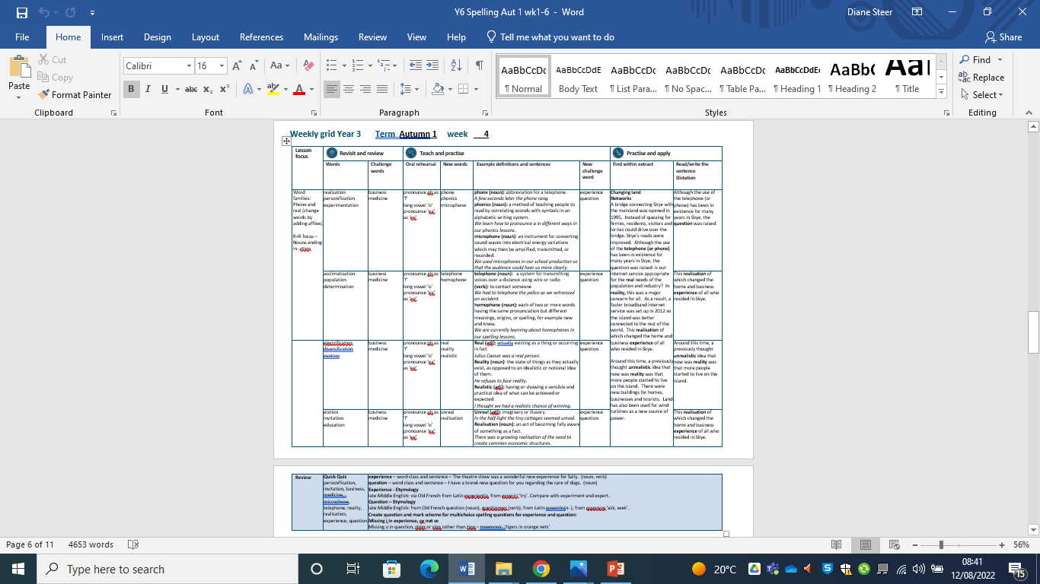

Slide 4
Let’s Revisit and Review…

Slide 5
Do you remember this challenge word?

Slide 6

Definition - a person's regular occupation, profession, or trade.
business
NOUN

Slide 7
The young women celebrated the opening of their small business selling cakes.
________

Slide 8
Do you remember this challenge word?

Slide 9
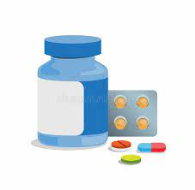
Definition – a drug or other preparation for the treatment or prevention of disease.
medicine
NOUN

Slide 10
Fred had to take medicine twice a day to fight the infection.
_______

Slide 11
Nouns ending in -ation

Slide 12
-ation suffix from middle English and Old French.
A suffix is a letter string (group of letters) that appear at the end of a word to change its word class

Slide 13

realisation

Slide 14

personification

Slide 15

experimentation

Slide 16
Let’s Teach and Practise

Slide 17
Word families – phone

Slide 18
Pronounce ph as f
Long vowel ‘o’
From the Greek – sound or voice

Slide 19
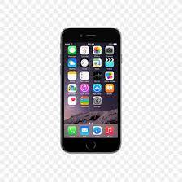
phone

Slide 20

phonics n

Slide 21

microphone

Slide 22
Definition –a a portable, electronic telephone device
phone
NOUN

Slide 23
Definition - a method of teaching people to read by correlating sounds with symbols in an alphabetic writing system.
phonics
NOUN

Slide 24
Definition - an instrument for converting sound waves into electrical energy variations which may then be amplified, transmitted, or recorded.
microphone
NOUN

Slide 25
A few minutes later, the phone rang.
_____

Slide 26
Sally was learning her phonics and could now read some words.
_______

Slide 27
A reporter stood behind him pointing a microphone.
__________

Slide 28
New CHALLENGE words.

Slide 29
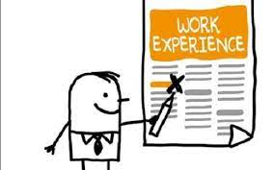
Definition - an event or occurrence which leaves an impression on someone
experience
NOUN

Slide 30
Weightlessness is an experience astronauts prepare for when going into space.
__________

Slide 31

Definition - a sentence worded or expressed so as to elicit information
question
NOUN

Slide 32
Fred had an interesting question for the science visitor.
________

Slide 33
Let’s Practise and Apply.

Slide 34
Can you spot the spelling rule words and the challenge words?

Slide 35
Changing land
Networks
A bridge connecting Skye with the mainland was opened in 1995. Instead of queuing for ferries, residents, visitors and lorries could drive over the bridge. Skye’s roads were improved. Although the use of the telephone (or phone) has been in existence for many years in Skye, the question was raised: is our internet service appropriate for the real needs of the population and industry? In reality, this was a major concern for all. As a result, a faster broadband internet service was set up in 2012 so the island was better connected to the rest of the world. This realisation of which changed the home and business experience of all who resided in Skye.
Around this time, a previously thought unrealistic idea that now was reality was that more people started to live on the island. There were new buildings for homes, businesses and tourists. Land has also been used for wind turbines as a new source of power.

Slide 36
Changing land
Networks
A bridge connecting Skye with the mainland was opened in 1995. Instead of queuing for ferries, residents, visitors and lorries could drive over the bridge. Skye’s roads were improved. Although the use of the telephone (or phone) has been in existence for many years in Skye, the question was raised: is our internet service appropriate for the real needs of the population and industry? In reality, this was a major concern for all. As a result, a faster broadband internet service was set up in 2012 so the island was better connected to the rest of the world. This realisation of which changed the home and business experience of all who resided in Skye.
Around this time, a previously thought unrealistic idea that now was reality was that more people started to live on the island. There were new buildings for homes, businesses and tourists. Land has also been used for wind turbines as a new source of power.

Slide 37
Write this sentence as I dictate it to you.
Notes:
Although the use of the telephone (or phone) has been in existence for many yeas in Skye, the question was raised.

Slide 38
Although the use of the telephone (or phone) has been in existence for many yeas in Skye, the question was raised.
Did you write it correctly?
Edit your work and make sure you have it correct.
Can you underline the spelling word that we have covered in this session?

Slide 39
Year 5 - Autumn 1
Week 4 - Tuesday

Slide 40
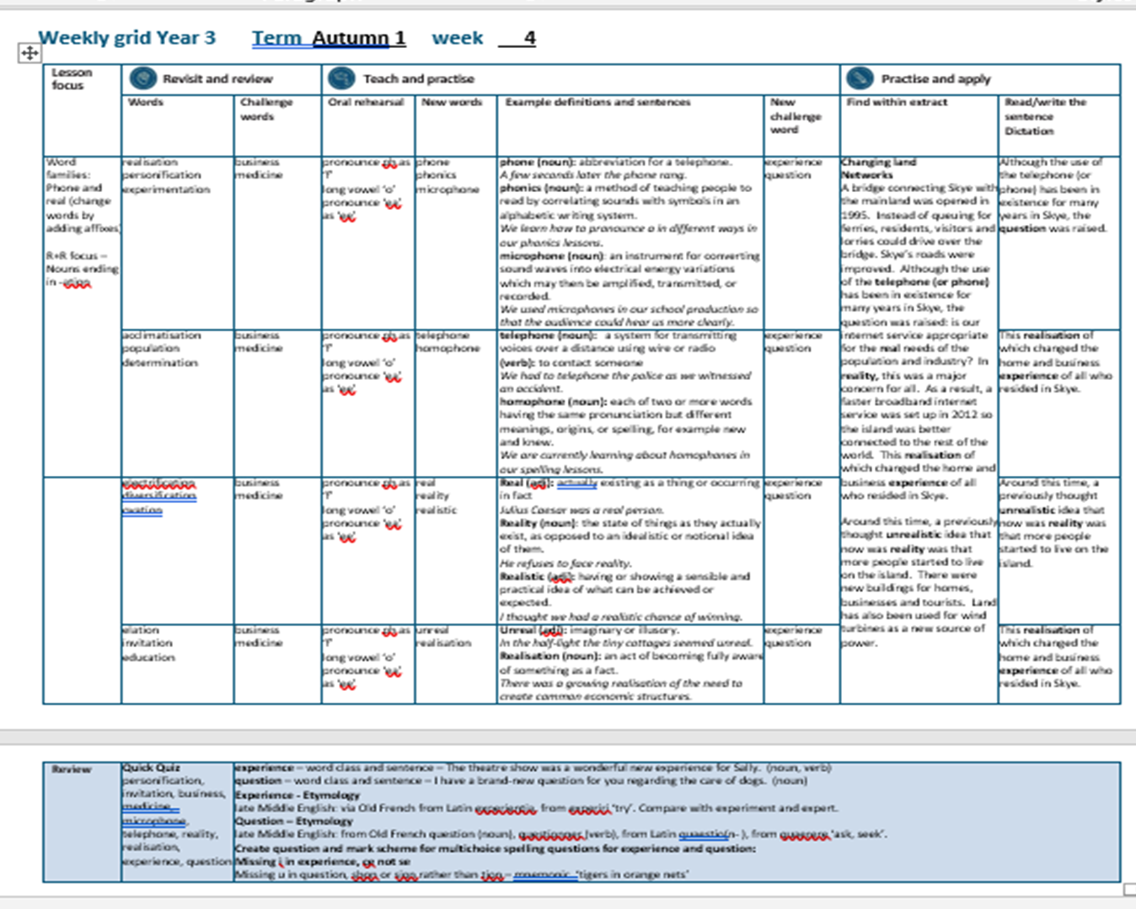

Slide 41
Let’s Revisit and Review…

Slide 42
Do you remember this challenge word?

Slide 43
Definition - a person's regular occupation, profession, or trade.
business
NOUN

Slide 44
The young women celebrated the opening of their small business selling cakes.
________

Slide 45
Do you remember this challenge word?

Slide 46
Definition – a drug or other preparation for the treatment or prevention of disease.
medicine
NOUN

Slide 47
Fred had to take medicine twice a day to fight the infection.
_______

Slide 48
Nouns ending in -ation

Slide 49
-ation suffix from middle English and Old French.
A suffix is a letter string (group of letters) that appear at the end of a word to change its word class

Slide 50
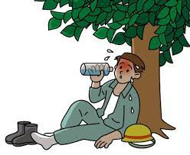
acclimatisation

Slide 51
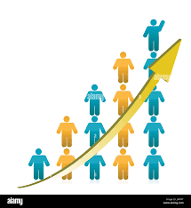
population

Slide 52

determination

Slide 53
Let’s Teach and Practise

Slide 54
Word families – phone

Slide 55

telephone

Slide 56
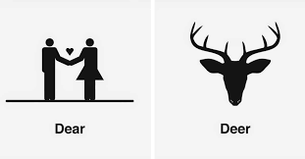
homophone

Slide 57
Definition - a system for transmitting voices over a distance using wire or radio, by converting acoustic vibrations to electrical signals.
telephone
NOUN

Slide 58
Definition - each of two or more words having the same pronunciation but different meanings, origins, or spelling, for example new and knew.
homophone
NOUN

Slide 59
The telephone rang many times during the morning.
_________

Slide 60
There discovered many homophones in the text that we were reading.
__________

Slide 61
New CHALLENGE words.

Slide 62
Definition - an event or occurrence which leaves an impression on someone
experience
NOUN

Slide 63
Weightlessness is an experience astronauts prepare for when going into space.
__________

Slide 64
Definition - a sentence worded or expressed so as to elicit information
question
NOUN

Slide 65
Fred had an interesting question for the science visitor.
________

Slide 66
Let’s Practise and Apply.

Slide 67
Can you spot the spelling rule words and the challenge words?

Slide 68
Changing land
Networks
A bridge connecting Skye with the mainland was opened in 1995. Instead of queuing for ferries, residents, visitors and lorries could drive over the bridge. Skye’s roads were improved. Although the use of the telephone (or phone) has been in existence for many years in Skye, the question was raised: is our internet service appropriate for the real needs of the population and industry? In reality, this was a major concern for all. As a result, a faster broadband internet service was set up in 2012 so the island was better connected to the rest of the world. This realisation of which changed the home and business experience of all who resided in Skye.
Around this time, a previously thought unrealistic idea that now was reality was that more people started to live on the island. There were new buildings for homes, businesses and tourists. Land has also been used for wind turbines as a new source of power.

Slide 69
Changing land
Networks
A bridge connecting Skye with the mainland was opened in 1995. Instead of queuing for ferries, residents, visitors and lorries could drive over the bridge. Skye’s roads were improved. Although the use of the telephone (or phone) has been in existence for many years in Skye, the question was raised: is our internet service appropriate for the real needs of the population and industry? In reality, this was a major concern for all. As a result, a faster broadband internet service was set up in 2012 so the island was better connected to the rest of the world. This realisation of which changed the home and business experience of all who resided in Skye.
Around this time, a previously thought unrealistic idea that now was reality was that more people started to live on the island. There were new buildings for homes, businesses and tourists. Land has also been used for wind turbines as a new source of power.

Slide 70
Write this sentence as I dictate it to you.
Notes:
This realisation of which changed the home and business experience of all who resided in Skye

Slide 71
This realisation of which changed the home and business experience of all who resided in Skye
Did you write it correctly?
Edit your work and make sure you have it correct.
Can you underline the spelling word that we have covered in this session?

Slide 72
Year 5 - Autumn 1
Week 4 - Wednesday
Notes:
Revisit and review the words from Y2 and challenge words – I say, we say, you say
Ask children to write words only in their spelling book
Introduce the new spelling rule
Children to write the new spelling rule words and challenge words into books when the sentences are shown with the spelling word missing.
Read the extract with the class as choral reading. Practise model of prosody etc.
Ask children to find the spelling words from the session in the text.
Then read allowed the chosen sentence for children to write fully in their books.
Show the extract and ask children to then edit their work to check they were correct in their dictation.

Slide 74
Let’s Revisit and Review…

Slide 75
Do you remember this challenge word?

Slide 76
Definition - a person's regular occupation, profession, or trade.
business
NOUN

Slide 77
The young women celebrated the opening of their small business selling cakes.
________

Slide 78
Do you remember this challenge word?

Slide 79
Definition – a drug or other preparation for the treatment or prevention of disease.
medicine
NOUN

Slide 80
Fred had to take medicine twice a day to fight the infection.
_______

Slide 81
Nouns ending in -ation

Slide 82
-ation suffix from middle English and Old French.
A suffix is a letter string (group of letters) that appear at the end of a word to change its word class

Slide 83
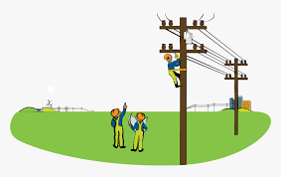
electrification

Slide 84

diversification

Slide 85

ovation

Slide 86
Let’s Teach and Practise

Slide 87
Word families – real

Slide 88
real late Latin ‘thing’

Slide 89
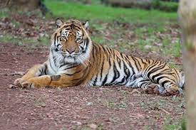
real

Slide 90
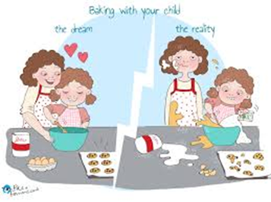
reality
tt

Slide 91

realistic

Slide 92
Definition - actually existing as a thing or occurring in fact; not imagined or supposed.
real
ADJECTIVE

Slide 93

Definition - the state of things as they actually exist, as opposed to an idealistic or notional idea of them.
reality
NOUN

Slide 94
Definition - having or showing a sensible and practical idea of what can be achieved or expected.
realistic
ADJECTIVE

Slide 95
The dessert was made with real fruit.
____

Slide 96
The reality was that we were lost.
_______

Slide 97
The stage scenery was very realistic.
_________

Slide 98
New CHALLENGE words.

Slide 99
Definition - an event or occurrence which leaves an impression on someone
experience
NOUN

Slide 100
Weightlessness is an experience astronauts prepare for when going into space.
__________

Slide 101
Definition - a sentence worded or expressed so as to elicit information
question
NOUN

Slide 102
Fred had an interesting question for the science visitor.
________

Slide 103
Let’s Practise and Apply.

Slide 104
Can you spot the spelling rule words and the challenge words?

Slide 105
Changing land
Networks
A bridge connecting Skye with the mainland was opened in 1995. Instead of queuing for ferries, residents, visitors and lorries could drive over the bridge. Skye’s roads were improved. Although the use of the telephone (or phone) has been in existence for many years in Skye, the question was raised: is our internet service appropriate for the real needs of the population and industry? In reality, this was a major concern for all. As a result, a faster broadband internet service was set up in 2012 so the island was better connected to the rest of the world. This realisation of which changed the home and business experience of all who resided in Skye.
Around this time, a previously thought unrealistic idea that now was reality was that more people started to live on the island. There were new buildings for homes, businesses and tourists. Land has also been used for wind turbines as a new source of power.

Slide 106
Changing land
Networks
A bridge connecting Skye with the mainland was opened in 1995. Instead of queuing for ferries, residents, visitors and lorries could drive over the bridge. Skye’s roads were improved. Although the use of the telephone (or phone) has been in existence for many years in Skye, the question was raised: is our internet service appropriate for the real needs of the population and industry? In reality, this was a major concern for all. As a result, a faster broadband internet service was set up in 2012 so the island was better connected to the rest of the world. This realisation of which changed the home and business experience of all who resided in Skye.
Around this time, a previously thought unrealistic idea that now was reality was that more people started to live on the island. There were new buildings for homes, businesses and tourists. Land has also been used for wind turbines as a new source of power.

Slide 107
Write this sentence as I dictate it to you.
Notes:
Around this time, a previously thought unrealistic idea that now was reality was that more people started to live on the island.

Slide 108
Around this time, a previously thought unrealistic idea that now was reality was that more people started to live on the island.
Did you write it correctly?
Edit your work and make sure you have it correct.

Slide 109
Year 5 - Autumn 1
Week 4 - Thursday
Notes:
Revisit and review the words from Y2 and challenge words – I say, we say, you say
Ask children to write words only in their spelling book
Introduce the new spelling rule
Children to write the new spelling rule words and challenge words into books when the sentences are shown with the spelling word missing.
Read the extract with the class as choral reading. Practise model of prosody etc.
Ask children to find the spelling words from the session in the text.
Then read allowed the chosen sentence for children to write fully in their books.
Show the extract and ask children to then edit their work to check they were correct in their dictation.

Slide 111
Let’s Revisit and Review…

Slide 112
Do you remember this challenge word?

Slide 113
Definition - a person's regular occupation, profession, or trade.
business
NOUN

Slide 114
The young women celebrated the opening of their small business selling cakes.
________

Slide 115
Do you remember this challenge word?

Slide 116
Definition – a drug or other preparation for the treatment or prevention of disease.
medicine
NOUN

Slide 117
Fred had to take medicine twice a day to fight the infection.
_______

Slide 118
Nouns ending in -ation

Slide 119
-ation suffix from middle English and Old French.
A suffix is a letter string (group of letters) that appear at the end of a word to change its word class

Slide 120

elation

Slide 121
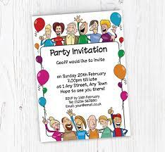
invitation

Slide 122

education

Slide 123
Let’s Teach and Practise

Slide 124
Word families – real

Slide 125
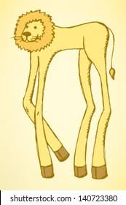
unreal

Slide 126

realisation

Slide 127
Definition - imaginary or illusory / not real
unreal
ADJECTIVE

Slide 128
Definition - an act of becoming fully aware of something as a fact.
realisation
NOUN

Slide 129
They saw the unusual bird that they initially thought was unreal.
______

Slide 130
Fran had a sudden realisation that her dream could come true.
___________

Slide 131
New CHALLENGE words.

Slide 132
Definition - an event or occurrence which leaves an impression on someone
experience
NOUN

Slide 133
Weightlessness is an experience astronauts prepare for when going into space.
__________

Slide 134
Definition - a sentence worded or expressed so as to elicit information
question
NOUN

Slide 135
Fred had an interesting question for the science visitor.
________

Slide 136
Let’s Practise and Apply.

Slide 137
Can you spot the spelling rule words and the challenge words?

Slide 138
Changing land
Networks
A bridge connecting Skye with the mainland was opened in 1995. Instead of queuing for ferries, residents, visitors and lorries could drive over the bridge. Skye’s roads were improved. Although the use of the telephone (or phone) has been in existence for many years in Skye, the question was raised: is our internet service appropriate for the real needs of the population and industry? In reality, this was a major concern for all. As a result, a faster broadband internet service was set up in 2012 so the island was better connected to the rest of the world. This realisation of which changed the home and business experience of all who resided in Skye.
Around this time, a previously thought unrealistic idea that now was reality was that more people started to live on the island. There were new buildings for homes, businesses and tourists. Land has also been used for wind turbines as a new source of power.

Slide 139
Changing land
Networks
A bridge connecting Skye with the mainland was opened in 1995. Instead of queuing for ferries, residents, visitors and lorries could drive over the bridge. Skye’s roads were improved. Although the use of the telephone (or phone) has been in existence for many years in Skye, the question was raised: is our internet service appropriate for the real needs of the population and industry? In reality, this was a major concern for all. As a result, a faster broadband internet service was set up in 2012 so the island was better connected to the rest of the world. This realisation of which changed the home and business experience of all who resided in Skye.
Around this time, a previously thought unrealistic idea that now was reality was that more people started to live on the island. There were new buildings for homes, businesses and tourists. Land has also been used for wind turbines as a new source of power.

Slide 140
Write this sentence as I dictate it to you.
Notes:
This realisation of which changed the home and business experience of all who resided in Skye.

Slide 141
This realisation of which changed the home and business experience of all who resided in Skye.
Did you write it correctly?
Edit your work and make sure you have it correct.
Can you underline the spelling word that we have covered in this session?

Slide 142
Year 5 - Autumn 1
Week 4 - Friday
Notes:
Click through the slides for all the R+R words for the week (both the focus and the challenge words)
Click through the slides for all the new learning this week

Slide 144
Let’s Revisit and Review…
Notes:
Click through the slides for all the R+R words for the week (both the focus and the challenge words)
Click through the slides for all the new learning this week

Slide 145
Old challenge words…

Slide 146
business

Slide 147
medicine

Slide 148
Old spelling rule words…

Slide 149
realisation

Slide 150
personification

Slide 151
experimentation

Slide 152
acclimatisation

Slide 153
population

Slide 154
determination

Slide 155
electrification

Slide 156
diversification

Slide 157
ovation

Slide 158
elation

Slide 159
invitation

Slide 160
education

Slide 161
New spelling rule words…

Slide 162
phone

Slide 163
phonics

Slide 164
microphone

Slide 165
telephone

Slide 166
homophone

Slide 167
real

Slide 168
reality

Slide 169
realistic

Slide 170
unreal

Slide 171
realisation

Slide 172
New challenge words…

Slide 173
experience

Slide 174
question

Slide 175
Quick Quiz time…
Notes:
personification, invitation, business, medicine, microphone, telephone, reality, realisation, experience, question

Slide 176
Did you get them correct?
Edit your work.
personification, invitation, business, medicine, microphone, telephone, reality, realisation, experience, question
Notes:
Say these words for the quiz
Medal, bored, straight, favourite,
Rough, enough, through, borough, peculiar, occasion

Slide 177
Word class time…

Slide 178
Pronoun verb verb pronoun noun preposition adjective noun
He had learned his lesson by painful experience.

Slide 179
Proper noun verb determiner adjective noun conjunction determiner adjective noun
Fred had an interesting question for the science visitor.

Slide 180
Etymology
The history of a word….

Slide 181
Experience - Etymology
late Middle English: via Old French from Latin experientia, from experiri ‘try’. Compare with experiment and expert.
Question – Etymology
late Middle English: from Old French question (noun), questionner (verb), from Latin quaestio(n- ), from quaerere ‘ask, seek’.

Slide 182
Let’s investigate….
Knowledge and experiment?

Slide 183
Words linked to experience…
involvement in
participation in
contact with
acquaintance with
exposure to
observation of
awareness of
familiarity with
conversance with
understanding of
impression of
insight into
circumstance
case
test
trial
ordeal
verb
undergo
encounter
meet
have experience of
come into contact with
run into
come across
come up against
face
be faced with
confront

Slide 184
Words linked to question…
inquiry
query
interrogation
examination
quiz
quizzing
verb
interrogate
ask questions of
put questions to
cross-examine
cross-question
quiz
probe
canvass
catechize
interview
debrief
sound out
examine
give the third degree to
grill
pump

Slide 185
Common errors with experience and question:
experience
missing i in experience – experence
-ce not –se – experiense
question
missing u in question – qestion
shon or –sion rather than –tion – queshon, quesion

