Slide 1
Spelling Y5
Mastering spellings: building on the foundations of phonics
Autumn 1
Week 6

Slide 2
Year 5 - Autumn 1
Week 6 - Monday

Slide 3
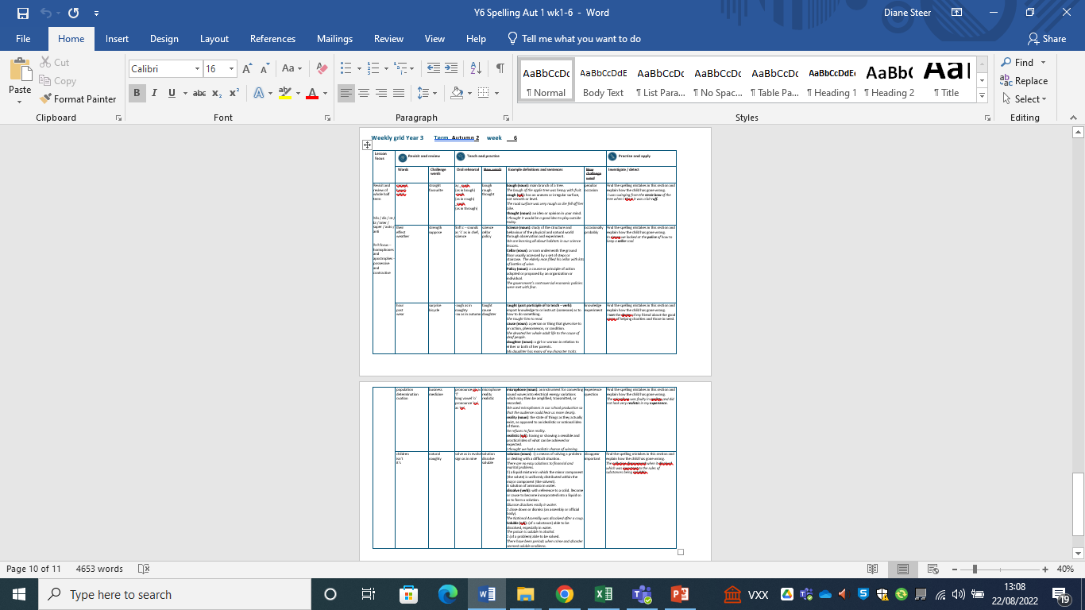

Slide 4
Do you remember this challenge word?

Slide 5

Definition – extending or moving uniformly in one direction only; without a curve or bend
straight
ADJECTIVE

Slide 6
The road was very straight with no curves or bends.
________

Slide 7
Do you remember this challenge word?

Slide 8

Definition – preferred to all others of the same kind
favourite
ADJECTIVE

Slide 9
This is my favourite colour.
_________

Slide 10
Homophones

Slide 11
Homophone homo = same phone = sound
(from Ancient Greek)

Slide 12
Homophone = a word that has the same sound but has a different meaning

Slide 13

medal

Slide 14
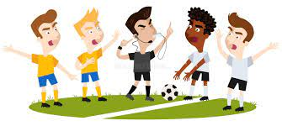
meddle

Slide 15
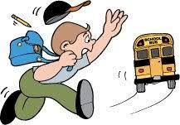
missed

Slide 16

mist

Slide 17
Let’s Teach and Practise

Slide 18
Letter string -ough

Slide 19
-ough

Slide 20
-ough
_ough (as in bough)
-ough (as in rough)
_ough (as in through)

Slide 21

bough

Slide 22
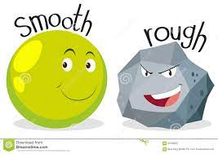
rough n

Slide 23
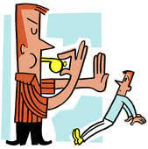
enough

Slide 24
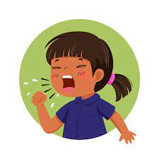
cough

Slide 25
Definition – the branch of a tree
bough
b + ough = bough
NOUN

Slide 26
Definition - has an uneven or irregular surface, not smooth or level.
rough
r + ough = rough
ADJECTIVE

Slide 27
Definition - to the required level or amount
enough
en + ough = enough
ADVERB

Slide 28
Definition - release of air from lungs with a sound (noun), act of coughing.
cough
c + ough = cough
noun
NOUN

Slide 29
He had a dreadful cough that made his eyes water.
_____

Slide 30
The bough of the apple tree was heavy with fruit.
_____

Slide 31
Due to a rough road surface, the cyclist dismounted.
_____

Slide 32
At the time, they were not old enough to vote.
______

Slide 33
New CHALLENGE words.

Slide 34
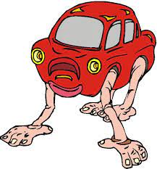
Definition - different to what is normal or expected; strange
peculiar
ADJECTIVE

Slide 35
This is a very peculiar story.
________

Slide 36

Definition – a particular event, or the time at which it takes place
occasion
NOUN

Slide 37
Fred was busy planning for the very special occasion of his birthday.
________

Slide 38
Let’s investigate …

Slide 39
Look at this sentence.
Change the spellings that are incorrect.
Explain how each one is wrong and how to remember to get it right next time.

Slide 40
I was swinging from the strait bow of the tree when I thort it was a bit ruff.

Slide 41
I was swinging from the strait bow of the tree when I thort it was a bit ruff. straight –ght not -t

Slide 42
I was swinging from the strait bow of the tree when I thort it was a bit ruff. bough –ough not -ow

Slide 43
I was swinging from the strait bow of the tree when I thort it was a bit ruff. thought –ought not -ort

Slide 44
I was swinging from the strait bow of the tree when I thort it was a bit ruff. rough –ough not -uff

Slide 45
I was swinging from the straight bough of the tree when I thought it was a bit rough.

Slide 46
Year 5 - Autumn 1
Week 6 - Tuesday
Notes:
Revisit and review the words from Y2 and challenge words – I say, we say, you say
Ask children to write words only in their spelling book
Introduce the new spelling rule
Children to write the new spelling rule words and challenge words into books when the sentences are shown with the spelling word missing.
Read the extract with the class as choral reading. Practise model of prosody etc.
Ask children to find the spelling words from the session in the text.
Then read allowed the chosen sentence for children to write fully in their books.
Show the extract and ask children to then edit their work to check they were correct in their dictation.

Slide 47
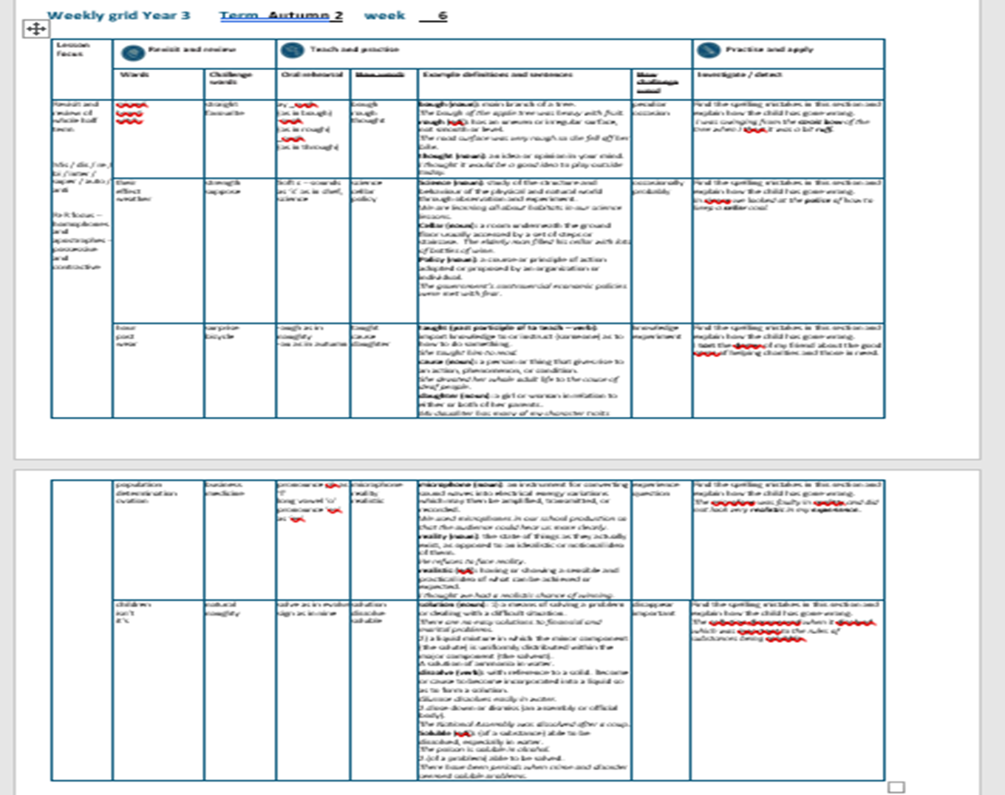

Slide 48
Do you remember this challenge word?

Slide 49
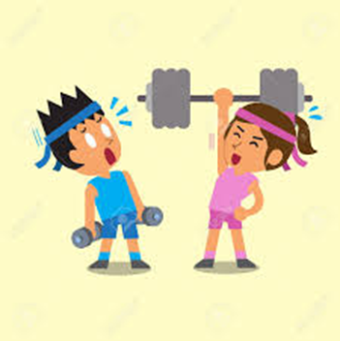
Definition - the quality or state of being physically strong.
strength
NOUN

Slide 50
The girl’s strength was incredible as she demonstrated moving the large table.
________

Slide 51
Do you remember this challenge word?

Slide 52

Definition – think or assume that something is true or probable but lack proof or certain knowledge
suppose
VERB

Slide 53
I suppose you are going to eat the last cup cake.
_______

Slide 54
Homophones

Slide 55
Homophone homo = same phone = sound
(from Ancient Greek)

Slide 56
Homophone a word that has the same sound but has a different meaning

Slide 57
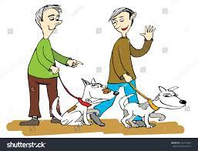
their

Slide 58
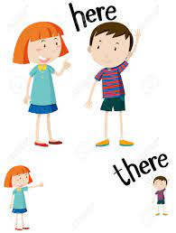
there

Slide 59
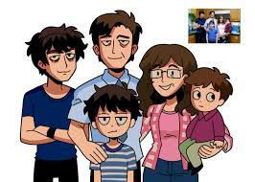
they’re
They’re altogether

Slide 60
Let’s Teach and Practise

Slide 61
Soft c

Slide 62
soft c – sh (as in chef) s (as in science)

Slide 63
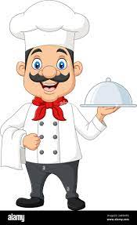
chef

Slide 64
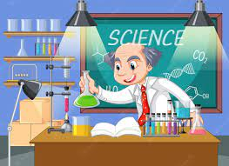
science n

Slide 65
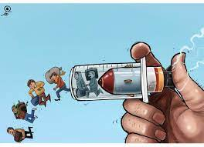
forced

Slide 66
Definition - a professional cook, typically the chief cook in a restaurant or hotel.
chef
ch + ef = chef
NOUN

Slide 67
Definition - study of the structure and behaviour of the physical and natural world through observation and experiment
science
sc + ience = science
ADJECTIVE

Slide 68
Definition - obtained or imposed by coercion or physical power / produced or maintained with effort; affected or unnatural.
forced
for + c + ed = forced
ADJECTIVE

Slide 69
Sally trained to be a chef at City College.
____

Slide 70
Science was Fran’s favourite subject in year six.
_______

Slide 71
There was no sign of a forced entry.
______

Slide 72
New CHALLENGE words.

Slide 73
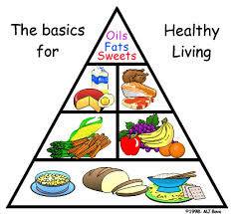
Definition - at infrequent or irregular intervals; now and then
occasionally
ADVERB

Slide 74
We eat chocolate occasionally at the weekend.
____________

Slide 75
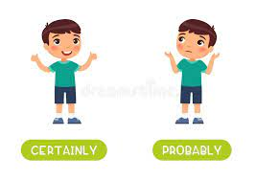
Definition - almost certainly; as far as one knows or can tell
probably
ADVERB

Slide 76
It will probably rain at the weekend as we are going camping!
_______

Slide 77
Let’s investigate...

Slide 78
Look at this sentence.
Change the spellings that are incorrect.
Explain how each one is wrong and how to remember to get it right next time.
Notes:
The population of Skye became smaller between 1840s and 1990s and many organisations were dissolved due to this decline.

Slide 79
In sience we looked at the police of how to keep a seller cool.

Slide 80
In sience, we looked at the police of how to keep a seller cool. science –sc not -s

Slide 81
In sience, we looked at the police of how to keep a seller cool. policy -cy not -ce

Slide 82
In sience, we looked at the policy of how to keep a seller cool. cellar c- not s-, -ar not -er

Slide 83
In science, we looked at the policy of how to keep a cellar cool.

Slide 84
Year 5 - Autumn 1
Week 6 - Wednesday
Notes:
Revisit and review the words from Y2 and challenge words – I say, we say, you say
Ask children to write words only in their spelling book
Introduce the new spelling rule
Children to write the new spelling rule words and challenge words into books when the sentences are shown with the spelling word missing.
Read the extract with the class as choral reading. Practise model of prosody etc.
Ask children to find the spelling words from the session in the text.
Then read allowed the chosen sentence for children to write fully in their books.
Show the extract and ask children to then edit their work to check they were correct in their dictation.

Slide 86
Do you remember this challenge word?

Slide 87

Definition - an unexpected or astonishing event, fact, etc.
surprise
NOUN

Slide 88
The bus tour was full of surprises.
_________

Slide 89
Do you remember this challenge word?

Slide 90

Definition – a vehicle consisting of two wheels held in a frame one behind the other, propelled by pedals and steered with handlebars attached to the front wheel.
bicycle
NOUN

Slide 91
My mum repaired the back tyre on my bicycle.
_______

Slide 92
Homophones

Slide 93
Homophone homo = same phone = sound
(from Ancient Greek)

Slide 94
Homophone a word that has the same sound but has a different meaning

Slide 95

are

Slide 96
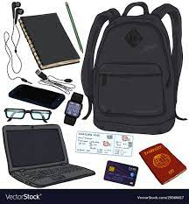
our
our belongings

Slide 97
missed

Slide 98

mist

Slide 99
Let’s Teach and Practise

Slide 100
Letter strings –augh and -au

Slide 101
-augh
-au

Slide 102
-augh or (as in naughty)
-au or (as in autumn)

Slide 103
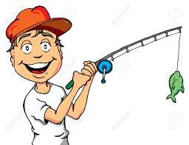
caught

Slide 104
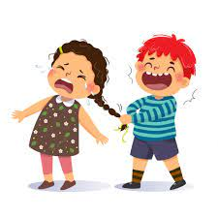
naughty n

Slide 105
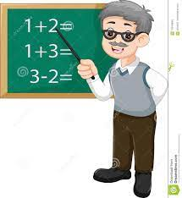
taught

Slide 106
Definition – intercept and hold (something which has been thrown, propelled or dropped).
caught
c + augh + t = caught
VERB

Slide 107
Definition - (especially of a child) badly behaved; disobedient.
naughty
n + augh + ty = naughty
ADJECTIVE

Slide 108
Definition - cause (someone) to learn or understand something by example or experience.
taught
t + augh + t = taught
VERB

Slide 109
She threw the bottle into the air and caught it again.
______

Slide 110
You’ve been a really naughty puppy.
_______

Slide 111
She taught him to read.
______

Slide 112
New CHALLENGE words.

Slide 113

Definition - facts, information, and skills acquired through experience or education; the theoretical or practical understanding of a subject
knowledge
NOUN

Slide 114
He has a fantastic recall of general knowledge.
_________

Slide 115
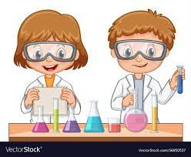
Definition - a scientific procedure undertaken to make a discovery, test a hypothesis, or demonstrate a known fact
experiment
NOUN

Slide 116
We carried out many experiments in our recent science learning.
__________

Slide 117
Let’s investigate …

Slide 118
Look at this sentence.
Change the spellings that are incorrect.
Explain how each one is wrong and how to remember to get it right next time.

Slide 119
I tort the dorter of my friend about the good corse of helping charities and those in need.

Slide 120
I tort the dorter of my friend about the good corse of helping charities and those in need. taught -augh not -or

Slide 121
I tort the dorter of my friend about the good corse of helping charities and those in need. daughter -augh not -or

Slide 122
I tort the dorter of my friend about the good corse of helping charities and those in need. cause -au not -or

Slide 123
I taught the daughter of my friend about the good cause of helping charities and those in need.

Slide 124
Year 5 - Autumn 1
Week 6 - Thursday

Slide 126
Do you remember this challenge word?

Slide 127

Definition - a person's regular occupation, profession, or trade.
business
NOUN

Slide 128
The young women celebrated the opening of their small business selling cakes.
________

Slide 129
Do you remember this challenge word?

Slide 130
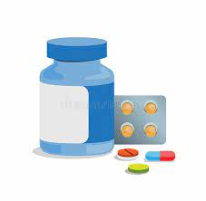
Definition – a drug or other preparation for the treatment or prevention of disease.
medicine
NOUN

Slide 131
Fred had to take medicine twice a day to fight the infection.
_______

Slide 132
Nouns ending in -ation

Slide 133
-ation suffix from middle English and Old French.
A suffix is a letter string (group of letters) that appear at the end of a word to change its word class

Slide 134

realisation

Slide 135

personification

Slide 136
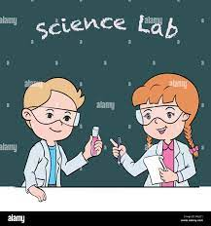
experimentation

Slide 137
Let’s Teach and Practise

Slide 138
Word families – phone

Slide 139
Pronounce ph as f
Long vowel ‘o’
From the Greek – sound or voice

Slide 140
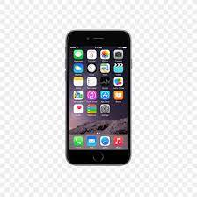
phone

Slide 141

phonics n

Slide 142

microphone

Slide 143
Definition –a a portable, electronic telephone device
phone
NOUN

Slide 144
Definition - a method of teaching people to read by correlating sounds with symbols in an alphabetic writing system.
phonics
NOUN

Slide 145
Definition - an instrument for converting sound waves into electrical energy variations which may then be amplified, transmitted, or recorded.
microphone
NOUN

Slide 146
A few minutes later, the phone rang.
_____

Slide 147
Sally was learning her phonics and could now read some words.
_______

Slide 148
A reporter stood behind him pointing a microphone.
__________

Slide 149
New CHALLENGE words.

Slide 150
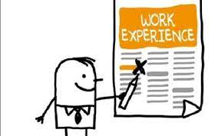
Definition - an event or occurrence which leaves an impression on someone
experience
NOUN

Slide 151
Weightlessness is an experience astronauts prepare for when going into space.
__________

Slide 152

Definition - a sentence worded or expressed so as to elicit information
question
NOUN

Slide 153
Fred had an interesting question for the science visitor.
________

Slide 154
Let’s investigate …

Slide 155
Look at this sentence.
Change the spellings that are incorrect.
Explain how each one is wrong and how to remember to get it right next time.

Slide 156
The microfone was faulty in realitty and did not look very reallistic in my expereence.

Slide 157
The microfone was faulty in realitty and did not look very reallistic in my expereence. microphone –ph not -f

Slide 158
The microfone was faulty in realitty and did not look very reallistic in my expereence. reality –ty not tty

Slide 159
The microfone was faulty in realitty and did not look very reallistic in my expereence. realistic –listic not llistic

Slide 160
The microfone was faulty in realitty and did not look very reallistic in my expereence. experience –ience not -eence

Slide 161
Year 5 - Autumn 1
Week 6 - Friday
Notes:
Click through the slides for all the R+R words for the week (both the focus and the challenge words)
Click through the slides for all the new learning this week

Slide 163
Do you remember this challenge word?

Slide 164

Definition - existing in or derived from nature; not made or caused by humankind.
natural
ADJECTIVE

Slide 165
Sharks have no natural enemies
_______

Slide 166
Do you remember this challenge word?

Slide 167
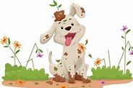
Definition – (especially of a child) badly behaved; disobedient.
naughty
ADJECTIVE

Slide 168
You've been a really naughty puppy.
_______

Slide 169
Plural and possessive apostrophes

Slide 170
a punctuation mark (‘) used to indicate either possession or the omission of letters or figures

Slide 171
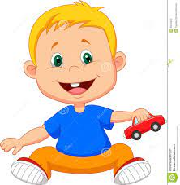
baby’s
baby’s toy car

Slide 172

children’s
children’s toys

Slide 173

don’t

Slide 174
Let’s Teach and Practise

Slide 175
Word families – solve and sign

Slide 176
solve
Latin - loosen sign
Latin – mark or token

Slide 177
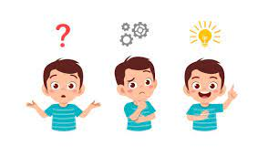
solve

Slide 178
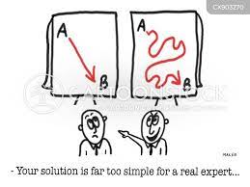
solution

Slide 179
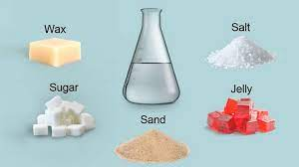
solublen

Slide 180
Definition - a means of solving a problem or dealing with a difficult situation.
solution
NOUN

Slide 181
Definition - find an answer to, explanation for, or means of effectively dealing with (a problem or mystery).
solve
VERB

Slide 182
Definition – (of a substance) able to be dissolved, especially in water.
(of a problem) able to be solved.
soluble
ADJECTIVE

Slide 183
We worked as a team to solve the mystery.
_____

Slide 184
Finally, we have found a solution to this problem.
________

Slide 185
Her experiment showed that salt is soluble in water.
_______

Slide 186
New CHALLENGE words.

Slide 187
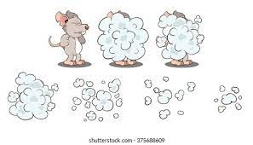
Definition - cease to be visible
disappear
VERB

Slide 188
The small mouse ran to disappear from the cat.
_________

Slide 189

Definition -of great significance or value
important
ADJECTIVE

Slide 190
Sally had a very important meeting to attend at 10 o’clock.
_________

Slide 191
Let’s investigate …

Slide 192
Look at this sentence.
Change the spellings that are incorrect.
Explain how each one is wrong and how to remember to get it right next time.

Slide 193
The sollution dissapeared when it disolved which was inportant to the rules of substances being solubble.

Slide 194
The sollution dissapeared when it disolved which was inportant to the rules of substances being solubble. solution –l not -ll

Slide 195
The sollution dissapeared when it disolved which was inportant to the rules of substances being solubble. disappeared –s not –ss, -pp not -p

Slide 196
The sollution dissapeared when it disolved which was inportant to the rules of substances being solubble. dissolved –ss not –s

Slide 197
The sollution dissapeared when it disolved which was inportant to the rules of substances being solubble. important –im not –in

Slide 198
The sollution dissapeared when it disolved which was inportant to the rules of substances being solubble. soluble –ble not –bble

Slide 199
The solution disappeared when it dissolved which was important to the rules of substances being soluble.

