Slide 1
Spelling Y5
Mastering spellings: building on the foundations of phonics
Autumn 2
Week 1

Slide 2
Year 5 - Autumn 2
Week 1 - Monday
Notes:
Revisit and review the words and challenge words – I say, we say, you say
Ask children to write words only in their spelling book
Introduce the new spelling rule
Children to write the new spelling rule words and challenge words into books when the sentences are shown with the spelling word missing.
Read the extract with the class as choral reading. Practise model of prosody etc.
Ask children to find the spelling words from the session in the text.
Then read allowed the chosen sentence for children to write fully in their books.
Show the extract and ask children to then edit their work to check they were correct in their dictation.

Slide 3
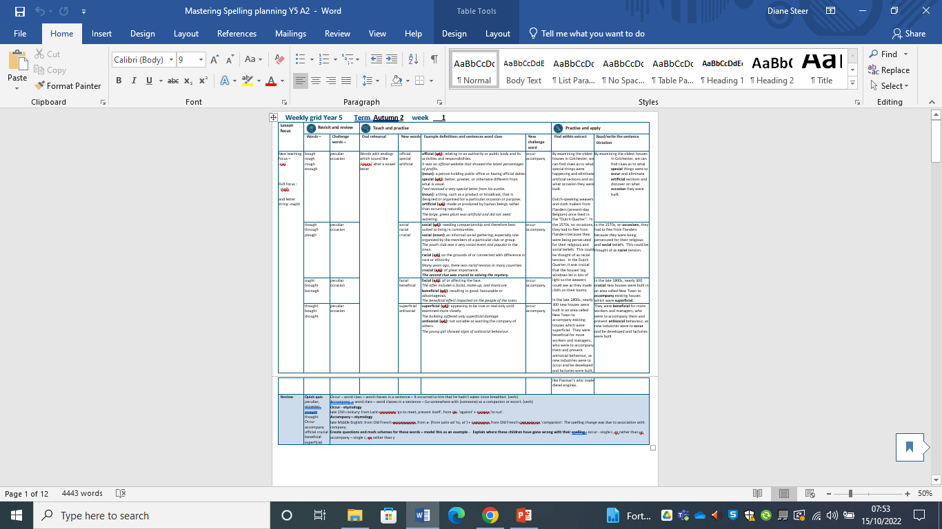
Notes:
Plan

Slide 4
Let’s Revisit and Review…

Slide 5
Do you remember this challenge word?

Slide 6
peculiar

Slide 7
peculiar adjective
Definition - different to what is normal or expected; strange.

Slide 8
Do you remember this challenge word?

Slide 9
occasion

Slide 10
occasion noun
Definition – a particular event, or the time at which it takes place.

Slide 11
Do you remember this rule?

Slide 12
ough

Slide 13
ough ough is one of the trickiest spellings in
English as it can be used to spell a number of different sounds.

Slide 14
bough

Slide 15
bough

Slide 16

bough
‘ow’ sound

Slide 17
rough

Slide 18
rough

Slide 19
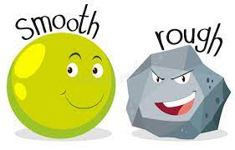
rough
‘uff’ sound

Slide 20
cough

Slide 21
cough

Slide 22
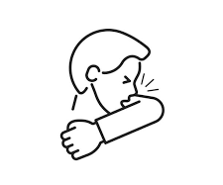
cough
‘off’ sound

Slide 23
enough

Slide 24
enough

Slide 25
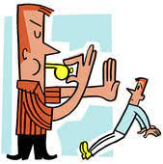
enough
‘uff’ sound

Slide 26
Let’s Teach and Practise

Slide 27
Words with ending sound /shuhl/ after a vowel letter
-cial

Slide 28
-cial

Slide 29
official

Slide 30
official

Slide 31
special

Slide 32
special

Slide 33
artificial

Slide 34
artificial

Slide 35
official

Slide 36
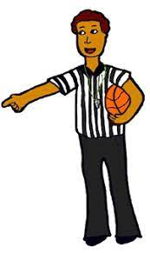
official offi + cial = official

Slide 37
official offi + cial = official noun definition -a person holding public office or having official duties, especially as a representative of an organisation or government department.

Slide 38

official offi + cial = official adjective definition - relating to an authority or public body and its activities and responsibilities.

Slide 39
official
It was an official website that showed the latest percentages of profits.

Slide 40
official
It was an -------- website that showed the latest percentages of profits.

Slide 41
official
It was an official website that showed the latest percentages of profits.

Slide 42
special

Slide 43

special spe + cial = special

Slide 44
special spe + cial = special adjective definition - better, greater, or otherwise different from what is usual.

Slide 45
special
Fred received a very special letter from his auntie.

Slide 46
special
Fred received a very ------- letter from his auntie.

Slide 47
special
Fred received a very special letter from his auntie.

Slide 48
artificial

Slide 49
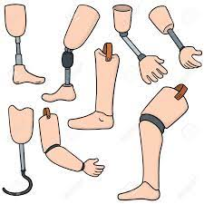
artificial artifi + cial = artificial

Slide 50
artificial artifi + cial = artificial adjective
Definition - made or produced by human beings rather than occurring naturally, especially as a copy of something natural.

Slide 51
artificial
The large, green plant was artificial and did not need watering.

Slide 52
artificial
The large, green plant was
---------- and did not need watering.

Slide 53
artificial
The large, green plant was artificial and did not need watering.

Slide 54
New CHALLENGE words.

Slide 55
occur

Slide 56
occur
For the event to occur, the rain had to stop.

Slide 57

occur
For the event to occur, the rain had to stop.

Slide 58
For the event to _____, the rain had to stop.

Slide 59
For the event to occur, the rain had to stop.

Slide 60
accompany

Slide 61
accompany
Ishmael had to accompany his dad to work.

Slide 62
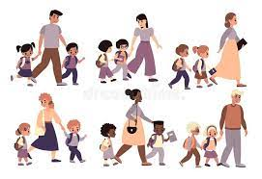
accompany
Ishmael had to accompany his dad to work.

Slide 63
Ishmael had to _________ his dad to work.

Slide 64
Ishmael had to accompany his dad to work.

Slide 65
Let’s Practise and Apply.

Slide 66
Can you spot the spelling rule words and the challenge words?

Slide 67
Houses
By examining the oldest houses in Colchester, we can find clues as to what special things were to occur and eliminate artificial sections and on what occasion they were built.
Dutch-speaking weavers and cloth makers from Flanders (present-day Belgium) once lived in the “Dutch Quarter”. In the 1570s, on occasions, they had to flee from Flanders because they were being persecuted for their religious and social beliefs. This could be thought of as racial tension. In the Dutch Quarter, it was crucial that the houses’ big windows let in lots of light so the weavers could see as they made cloth on their looms.
In the late 1800s, nearly 300 crucial new houses were built in an area called New Town to accompany existing houses which were superficial. They were beneficial for more workers and managers, who were to accompany them and prevent antisocial behaviour, as new industries were to occur and be developed and factories were built, like Paxman’s who made diesel engines.

Slide 68
Houses
By examining the oldest houses in Colchester, we can find clues as to what special things were to occur and eliminate artificial sections and on what occasion they were built.
Dutch-speaking weavers and cloth makers from Flanders (present-day Belgium) once lived in the “Dutch Quarter”. In the 1570s, on occasions, they had to flee from Flanders because they were being persecuted for their religious and social beliefs. This could be thought of as racial tension. In the Dutch Quarter, it was crucial that the houses’ big windows let in lots of light so the weavers could see as they made cloth on their looms.
In the late 1800s, nearly 300 crucial new houses were built in an area called New Town to accompany existing houses which were superficial. They were beneficial for more workers and managers, who were to accompany them and prevent antisocial behaviour, as new industries were to occur and be developed and factories were built, like Paxman’s who made diesel engines.

Slide 69
Write this sentence as I dictate it to you.
Notes:
By examining the oldest houses in Colchester, we can find clues as to what special things were to occur and eliminate artificial sections and discover on what occasion they were built.

Slide 70
By examining the oldest houses in Colchester, we can find clues as to what special things were to occur and eliminate artificial sections and discover on what occasion they were built.
Did you write it correctly?
Edit your work and make sure you have it correct.
Can you underline the spelling word that we have covered in this session?

Slide 71
Year 5 - Autumn 2
Week 1 - Tuesday
Notes:
Revisit and review the words and challenge words – I say, we say, you say
Ask children to write words only in their spelling book
Introduce the new spelling rule
Children to write the new spelling rule words and challenge words into books when the sentences are shown with the spelling word missing.
Read the extract with the class as choral reading. Practise model of prosody etc.
Ask children to find the spelling words from the session in the text.
Then read allowed the chosen sentence for children to write fully in their books.
Show the extract and ask children to then edit their work to check they were correct in their dictation.

Slide 72
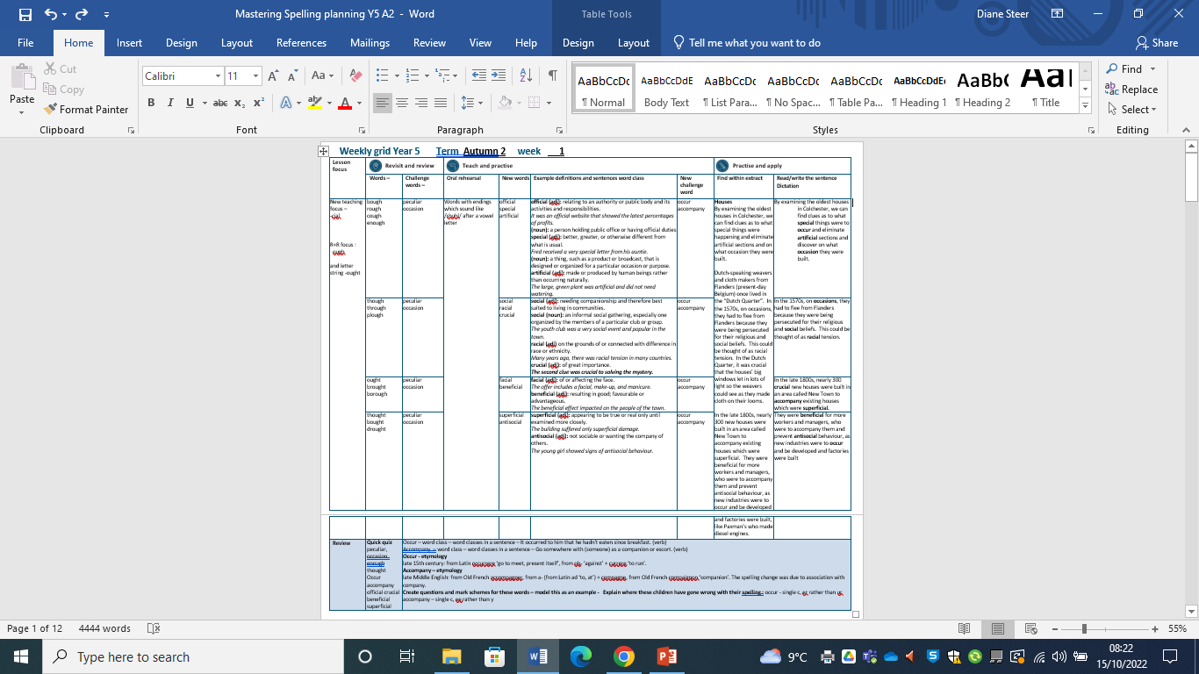
Notes:
Plan

Slide 73
Let’s Revisit and Review…

Slide 74
Do you remember this challenge word?

Slide 75
peculiar

Slide 76
peculiar adjective
Definition - different to what is normal or expected; strange.

Slide 77
Do you remember this challenge word?

Slide 78
occasion

Slide 79
occasion noun
Definition – a particular event, or the time at which it takes place.

Slide 80
Do you remember this rule?

Slide 81
ough

Slide 82
ough ough is one of the trickiest spellings in
English as it can be used to spell a number of different sounds.

Slide 83
though

Slide 84
though

Slide 85

though

Slide 86
through

Slide 87
through

Slide 88

through

Slide 89
plough

Slide 90
plough

Slide 91
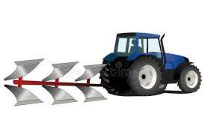
plough

Slide 92
Let’s Teach and Practise

Slide 93
Words with ending sound /shuhl/ after a vowel letter
-cial

Slide 94
-cial

Slide 95
social

Slide 96
social

Slide 97
racial

Slide 98
racial

Slide 99
crucial

Slide 100
crucial

Slide 101
social

Slide 102
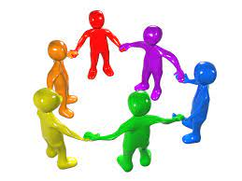
social so + cial = social

Slide 103
social so + cial = social adjective definition - needing companionship and therefore best suited to living in communities.

Slide 104
social
The youth club was a very social event and popular in the town.

Slide 105
social
The youth club was a very ------ event and popular in the town.

Slide 106
social
The youth club was a very social event and popular in the town.

Slide 107
racial

Slide 108

racial ra + cial = racial

Slide 109
racial ra + cial = racial adjective definition - relating to the major groupings into which humankind is sometimes divided on the basis of physical characteristics or shared ancestry.

Slide 110
racial
Many years ago, there was racial tension in many countries.

Slide 111
racial
Many years ago, there was
------ tension in many countries.

Slide 112
racial
Many years ago, there was racial tension in many countries.

Slide 113
crucial

Slide 114

crucial cru + cial = crucial

Slide 115
crucial cru + cial = crucial adjective definition – of great importance

Slide 116
crucial
The second clue was crucial to solving the mystery.

Slide 117
crucial
The second clue was ------- to solving the mystery.

Slide 118
crucial
The second clue was crucial to solving the mystery.

Slide 119
New CHALLENGE words.

Slide 120
occur

Slide 121
occur
For the event to occur, the rain had to stop.

Slide 122
occur
For the event to occur, the rain had to stop.

Slide 123
For the event to _____, the rain had to stop.

Slide 124
For the event to occur, the rain had to stop.

Slide 125
accompany

Slide 126
accompany
Ishmael had to accompany his dad to work.

Slide 127
accompany
Ishmael had to accompany his dad to work.

Slide 128
Ishmael had to _________ his dad to work.

Slide 129
Ishmael had to accompany his dad to work.

Slide 130
Let’s Practise and Apply.

Slide 131
Can you spot the spelling rule words and the challenge words?

Slide 132
Houses
By examining the oldest houses in Colchester, we can find clues as to what special things were to occur and eliminate artificial sections and on what occasion they were built.
Dutch-speaking weavers and cloth makers from Flanders (present-day Belgium) once lived in the “Dutch Quarter”. In the 1570s, on occasions, they had to flee from Flanders because they were being persecuted for their religious and social beliefs. This could be thought of as racial tension. In the Dutch Quarter, it was crucial that the houses’ big windows let in lots of light so the weavers could see as they made cloth on their looms.
In the late 1800s, nearly 300 crucial new houses were built in an area called New Town to accompany existing houses which were superficial. They were beneficial for more workers and managers, who were to accompany them and prevent antisocial behaviour, as new industries were to occur and be developed and factories were built, like Paxman’s who made diesel engines.

Slide 133
Houses
By examining the oldest houses in Colchester, we can find clues as to what special things were to occur and eliminate artificial sections and on what occasion they were built.
Dutch-speaking weavers and cloth makers from Flanders (present-day Belgium) once lived in the “Dutch Quarter”. In the 1570s, on occasions, they had to flee from Flanders because they were being persecuted for their religious and social beliefs. This could be thought of as racial tension. In the Dutch Quarter, it was crucial that the houses’ big windows let in lots of light so the weavers could see as they made cloth on their looms.
In the late 1800s, nearly 300 crucial new houses were built in an area called New Town to accompany existing houses which were superficial. They were beneficial for more workers and managers, who were to accompany them and prevent antisocial behaviour, as new industries were to occur and be developed and factories were built, like Paxman’s who made diesel engines.

Slide 134
Write these sentences as I dictate to you.
Notes:
In the 1570s, on occasions, they had to flee from Flanders because they were being persecuted for their religious and social beliefs. This could be thought of as racial tension.

Slide 135
In the 1570s, on occasions, they had to flee from Flanders because they were being persecuted for their religious and social beliefs. This could be thought of as racial tension.
Did you write it correctly?
Edit your work and make sure you have it correct.
Can you underline the spelling word that we have covered in this session?

Slide 136
Year 5 - Autumn 2
Week 1 - Wednesday
Notes:
Revisit and review the words and challenge words – I say, we say, you say
Ask children to write words only in their spelling book
Introduce the new spelling rule
Children to write the new spelling rule words and challenge words into books when the sentences are shown with the spelling word missing.
Read the extract with the class as choral reading. Practise model of prosody etc.
Ask children to find the spelling words from the session in the text.
Then read allowed the chosen sentence for children to write fully in their books.
Show the extract and ask children to then edit their work to check they were correct in their dictation.

Slide 137
Notes:
Plan

Slide 138
Let’s Revisit and Review…

Slide 139
Do you remember this challenge word?

Slide 140
peculiar

Slide 141
peculiar adjective
Definition - different to what is normal or expected; strange.

Slide 142
Do you remember this challenge word?

Slide 143
occasion

Slide 144
occasion noun
Definition – a particular event, or the time at which it takes place.

Slide 145
Do you remember this rule?

Slide 146
ough

Slide 147
ough ough is one of the trickiest spellings in
English as it can be used to spell a number of different sounds.

Slide 148
ought

Slide 149
ought

Slide 150

ought

Slide 151
brought

Slide 152
brought

Slide 153

brought

Slide 154
borough

Slide 155
borough

Slide 156
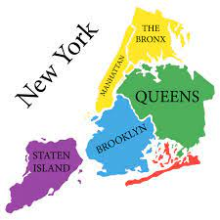
borough

Slide 157
Let’s Teach and Practise

Slide 158
Words with ending sound /shuhl/ after a vowel letter
-cial

Slide 159
-cial

Slide 160
facial

Slide 161
facial

Slide 162
beneficial

Slide 163
beneficial

Slide 164
facial

Slide 165
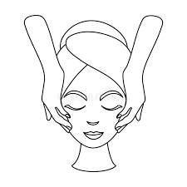
facial fa + cial = facial

Slide 166
facial fa + cial = facial noun definition - a beauty treatment for the face.

Slide 167
facial
The offer includes a facial, make-up, and manicure.

Slide 168
facial
The offer includes a ------, make-up, and manicure.

Slide 169
facial
The offer includes a facial, make-up, and manicure.

Slide 170
beneficial

Slide 171

beneficial benefi + cial = beneficial

Slide 172
beneficial benefi + cial = beneficial adjective definition - resulting in good; favourable or advantageous.

Slide 173
beneficial
The beneficial effect impacted on the people of the town.

Slide 174
beneficial
The ---------- effect impacted on the people of the town.

Slide 175
beneficial
The beneficial effect impacted on the people of the town.

Slide 176
New CHALLENGE words.

Slide 177
occur

Slide 178
occur
For the event to occur, the rain had to stop.

Slide 179
occur
For the event to occur, the rain had to stop.

Slide 180
For the event to _____, the rain had to stop.

Slide 181
For the event to occur, the rain had to stop.

Slide 182
accompany

Slide 183
accompany
Ishmael had to accompany his dad to work.

Slide 184
accompany
Ishmael had to accompany his dad to work.

Slide 185
Ishmael had to _________ his dad to work.

Slide 186
Ishmael had to accompany his dad to work.

Slide 187
Let’s Practise and Apply.

Slide 188
Can you spot the spelling rule words and the challenge words?

Slide 189
Houses
By examining the oldest houses in Colchester, we can find clues as to what special things were to occur and eliminate artificial sections and on what occasion they were built.
Dutch-speaking weavers and cloth makers from Flanders (present-day Belgium) once lived in the “Dutch Quarter”. In the 1570s, on occasions, they had to flee from Flanders because they were being persecuted for their religious and social beliefs. This could be thought of as racial tension. In the Dutch Quarter, it was crucial that the houses’ big windows let in lots of light so the weavers could see as they made cloth on their looms.
In the late 1800s, nearly 300 crucial new houses were built in an area called New Town to accompany existing houses which were superficial. They were beneficial for more workers and managers, who were to accompany them and prevent antisocial behaviour, as new industries were to occur and be developed and factories were built, like Paxman’s who made diesel engines.

Slide 190
Houses
By examining the oldest houses in Colchester, we can find clues as to what special things were to occur and eliminate artificial sections and on what occasion they were built.
Dutch-speaking weavers and cloth makers from Flanders (present-day Belgium) once lived in the “Dutch Quarter”. In the 1570s, on occasions, they had to flee from Flanders because they were being persecuted for their religious and social beliefs. This could be thought of as racial tension. In the Dutch Quarter, it was crucial that the houses’ big windows let in lots of light so the weavers could see as they made cloth on their looms.
In the late 1800s, nearly 300 crucial new houses were built in an area called New Town to accompany existing houses which were superficial. They were beneficial for more workers and managers, who were to accompany them and prevent antisocial behaviour, as new industries were to occur and be developed and factories were built, like Paxman’s who made diesel engines.

Slide 191
Write this sentence as I dictate it to you.
Notes:
In the late 1800s, nearly 300 crucial new houses were built in an area called New Town to accompany existing houses which were superficial.

Slide 192
In the late 1800s, nearly 300 crucial new houses were built in an area called New Town to accompany existing houses which were superficial.
Did you write it correctly?
Edit your work and make sure you have it correct.
Can you underline the spelling word that we have covered in this session?

Slide 193
Year 5 - Autumn 2
Week 1 - Thursday
Notes:
Revisit and review the words and challenge words – I say, we say, you say
Ask children to write words only in their spelling book
Introduce the new spelling rule
Children to write the new spelling rule words and challenge words into books when the sentences are shown with the spelling word missing.
Read the extract with the class as choral reading. Practise model of prosody etc.
Ask children to find the spelling words from the session in the text.
Then read allowed the chosen sentence for children to write fully in their books.
Show the extract and ask children to then edit their work to check they were correct in their dictation.

Slide 194
Notes:
Plan

Slide 195
Let’s Revisit and Review…

Slide 196
Do you remember this challenge word?

Slide 197
peculiar

Slide 198
peculiar adjective
Definition - different to what is normal or expected; strange.

Slide 199
Do you remember this challenge word?

Slide 200
occasion

Slide 201
occasion noun
Definition – a particular event, or the time at which it takes place.

Slide 202
Do you remember this rule?

Slide 203
ough

Slide 204
ough ough is one of the trickiest spellings in
English as it can be used to spell a number of different sounds.

Slide 205
thought

Slide 206
thought

Slide 207

thought

Slide 208
bought

Slide 209
bought

Slide 210

bought

Slide 211
drought

Slide 212
drought

Slide 213
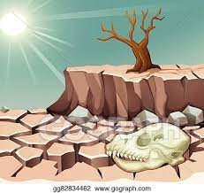
drought

Slide 214
Let’s Teach and Practise

Slide 215
Words with ending sound /shuhl/ after a vowel letter
-cial

Slide 216
-cial

Slide 217
superficial

Slide 218
superficial

Slide 219
antisocial

Slide 220
antisocial

Slide 221
superficial

Slide 222
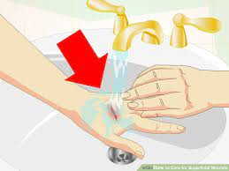
superficial superfi + cial = superficial

Slide 223
superficial superfi + cial = superficial adjective
Definition - existing or occurring at or on the surface.

Slide 224
superficial
The building suffered only superficial damage.

Slide 225
superficial
The building suffered only
----------- damage.

Slide 226
superficial
The building suffered only superficial damage.

Slide 227
antisocial

Slide 228

antisocial antiso + cial = antisocial

Slide 229
antisocial antiso + cial = antisocial adjective
Definition - contrary to the laws and customs of society, in a way that causes annoyance and disapproval in others.

Slide 230
antisocial
The young girl showed signs of antisocial behaviour.

Slide 231
antisocial
The young girl showed signs of
---------- behaviour.

Slide 232
antisocial
The young girl showed signs of antisocial behaviour.

Slide 233
New CHALLENGE words.

Slide 234
occur

Slide 235
occur
For the event to occur, the rain had to stop.

Slide 236
occur
For the event to occur, the rain had to stop.

Slide 237
For the event to _____, the rain had to stop.

Slide 238
For the event to occur, the rain had to stop.

Slide 239
accompany

Slide 240
accompany
Ishmael had to accompany his dad to work.

Slide 241
accompany
Ishmael had to accompany his dad to work.

Slide 242
Ishmael had to _________ his dad to work.

Slide 243
Ishmael had to accompany his dad to work.

Slide 244
Let’s Practise and Apply.

Slide 245
Can you spot the spelling rule words and the challenge words?

Slide 246
Houses
By examining the oldest houses in Colchester, we can find clues as to what special things were to occur and eliminate artificial sections and on what occasion they were built.
Dutch-speaking weavers and cloth makers from Flanders (present-day Belgium) once lived in the “Dutch Quarter”. In the 1570s, on occasions, they had to flee from Flanders because they were being persecuted for their religious and social beliefs. This could be thought of as racial tension. In the Dutch Quarter, it was crucial that the houses’ big windows let in lots of light so the weavers could see as they made cloth on their looms.
In the late 1800s, nearly 300 crucial new houses were built in an area called New Town to accompany existing houses which were superficial. They were beneficial for more workers and managers, who were to accompany them and prevent antisocial behaviour, as new industries were to occur and be developed and factories were built, like Paxman’s who made diesel engines.

Slide 247
Houses
By examining the oldest houses in Colchester, we can find clues as to what special things were to occur and eliminate artificial sections and on what occasion they were built.
Dutch-speaking weavers and cloth makers from Flanders (present-day Belgium) once lived in the “Dutch Quarter”. In the 1570s, on occasions, they had to flee from Flanders because they were being persecuted for their religious and social beliefs. This could be thought of as racial tension. In the Dutch Quarter, it was crucial that the houses’ big windows let in lots of light so the weavers could see as they made cloth on their looms.
In the late 1800s, nearly 300 crucial new houses were built in an area called New Town to accompany existing houses which were superficial. They were beneficial for more workers and managers, who were to accompany them and prevent antisocial behaviour, as new industries were to occur and be developed and factories were built, like Paxman’s who made diesel engines.

Slide 248
Write this sentence as I dictate it to you.
Notes:
They were beneficial for more workers and managers, who were to accompany them and prevent antisocial behaviour, as new industries were to occur and be developed and factories were built.

Slide 249
They were beneficial for more workers and managers, who were to accompany them and prevent antisocial behaviour, as new industries were to occur and be developed and factories were built.
Did you write it correctly?
Edit your work and make sure you have it correct.
Can you underline the spelling word that we have covered in this session?

Slide 250
Year 5 - Autumn 2
Week 1 - Friday
Notes:
Click through the slides for all the R+R words for the week (both the focus and the challenge words)
Click through the slides for all the new learning this week

Slide 251
Notes:
Plan

Slide 252
Let’s Revisit and Review…
Notes:
Click through the slides for all the R+R words for the week (both the focus and the challenge words)
Click through the slides for all the new learning this week

Slide 253
Old challenge words…

Slide 254
peculiar

Slide 255
occasion

Slide 256
Old spelling rule words…

Slide 257
Different sounds used by ‘ough’

Slide 258
bough

Slide 259
rough

Slide 260
cough

Slide 261
enough

Slide 262
though

Slide 263
through

Slide 264
plough

Slide 265
ought

Slide 266
brought

Slide 267
borough

Slide 268
thought

Slide 269
bought

Slide 270
drought

Slide 271
New spelling rule words…

Slide 272
official

Slide 273
special

Slide 274
artificial

Slide 275
social

Slide 276
racial

Slide 277
crucial

Slide 278
facial

Slide 279
beneficial

Slide 280
superficial

Slide 281
antisocial

Slide 282
New challenge words…

Slide 283
occur

Slide 284
accompany

Slide 285
Quick Quiz time…
Notes:
Peculiar occasion enough thought occur accompany official crucial beneficial superficial

Slide 286
Did you get them correct?
Edit your work.
peculiar occasion enough thought occur accompany official crucial beneficial superficial

Slide 287
Word class time…

Slide 288
It occurred to him that he hadn't eaten since breakfast.

Slide 289
It occurred to him that he hadn't eaten since breakfast.
Pronoun verb preposition pronoun pronoun, pronoun, verb, verb, subordinate conjunction, noun
Notes:
that is a demonstrative pronoun (that, these, those)

Slide 290
It occurred to him that he hadn't eaten since breakfast.
Pronoun verb preposition pronoun pronoun, pronoun, verb, verb, subordinate conjunction, noun
Notes:
that is a demonstrative pronoun (that, these, those)

Slide 291
Mr Smith asked Fred to accompany him to the office.

Slide 292
Mr Smith asked Fred to accompany him to the office. noun, proper noun, verb, proper noun, preposition, verb, pronoun preposition, determiner, noun
Notes:
Mr is a noun (abbreviated from Mister)

Slide 293
Mr Smith asked Fred to accompany him to the office. noun, proper noun, verb, proper noun, preposition, verb, pronoun preposition, determiner, noun
Notes:
Mr is a noun (abbreviated from Mister)

Slide 294
Etymology
The history of a word….

Slide 295
Occur (verb) – Etymology
late 15th century: from Latin occurrere ‘go to meet, present itself’, from ob- ‘against’ + currere ‘to run’.
Accompany (verb) – Etymology
late Middle English: from Old French accompagner, from a- (from Latin ad ‘to, at’) + compagne, from Old French compaignon ‘companion’. The spelling change was due to association with company.

Slide 296
Let’s investigate….
Knowledge and experiment?

Slide 297
Words linked to occur…
be,
befall,
betide,
chance,
come,
come about,
come down,
come off,

Slide 298
Words linked to accompany…
attend
drag
guard
shadow
tailgate
usher
associate with
come along
go along
hang around with
hang out
keep company
look after

Slide 299
Common errors with occur and accompany:
occur - single c, er rather than ur ocer
accompany – single c, ee rather than y acompanee

