Slide 1
Spelling Y5
Mastering spellings: building on the foundations of phonics
Autumn 2
Week 2

Slide 2
Year 5 - Autumn 2
Week 2 - Monday
Notes:
Revisit and review the words and challenge words – I say, we say, you say
Ask children to write words only in their spelling book
Introduce the new spelling rule
Children to write the new spelling rule words and challenge words into books when the sentences are shown with the spelling word missing.
Read the extract with the class as choral reading. Practise model of prosody etc.
Ask children to find the spelling words from the session in the text.
Then read allowed the chosen sentence for children to write fully in their books.
Show the extract and ask children to then edit their work to check they were correct in their dictation.

Slide 3
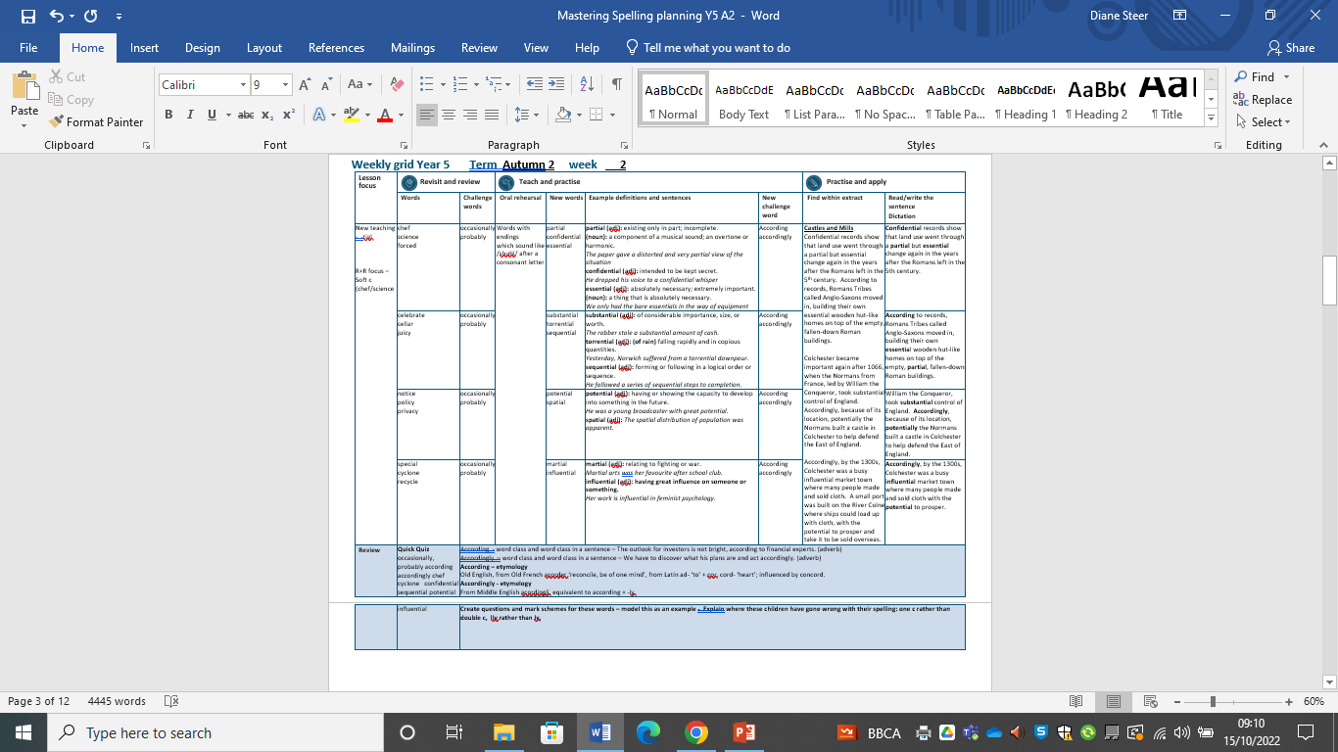
Notes:
Plan

Slide 4
Let’s Revisit and Review…

Slide 5
Do you remember this challenge word?

Slide 6
occasionally

Slide 7
occasionally adverb
Definition - at infrequent or irregular intervals; now and then.

Slide 8
Do you remember this challenge word?

Slide 9
probably

Slide 10
probably adverb
Definition – almost certainly; as far as one knows or can tell.

Slide 11
Do you remember this rule?

Slide 12
Soft c

Slide 13
soft c
Words with the /ʃ/ sound spelt ch
(mostly French in origin) or with the /s/ sound spelt sc (Latin in origin)

Slide 14
chef

Slide 15
chef

Slide 16

chef

Slide 17
science

Slide 18
science

Slide 19

science

Slide 20
forced

Slide 21
forced

Slide 22

forced

Slide 23
Let’s Teach and Practise

Slide 24
Words with ending sound /shuhl/ after a consonant letter
-tial

Slide 25
-tial

Slide 26
partial

Slide 27
partial

Slide 28
confidential

Slide 29
confidential

Slide 30
essential

Slide 31
essential

Slide 32
partial

Slide 33

partial par + tial = partial

Slide 34
partial par + tial = partial adjective
Definition - existing only in part; incomplete.

Slide 35
partial
The paper gave a distorted and very partial view of the situation.

Slide 36
partial
The paper gave a distorted and very ------- view of the situation.

Slide 37
partial
The paper gave a distorted and very partial view of the situation.

Slide 38
confidential

Slide 39

confidential confiden + tial = confidential

Slide 40
confidential confiden + tial = confidential adjective definition - intended to be kept secret.

Slide 41
confidential
He dropped his voice to a confidential whisper.

Slide 42
confidential
He dropped his voice to a
------------ whisper.

Slide 43
confidential
He dropped his voice to a confidential whisper.

Slide 44
essential

Slide 45
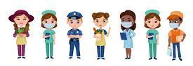
essential essen + tial = essential

Slide 46
essential essen + tial = essential adjective
Definition - absolutely necessary; extremely important.

Slide 47
essential
We only had the bare essentials in the way of equipment.

Slide 48
essential
We only had the bare ---------- in the way of equipment.

Slide 49
essential
We only had the bare essentials in the way of equipment.

Slide 50
New CHALLENGE words.

Slide 51
according

Slide 52
according
According to the weather report, there will be sunshine today.

Slide 53

according
According to the weather report, there will be sunshine today.

Slide 54
_________ to the weather report, there will be sunshine today.

Slide 55
According to the weather report, there will be sunshine today.

Slide 56
accordingly

Slide 57
accordingly
If there is rain, then I dress accordingly.

Slide 58
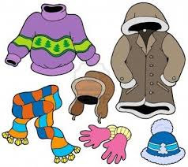
accordingly
If there is rain, then I dress accordingly.

Slide 59
If there is rain, then I dress accordingly.

Slide 60
If there is rain, then I dress ___________.

Slide 61
If there is rain, then I dress accordingly.

Slide 62
Let’s Practise and Apply.

Slide 63
Can you spot the spelling rule words and the challenge words?

Slide 64
Castles and Mills
Confidential records show that land use went through a partial but essential change again in the years after the Romans left in the 5th century. According to records, Romans Tribes called Anglo-Saxons moved in, building their own essential wooden hut-like homes on top of the empty, fallen-down Roman buildings.
Colchester became important again after 1066, when the Normans from France, led by William the Conqueror, took substantial control of England. Accordingly, because of its location, potentially the Normans built a castle in Colchester to help defend the East of England.
Accordingly, by the 1300s, Colchester was a busy influential market town where many people made and sold cloth. A small port was built on the River Colne where ships could load up with cloth, with the potential to prosper and take it to be sold overseas.

Slide 65
Castles and Mills
Confidential records show that land use went through a partial but essential change again in the years after the Romans left in the 5th century. According to records, Romans Tribes called Anglo-Saxons moved in, building their own essential wooden hut-like homes on top of the empty, partial, fallen-down Roman buildings.
Colchester became important again after 1066, when the Normans from France, led by William the Conqueror, took substantial control of England. Accordingly, because of its location, potentially the Normans built a castle in Colchester to help defend the East of England.
Accordingly, by the 1300s, Colchester was a busy influential market town where many people made and sold cloth. A small port was built on the River Colne where ships could load up with cloth, with the potential to prosper and take it to be sold overseas.

Slide 66
Write this sentence as I dictate it to you.
Notes:
Confidential records show that land use went through a partial but essential change again in the years after the Romans left in the 5th century.

Slide 67
Confidential records show that land use went through a partial but essential change again in the years after the Romans left in the 5th century.
Did you write it correctly?
Edit your work and make sure you have it correct.
Can you underline the spelling word that we have covered in this session?

Slide 68
Year 5 - Autumn 2
Week 2 - Tuesday
Notes:
Revisit and review the words and challenge words – I say, we say, you say
Ask children to write words only in their spelling book
Introduce the new spelling rule
Children to write the new spelling rule words and challenge words into books when the sentences are shown with the spelling word missing.
Read the extract with the class as choral reading. Practise model of prosody etc.
Ask children to find the spelling words from the session in the text.
Then read allowed the chosen sentence for children to write fully in their books.
Show the extract and ask children to then edit their work to check they were correct in their dictation.

Slide 69
Notes:
Plan

Slide 70
Let’s Revisit and Review…

Slide 71
Do you remember this challenge word?

Slide 72
occasionally

Slide 73
occasionally adverb
Definition - at infrequent or irregular intervals; now and then.

Slide 74
Do you remember this challenge word?

Slide 75
probably

Slide 76
probably adverb
Definition – almost certainly; as far as one knows or can tell.

Slide 77
Do you remember this rule?

Slide 78
Soft c

Slide 79
soft c
Words with the /ʃ/ sound spelt ch
(mostly French in origin) or with the /s/ sound spelt sc (Latin in origin)

Slide 80
celebrate

Slide 81
celebrate

Slide 82

celebrate

Slide 83
cellar

Slide 84
cellar

Slide 85
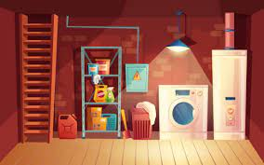
cellar

Slide 86
juicy

Slide 87
juicy

Slide 88

juicy

Slide 89
Let’s Teach and Practise

Slide 90
Words with ending sound /shuhl/ after a consonant letter
-tial

Slide 91
-tial

Slide 92
substantial

Slide 93
substantial

Slide 94
torrential

Slide 95
torrential

Slide 96
sequential

Slide 97
sequential

Slide 98
substantial

Slide 99
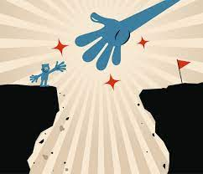
substantial substan + tial = substantial

Slide 100
substantial substan + tial = substantial adjective
Definition - of considerable importance, size, or worth.

Slide 101
substantial
The robber stole a substantial amount of cash.

Slide 102
substantial
The robber stole a -----------amount of cash.

Slide 103
substantial
The robber stole a substantial amount of cash.

Slide 104
torrential

Slide 105
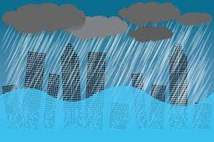
torrential torren + tial = torrential

Slide 106
torrential torren + tial = torrential adjective
Definition - (of rain) falling rapidly and in copious quantities.

Slide 107
torrential
Yesterday, Norwich suffered from a torrential downpour.

Slide 108
torrential
Yesterday, Norwich suffered from a ---------- downpour.

Slide 109
torrential
Yesterday, Norwich suffered from a torrential downpour.

Slide 110
sequential

Slide 111

sequential sequen + tial = sequential

Slide 112
sequential sequen + tial = sequential adjective definition - forming or following in a logical order or sequence.

Slide 113
sequential
He followed a series of sequential steps to completion.

Slide 114
sequential
He followed a series of ---------- steps to completion.

Slide 115
sequential
He followed a series of sequential steps to completion.

Slide 116
New CHALLENGE words.

Slide 117
according

Slide 118
according
According to the weather report, there will be sunshine today.

Slide 119
according
According to the weather report, there will be sunshine today.

Slide 120
_________ to the weather report, there will be sunshine today.

Slide 121
According to the weather report, there will be sunshine today.

Slide 122
accordingly

Slide 123
accordingly
If there is rain, then I dress accordingly.

Slide 124
accordingly
If there is rain, then I dress accordingly.

Slide 125
If there is rain, then I dress accordingly.

Slide 126
If there is rain, then I dress ___________.

Slide 127
If there is rain, then I dress accordingly.

Slide 128
Let’s Practise and Apply.

Slide 129
Can you spot the spelling rule words and the challenge words?

Slide 130
Castles and Mills
Confidential records show that land use went through a partial but essential change again in the years after the Romans left in the 5th century. According to records, Romans Tribes called Anglo-Saxons moved in, building their own essential wooden hut-like homes on top of the empty, fallen-down Roman buildings.
Colchester became important again after 1066, when the Normans from France, led by William the Conqueror, took substantial control of England. Accordingly, because of its location, potentially the Normans built a castle in Colchester to help defend the East of England.
Accordingly, by the 1300s, Colchester was a busy influential market town where many people made and sold cloth. A small port was built on the River Colne where ships could load up with cloth, with the potential to prosper and take it to be sold overseas.

Slide 131
Castles and Mills
Confidential records show that land use went through a partial but essential change again in the years after the Romans left in the 5th century. According to records, Romans Tribes called Anglo-Saxons moved in, building their own essential wooden hut-like homes on top of the empty, partial, fallen-down Roman buildings.
Colchester became important again after 1066, when the Normans from France, led by William the Conqueror, took substantial control of England. Accordingly, because of its location, potentially the Normans built a castle in Colchester to help defend the East of England.
Accordingly, by the 1300s, Colchester was a busy influential market town where many people made and sold cloth. A small port was built on the River Colne where ships could load up with cloth, with the potential to prosper and take it to be sold overseas.

Slide 132
Write this sentence as I dictate it to you.
Notes:
According to records, Romans Tribes called Anglo-Saxons moved in, building their own essential wooden hut-like homes on top of the empty, partial, fallen-down Roman buildings.

Slide 133
According to records, Romans Tribes called Anglo-Saxons moved in, building their own essential wooden hut-like homes on top of the empty, partial, fallen-down Roman buildings.
Did you write it correctly?
Edit your work and make sure you have it correct.
Can you underline the spelling word that we have covered in this session?

Slide 134
Year 5 - Autumn 2
Week 2 - Wednesday
Notes:
Revisit and review the words and challenge words – I say, we say, you say
Ask children to write words only in their spelling book
Introduce the new spelling rule
Children to write the new spelling rule words and challenge words into books when the sentences are shown with the spelling word missing.
Read the extract with the class as choral reading. Practise model of prosody etc.
Ask children to find the spelling words from the session in the text.
Then read allowed the chosen sentence for children to write fully in their books.
Show the extract and ask children to then edit their work to check they were correct in their dictation.

Slide 135
Notes:
Plan

Slide 136
Let’s Revisit and Review…

Slide 137
Do you remember this challenge word?

Slide 138
occasionally

Slide 139
occasionally adverb
Definition - at infrequent or irregular intervals; now and then.

Slide 140
Do you remember this challenge word?

Slide 141
probably

Slide 142
probably adverb
Definition – almost certainly; as far as one knows or can tell.

Slide 143
Do you remember this rule?

Slide 144
Soft c

Slide 145
soft c
Words with the /ʃ/ sound spelt ch
(mostly French in origin) or with the /s/ sound spelt sc (Latin in origin)

Slide 146
notice

Slide 147
notice

Slide 148

notice

Slide 149
policy

Slide 150
policy

Slide 151

policy

Slide 152
privacy

Slide 153
privacy

Slide 154

privacy

Slide 155
Let’s Teach and Practise

Slide 156
Words with ending sound /shuhl/ after a consonant letter
-tial

Slide 157
-tial

Slide 158
potential

Slide 159
potential

Slide 160
spatial

Slide 161
spatial

Slide 162
potential

Slide 163

potential poten + tial = potential

Slide 164
potential poten + tial = potential adjective
Definition - having or showing the capacity to develop into something in the future.

Slide 165
potential
He was a young broadcaster with great potential.

Slide 166
potential
He was a young broadcaster with great ---------.

Slide 167
potential
He was a young broadcaster with great potential.

Slide 168
spatial

Slide 169
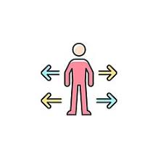
spatial spa + tial = spatial

Slide 170
spatial spa + tial = spatial adjective
Definition - relating to or occupying space.

Slide 171
spatial
The spatial distribution of population was apparent.

Slide 172
spatial
The ------- distribution of population was apparent.

Slide 173
spatial
The spatial distribution of population was apparent.

Slide 174
New CHALLENGE words.

Slide 175
according

Slide 176
according
According to the weather report, there will be sunshine today.

Slide 177
according
According to the weather report, there will be sunshine today.

Slide 178
_________ to the weather report, there will be sunshine today.

Slide 179
According to the weather report, there will be sunshine today.

Slide 180
accordingly

Slide 181
accordingly
If there is rain, then I dress accordingly.

Slide 182
accordingly
If there is rain, then I dress accordingly.

Slide 183
If there is rain, then I dress accordingly.

Slide 184
If there is rain, then I dress ___________.

Slide 185
If there is rain, then I dress accordingly.

Slide 186
Let’s Practise and Apply.

Slide 187
Can you spot the spelling rule words and the challenge words?

Slide 188
Castles and Mills
Confidential records show that land use went through a partial but essential change again in the years after the Romans left in the 5th century. According to records, Romans Tribes called Anglo-Saxons moved in, building their own essential wooden hut-like homes on top of the empty, fallen-down Roman buildings.
Colchester became important again after 1066, when the Normans from France, led by William the Conqueror, took substantial control of England. Accordingly, because of its location, potentially the Normans built a castle in Colchester to help defend the East of England.
Accordingly, by the 1300s, Colchester was a busy influential market town where many people made and sold cloth. A small port was built on the River Colne where ships could load up with cloth, with the potential to prosper and take it to be sold overseas.

Slide 189
Castles and Mills
Confidential records show that land use went through a partial but essential change again in the years after the Romans left in the 5th century. According to records, Romans Tribes called Anglo-Saxons moved in, building their own essential wooden hut-like homes on top of the empty, partial, fallen-down Roman buildings.
Colchester became important again after 1066, when the Normans from France, led by William the Conqueror, took substantial control of England. Accordingly, because of its location, potentially the Normans built a castle in Colchester to help defend the East of England.
Accordingly, by the 1300s, Colchester was a busy influential market town where many people made and sold cloth. A small port was built on the River Colne where ships could load up with cloth, with the potential to prosper and take it to be sold overseas.

Slide 190
Write this sentence as I dictate it to you.
Notes:
William the Conqueror, took substantial control of England. Accordingly, because of its location, potentially the Normans built a castle in Colchester to help defend the East of England.

Slide 191
William the Conqueror, took substantial control of England. Accordingly, because of its location, potentially the Normans built a castle in Colchester to help defend the East of England.
Did you write it correctly?
Edit your work and make sure you have it correct.
Can you underline the spelling word that we have covered in this session?

Slide 192
Year 5 - Autumn 2
Week 2 - Thursday
Notes:
Revisit and review the words and challenge words – I say, we say, you say
Ask children to write words only in their spelling book
Introduce the new spelling rule
Children to write the new spelling rule words and challenge words into books when the sentences are shown with the spelling word missing.
Read the extract with the class as choral reading. Practise model of prosody etc.
Ask children to find the spelling words from the session in the text.
Then read allowed the chosen sentence for children to write fully in their books.
Show the extract and ask children to then edit their work to check they were correct in their dictation.

Slide 193
Notes:
Plan

Slide 194
Let’s Revisit and Review…

Slide 195
Do you remember this challenge word?

Slide 196
occasionally

Slide 197
occasionally adverb
Definition - at infrequent or irregular intervals; now and then.

Slide 198
Do you remember this challenge word?

Slide 199
probably

Slide 200
probably adverb
Definition – almost certainly; as far as one knows or can tell.

Slide 201
Do you remember this rule?

Slide 202
Soft c

Slide 203
soft c
Words with the /ʃ/ sound spelt ch
(mostly French in origin) or with the /s/ sound spelt sc (Latin in origin)

Slide 204
special

Slide 205
special

Slide 206

special

Slide 207
cyclone

Slide 208
cyclone

Slide 209

cyclone

Slide 210
recycle

Slide 211
recycle

Slide 212
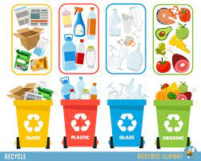
recycle

Slide 213
Let’s Teach and Practise

Slide 214
Words with ending sound /shuhl/ after a consonant letter
-tial

Slide 215
-tial

Slide 216
martial

Slide 217
martial

Slide 218
influential

Slide 219
influential

Slide 220
martial

Slide 221

martial mar + tial = martial

Slide 222
martial mar + tial = martial adjective
Definition - relating to fighting or war.

Slide 223
martial
Martial arts were her favourite after school club.

Slide 224
martial
------- arts were her favourite after school club.

Slide 225
martial
Martial arts were her favourite after school club.

Slide 226
influential

Slide 227

influential influen + tial = influential

Slide 228
influential influen + tial = influential adjective
Definition - having great influence on someone or something.

Slide 229
influential
Her work is influential in feminist psychology.

Slide 230
influential
Her work is ----------- in feminist psychology.

Slide 231
influential
Her work is influential in feminist psychology.

Slide 232
New CHALLENGE words.

Slide 233
according

Slide 234
according
According to the weather report, there will be sunshine today.

Slide 235
according
According to the weather report, there will be sunshine today.

Slide 236
_________ to the weather report, there will be sunshine today.

Slide 237
According to the weather report, there will be sunshine today.

Slide 238
accordingly

Slide 239
accordingly
If there is rain, then I dress accordingly.

Slide 240
accordingly
If there is rain, then I dress accordingly.

Slide 241
If there is rain, then I dress accordingly.

Slide 242
If there is rain, then I dress ___________.

Slide 243
If there is rain, then I dress accordingly.

Slide 244
Let’s Practise and Apply.

Slide 245
Can you spot the spelling rule words and the challenge words?

Slide 246
Castles and Mills
Confidential records show that land use went through a partial but essential change again in the years after the Romans left in the 5th century. According to records, Romans Tribes called Anglo-Saxons moved in, building their own essential wooden hut-like homes on top of the empty, fallen-down Roman buildings.
Colchester became important again after 1066, when the Normans from France, led by William the Conqueror, took substantial control of England. Accordingly, because of its location, potentially the Normans built a castle in Colchester to help defend the East of England.
Accordingly, by the 1300s, Colchester was a busy influential market town where many people made and sold cloth. A small port was built on the River Colne where ships could load up with cloth, with the potential to prosper and take it to be sold overseas.

Slide 247
Castles and Mills
Confidential records show that land use went through a partial but essential change again in the years after the Romans left in the 5th century. According to records, Romans Tribes called Anglo-Saxons moved in, building their own essential wooden hut-like homes on top of the empty, partial, fallen-down Roman buildings.
Colchester became important again after 1066, when the Normans from France, led by William the Conqueror, took substantial control of England. Accordingly, because of its location, potentially the Normans built a castle in Colchester to help defend the East of England.
Accordingly, by the 1300s, Colchester was a busy influential market town where many people made and sold cloth. A small port was built on the River Colne where ships could load up with cloth, with the potential to prosper and take it to be sold overseas.

Slide 248
Write this sentence as I dictate it to you.
Notes:
Accordingly, by the 1300s, Colchester was a busy influential market town where many people made and sold cloth with the potential to prosper.

Slide 249
Accordingly, by the 1300s, Colchester was a busy influential market town where many people made and sold cloth with the potential to prosper.
Did you write it correctly?
Edit your work and make sure you have it correct.
Can you underline the spelling word that we have covered in this session?

Slide 250
Year 5 - Autumn 2
Week 2 - Friday
Notes:
Click through the slides for all the R+R words for the week (both the focus and the challenge words)
Click through the slides for all the new learning this week

Slide 251
Notes:
Plan

Slide 252
Let’s Revisit and Review…
Notes:
Click through the slides for all the R+R words for the week (both the focus and the challenge words)
Click through the slides for all the new learning this week

Slide 253
Old challenge words…

Slide 254
occasionally

Slide 255
probably

Slide 256
Old spelling rule words…

Slide 257
chef

Slide 258
science

Slide 259
forced

Slide 260
celebrate

Slide 261
cellar

Slide 262
juicy

Slide 263
notice

Slide 264
policy

Slide 265
privacy

Slide 266
special

Slide 267
cyclone

Slide 268
recycle

Slide 269
New spelling rule words…

Slide 270
partial

Slide 271
confidential

Slide 272
essential

Slide 273
substantial

Slide 274
torrential

Slide 275
sequential

Slide 276
potential

Slide 277
spatial

Slide 278
martial

Slide 279
influential

Slide 280
New challenge words…

Slide 281
according

Slide 282
accordingly

Slide 283
Quick Quiz time…
Notes:
Occasionally probably according accordingly chef cyclone confidential sequential potential influential

Slide 284
Did you get them correct?
Edit your work.
occasionally probably according accordingly chef cyclone confidential sequential potential influential

Slide 285
Word class time…

Slide 286
The outlook for investors is not bright, according to financial experts.

Slide 287
The outlook for investors is not bright, according to financial experts. determiner, noun, preposition, noun, verb, adverb, adjective, verb, preposition, adjective, noun

Slide 288
The outlook for investors is not bright, according to financial experts. determiner, noun, preposition, noun, verb, adverb, adjective, verb, preposition, adjective, noun

Slide 289
We have to discover what his plans are and act accordingly.

Slide 290
We have to discover what his plans are and act accordingly. pronoun, verb, verb, pronoun, pronoun, noun, verb, conjunction, verb, adverb

Slide 291
We have to discover what his plans are and act accordingly. pronoun, verb, verb, pronoun, pronoun, noun, verb, conjunction, verb, adverb

Slide 292
Etymology
The history of a word….

Slide 293
according – Etymology
Old English, from Old French acorder ‘reconcile, be of one mind’, from Latin ad- ‘to’ + cor, cord- ‘heart’; influenced by concord.
accordingly – Etymology
From Middle English acordingli, equivalent to according +‎ -ly.

Slide 294
Let’s investigate….

Slide 295
Words linked to (synonyms) according …
as stated by
as maintained by
as claimed by
on the authority of
on the report of
in the opinion of

Slide 296
Words linked to (synonyms) accordingly…
appropriately
correspondingly
suitably
fitly
duly
consistently
properly
correctly
therefore
for that reason
consequently
so
as a result
as a consequence
in consequence

Slide 297
Common errors with according and accordingly:
One c rather than double c, - accordingly
lly rather than ly, - accordinglly

