Slide 1
Spelling Y5
Mastering spellings: building on the foundations of phonics
Autumn 2
Week 3

Slide 2
Year 5 - Autumn 2
Week 3 - Monday
Notes:
Revisit and review the words and challenge words – I say, we say, you say
Ask children to write words only in their spelling book
Introduce the new spelling rule
Children to write the new spelling rule words and challenge words into books when the sentences are shown with the spelling word missing.
Read the extract with the class as choral reading. Practise model of prosody etc.
Ask children to find the spelling words from the session in the text.
Then read allowed the chosen sentence for children to write fully in their books.
Show the extract and ask children to then edit their work to check they were correct in their dictation.

Slide 3
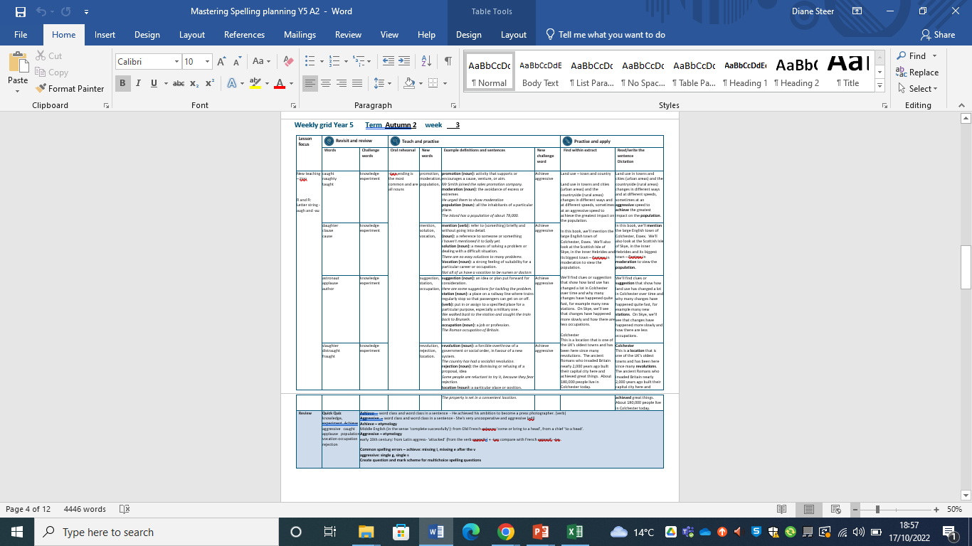
Notes:
Plan

Slide 4
Let’s Revisit and Review…

Slide 5
Do you remember this challenge word?

Slide 6
knowledge

Slide 7
knowledge noun
Definition - facts, information, and skills acquired through experience or education; the theoretical or practical understanding of a subject.

Slide 8
Do you remember this challenge word?

Slide 9
experiment

Slide 10
experiment noun
Definition - a scientific procedure undertaken to make a discovery, test a hypothesis, or demonstrate a known fact.

Slide 11
Do you remember this rule?

Slide 12
Letter strings – augh and au

Slide 13
letter string - augh
The grapheme 'augh' is a very rare spelling variation of the /or/ (or /aw/) phoneme. Words such as 'taught', 'caught' and 'daughter', however, are used very commonly.

Slide 14
caught

Slide 15
caught

Slide 16

caught

Slide 17
naughty

Slide 18
naughty

Slide 19

naughty

Slide 20
taught

Slide 21
taught

Slide 22

taught

Slide 23
Let’s Teach and Practise

Slide 24
Words with ending sound /ʃən/ –tion is the most common spelling.
It is used if the root word ends in t or te.

Slide 25
-tion

Slide 26
promotion

Slide 27
promotion

Slide 28
moderation

Slide 29
moderation

Slide 30
population

Slide 31
population

Slide 32
promotion

Slide 33
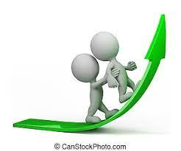
promotion promo(te) + tion = promotion

Slide 34
promotion promo(te) + tion = promotion noun
Definition - activity that supports or encourages a cause, venture, or aim.

Slide 35
promotion
Mr Smith joined the sales promotion company.

Slide 36
Mr Smith joined the sales
--------- company.

Slide 37
promotion
Mr Smith joined the sales promotion company.

Slide 38
moderation

Slide 39
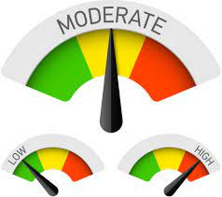
moderation modera(te) + tion = moderation

Slide 40
moderation modera(te) + tion = moderation noun
Definition - the avoidance of excess or extremes, especially in one's behaviour or political opinions.

Slide 41
moderation
He urged them to show moderation.

Slide 42
He urged them to show ----------

Slide 43
moderation
He urged them to show moderation.

Slide 44
population

Slide 45

population popula(te) + tion = population

Slide 46
population popula(te) + tion = population noun
Definition - all the inhabitants of a particular place.

Slide 47
population
The island has a population of about 78,000.

Slide 48
The island has a ---------- of about 78,000.

Slide 49
population
The island has a population of about 78,000.

Slide 50
New CHALLENGE words.

Slide 51
achieve

Slide 52
achieve
If you believe in yourself, you can achieve anything.

Slide 53

achieve
If you believe in yourself, you can achieve anything.

Slide 54
If you believe in yourself, you can _______ anything.

Slide 55
If you believe in yourself, you can achieve anything.

Slide 56
aggressive

Slide 57
aggressive
Some animals, when provoked, can become aggressive.

Slide 58

aggressive
Some animals, when provoked, can become aggressive.

Slide 59
Some animals, when provoked, can become aggressive.

Slide 60
Some animals, when provoked, can become __________.

Slide 61
Some animals, when provoked, can become aggressive.

Slide 62
Let’s Practise and Apply.

Slide 63
Can you spot the spelling rule words and the challenge words?

Slide 64
Land use – town and country
Land use in towns and cities (urban areas) and the countryside (rural areas) changes in different ways and at different speeds, sometimes at an aggressive speed to achieve the greatest impact on the population.
In this book, we’ll mention the large English town of Colchester, Essex. We’ll also look at the Scottish Isle of Skye, in the Inner Hebrides and its biggest town – Portree in moderation to view the population.
We’ll find clues or suggestion that show how land use has changed a lot in Colchester over time and why many changes have happened quite fast, for example many new stations. On Skye, we’ll see that changes have happened more slowly and how there are less occupations.
Colchester
This is a location that is one of the UK’s oldest towns and has been here since many revolutions. The ancient Romans who invaded Britain nearly 2,000 years ago built their capital city here and achieved great things. About 180,000 people live in Colchester today.

Slide 65
Land use – town and country
Land use in towns and cities (urban areas) and the countryside (rural areas) changes in different ways and at different speeds, sometimes at an aggressive speed to achieve the greatest impact on the population.
In this book, we’ll mention the large English town of Colchester, Essex. We’ll also look at the Scottish Isle of Skye, in the Inner Hebrides and its biggest town – Portree in moderation to view the population.
We’ll find clues or suggestion that show how land use has changed a lot in Colchester over time and why many changes have happened quite fast, for example many new stations. On Skye, we’ll see that changes have happened more slowly and how there are less occupations.
Colchester
This is a location that is one of the UK’s oldest towns and has been here since many revolutions. The ancient Romans who invaded Britain nearly 2,000 years ago built their capital city here and achieved great things. About 180,000 people live in Colchester today.

Slide 66
Write this sentence as I dictate it to you.
Notes:
Land use in towns and cities (urban areas) and the countryside (rural areas) changes in different ways and at different speeds, sometimes at an aggressive speed to achieve the greatest impact on the population.

Slide 67
Land use in towns and cities (urban areas) and the countryside (rural areas) changes in different ways and at different speeds, sometimes at an aggressive speed to achieve the greatest impact on the population.
Did you write it correctly?
Edit your work and make sure you have it correct.
Can you underline the spelling word that we have covered in this session?

Slide 68
Year 5 - Autumn 2
Week 3 - Tuesday
Notes:
Revisit and review the words and challenge words – I say, we say, you say
Ask children to write words only in their spelling book
Introduce the new spelling rule
Children to write the new spelling rule words and challenge words into books when the sentences are shown with the spelling word missing.
Read the extract with the class as choral reading. Practise model of prosody etc.
Ask children to find the spelling words from the session in the text.
Then read allowed the chosen sentence for children to write fully in their books.
Show the extract and ask children to then edit their work to check they were correct in their dictation.

Slide 69
Notes:
Plan

Slide 70
Let’s Revisit and Review…

Slide 71
Do you remember this challenge word?

Slide 72
knowledge

Slide 73
knowledge noun
Definition - facts, information, and skills acquired through experience or education; the theoretical or practical understanding of a subject.

Slide 74
Do you remember this challenge word?

Slide 75
experiment

Slide 76
experiment noun
Definition - a scientific procedure undertaken to make a discovery, test a hypothesis, or demonstrate a known fact.

Slide 77
Do you remember this rule?

Slide 78
Letter strings – augh and au

Slide 79
letter string - augh
The grapheme 'augh' is a very rare spelling variation of the /or/ (or /aw/) phoneme. Words such as 'taught', 'caught' and 'daughter', however, are used very commonly.

Slide 80
daughter

Slide 81
daughter

Slide 82
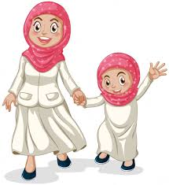
daughter

Slide 83
clause

Slide 84
clause

Slide 85
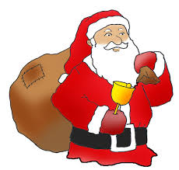
clause

Slide 86
cause

Slide 87
cause

Slide 88

cause

Slide 89
Let’s Teach and Practise

Slide 90
Words with ending sound /ʃən/ –tion is the most common spelling.
It is used if the root word ends in t or te.

Slide 91
-tion

Slide 92
mention

Slide 93
mention

Slide 94
solution

Slide 95
solution

Slide 96
vocation

Slide 97
vocation

Slide 98
mention

Slide 99

mention

Slide 100
mention verb
Definition - refer to (something) briefly and without going into detail.

Slide 101
mention
I haven't mentioned it to Sally yet.

Slide 102
I haven’t --------- it to Sally yet.

Slide 103
mention
I haven't mentioned it to Sally yet.

Slide 104
solution

Slide 105

solution

Slide 106
solution noun
Definition - a means of solving a problem or dealing with a difficult situation.

Slide 107
solution
There are no easy solutions to many problems.

Slide 108
There are no easy -------- to many problems.

Slide 109
solution
There are no easy solutions to many problems.

Slide 110

vocation

Slide 111
vocation noun
Definition - a strong feeling of suitability for a particular career or occupation.

Slide 112
vocation
Not all of us have a vocation to be nurses or doctors.

Slide 113
Not all of us have a -------- to be nurses or doctors.

Slide 114
vocation
Not all of us have a vocation to be nurses or doctors.

Slide 115
New CHALLENGE words.

Slide 116
achieve

Slide 117
achieve
If you believe in yourself, you can achieve anything.

Slide 118
achieve
If you believe in yourself, you can achieve anything.

Slide 119
If you believe in yourself, you can _______ anything.

Slide 120
If you believe in yourself, you can achieve anything.

Slide 121
aggressive

Slide 122
aggressive
Some animals, when provoked, can become aggressive.

Slide 123
aggressive
Some animals, when provoked, can become aggressive.

Slide 124
Some animals, when provoked, can become aggressive.

Slide 125
Some animals, when provoked, can become __________.

Slide 126
Some animals, when provoked, can become aggressive.

Slide 127
Let’s Practise and Apply.

Slide 128
Can you spot the spelling rule words and the challenge words?

Slide 129
Land use – town and country
Land use in towns and cities (urban areas) and the countryside (rural areas) changes in different ways and at different speeds, sometimes at an aggressive speed to achieve the greatest impact on the population.
In this book, we’ll mention the large English town of Colchester, Essex. We’ll also look at the Scottish Isle of Skye, in the Inner Hebrides and its biggest town – Portree in moderation to view the population.
We’ll find clues or suggestion that show how land use has changed a lot in Colchester over time and why many changes have happened quite fast, for example many new stations. On Skye, we’ll see that changes have happened more slowly and how there are less occupations.
Colchester
This is a location that is one of the UK’s oldest towns and has been here since many revolutions. The ancient Romans who invaded Britain nearly 2,000 years ago built their capital city here and achieved great things. About 180,000 people live in Colchester today.

Slide 130
Land use – town and country
Land use in towns and cities (urban areas) and the countryside (rural areas) changes in different ways and at different speeds, sometimes at an aggressive speed to achieve the greatest impact on the population.
In this book, we’ll mention the large English town of Colchester, Essex. We’ll also look at the Scottish Isle of Skye, in the Inner Hebrides and its biggest town – Portree in moderation to view the population.
We’ll find clues or suggestion that show how land use has changed a lot in Colchester over time and why many changes have happened quite fast, for example many new stations. On Skye, we’ll see that changes have happened more slowly and how there are less occupations.
Colchester
This is a location that is one of the UK’s oldest towns and has been here since many revolutions. The ancient Romans who invaded Britain nearly 2,000 years ago built their capital city here and achieved great things. About 180,000 people live in Colchester today.

Slide 131
Write this sentence as I dictate it to you.
Notes:
In this book, we’ll mention the large English town of Colchester, Essex. We’ll also look at the Scottish Isle of Skye, in the Inner Hebrides and its biggest town – Portree in moderation to view the population.

Slide 132
In this book, we’ll mention the large English town of Colchester, Essex. We’ll also look at the Scottish Isle of Skye, in the Inner Hebrides and its biggest town – Portree in moderation to view the population.
Did you write it correctly?
Edit your work and make sure you have it correct.
Can you underline the spelling word that we have covered in this session?

Slide 133
Year 5 - Autumn 2
Week 3 - Wednesday
Notes:
Revisit and review the words and challenge words – I say, we say, you say
Ask children to write words only in their spelling book
Introduce the new spelling rule
Children to write the new spelling rule words and challenge words into books when the sentences are shown with the spelling word missing.
Read the extract with the class as choral reading. Practise model of prosody etc.
Ask children to find the spelling words from the session in the text.
Then read allowed the chosen sentence for children to write fully in their books.
Show the extract and ask children to then edit their work to check they were correct in their dictation.

Slide 134
Notes:
Plan

Slide 135
Let’s Revisit and Review…

Slide 136
Do you remember this challenge word?

Slide 137
knowledge

Slide 138
knowledge noun
Definition - facts, information, and skills acquired through experience or education; the theoretical or practical understanding of a subject.

Slide 139
Do you remember this challenge word?

Slide 140
experiment

Slide 141
experiment noun
Definition - a scientific procedure undertaken to make a discovery, test a hypothesis, or demonstrate a known fact.

Slide 142
Do you remember this rule?

Slide 143
Letter strings – augh and au

Slide 144
letter string - augh
The grapheme 'augh' is a very rare spelling variation of the /or/ (or /aw/) phoneme. Words such as 'taught', 'caught' and 'daughter', however, are used very commonly.

Slide 145
astronaut

Slide 146
astronaut

Slide 147

astronaut

Slide 148
applause

Slide 149
applause

Slide 150

applause

Slide 151
author

Slide 152
author

Slide 153

author

Slide 154
Let’s Teach and Practise

Slide 155
Words with ending sound /ʃən/ –tion is the most common spelling.
It is used if the root word ends in t or te.

Slide 156
-tion

Slide 157
suggestion

Slide 158
suggestion

Slide 159
station

Slide 160
station

Slide 161
occupation

Slide 162
occupation

Slide 163
suggestion

Slide 164

suggestion sugges(t) + tion = suggestion

Slide 165
suggestion sugges(t) + tion = suggestion noun
Definition - an idea or plan put forward for consideration.

Slide 166
suggestion
Here are some suggestions for tackling the problem.

Slide 167
Here are some ----------- for tackling the problem.

Slide 168
suggestion
Here are some suggestions for tackling the problem.

Slide 169
station

Slide 170
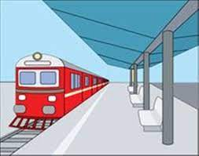
station

Slide 171
station noun
Definition - a place on a railway line where trains regularly stop so that passengers can get on or off.

Slide 172
station
We walked back to the station and caught the train back to Brussels.

Slide 173
We walked back to the ------- and caught the train back to Brussels.

Slide 174
station
We walked back to the station and caught the train back to Brussels.

Slide 175
occupation

Slide 176

occupation

Slide 177
occupation noun
Definition - a job or profession.

Slide 178
occupation
The Roman occupation of Britain.

Slide 179
The Roman ---------- of Britain.

Slide 180
occupation
The Roman occupation of Britain.

Slide 181
New CHALLENGE words.

Slide 182
achieve

Slide 183
achieve
If you believe in yourself, you can achieve anything.

Slide 184
achieve
If you believe in yourself, you can achieve anything.

Slide 185
If you believe in yourself, you can _______ anything.

Slide 186
If you believe in yourself, you can achieve anything.

Slide 187
aggressive

Slide 188
aggressive
Some animals, when provoked, can become aggressive.

Slide 189
aggressive
Some animals, when provoked, can become aggressive.

Slide 190
Some animals, when provoked, can become aggressive.

Slide 191
Some animals, when provoked, can become __________.

Slide 192
Some animals, when provoked, can become aggressive.

Slide 193
Let’s Practise and Apply.

Slide 194
Can you spot the spelling rule words and the challenge words?

Slide 195
Land use – town and country
Land use in towns and cities (urban areas) and the countryside (rural areas) changes in different ways and at different speeds, sometimes at an aggressive speed to achieve the greatest impact on the population.
In this book, we’ll mention the large English town of Colchester, Essex. We’ll also look at the Scottish Isle of Skye, in the Inner Hebrides and its biggest town – Portree in moderation to view the population.
We’ll find clues or suggestion that show how land use has changed a lot in Colchester over time and why many changes have happened quite fast, for example many new stations. On Skye, we’ll see that changes have happened more slowly and how there are less occupations.
Colchester
This is a location that is one of the UK’s oldest towns and has been here since many revolutions. The ancient Romans who invaded Britain nearly 2,000 years ago built their capital city here and achieved great things. About 180,000 people live in Colchester today.

Slide 196
Land use – town and country
Land use in towns and cities (urban areas) and the countryside (rural areas) changes in different ways and at different speeds, sometimes at an aggressive speed to achieve the greatest impact on the population.
In this book, we’ll mention the large English town of Colchester, Essex. We’ll also look at the Scottish Isle of Skye, in the Inner Hebrides and its biggest town – Portree in moderation to view the population.
We’ll find clues or suggestion that show how land use has changed a lot in Colchester over time and why many changes have happened quite fast, for example many new stations. On Skye, we’ll see that changes have happened more slowly and how there are less occupations.
Colchester
This is a location that is one of the UK’s oldest towns and has been here since many revolutions. The ancient Romans who invaded Britain nearly 2,000 years ago built their capital city here and achieved great things. About 180,000 people live in Colchester today.

Slide 197
Write this sentence as I dictate it to you.
Notes:
We’ll find clues or suggestion that show how land use has changed a lot in Colchester over time and why many changes have happened quite fast, for example many new stations. On Skye, we’ll see that changes have happened more slowly and how there are less occupations.

Slide 198
We’ll find clues or suggestion that show how land use has changed a lot in Colchester over time and why many changes have happened quite fast, for example many new stations. On Skye, we’ll see that changes have happened more slowly and how there are less occupations.
Did you write it correctly?
Edit your work and make sure you have it correct.
Can you underline the spelling word that we have covered in this session?

Slide 199
Year 5 - Autumn 2
Week 3 - Thursday
Notes:
Revisit and review the words and challenge words – I say, we say, you say
Ask children to write words only in their spelling book
Introduce the new spelling rule
Children to write the new spelling rule words and challenge words into books when the sentences are shown with the spelling word missing.
Read the extract with the class as choral reading. Practise model of prosody etc.
Ask children to find the spelling words from the session in the text.
Then read allowed the chosen sentence for children to write fully in their books.
Show the extract and ask children to then edit their work to check they were correct in their dictation.

Slide 200
Notes:
Plan

Slide 201
Let’s Revisit and Review…

Slide 202
Do you remember this challenge word?

Slide 203
knowledge

Slide 204
knowledge noun
Definition - facts, information, and skills acquired through experience or education; the theoretical or practical understanding of a subject.

Slide 205
Do you remember this challenge word?

Slide 206
experiment

Slide 207
experiment noun
Definition - a scientific procedure undertaken to make a discovery, test a hypothesis, or demonstrate a known fact.

Slide 208
Do you remember this rule?

Slide 209
Letter strings – augh and au

Slide 210
letter string - augh
The grapheme 'augh' is a very rare spelling variation of the /or/ (or /aw/) phoneme. Words such as 'taught', 'caught' and 'daughter', however, are used very commonly.

Slide 211
slaughter

Slide 212
slaughter

Slide 213
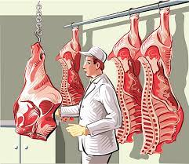
slaughter

Slide 214
distraught

Slide 215
distraught

Slide 216

distraught

Slide 217
fraught

Slide 218
fraught

Slide 219
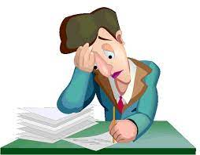
fraught

Slide 220
Let’s Teach and Practise

Slide 221
Words with ending sound /ʃən/ –tion is the most common spelling.
It is used if the root word ends in t or te.

Slide 222
-tion

Slide 223
revolution

Slide 224
revolution

Slide 225
rejection

Slide 226
rejection

Slide 227
location

Slide 228
location

Slide 229
revolution

Slide 230

revolution

Slide 231
revolution noun
Definition - a forcible overthrow of a government or social order, in favour of a new system.

Slide 232
revolution
The country has had a socialist revolution.

Slide 233
The country has had a socialist
----------.

Slide 234
revolution
The country has had a socialist revolution.

Slide 235
rejection

Slide 236

rejection rejec(t) + tion = rejection

Slide 237
rejection rejec(t) + tion = rejection noun the dismissing or refusing of a proposal, idea, etc.

Slide 238
rejection
Some people are reluctant to try it, because they fear rejection.

Slide 239
Some people are reluctant to try it, because they fear ---------.

Slide 240
rejection
Some people are reluctant to try it, because they fear rejection.

Slide 241
location

Slide 242

location loca(te) + tion = location

Slide 243
location loca(te) + tion = location noun
Definition - a particular place or position.

Slide 244
location
The property is set in a convenient location.

Slide 245
The property is set in a convenient --------.

Slide 246
location
The property is set in a convenient location.

Slide 247
New CHALLENGE words.

Slide 248
achieve

Slide 249
achieve
If you believe in yourself, you can achieve anything.

Slide 250
achieve
If you believe in yourself, you can achieve anything.

Slide 251
If you believe in yourself, you can _______ anything.

Slide 252
If you believe in yourself, you can achieve anything.

Slide 253
aggressive

Slide 254
aggressive
Some animals, when provoked, can become aggressive.

Slide 255
aggressive
Some animals, when provoked, can become aggressive.

Slide 256
Some animals, when provoked, can become aggressive.

Slide 257
Some animals, when provoked, can become __________.

Slide 258
Some animals, when provoked, can become aggressive.

Slide 259
Let’s Practise and Apply.

Slide 260
Can you spot the spelling rule words and the challenge words?

Slide 261
Land use – town and country
Land use in towns and cities (urban areas) and the countryside (rural areas) changes in different ways and at different speeds, sometimes at an aggressive speed to achieve the greatest impact on the population.
In this book, we’ll mention the large English town of Colchester, Essex. We’ll also look at the Scottish Isle of Skye, in the Inner Hebrides and its biggest town – Portree in moderation to view the population.
We’ll find clues or suggestion that show how land use has changed a lot in Colchester over time and why many changes have happened quite fast, for example many new stations. On Skye, we’ll see that changes have happened more slowly and how there are less occupations.
Colchester
This is a location that is one of the UK’s oldest towns and has been here since many revolutions. The ancient Romans who invaded Britain nearly 2,000 years ago built their capital city here and achieved great things. About 180,000 people live in Colchester today.

Slide 262
Land use – town and country
Land use in towns and cities (urban areas) and the countryside (rural areas) changes in different ways and at different speeds, sometimes at an aggressive speed to achieve the greatest impact on the population.
In this book, we’ll mention the large English town of Colchester, Essex. We’ll also look at the Scottish Isle of Skye, in the Inner Hebrides and its biggest town – Portree in moderation to view the population.
We’ll find clues or suggestion that show how land use has changed a lot in Colchester over time and why many changes have happened quite fast, for example many new stations. On Skye, we’ll see that changes have happened more slowly and how there are less occupations.
Colchester
This is a location that is one of the UK’s oldest towns and has been here since many revolutions. The ancient Romans who invaded Britain nearly 2,000 years ago built their capital city here and achieved great things. About 180,000 people live in Colchester today.

Slide 263
Write this sentence as I dictate it to you.
Notes:
Colchester
This is a location that is one of the UK’s oldest towns and has been here since many revolutions. The ancient Romans who invaded Britain nearly 2,000 years ago built their capital city here and achieved great things. About 180,000 people live in Colchester today.

Slide 264
Colchester
This is a location that is one of the UK’s oldest towns and has been here since many revolutions. The ancient Romans who invaded Britain nearly 2,000 years ago built their capital city here and achieved great things. About 180,000 people live in Colchester today.
Did you write it correctly?
Edit your work and make sure you have it correct.
Can you underline the spelling word that we have covered in this session?

Slide 265
Year 5 - Autumn 2
Week 3 - Friday
Notes:
Click through the slides for all the R+R words for the week (both the focus and the challenge words)
Click through the slides for all the new learning this week

Slide 266
Notes:
Plan

Slide 267
Let’s Revisit and Review…
Notes:
Click through the slides for all the R+R words for the week (both the focus and the challenge words)
Click through the slides for all the new learning this week

Slide 268
Old challenge words…

Slide 269
knowledge

Slide 270
experiment

Slide 271
Old spelling rule words…

Slide 272
caught

Slide 273
naughty

Slide 274
taught

Slide 275
daughter

Slide 276
clause

Slide 277
cause

Slide 278
astronaut

Slide 279
applause

Slide 280
author

Slide 281
slaughter

Slide 282
distraught

Slide 283
fraught

Slide 284
New spelling rule words…

Slide 285
promotion

Slide 286
moderation

Slide 287
population

Slide 288
mention

Slide 289
solution

Slide 290
vocation

Slide 291
suggestion

Slide 292
station

Slide 293
occupation

Slide 294
revolution

Slide 295
rejection

Slide 296
location

Slide 297
New challenge words…

Slide 298
achieve

Slide 299
aggressive

Slide 300
Quick Quiz time…
Notes:
Knowledge experiment achieve aggressive caught applause population vocation occupation rejection

Slide 301
Did you get them correct?
Edit your work.
knowledge experiment achieve aggressive caught applause population vocation occupation rejection

Slide 302
Word class time…

Slide 303
He achieved his ambition to become a press photographer.

Slide 304
He achieved his ambition to become a press photographer. pronoun, verb, pronoun, noun, preposition, verb, determiner, noun, noun,

Slide 305
He achieved his ambition to become a press photographer. pronoun, verb, pronoun, noun, preposition, verb, determiner, noun, noun,

Slide 306
She's very uncooperative and aggressive.

Slide 307
She's very uncooperative and aggressive. pronoun, verb, adverb, adjective determiner, adjective

Slide 308
She's very uncooperative and aggressive. pronoun, verb, adverb, adjective determiner, adjective

Slide 309
Etymology
The history of a word….

Slide 310
achieve – Etymology
Middle English (in the sense ‘complete successfully’): from Old French achever ‘come or bring to a head’, from a chief ‘to a head’.
aggressive – Etymology
Early 19th century: from Latin aggress- ‘attacked’ (from the verb aggredi ) + -ive; compare with French agressif, -ive .

Slide 311
Let’s investigate….
Knowledge and experiment?

Slide 312
Words linked to achieve…
achieve
verb
attain
reach
arrive at
realize
carry off
bring off
pull off
bring about
accomplish
carry through
fulfil
execute
perform
engineer
carry out

Slide 313
Words linked to aggressive…
hostile
belligerent
antagonistic
truculent
pugnacious
combative
violent
macho
confrontational
quarrelsome
argumentative

Slide 314
Common errors with achieve:
missing I, missing e after the v

Slide 315
Common errors with aggressive:
single g, single s

