Slide 1
Spelling Y5
Mastering spellings: building on the foundations of phonics
Autumn 2
Week 4

Slide 2
Year 5 - Autumn 2
Week 4 - Monday
Notes:
Revisit and review the words and challenge words – I say, we say, you say
Ask children to write words only in their spelling book
Introduce the new spelling rule
Children to write the new spelling rule words and challenge words into books when the sentences are shown with the spelling word missing.
Read the extract with the class as choral reading. Practise model of prosody etc.
Ask children to find the spelling words from the session in the text.
Then read allowed the chosen sentence for children to write fully in their books.
Show the extract and ask children to then edit their work to check they were correct in their dictation.

Slide 3
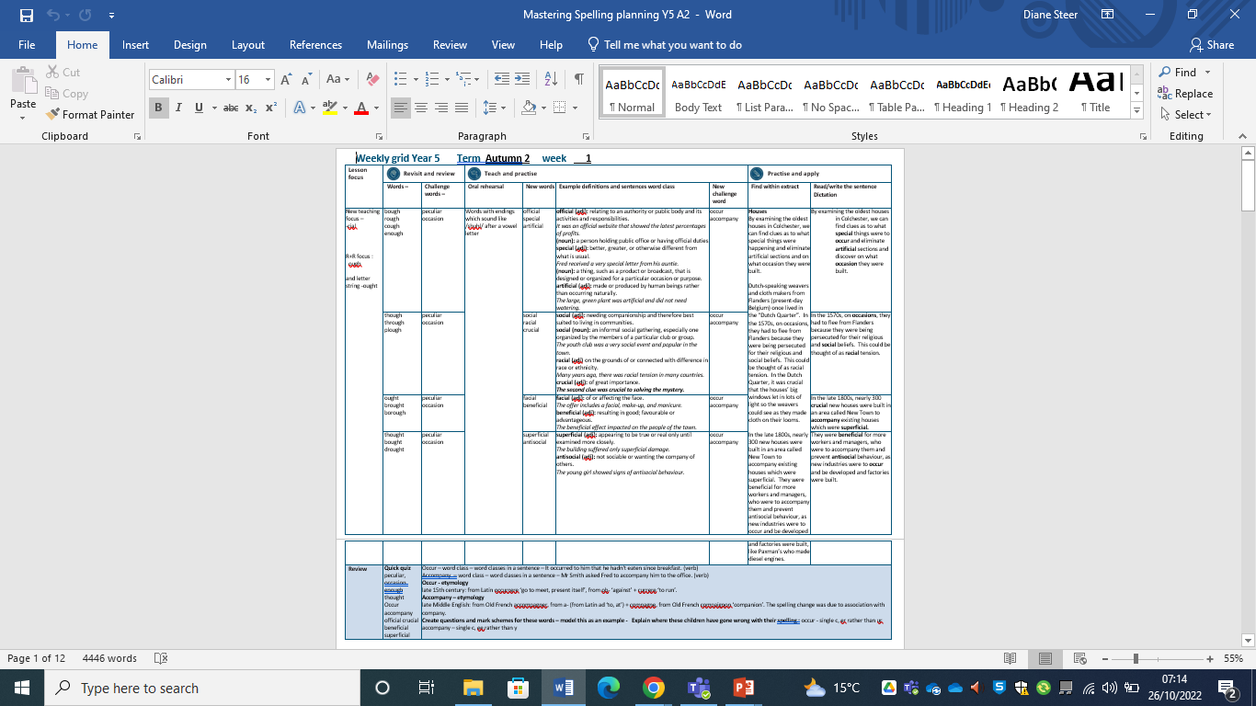
Notes:
Plan

Slide 4
Let’s Revisit and Review…

Slide 5
Do you remember this challenge word?

Slide 6
experience

Slide 7
experience noun
Definition - practical contact with and observation of facts or events.

Slide 8
Do you remember this challenge word?

Slide 9
question

Slide 10
question noun
Definition - a sentence worded or expressed so as to elicit information.

Slide 11
Do you remember this rule?

Slide 12
Word families – phone and real

Slide 13

word family - phone

Slide 14
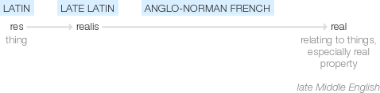
word family - real

Slide 15
phone

Slide 16
phone

Slide 17

phone

Slide 18
phonics

Slide 19
phonics

Slide 20

phonics

Slide 21
microphone

Slide 22
microphone

Slide 23

microphone

Slide 24
Let’s Teach and Practise

Slide 25
Words with ending sound /ʃən/ –tian and -cian
-tian mean a place or origin
-cian mean occupation / job

Slide 26
-cian

Slide 27
statistician

Slide 28
statistician

Slide 29
physician

Slide 30
physician

Slide 31
magician

Slide 32
magician

Slide 33
statistician

Slide 34
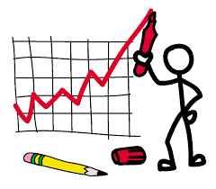
statistician

Slide 35
statistician noun
Definition - an expert in the preparation and analysis of statistics.

Slide 36
statistician
The young girl wished to train as a statistician when she was older.

Slide 37
The young girl wished to train as a ------------ when she was older.

Slide 38
statistician
The young girl wished to train as a statistician when she was older.

Slide 39
physician

Slide 40

physician

Slide 41
physician noun
Definition - a person qualified to practise medicine, especially one who specializes in diagnosis and medical treatment as distinct from surgery.

Slide 42
physician
Our family physician was due to retire soon.

Slide 43
Our family --------- was due to retire soon.

Slide 44
physician
Our family physician was due to retire soon.

Slide 45
magician

Slide 46
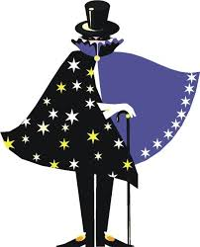
magician

Slide 47
magician noun
Definition - a person with magical powers.

Slide 48
magician
He was the magician of the fan belt.

Slide 49
He was the -------- of the fan belt.

Slide 50
magician
He was the magician of the fan belt.

Slide 51
New CHALLENGE words.

Slide 52
forty

Slide 53
forty
The number forty has significant meaning in the bible.

Slide 54

forty
The number forty has significant meaning in the bible.

Slide 55
The number forty has significant meaning in the bible.

Slide 56
The number _____ has significant meaning in the bible.

Slide 57
The number forty has significant meaning in the bible.

Slide 58
ancient

Slide 59
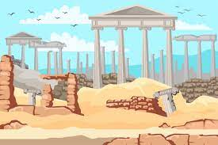
ancient
Some trees are said to be ancient and are needing protection.

Slide 60
Some trees are said to be ancient and are needing protection.

Slide 61
Some trees are said to be _______ and are needing protection.

Slide 62
Some trees are said to be ancient and are needing protection.

Slide 63
Let’s Practise and Apply.

Slide 64
Can you spot the spelling rule words and the challenge words?

Slide 65
Underground clues show how some of the first forty people to live in the Colchester area used the ancient land.
Archaeologists have discovered ditches dug into the earth, coins and other clues showing there was a big settlement here over 2,000 years ago maybe with physicians, magicians and even statisticians. People used ditches and two rivers to protect the ancient settlement from attack.
The ancient Romans invaded and turned the settlement into a wealthy Roman town.
We know there was a Roman ancient town at Colchester because archaeologists have found the remains of Roman buildings such as houses, a chariot-racing arena, a theatre and temples, with numbers over forty.

Slide 66
Underground clues show how some of the first forty people to live in the Colchester area used the ancient land.
Archaeologists have discovered ditches dug into the earth, coins and other clues showing there was a big settlement here over 2,000 years ago maybe with physicians, magicians and even statisticians. People used ditches and two rivers to protect the ancient settlement from attack.
The ancient Romans invaded and turned the settlement into a wealthy Roman town with many dalmatians.
We know there was a Roman ancient town at Colchester because archaeologists have found the remains of Roman buildings such as houses, a chariot-racing arena, a theatre and temples, with numbers over forty. Now there are many different nationalities such as Croatians.

Slide 67
Write this sentence as I dictate it to you.
Notes:
We know there was a Roman ancient town at Colchester because archaeologists have found the remains of Roman buildings such as houses, a chariot-racing arena, a theatre and temples, with numbers over forty.
Now there are many different nationalities such as Croatians.

Slide 68
We know there was a Roman ancient town at Colchester because archaeologists have found the remains of Roman buildings such as houses, a chariot-racing arena, a theatre and temples, with numbers over forty.
Now there are many different nationalities such as Croatians.
Did you write it correctly?
Edit your work and make sure you have it correct.
Can you underline the spelling word that we have covered in this session?

Slide 69
Year 5 - Autumn 2
Week 4 - Tuesday
Notes:
Revisit and review the words and challenge words – I say, we say, you say
Ask children to write words only in their spelling book
Introduce the new spelling rule
Children to write the new spelling rule words and challenge words into books when the sentences are shown with the spelling word missing.
Read the extract with the class as choral reading. Practise model of prosody etc.
Ask children to find the spelling words from the session in the text.
Then read allowed the chosen sentence for children to write fully in their books.
Show the extract and ask children to then edit their work to check they were correct in their dictation.

Slide 70
Notes:
Plan

Slide 71
Let’s Revisit and Review…

Slide 72
Do you remember this challenge word?

Slide 73
experience

Slide 74
experience noun
Definition - practical contact with and observation of facts or events.

Slide 75
Do you remember this challenge word?

Slide 76
question

Slide 77
question noun
Definition - a sentence worded or expressed so as to elicit information.

Slide 78
Do you remember this rule?

Slide 79
Word families – phone and real

Slide 80
word family - phone

Slide 81
word family - real

Slide 82
telephone

Slide 83
telephone

Slide 84
telephone

Slide 85
homophone

Slide 86
homophone

Slide 87
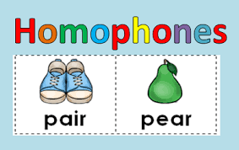
homophone

Slide 88
Let’s Teach and Practise

Slide 89
Words with ending sound /ʃən/ –tian and -cian
-tian mean a place or origin
-cian mean occupation / job

Slide 90
-cian

Slide 91
dietician

Slide 92
dietician

Slide 93
electrician

Slide 94
electrician

Slide 95
technician

Slide 96
technician

Slide 97
dietician

Slide 98
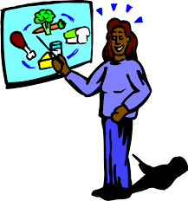
dietician

Slide 99
dietician noun
Definition - an expert on diet and nutrition.

Slide 100
dietician
We have a team of dieticians to ensure patients get healthy, balanced meals.

Slide 101
We have a team of --------- to ensure patients get healthy, balanced meals.

Slide 102
dietician
We have a team of dieticians to ensure patients get healthy, balanced meals.

Slide 103
electrician

Slide 104
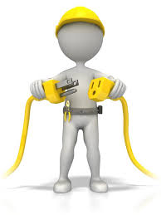
electrician

Slide 105
electrician noun
Definition - a person who installs and maintains electrical equipment.

Slide 106
electrician
We need to book an electrician to fit our new cooker in the kitchen.

Slide 107
electrician
We need to book an ----------- to fit our new cooker in the kitchen.

Slide 108
electrician
We need to book an electrician to fit our new cooker in the kitchen.

Slide 109
technician

Slide 110

technician

Slide 111
technician noun
Definition - a person employed to look after technical equipment or do practical work in a laboratory.

Slide 112
technician
The science lab technician had made a new discovery.

Slide 113
The science lab ---------- had made a new discovery.

Slide 114
technician
The science lab technician had made a new discovery.

Slide 115
New CHALLENGE words.

Slide 116
forty

Slide 117
forty
The number forty has significant meaning in the bible.

Slide 118
forty
The number forty has significant meaning in the bible.

Slide 119
The number forty has significant meaning in the bible.

Slide 120
The number _____ has significant meaning in the bible.

Slide 121
The number forty has significant meaning in the bible.

Slide 122
ancient

Slide 123
ancient
Some trees are said to be ancient and are needing protection.

Slide 124
Some trees are said to be ancient and are needing protection.

Slide 125
Some trees are said to be _______ and are needing protection.

Slide 126
Some trees are said to be ancient and are needing protection.

Slide 127
Let’s Practise and Apply.

Slide 128
Can you spot the spelling rule words and the challenge words?

Slide 129
Underground clues show how some of the first forty people to live in the Colchester area used the ancient land.
Archaeologists have discovered ditches dug into the earth, coins and other clues showing there was a big settlement here over 2,000 years ago maybe with physicians, magicians and even statisticians. People used ditches and two rivers to protect the ancient settlement from attack.
The ancient Romans invaded and turned the settlement into a wealthy Roman town.
We know there was a Roman ancient town at Colchester because archaeologists have found the remains of Roman buildings such as houses, a chariot-racing arena, a theatre and temples, with numbers over forty.

Slide 130
Underground clues show how some of the first forty people to live in the Colchester area used the ancient land.
Archaeologists have discovered ditches dug into the earth, coins and other clues showing there was a big settlement here over 2,000 years ago maybe with physicians, magicians and even statisticians. People used ditches and two rivers to protect the ancient settlement from attack.
The ancient Romans invaded and turned the settlement into a wealthy Roman town with many dalmatians.
We know there was a Roman ancient town at Colchester because archaeologists have found the remains of Roman buildings such as houses, a chariot-racing arena, a theatre and temples, with numbers over forty. Now there are many different nationalities such as Croatians.

Slide 131
Write this sentence as I dictate it to you.
Notes:
Archaeologists have discovered ditches dug into the earth, coins and other clues showing there was a big settlement here over 2,000 years ago maybe with physicians, magicians and even statisticians.

Slide 132
Archaeologists have discovered ditches dug into the earth, coins and other clues showing there was a big settlement here over 2,000 years ago maybe with physicians, magicians and even statisticians.
Did you write it correctly?
Edit your work and make sure you have it correct.
Can you underline the spelling word that we have covered in this session?

Slide 133
Year 5 - Autumn 2
Week 4 - Wednesday
Notes:
Revisit and review the words and challenge words – I say, we say, you say
Ask children to write words only in their spelling book
Introduce the new spelling rule
Children to write the new spelling rule words and challenge words into books when the sentences are shown with the spelling word missing.
Read the extract with the class as choral reading. Practise model of prosody etc.
Ask children to find the spelling words from the session in the text.
Then read allowed the chosen sentence for children to write fully in their books.
Show the extract and ask children to then edit their work to check they were correct in their dictation.

Slide 134
Notes:
Plan

Slide 135
Let’s Revisit and Review…

Slide 136
Do you remember this challenge word?

Slide 137
experience

Slide 138
experience noun
Definition - practical contact with and observation of facts or events.

Slide 139
Do you remember this challenge word?

Slide 140
question

Slide 141
question noun
Definition - a sentence worded or expressed so as to elicit information.

Slide 142
Do you remember this rule?

Slide 143
Word families – phone and real

Slide 144
word family - phone

Slide 145
word family - real

Slide 146
real

Slide 147
real

Slide 148
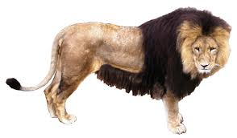
real

Slide 149
reality

Slide 150
reality

Slide 151

reality

Slide 152
realistic

Slide 153
realistic

Slide 154
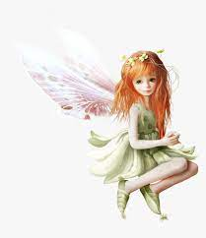
realistic

Slide 155
Let’s Teach and Practise

Slide 156
Words with ending sound /ʃən/ –tian and -cian
-tian mean a place or origin
-cian mean occupation / job

Slide 157
-tian

Slide 158
Martian

Slide 159
Martian

Slide 160
Dalmatian

Slide 161
Dalmatian

Slide 162
Martian

Slide 163
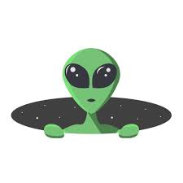
Martian

Slide 164
Martian noun
Definition - of or relating to the planet Mars or its hypothetical inhabitants.

Slide 165
martian
Fred dreamt of martians invading his village.

Slide 166
Fred dreamt of -------- invading his village.

Slide 167
martian
Fred dreamt of martians invading his village.

Slide 168
dalmatian

Slide 169
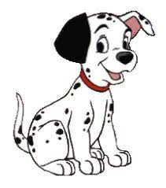
Dalmatian

Slide 170
dalmatian noun
Definition - a dog of a large, white short-haired breed with dark spots.

Slide 171
dalmatian
Sally’s new puppy was a dalmatian.

Slide 172
Sally’s new puppy was a
---------.

Slide 173
dalmatian
Sally’s new puppy was a dalmatian.

Slide 174
New CHALLENGE words.

Slide 175
forty

Slide 176
forty
The number forty has significant meaning in the bible.

Slide 177
forty
The number forty has significant meaning in the bible.

Slide 178
The number forty has significant meaning in the bible.

Slide 179
The number _____ has significant meaning in the bible.

Slide 180
The number forty has significant meaning in the bible.

Slide 181
ancient

Slide 182
ancient
Some trees are said to be ancient and are needing protection.

Slide 183
Some trees are said to be ancient and are needing protection.

Slide 184
Some trees are said to be _______ and are needing protection.

Slide 185
Some trees are said to be ancient and are needing protection.

Slide 186
Let’s Practise and Apply.

Slide 187
Can you spot the spelling rule words and the challenge words?

Slide 188
Underground clues show how some of the first forty people to live in the Colchester area used the ancient land.
Archaeologists have discovered ditches dug into the earth, coins and other clues showing there was a big settlement here over 2,000 years ago maybe with physicians, magicians and even statisticians. People used ditches and two rivers to protect the ancient settlement from attack.
The ancient Romans invaded and turned the settlement into a wealthy Roman town.
We know there was a Roman ancient town at Colchester because archaeologists have found the remains of Roman buildings such as houses, a chariot-racing arena, a theatre and temples, with numbers over forty.

Slide 189
Underground clues show how some of the first forty people to live in the Colchester area used the ancient land.
Archaeologists have discovered ditches dug into the earth, coins and other clues showing there was a big settlement here over 2,000 years ago maybe with physicians, magicians and even statisticians. People used ditches and two rivers to protect the ancient settlement from attack.
The ancient Romans invaded and turned the settlement into a wealthy Roman town with many dalmatians.
We know there was a Roman ancient town at Colchester because archaeologists have found the remains of Roman buildings such as houses, a chariot-racing arena, a theatre and temples, with numbers over forty. Now there are many different nationalities such as Croatians.

Slide 190
Write this sentence as I dictate it to you.
Notes:
People used ditches and two rivers to protect the ancient settlement from attack.
The ancient Romans invaded and turned the settlement into a wealthy Roman town with many dalmatians.

Slide 191
People used ditches and two rivers to protect the ancient settlement from attack.
The ancient Romans invaded and turned the settlement into a wealthy Roman town with many dalmatians.
Did you write it correctly?
Edit your work and make sure you have it correct.
Can you underline the spelling word that we have covered in this session?

Slide 192
Year 5 - Autumn 2
Week 4 - Thursday
Notes:
Revisit and review the words and challenge words – I say, we say, you say
Ask children to write words only in their spelling book
Introduce the new spelling rule
Children to write the new spelling rule words and challenge words into books when the sentences are shown with the spelling word missing.
Read the extract with the class as choral reading. Practise model of prosody etc.
Ask children to find the spelling words from the session in the text.
Then read allowed the chosen sentence for children to write fully in their books.
Show the extract and ask children to then edit their work to check they were correct in their dictation.

Slide 193
Notes:
Plan

Slide 194
Let’s Revisit and Review…

Slide 195
Do you remember this challenge word?

Slide 196
experience

Slide 197
experience noun
Definition - practical contact with and observation of facts or events.

Slide 198
Do you remember this challenge word?

Slide 199
question

Slide 200
question noun
Definition - a sentence worded or expressed so as to elicit information.

Slide 201
Do you remember this rule?

Slide 202
Word families – phone and real

Slide 203
word family - phone

Slide 204
word family - real

Slide 205
unreal

Slide 206
unreal

Slide 207
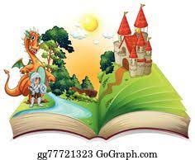
unreal

Slide 208
realisation

Slide 209
realisation

Slide 210
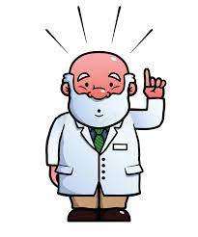
realisation

Slide 211
Let’s Teach and Practise

Slide 212
Words with ending sound /ʃən/ –tian and -cian
-tian mean a place or origin
-cian mean occupation / job

Slide 213
-tian

Slide 214
Christian

Slide 215
Christian

Slide 216
Faustian

Slide 217
Faustian

Slide 218
Croatian

Slide 219
Croatian

Slide 220
Christian

Slide 221

Christian

Slide 222
Christian noun
Definition - a person who has received Christian baptism or is a believer in Christianity.

Slide 223
Christian
Harvest is one of many Christian festivals.

Slide 224
Harvest is one of many --------- festivals.

Slide 225
Christian
Harvest is one of many Christian festivals.

Slide 226
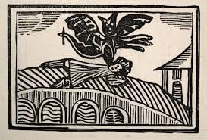
dietitian

Slide 227

dietitian adjective
Definition - dietitian (noun): an expert on diet and nutrition.
We have a team of dietitians to ensure patients get healthy, balanced meals.

Slide 228
dietitian
We have a team of dietitians to ensure patients get healthy, balanced meals.

Slide 229
We have a team of --------- to ensure patients get healthy, balanced meals.

Slide 230
dietitian
We have a team of dietitians to ensure patients get healthy, balanced meals.

Slide 231
Croatian

Slide 232
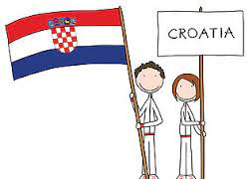
Croatian

Slide 233
Croatian noun
Definition - a native or inhabitant of Croatia, or a person of Croatian descent.

Slide 234
Croatian
Natives from Croatia are referred to as Croatian.

Slide 235
Natives from Croatia are referred to as --------.

Slide 236
Croatian
Natives from Croatia are referred to as Croatian.

Slide 237
New CHALLENGE words.

Slide 238
forty

Slide 239
forty
The number forty has significant meaning in the bible.

Slide 240
forty
The number forty has significant meaning in the bible.

Slide 241
The number forty has significant meaning in the bible.

Slide 242
The number _____ has significant meaning in the bible.

Slide 243
The number forty has significant meaning in the bible.

Slide 244
ancient

Slide 245
ancient
Some trees are said to be ancient and are needing protection.

Slide 246
Some trees are said to be ancient and are needing protection.

Slide 247
Some trees are said to be _______ and are needing protection.

Slide 248
Some trees are said to be ancient and are needing protection.

Slide 249
Let’s Practise and Apply.

Slide 250
Can you spot the spelling rule words and the challenge words?

Slide 251
Underground clues show how some of the first forty people to live in the Colchester area used the ancient land.
Archaeologists have discovered ditches dug into the earth, coins and other clues showing there was a big settlement here over 2,000 years ago maybe with physicians, magicians and even statisticians. People used ditches and two rivers to protect the ancient settlement from attack.
The ancient Romans invaded and turned the settlement into a wealthy Roman town.
We know there was a Roman ancient town at Colchester because archaeologists have found the remains of Roman buildings such as houses, a chariot-racing arena, a theatre and temples, with numbers over forty.

Slide 252
Underground clues show how some of the first forty people to live in the Colchester area used the ancient land.
Archaeologists have discovered ditches dug into the earth, coins and other clues showing there was a big settlement here over 2,000 years ago maybe with physicians, magicians and even statisticians. People used ditches and two rivers to protect the ancient settlement from attack.
The ancient Romans invaded and turned the settlement into a wealthy Roman town with many dalmatians.
We know there was a Roman ancient town at Colchester because archaeologists have found the remains of Roman buildings such as houses, a chariot-racing arena, a theatre and temples, with numbers over forty. Now there are many different nationalities such as Croatians.

Slide 253
Write this sentence as I dictate it to you.
Notes:
We know there was a Roman ancient town at Colchester because archaeologists have found the remains of Roman buildings such as houses, a chariot-racing arena, a theatre and temples, with numbers over forty.
Now there are many different nationalities such as Croatians.

Slide 254
We know there was a Roman ancient town at Colchester because archaeologists have found the remains of Roman buildings such as houses, a chariot-racing arena, a theatre and temples, with numbers over forty.
Now there are many different nationalities such as Croatians.
Did you write it correctly?
Edit your work and make sure you have it correct.
Can you underline the spelling word that we have covered in this session?

Slide 255
Year 5 - Autumn 2
Week 4 - Friday
Notes:
Click through the slides for all the R+R words for the week (both the focus and the challenge words)
Click through the slides for all the new learning this week

Slide 256
Notes:
Plan

Slide 257
Let’s Revisit and Review…
Notes:
Click through the slides for all the R+R words for the week (both the focus and the challenge words)
Click through the slides for all the new learning this week

Slide 258
Old challenge words…

Slide 259
experience

Slide 260
question

Slide 261
Old spelling rule words…

Slide 262
phone

Slide 263
phonics

Slide 264
microphone

Slide 265
telephone

Slide 266
homophone

Slide 267
real

Slide 268
reality

Slide 269
realistic

Slide 270
unreal

Slide 271
realisation

Slide 272
New spelling rule words…

Slide 273
statistician

Slide 274
physician

Slide 275
magician

Slide 276
dietician

Slide 277
electrician

Slide 278
technician

Slide 279
Martian

Slide 280
Dalmatian

Slide 281
Christian

Slide 282
Faustian

Slide 283
Croatian

Slide 284
New challenge words…

Slide 285
forty

Slide 286
ancient

Slide 287
Quick Quiz time…
Notes:
experience question forty ancient microphone reality physician electrician Christian dalmatian

Slide 288
Did you get them correct?
Edit your work.
experience question forty ancient microphone reality physician electrician Christian dalmatian

Slide 289
Word class time…

Slide 290
Fred managed to count to forty before the bell rang.

Slide 291
Fred managed to count to forty before the bell rang.
Proper noun, verb, preposition, verb, preposition, noun, preposition, determiner, noun, verb,

Slide 292
Fred managed to count to forty before the bell rang.
Proper noun, verb, preposition, verb, preposition, noun, preposition, determiner, noun, verb,

Slide 293
We visited the ancient woodland site to learn more.

Slide 294
We visited the ancient woodland site to learn more. pronoun, verb, determiner, adjective, noun, noun, preposition, verb, adjective.

Slide 295
We visited the ancient woodland site to learn more. pronoun, verb, determiner, adjective, noun, noun, preposition, verb, adjective.

Slide 296
Etymology
The history of a word….

Slide 297
forty – Etymology
1 more than thirty-nine, twice twenty; the number which is one more than thirty-nine; a symbol representing this number;" early 12c., feowerti, from Old English feowertig, Northumbrian feuortig "forty," from feower "four" (from PIE root *kwetwer- "four") + tig "group of ten" (see -ty)
ancient – Etymology
late Middle English: from Old French ancien, based on Latin ante ‘before’.

Slide 298
Let’s investigate….
Knowledge and experiment?

Slide 299
Words linked to forty…
quadragenarian.
quadragesimal.

Slide 300
Words linked to ancient…
adjective
of long ago
earliest
first
early
past
former
bygone
prehistoric
primeval
primordial
primitive
classical
olden
of yore
foregone

Slide 301
Common errors with forty:
our instead of or as four has our

Slide 302
Common errors with ancient:
-shent for -cient,
miss the first n out: acient

