Slide 1
Spelling Y5
Mastering spellings: building on the foundations of phonics
Autumn 2
Week 5

Slide 2
Year 5 - Autumn 2
Week 5 - Monday
Notes:
Revisit and review the words and challenge words – I say, we say, you say
Ask children to write words only in their spelling book
Introduce the new spelling rule
Children to write the new spelling rule words and challenge words into books when the sentences are shown with the spelling word missing.
Read the extract with the class as choral reading. Practise model of prosody etc.
Ask children to find the spelling words from the session in the text.
Then read allowed the chosen sentence for children to write fully in their books.
Show the extract and ask children to then edit their work to check they were correct in their dictation.

Slide 3
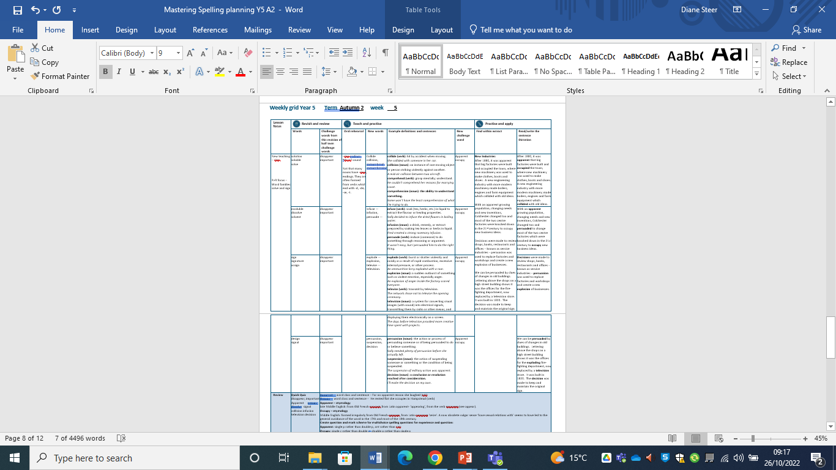
Notes:
Plan

Slide 4
Let’s Revisit and Review…

Slide 5
Do you remember this challenge word?

Slide 6
disappear

Slide 7
disappear verb
Definition - cease to be visible.

Slide 8
Do you remember this challenge word?

Slide 9
important

Slide 10
important adjective
Definition - of great significance or value.

Slide 11
Do you remember this rule?

Slide 12
Word families – solve and sign

Slide 13

word family - solve

Slide 14

word family - sign

Slide 15
solve

Slide 16
solve

Slide 17
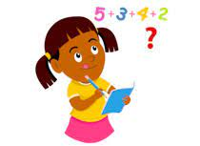
solve

Slide 18
soluble

Slide 19
soluble

Slide 20
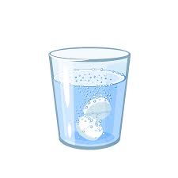
soluble

Slide 21
solution

Slide 22
solution

Slide 23

solution

Slide 24
Let’s Teach and Practise

Slide 25
Words with ending sound /ʃən/
–sion
–sion is used if the root word ends in d or se.
Exceptions: attend – attention, intend – intention

Slide 26
-sion

Slide 27
collide

Slide 28
collide

Slide 29
collision

Slide 30
collision

Slide 31
comprehend

Slide 32
comprehend

Slide 33
comprehension

Slide 34
comprehension

Slide 35
collide -> collision

Slide 36
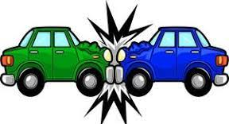
collide -> collision

Slide 37
collide -> collision verb -> noun

Slide 38
collide -> collision verb -> noun collision - noun
Definition - an instance of one moving object or person striking violently against another.

Slide 39
collision
A mid-air collision between two aircraft.

Slide 40
A mid-air --------- between two aircraft.

Slide 41
collision
A mid-air collision between two aircraft.

Slide 42
comprehend -> comprehension

Slide 43
comprehend -> comprehension

Slide 44

comprehend -> comprehension verb -> noun

Slide 45
comprehend -> comprehension verb -> noun comprehension – noun
Definition - the ability to understand something.

Slide 46
comprehension
Some won't have the least comprehension of what I'm trying to do.

Slide 47
Some won't have the least
------------- of what I'm trying to do.

Slide 48
comprehension
Some won't have the least comprehension of what I'm trying to do.

Slide 49
New CHALLENGE words.

Slide 50
apparent

Slide 51

apparent
The solution was apparent to all except the teacher.

Slide 52
The solution was apparent to all except the teacher.

Slide 53
The solution was ________ to all except the teacher.

Slide 54
The solution was apparent to all except the teacher.

Slide 55
occupy

Slide 56
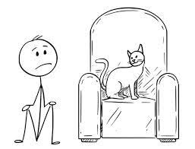
occupy
To occupy the top office in the country is to be Prime Minister.

Slide 57
To occupy the top office in the country is to be Prime Minister.

Slide 58
To ______ the top office in the country is to be Prime Minister.

Slide 59
To occupy the top office in the country is to be Prime Minister.

Slide 60
Let’s Practise and Apply.

Slide 61
Can you spot the spelling rule words and the challenge words?

Slide 62
New Industries
After 1880, it was apparent that big factories were built and occupied the town, where new machinery was used to make clothes, boots and shoes. A new engineering industry with more modern machinery made boilers, engines and farm equipment which collided with old ideas.
With an apparent growing population, changing needs and new inventions, Colchester changed too and most of the two centre factories were knocked down in the 21st century to occupy new business ideas.
Decisions were made to review shops, banks, restaurants and offices – known as service industries – persuasion was used to replace factories and workshops and create a new explosion of businesses.
We can be persuaded by clues of changes in old buildings. Lettering above the shops on a high street building shows it was the offices for the fire-fighting department, now replaced by a television store. It was built in 1820. The decision was made to keep and maintain the original sign.

Slide 63
New Industries
After 1880, it was apparent that big factories were built and occupied the town, where new machinery was used to make clothes, boots and shoes. A new engineering industry with more modern machinery made boilers, engines and farm equipment which collided with old ideas.
With an apparent growing population, changing needs and new inventions, Colchester changed too and persuaded to change most of the two centre factories were knocked down in the 21st century to occupy new business ideas.
Decisions were made to review shops, banks, restaurants and offices – known as service industries – persuasion was used to replace factories and workshops and create a new explosion of businesses.
We can be persuaded by clues of changes in old buildings. Lettering above the shops on a high street building shows it was the offices for the fire-fighting department, now replaced by a television store. It was built in 1820. The decision was made to keep and maintain the original sign.

Slide 64
Write this sentence as I dictate it to you.
Notes:
After 1880, it was apparent that big factories were built and occupied the town, where new machinery was used to make clothes, boots and shoes. A new engineering industry with more modern machinery made boilers, engines and farm equipment which collided with old ideas.

Slide 65
After 1880, it was apparent that big factories were built and occupied the town, where new machinery was used to make clothes, boots and shoes. A new engineering industry with more modern machinery made boilers, engines and farm equipment which collided with old ideas.
Did you write it correctly?
Edit your work and make sure you have it correct.
Can you underline the spelling word that we have covered in this session?

Slide 66
Year 5 - Autumn 2
Week 5 - Tuesday
Notes:
Revisit and review the words and challenge words – I say, we say, you say
Ask children to write words only in their spelling book
Introduce the new spelling rule
Children to write the new spelling rule words and challenge words into books when the sentences are shown with the spelling word missing.
Read the extract with the class as choral reading. Practise model of prosody etc.
Ask children to find the spelling words from the session in the text.
Then read allowed the chosen sentence for children to write fully in their books.
Show the extract and ask children to then edit their work to check they were correct in their dictation.

Slide 67
Notes:
Plan

Slide 68
Let’s Revisit and Review…

Slide 69
Do you remember this challenge word?

Slide 70
disappear

Slide 71
disappear verb
Definition - cease to be visible.

Slide 72
Do you remember this challenge word?

Slide 73
important

Slide 74
important adjective
Definition - of great significance or value.

Slide 75
Do you remember this rule?

Slide 76
Word families – solve and sign

Slide 77
word family - solve

Slide 78
word family - sign

Slide 79
insoluble

Slide 80
insoluble

Slide 81
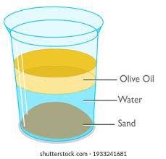
insoluble

Slide 82
dissolve

Slide 83
dissolve

Slide 84
dissolve

Slide 85
solvent

Slide 86
solvent

Slide 87
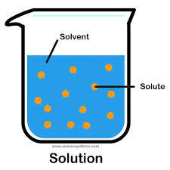
solvent

Slide 88
Let’s Teach and Practise

Slide 89
Words with ending sound /ʃən/
–sion
–sion is used if the root word ends in d or se.
Exceptions: attend – attention, intend – intention

Slide 90
-sion

Slide 91
infuse

Slide 92
infuse

Slide 93
infusion

Slide 94
infusion

Slide 95
persuade

Slide 96
persuade

Slide 97
persuasion

Slide 98
persuasion

Slide 99
infuse -> infusion

Slide 100
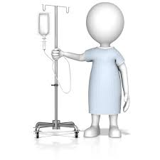
infuse -> infusion

Slide 101
infuse -> infusion verb -> noun

Slide 102
infuse -> infusion verb -> noun infusion - noun
Definition - a drink, remedy, or extract prepared by soaking tea leaves or herbs in liquid.

Slide 103
infusion
Fred created a strong rosemary infusion.

Slide 104
Fred created a strong rosemary
--------.

Slide 105
infusion
Fred created a strong rosemary infusion.

Slide 106
persuade -> persuasion

Slide 107

persuade -> persuasion

Slide 108
persuade -> persuasion verb -> noun

Slide 109
persuade -> persuasion verb -> noun persuasion - noun
Definition - the action or process of persuading someone or of being persuaded to do or believe something.

Slide 110
persuasion
Sally needed plenty of persuasion before she actually left.

Slide 111
Sally needed plenty of ---------- before she actually left.

Slide 112
persuasion
Sally needed plenty of persuasion before she actually left.

Slide 113
New CHALLENGE words.

Slide 114
apparent

Slide 115
apparent
The solution was apparent to all except the teacher.

Slide 116
The solution was apparent to all except the teacher.

Slide 117
The solution was ________ to all except the teacher.

Slide 118
The solution was apparent to all except the teacher.

Slide 119
occupy

Slide 120
occupy
To occupy the top office in the country is to be Prime Minister.

Slide 121
To occupy the top office in the country is to be Prime Minister.

Slide 122
To ______ the top office in the country is to be Prime Minister.

Slide 123
To occupy the top office in the country is to be Prime Minister.

Slide 124
Let’s Practise and Apply.

Slide 125
Can you spot the spelling rule words and the challenge words?

Slide 126
New Industries
After 1880, it was apparent that big factories were built and occupied the town, where new machinery was used to make clothes, boots and shoes. A new engineering industry with more modern machinery made boilers, engines and farm equipment which collided with old ideas.
With an apparent growing population, changing needs and new inventions, Colchester changed too and most of the two centre factories were knocked down in the 21st century to occupy new business ideas.
Decisions were made to review shops, banks, restaurants and offices – known as service industries – persuasion was used to replace factories and workshops and create a new explosion of businesses.
We can be persuaded by clues of changes in old buildings. Lettering above the shops on a high street building shows it was the offices for the fire-fighting department, now replaced by a television store. It was built in 1820. The decision was made to keep and maintain the original sign.

Slide 127
New Industries
After 1880, it was apparent that big factories were built and occupied the town, where new machinery was used to make clothes, boots and shoes. A new engineering industry with more modern machinery made boilers, engines and farm equipment which collided with old ideas.
With an apparent growing population, changing needs and new inventions, Colchester changed too and persuaded to change most of the two centre factories were knocked down in the 21st century to occupy new business ideas.
Decisions were made to review shops, banks, restaurants and offices – known as service industries – persuasion was used to replace factories and workshops and create a new explosion of businesses.
We can be persuaded by clues of changes in old buildings. Lettering above the shops on a high street building shows it was the offices for the fire-fighting department, now replaced by a television store. It was built in 1820. The decision was made to keep and maintain the original sign.

Slide 128
Write this sentence as I dictate it to you.
Notes:
With an apparent growing population, changing needs and new inventions, Colchester changed too and persuaded to change most of the two centre factories which were knocked down in the 21st century to occupy new business ideas.

Slide 129
With an apparent growing population, changing needs and new inventions, Colchester changed too and persuaded to change most of the two centre factories which were knocked down in the 21st century to occupy new business ideas.
Did you write it correctly?
Edit your work and make sure you have it correct.
Can you underline the spelling word that we have covered in this session?

Slide 130
Year 5 - Autumn 2
Week 5 - Wednesday
Notes:
Revisit and review the words and challenge words – I say, we say, you say
Ask children to write words only in their spelling book
Introduce the new spelling rule
Children to write the new spelling rule words and challenge words into books when the sentences are shown with the spelling word missing.
Read the extract with the class as choral reading. Practise model of prosody etc.
Ask children to find the spelling words from the session in the text.
Then read allowed the chosen sentence for children to write fully in their books.
Show the extract and ask children to then edit their work to check they were correct in their dictation.

Slide 131
Notes:
Plan

Slide 132
Let’s Revisit and Review…

Slide 133
Do you remember this challenge word?

Slide 134
disappear

Slide 135
disappear verb
Definition - cease to be visible.

Slide 136
Do you remember this challenge word?

Slide 137
important

Slide 138
important adjective
Definition - of great significance or value.

Slide 139
Do you remember this rule?

Slide 140
Word families – solve and sign

Slide 141
word family - solve

Slide 142
word family - sign

Slide 143
sign

Slide 144
sign

Slide 145

sign

Slide 146
signature

Slide 147
signature

Slide 148

signature

Slide 149
assign

Slide 150
assign

Slide 151

assign

Slide 152
Let’s Teach and Practise

Slide 153
Words with ending sound /ʃən/
–sion
–sion is used if the root word ends in d or se.
Exceptions: attend – attention, intend – intention

Slide 154
-sion

Slide 155
explode

Slide 156
explode

Slide 157
explosion

Slide 158
explosion

Slide 159
televise

Slide 160
televise

Slide 161
television

Slide 162
television

Slide 163
explode -> explosion

Slide 164

explode -> explosion

Slide 165
explode -> explosion verb -> noun

Slide 166
explode -> explosion verb -> noun explosion - noun
Definition - a violent shattering or blowing apart of something, as is caused by a bomb.

Slide 167
explosion
An explosion of anger inside the factory scared everyone.

Slide 168
explosion
An --------- of anger inside the factory scared everyone.

Slide 169
explosion
An explosion of anger inside the factory scared everyone.

Slide 170
televise -> television

Slide 171

televise -> television

Slide 172
televise -> television verb -> noun

Slide 173
televise -> television verb -> noun television - noun
Definition - a system for converting visual images (with sound) into electrical signals, transmitting them by radio or other means, and displaying them electronically on a screen.

Slide 174
television
The days before television provided more creative time spent with projects.

Slide 175
The days before ---------- provided more creative time spent with projects.

Slide 176
television
The days before television provided more creative time spent with projects.

Slide 177
New CHALLENGE words.

Slide 178
apparent

Slide 179
apparent
The solution was apparent to all except the teacher.

Slide 180
The solution was apparent to all except the teacher.

Slide 181
The solution was ________ to all except the teacher.

Slide 182
The solution was apparent to all except the teacher.

Slide 183
occupy

Slide 184
occupy
To occupy the top office in the country is to be Prime Minister.

Slide 185
To occupy the top office in the country is to be Prime Minister.

Slide 186
To ______ the top office in the country is to be Prime Minister.

Slide 187
To occupy the top office in the country is to be Prime Minister.

Slide 188
Let’s Practise and Apply.

Slide 189
Can you spot the spelling rule words and the challenge words?

Slide 190
New Industries
After 1880, it was apparent that big factories were built and occupied the town, where new machinery was used to make clothes, boots and shoes. A new engineering industry with more modern machinery made boilers, engines and farm equipment which collided with old ideas.
With an apparent growing population, changing needs and new inventions, Colchester changed too and most of the two centre factories were knocked down in the 21st century to occupy new business ideas.
Decisions were made to review shops, banks, restaurants and offices – known as service industries – persuasion was used to replace factories and workshops and create a new explosion of businesses.
We can be persuaded by clues of changes in old buildings. Lettering above the shops on a high street building shows it was the offices for the fire-fighting department, now replaced by a television store. It was built in 1820. The decision was made to keep and maintain the original sign.

Slide 191
New Industries
After 1880, it was apparent that big factories were built and occupied the town, where new machinery was used to make clothes, boots and shoes. A new engineering industry with more modern machinery made boilers, engines and farm equipment which collided with old ideas.
With an apparent growing population, changing needs and new inventions, Colchester changed too and persuaded to change most of the two centre factories were knocked down in the 21st century to occupy new business ideas.
Decisions were made to review shops, banks, restaurants and offices – known as service industries – persuasion was used to replace factories and workshops and create a new explosion of businesses.
We can be persuaded by clues of changes in old buildings. Lettering above the shops on a high street building shows it was the offices for the fire-fighting department, now replaced by a television store. It was built in 1820. The decision was made to keep and maintain the original sign.

Slide 192
Write this sentence as I dictate it to you.
Notes:
Decisions were made to review shops, banks, restaurants and offices – known as service industries – persuasion was used to replace factories and workshops and create a new explosion of businesses.

Slide 193
Decisions were made to review shops, banks, restaurants and offices – known as service industries – persuasion was used to replace factories and workshops and create a new explosion of businesses.
Did you write it correctly?
Edit your work and make sure you have it correct.
Can you underline the spelling word that we have covered in this session?

Slide 194
Year 5 - Autumn 2
Week 5 - Thursday
Notes:
Revisit and review the words and challenge words – I say, we say, you say
Ask children to write words only in their spelling book
Introduce the new spelling rule
Children to write the new spelling rule words and challenge words into books when the sentences are shown with the spelling word missing.
Read the extract with the class as choral reading. Practise model of prosody etc.
Ask children to find the spelling words from the session in the text.
Then read allowed the chosen sentence for children to write fully in their books.
Show the extract and ask children to then edit their work to check they were correct in their dictation.

Slide 195
Notes:
Plan

Slide 196
Let’s Revisit and Review…

Slide 197
Do you remember this challenge word?

Slide 198
disappear

Slide 199
disappear verb
Definition - cease to be visible.

Slide 200
Do you remember this challenge word?

Slide 201
important

Slide 202
important adjective
Definition - of great significance or value.

Slide 203
Do you remember this rule?

Slide 204
Word families – solve and sign

Slide 205
word family - solve

Slide 206
word family - sign

Slide 207
design

Slide 208
design

Slide 209
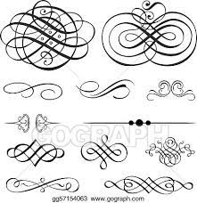
design

Slide 210
signal

Slide 211
signal

Slide 212

signal

Slide 213
Let’s Teach and Practise

Slide 214
Words with ending sound /ʃən/
–sion
–sion is used if the root word ends in d or se.
Exceptions: attend – attention, intend – intention

Slide 215
-sion

Slide 216
decide

Slide 217
decide

Slide 218
decision

Slide 219
decision

Slide 220
suspend

Slide 221
suspend

Slide 222
suspension

Slide 223
suspension

Slide 224
decide -> decision

Slide 225

decide -> decision

Slide 226
decide -> decision verb -> noun

Slide 227
decide -> decision verb -> noun decision - noun
Definition - a conclusion or resolution reached after consideration.

Slide 228
decision
I'll make the decision on my own.

Slide 229
I'll make the -------- on my own.

Slide 230
decision
I'll make the decision on my own.

Slide 231
suspend -> suspension

Slide 232

suspend -> suspension

Slide 233
suspend -> suspension verb -> noun

Slide 234
suspend -> suspension verb -> noun suspension - noun
Definition - the action of suspending someone or something or the condition of being suspended.

Slide 235
suspension
The suspension of military action was apparent.

Slide 236
The ---------- of military action was apparent.

Slide 237
suspension
The suspension of military action was apparent.

Slide 238
New CHALLENGE words.

Slide 239
apparent

Slide 240
apparent
The solution was apparent to all except the teacher.

Slide 241
The solution was apparent to all except the teacher.

Slide 242
The solution was ________ to all except the teacher.

Slide 243
The solution was apparent to all except the teacher.

Slide 244
occupy

Slide 245
occupy
To occupy the top office in the country is to be Prime Minister.

Slide 246
To occupy the top office in the country is to be Prime Minister.

Slide 247
To ______ the top office in the country is to be Prime Minister.

Slide 248
To occupy the top office in the country is to be Prime Minister.

Slide 249
Let’s Practise and Apply.

Slide 250
Can you spot the spelling rule words and the challenge words?

Slide 251
New Industries
After 1880, it was apparent that big factories were built and occupied the town, where new machinery was used to make clothes, boots and shoes. A new engineering industry with more modern machinery made boilers, engines and farm equipment which collided with old ideas.
With an apparent growing population, changing needs and new inventions, Colchester changed too and most of the two centre factories were knocked down in the 21st century to occupy new business ideas.
Decisions were made to review shops, banks, restaurants and offices – known as service industries – persuasion was used to replace factories and workshops and create a new explosion of businesses.
We can be persuaded by clues of changes in old buildings. Lettering above the shops on a high street building shows it was the offices for the fire-fighting department, now replaced by a television store. It was built in 1820. The decision was made to keep and maintain the original sign.

Slide 252
New Industries
After 1880, it was apparent that big factories were built and occupied the town, where new machinery was used to make clothes, boots and shoes. A new engineering industry with more modern machinery made boilers, engines and farm equipment which collided with old ideas.
With an apparent growing population, changing needs and new inventions, Colchester changed too and persuaded to change most of the two centre factories were knocked down in the 21st century to occupy new business ideas.
Decisions were made to review shops, banks, restaurants and offices – known as service industries – persuasion was used to replace factories and workshops and create a new explosion of businesses.
We can be persuaded by clues of changes in old buildings. Lettering above the shops on a high street building shows it was the offices for the fire-fighting department, now replaced by a television store. It was built in 1820. The decision was made to keep and maintain the original sign.

Slide 253
Write this sentence as I dictate it to you.
Notes:
We can be persuaded by clues of changes in old buildings. Lettering above the shops on a high street building shows it was the offices for the exploding fire-fighting department, now replaced by a television store. It was built in 1820. The decision was made to keep and maintain the original sign.

Slide 254
We can be persuaded by clues of changes in old buildings. Lettering above the shops on a high street building shows it was the offices for the exploding fire-fighting department, now replaced by a television store. It was built in 1820. The decision was made to keep and maintain the original sign.
Did you write it correctly?
Edit your work and make sure you have it correct.
Can you underline the spelling word that we have covered in this session?

Slide 255
Year 5 - Autumn 2
Week 5 - Friday
Notes:
Click through the slides for all the R+R words for the week (both the focus and the challenge words)
Click through the slides for all the new learning this week

Slide 256
Notes:
Plan

Slide 257
Let’s Revisit and Review…
Notes:
Click through the slides for all the R+R words for the week (both the focus and the challenge words)
Click through the slides for all the new learning this week

Slide 258
Old challenge words…

Slide 259
disappear

Slide 260
important

Slide 261
Old spelling rule words…

Slide 262
solution

Slide 263
soluble

Slide 264
solve

Slide 265
insoluble

Slide 266
dissolve

Slide 267
solvent

Slide 268
sign

Slide 269
signature

Slide 270
assign

Slide 271
design

Slide 272
signal

Slide 273
New spelling rule words…

Slide 274
collide

Slide 275
collision

Slide 276
comprehend

Slide 277
comprehension

Slide 278
infuse

Slide 279
infusion

Slide 280
persuade

Slide 281
persuasion

Slide 282
explode

Slide 283
explosion

Slide 284
televise

Slide 285
television

Slide 286
decide

Slide 287
decision

Slide 288
suspend

Slide 289
suspension

Slide 290
New challenge words…

Slide 291
apparent

Slide 292
occupy

Slide 293
Quick Quiz time…
Notes:
Disappear important apparent occupy dissolve signal collision infusion television decision

Slide 294
Did you get them correct?
Edit your work.
disappear important apparent occupy dissolve signal collision infusion television decision

Slide 295
Word class time…

Slide 296
For no apparent reason she laughed.

Slide 297
For no apparent reason she laughed. preposition, determiner, adjective, noun, pronoun, verb,

Slide 298
For no apparent reason she laughed. preposition, determiner, adjective, noun, pronoun, verb,

Slide 299
He rented the flat she occupies in Hampstead

Slide 300
He rented the flat she occupies in Hampstead. pronoun, verb, determiner, noun, pronoun, verb, preposition, proper noun.

Slide 301
He rented the flat she occupies in Hampstead. pronoun, verb, determiner, noun, pronoun, verb, preposition, proper noun.

Slide 302
Etymology
The history of a word….

Slide 303
apparent – Etymology
late Middle English: from Old French aparant, from Latin apparent- ‘appearing’, from the verb apparere (see appear).
occupy – Etymology
Middle English: formed irregularly from Old French occuper, from Latin occupare ‘seize’. A now obsolete vulgar sense ‘have sexual relations with’ seems to have led to the general avoidance of the word in the 17th and most of the 18th century.

Slide 304
Let’s investigate….
Knowledge and experiment?

Slide 305
Words linked to apparent…
evident
plain
obvious
clear
manifest
visible
discernible
perceptible
perceivable
noticeable
detectable
recognizable
observable
unmistakable
crystal clear
as clear as crystal
transparent
palpable

Slide 306
Words linked to occupy…
inhabited
lived-in
tenanted
settled
live in
inhabit
be the tenant of
tenant
lodge in
be established/ensconced in
establish/ensconce oneself in
take up residence in
move into
people
populate
settle
stay in
reside in

Slide 307
Common errors with apparent:
single p rather than double p
ant rather than ent

Slide 308
Common errors with occupy:
single p rather than double p
ant rather than ent

