Slide 1
Spelling Y5
Mastering spellings: building on the foundations of phonics
Autumn 2
Week 1

Slide 2
Year 5 - Autumn 2
Week 6 - Monday
Notes:
Revisit and review the words and challenge words – I say, we say, you say
Ask children to write words only in their spelling book
Introduce the new spelling rule
Children to write the new spelling rule words and challenge words into books when the sentences are shown with the spelling word missing.
Read the extract with the class as choral reading. Practise model of prosody etc.
Ask children to find the spelling words from the session in the text.
Then read allowed the chosen sentence for children to write fully in their books.
Show the extract and ask children to then edit their work to check they were correct in their dictation.

Slide 3
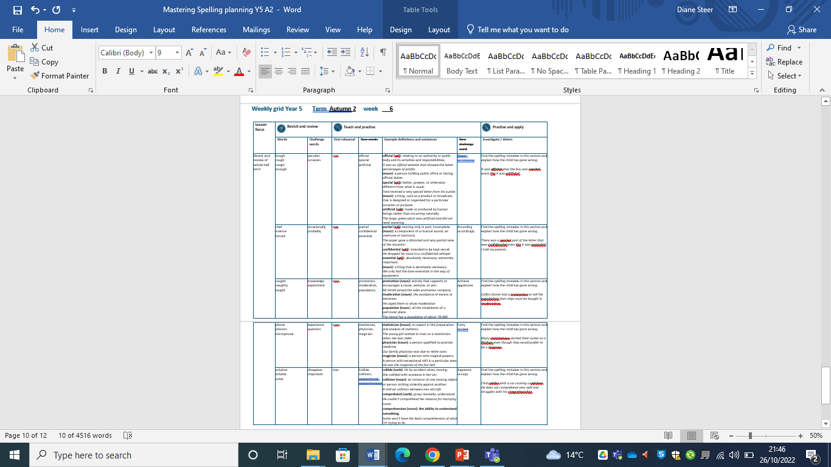
Notes:
Plan

Slide 4
Revisit and Review of A2 Week 1

Slide 5
Do you remember this challenge word?

Slide 6
peculiar

Slide 7
peculiar adjective
Definition - different to what is normal or expected; strange.

Slide 8
Do you remember this challenge word?

Slide 9
occasion

Slide 10
occasion noun
Definition – a particular event, or the time at which it takes place.

Slide 11
Do you remember this rule?

Slide 12
ough

Slide 13
ough ough is one of the trickiest spellings in
English as it can be used to spell a number of different sounds.

Slide 14
bough

Slide 15
bough

Slide 16

bough
‘ow’ sound

Slide 17
rough

Slide 18
rough

Slide 19
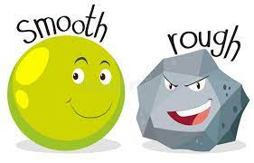
rough
‘uff’ sound

Slide 20
cough

Slide 21
cough

Slide 22
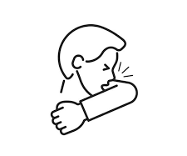
cough
‘off’ sound

Slide 23
enough

Slide 24
enough

Slide 25
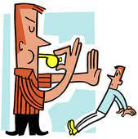
enough
‘uff’ sound

Slide 26
Words with ending sound /shuhl/ after a vowel letter
-cial

Slide 27
-cial

Slide 28
official

Slide 29
official

Slide 30
special

Slide 31
special

Slide 32
artificial

Slide 33
artificial

Slide 34
official

Slide 35
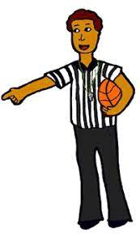
official offi + cial = official

Slide 36
official offi + cial = official noun definition -a person holding public office or having official duties, especially as a representative of an organisation or government department.

Slide 37

official offi + cial = official adjective definition - relating to an authority or public body and its activities and responsibilities.

Slide 38
official
It was an official website that showed the latest percentages of profits.

Slide 39
official
It was an -------- website that showed the latest percentages of profits.

Slide 40
official
It was an official website that showed the latest percentages of profits.

Slide 41
special

Slide 42

special spe + cial = special

Slide 43
special spe + cial = special adjective definition - better, greater, or otherwise different from what is usual.

Slide 44
special
Fred received a very special letter from his auntie.

Slide 45
special
Fred received a very ------- letter from his auntie.

Slide 46
special
Fred received a very special letter from his auntie.

Slide 47
artificial

Slide 48
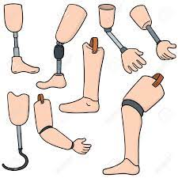
artificial artifi + cial = artificial

Slide 49
artificial artifi + cial = artificial adjective
Definition - made or produced by human beings rather than occurring naturally, especially as a copy of something natural.

Slide 50
artificial
The large, green plant was artificial and did not need watering.

Slide 51
artificial
The large, green plant was
---------- and did not need watering.

Slide 52
artificial
The large, green plant was artificial and did not need watering.

Slide 53
CHALLENGE words.

Slide 54
occur

Slide 55
occur
For the event to occur, the rain had to stop.

Slide 56

occur
For the event to occur, the rain had to stop.

Slide 57
For the event to _____, the rain had to stop.

Slide 58
For the event to occur, the rain had to stop.

Slide 59
accompany

Slide 60
accompany
Ishmael had to accompany his dad to work.

Slide 61
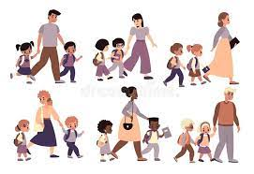
accompany
Ishmael had to accompany his dad to work.

Slide 62
Ishmael had to _________ his dad to work.

Slide 63
Ishmael had to accompany his dad to work.

Slide 64
Let’s investigate and detect …

Slide 65
Look at this sentence.
Change the spellings that are incorrect.
Explain how each one is wrong and how to remember to get it right next time.
It was offishal that the boy was speshal even tho it was artifishal.

Slide 66
It was offishal that the boy was speshal even tho it was artifishal. official – -cial not -shal

Slide 67
It was offishal that the boy was speshal even tho it was artifishal. special – -cial not -shal

Slide 68
It was offishal that the boy was speshal even tho it was artifishal. though– -ugh not just o on the end

Slide 69
It was offishal that the boy was speshal even tho it was artifishal. artificial– -cial not -shal

Slide 70
It was official that the boy was special even thoough it was artificial.

Slide 71
Year 5 - Autumn 2
Week 6 - Tuesday
Notes:
Revisit and review the words and challenge words – I say, we say, you say
Ask children to write words only in their spelling book
Introduce the new spelling rule
Children to write the new spelling rule words and challenge words into books when the sentences are shown with the spelling word missing.
Read the extract with the class as choral reading. Practise model of prosody etc.
Ask children to find the spelling words from the session in the text.
Then read allowed the chosen sentence for children to write fully in their books.
Show the extract and ask children to then edit their work to check they were correct in their dictation.

Slide 72
Notes:
Plan

Slide 73
Revisit and Review of A2 Week 2

Slide 74
Do you remember this challenge word?

Slide 75
occasionally adverb
Definition - at infrequent or irregular intervals; now and then.

Slide 76
Do you remember this challenge word?

Slide 77
probably

Slide 78
probably adverb
Definition – almost certainly; as far as one knows or can tell.

Slide 79
Do you remember this rule?

Slide 80
Soft c

Slide 81
soft c
Words with the /ʃ/ sound spelt ch
(mostly French in origin) or with the /s/ sound spelt sc (Latin in origin)

Slide 82
chef

Slide 83
chef

Slide 84

chef

Slide 85
science

Slide 86
science

Slide 87

science

Slide 88
forced

Slide 89
forced

Slide 90

forced

Slide 91
Words with ending sound /shuhl/ after a consonant letter
-tial

Slide 92
-tial

Slide 93
partial

Slide 94
partial

Slide 95
confidential

Slide 96
confidential

Slide 97
essential

Slide 98
essential

Slide 99
partial

Slide 100

partial par + tial = partial

Slide 101
partial par + tial = partial adjective
Definition - existing only in part; incomplete.

Slide 102
partial
The paper gave a distorted and very partial view of the situation.

Slide 103
partial
The paper gave a distorted and very ------- view of the situation.

Slide 104
partial
The paper gave a distorted and very partial view of the situation.

Slide 105
confidential

Slide 106

confidential confiden + tial = confidential

Slide 107
confidential confiden + tial = confidential adjective definition - intended to be kept secret.

Slide 108
confidential
He dropped his voice to a confidential whisper.

Slide 109
confidential
He dropped his voice to a
------------ whisper.

Slide 110
confidential
He dropped his voice to a confidential whisper.

Slide 111
essential

Slide 112
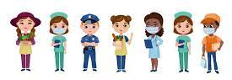
essential essen + tial = essential

Slide 113
essential essen + tial = essential adjective
Definition - absolutely necessary; extremely important.

Slide 114
essential
We only had the bare essentials in the way of equipment.

Slide 115
essential
We only had the bare ---------- in the way of equipment.

Slide 116
essential
We only had the bare essentials in the way of equipment.

Slide 117
CHALLENGE words.

Slide 118
according

Slide 119
according
According to the weather report, there will be sunshine today.

Slide 120

according
According to the weather report, there will be sunshine today.

Slide 121
_________ to the weather report, there will be sunshine today.

Slide 122
According to the weather report, there will be sunshine today.

Slide 123
accordingly

Slide 124
accordingly
If there is rain, then I dress accordingly.

Slide 125
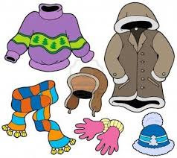
accordingly
If there is rain, then I dress accordingly.

Slide 126
If there is rain, then I dress accordingly.

Slide 127
If there is rain, then I dress ___________.

Slide 128
If there is rain, then I dress accordingly.

Slide 129
Let’s investigate and detect …

Slide 130
Look at this sentence.
Change the spellings that are incorrect.
Explain how each one is wrong and how to remember to get it right next time.
There was a parshal part of the letter that was confidenshal even tho it was essenshal I told my parents.

Slide 131
There was a parshal part of the letter that was confidenshal even tho it was essenshal I told my parents. partial – -tial not -shal

Slide 132
There was a parshal part of the letter that was confidenshal even tho it was essenshal I told my parents. confidential – -tial not -shal

Slide 133
There was a parshal part of the letter that was confidenshal even tho it was essenshal I told my parents. though – -ough not -o

Slide 134
There was a parshal part of the letter that was confidenshal even tho it was essenshal I told my parents. essential – -tial not -shal

Slide 135
There was a partial part of the letter that was confidential even though it was essential I told my parents.

Slide 136
Year 5 - Autumn 2
Week 6 - Wednesday
Notes:
Revisit and review the words and challenge words – I say, we say, you say
Ask children to write words only in their spelling book
Introduce the new spelling rule
Children to write the new spelling rule words and challenge words into books when the sentences are shown with the spelling word missing.
Read the extract with the class as choral reading. Practise model of prosody etc.
Ask children to find the spelling words from the session in the text.
Then read allowed the chosen sentence for children to write fully in their books.
Show the extract and ask children to then edit their work to check they were correct in their dictation.

Slide 137
Notes:
Plan

Slide 138
Revisit and Review of A2 Week 3

Slide 139
Do you remember this challenge word?

Slide 140
knowledge

Slide 141
knowledge noun
Definition - facts, information, and skills acquired through experience or education; the theoretical or practical understanding of a subject.

Slide 142
Do you remember this challenge word?

Slide 143
experiment

Slide 144
experiment noun
Definition - a scientific procedure undertaken to make a discovery, test a hypothesis, or demonstrate a known fact.

Slide 145
Do you remember this rule?

Slide 146
Letter strings – augh and au

Slide 147
letter string - augh
The grapheme 'augh' is a very rare spelling variation of the /or/ (or /aw/) phoneme. Words such as 'taught', 'caught' and 'daughter', however, are used very commonly.

Slide 148
caught

Slide 149
caught

Slide 150
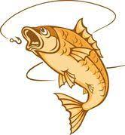
caught

Slide 151
naughty

Slide 152
naughty

Slide 153

naughty

Slide 154
taught

Slide 155
taught

Slide 156

taught

Slide 157
Words with ending sound /ʃən/ –tion is the most common spelling.
It is used if the root word ends in t or te.

Slide 158
-tion

Slide 159
promotion

Slide 160
promotion

Slide 161
moderation

Slide 162
moderation

Slide 163
population

Slide 164
population

Slide 165
promotion

Slide 166
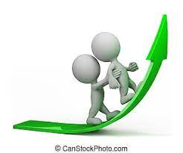
promotion promo(te) + tion = promotion

Slide 167
promotion promo(te) + tion = promotion noun
Definition - activity that supports or encourages a cause, venture, or aim.

Slide 168
promotion
Mr Smith joined the sales promotion company.

Slide 169
Mr Smith joined the sales
--------- company.

Slide 170
promotion
Mr Smith joined the sales promotion company.

Slide 171
moderation

Slide 172
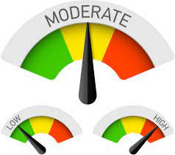
moderation modera(te) + tion = moderation

Slide 173
moderation modera(te) + tion = moderation noun
Definition - the avoidance of excess or extremes, especially in one's behaviour or political opinions.

Slide 174
moderation
He urged them to show moderation.

Slide 175
He urged them to show ----------

Slide 176
moderation
He urged them to show moderation.

Slide 177
population

Slide 178

population popula(te) + tion = population

Slide 179
population popula(te) + tion = population noun
Definition - all the inhabitants of a particular place.

Slide 180
population
The island has a population of about 78,000.

Slide 181
The island has a ---------- of about 78,000.

Slide 182
population
The island has a population of about 78,000.

Slide 183
CHALLENGE words.

Slide 184
achieve

Slide 185
achieve
If you believe in yourself, you can achieve anything.

Slide 186

achieve
If you believe in yourself, you can achieve anything.

Slide 187
If you believe in yourself, you can _______ anything.

Slide 188
If you believe in yourself, you can achieve anything.

Slide 189
aggressive

Slide 190
aggressive
Some animals, when provoked, can become aggressive.

Slide 191
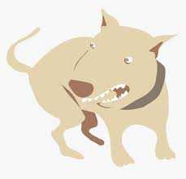
aggressive
Some animals, when provoked, can become aggressive.

Slide 192
Some animals, when provoked, can become aggressive.

Slide 193
Some animals, when provoked, can become __________.

Slide 194
Some animals, when provoked, can become aggressive.

Slide 195
Let’s investigate and detect …

Slide 196
Look at this sentence.
Change the spellings that are incorrect.
Explain how each one is wrong and how to remember to get it right next time.
Collins Stores had a promoshon to tell the populashon that chips must be bought in moderashon.

Slide 197
Collins Stores had a promoshon to tell the populashon that chips must be bought in moderashon. promotion – -tion not -shon

Slide 198
Collins Stores had a promoshon to tell the populashon that chips must be bought in moderashon. population – -tion not -shon

Slide 199
Collins Stores had a promoshon to tell the populashon that chips must be bought in moderashon. moderation – -tion not -shon

Slide 200
Collins Stores had a promotion to tell the population that chips must be bought in moderation.

Slide 201
Year 5 - Autumn 2
Week 6 - Thursday
Notes:
Revisit and review the words and challenge words – I say, we say, you say
Ask children to write words only in their spelling book
Introduce the new spelling rule
Children to write the new spelling rule words and challenge words into books when the sentences are shown with the spelling word missing.
Read the extract with the class as choral reading. Practise model of prosody etc.
Ask children to find the spelling words from the session in the text.
Then read allowed the chosen sentence for children to write fully in their books.
Show the extract and ask children to then edit their work to check they were correct in their dictation.

Slide 202
Notes:
Plan

Slide 203
Revisit and Review of A2 Week 4

Slide 204
Do you remember this challenge word?

Slide 205
experience

Slide 206
experience noun
Definition - practical contact with and observation of facts or events.

Slide 207
Do you remember this challenge word?

Slide 208
question

Slide 209
question noun
Definition - a sentence worded or expressed so as to elicit information.

Slide 210
Do you remember this rule?

Slide 211
Word families – phone and real

Slide 212

word family - phone

Slide 213
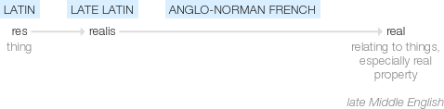
word family - real

Slide 214
phone

Slide 215
phone

Slide 216

phone

Slide 217
phonics

Slide 218
phonics

Slide 219

phonics

Slide 220
microphone

Slide 221
microphone

Slide 222

microphone

Slide 223
Words with ending sound /ʃən/ –tian and -cian
-tian mean a place or origin
-cian mean occupation / job

Slide 224
-cian

Slide 225
statistician

Slide 226
statistician

Slide 227
physician

Slide 228
physician

Slide 229
magician

Slide 230
magician

Slide 231
statistician

Slide 232
statistician

Slide 233
statistician

Slide 234
physician

Slide 235
physician

Slide 236
magician

Slide 237
magician

Slide 238
statistician

Slide 239
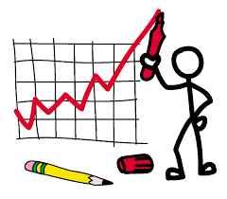
statistician

Slide 240
statistician noun
Definition - an expert in the preparation and analysis of statistics.

Slide 241
statistician
The young girl wished to train as a statistician when she was older.

Slide 242
The young girl wished to train as a ------------ when she was older.

Slide 243
statistician
The young girl wished to train as a statistician when she was older.

Slide 244
physician

Slide 245

physician

Slide 246
physician noun
Definition - a person qualified to practise medicine, especially one who specializes in diagnosis and medical treatment as distinct from surgery.

Slide 247
physician
Our family physician was due to retire soon.

Slide 248
Our family --------- was due to retire soon.

Slide 249
physician
Our family physician was due to retire soon.

Slide 250
magician

Slide 251
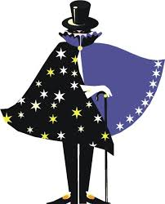
magician

Slide 252
magician noun
Definition - a person with magical powers.

Slide 253
magician
He was the magician of the fan belt.

Slide 254
He was the -------- of the fan belt.

Slide 255
magician
He was the magician of the fan belt.

Slide 256
CHALLENGE words.

Slide 257
forty

Slide 258
forty
The number forty has significant meaning in the bible.

Slide 259

forty
The number forty has significant meaning in the bible.

Slide 260
The number forty has significant meaning in the bible.

Slide 261
The number _____ has significant meaning in the bible.

Slide 262
The number forty has significant meaning in the bible.

Slide 263
ancient

Slide 264
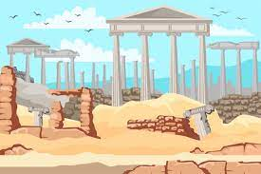
ancient
Some trees are said to be ancient and are needing protection.

Slide 265
Some trees are said to be ancient and are needing protection.

Slide 266
Some trees are said to be _______ and are needing protection.

Slide 267
Some trees are said to be ancient and are needing protection.

Slide 268
Let’s investigate and detect …

Slide 269
Look at this sentence.
Change the spellings that are incorrect.
Explain how each one is wrong and how to remember to get it right next time.
Many statistishons started their career as a fisishon even though they would prefer to be a magison.

Slide 270
Many statistishons started their career as a fisishon even though they would prefer to be a magison. statistician – -cian not -shon

Slide 271
Many statistishons started their career as a fisishon even though they would prefer to be a magison. physician – -phy not –fi
-cian not -shon

Slide 272
Many statistishons started their career as a fisishon even though they would prefer to be a magison. magician – -cian not -son

Slide 273
Many statisticians started their career as a physician even though they would prefer to be a magician.

Slide 274
Year 5 - Autumn 2
Week 6 - Friday
Notes:
Revisit and review the words and challenge words – I say, we say, you say
Ask children to write words only in their spelling book
Introduce the new spelling rule
Children to write the new spelling rule words and challenge words into books when the sentences are shown with the spelling word missing.
Read the extract with the class as choral reading. Practise model of prosody etc.
Ask children to find the spelling words from the session in the text.
Then read allowed the chosen sentence for children to write fully in their books.
Show the extract and ask children to then edit their work to check they were correct in their dictation.

Slide 275
Notes:
Plan

Slide 276
Revisit and Review of A2 Week 5

Slide 277
Do you remember this challenge word?

Slide 278
disappear

Slide 279
disappear verb
Definition - cease to be visible.

Slide 280
Do you remember this challenge word?

Slide 281
important

Slide 282
important adjective
Definition - of great significance or value.

Slide 283
Do you remember this rule?

Slide 284
Word families – solve and sign

Slide 285

word family - solve

Slide 286

word family - sign

Slide 287
solve

Slide 288
solve

Slide 289
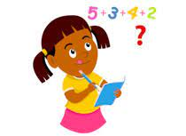
solve

Slide 290
soluble

Slide 291
soluble

Slide 292
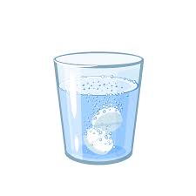
soluble

Slide 293
solution

Slide 294
solution

Slide 295

solution

Slide 296
Words with ending sound /ʃən/
–sion
–sion is used if the root word ends in d or se.
Exceptions: attend – attention, intend – intention

Slide 297
-sion

Slide 298
collide

Slide 299
collide

Slide 300
collision

Slide 301
collision

Slide 302
comprehend

Slide 303
comprehend

Slide 304
comprehension

Slide 305
comprehension

Slide 306
collide -> collision

Slide 307
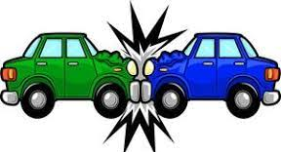
collide -> collision

Slide 308
collide -> collision verb -> noun

Slide 309
collide -> collision verb -> noun collision - noun
Definition - an instance of one moving object or person striking violently against another.

Slide 310
collision
A mid-air collision between two aircraft.

Slide 311
A mid-air --------- between two aircraft.

Slide 312
collision
A mid-air collision between two aircraft.

Slide 313
comprehend -> comprehension

Slide 314
comprehend -> comprehension

Slide 315
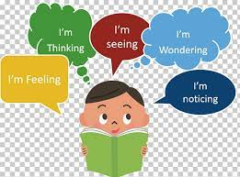
comprehend -> comprehension verb -> noun

Slide 316
comprehend -> comprehension verb -> noun comprehension – noun
Definition - the ability to understand something.

Slide 317
comprehension
Some won't have the least comprehension of what I'm trying to do.

Slide 318
Some won't have the least
------------- of what I'm trying to do.

Slide 319
comprehension
Some won't have the least comprehension of what I'm trying to do.

Slide 320
CHALLENGE words.

Slide 321
apparent

Slide 322

apparent
The solution was apparent to all except the teacher.

Slide 323
The solution was apparent to all except the teacher.

Slide 324
The solution was ________ to all except the teacher.

Slide 325
The solution was apparent to all except the teacher.

Slide 326
occupy

Slide 327
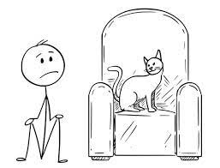
occupy
To occupy the top office in the country is to be Prime Minister.

Slide 328
To occupy the top office in the country is to be Prime Minister.

Slide 329
To ______ the top office in the country is to be Prime Minister.

Slide 330
To occupy the top office in the country is to be Prime Minister.

Slide 331
Let’s investigate and detect …

Slide 332
Look at this sentence.
Change the spellings that are incorrect.
Explain how each one is wrong and how to remember to get it right next time.
Fred colides with a car causing a colishon. He does not comprehend very well and struggles with his comprehenshon.

Slide 333
Fred colides with a car causing a colishon. He does not comprehend very well and struggles with his comprehenshon. collides– -ll not -l

Slide 334
Fred colides with a car causing a colishon. He does not comprehend very well and struggles with his comprehenshon. collision– -ll not –l
-sion not -shon

Slide 335
Fred colides with a car causing a colishon. He does not comprehend very well and struggles with his comprehenshon. comprehension– -sion not -shon

Slide 336
Fred collides with a car causing a collision. He does not comprehend very well and struggles with his comprehension.

