Slide 1
Spelling Y4
Mastering spellings: building of the foundations of phonics
Autumn 1
Week 1
(Duplicate of Year 3 summer 2 week 1)

Slide 2
Year 4 - Autumn 1
Week 2- Monday
Notes:
Revisit and review the words from Y3 with the prefix sure and ture and challenge words – I say, we say, you say
Ask children to write words only in their spelling book
Introduce the new spelling rule of Words with a short /u/ sound spelt with ‘ou’
Children to write the new spelling rule words and challenge words into books when the sentences are shown with the spelling word missing.
Read the extract with the class as choral reading. Practise model of prosody etc.
Ask children to find the spelling words from the session in the text.
Then read allowed the chosen sentence for children to write fully in their books.
Show the extract and ask children to then edit their work to check they were correct in their dictation.

Slide 3
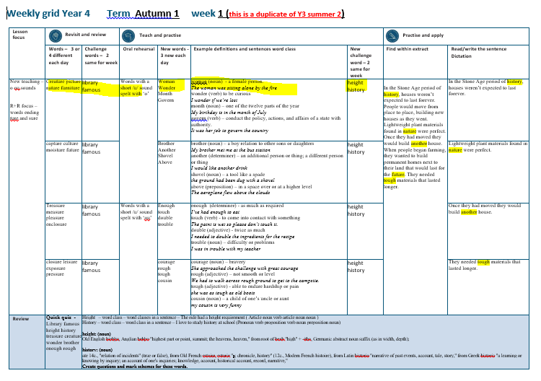

Slide 4
Let’s Revisit and Review…

Slide 5
Do you remember this challenge word?

Slide 6

library
NOUN
Definition – a building or room containing a collection of books

Slide 7
We visited the local library to pick up some new books.
_______

Slide 8

famous
ADJECTIVE
Definition – known about by a great number of people

Slide 9
It was her dream to become a famous athlete
______

Slide 10
The suffix
-ture

Slide 11
ture

Slide 12
creature

Slide 13
picture

Slide 14
nature

Slide 15
furniture

Slide 16
Let’s Teach and Practise

Slide 17
Words with a short /u/ sound spelt with ‘o’

Slide 18

woman

Slide 19

wonder

Slide 20
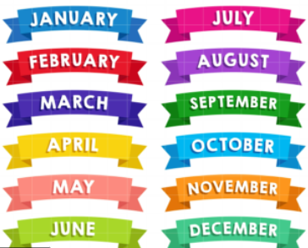
month

Slide 21

govern

Slide 22
Definition - a female person
woman
(noun)

Slide 23
Definition - to be curious
wonder
(verb)

Slide 24
Definition - one of the twelve parts of the year
month
(noun)

Slide 25
Definition - conduct the policy, actions, and affairs of a state with authority
govern
(verb)

Slide 26
The woman was sitting alone by the fire.
_____

Slide 27
I wonder if we’re lost.
______

Slide 28
My birthday is in the month of July.
_____

Slide 29
It was her job to govern the country.
______

Slide 30
New CHALLENGE words.

Slide 31

height
NOUN
Definition - the measurement of someone or something from head to foot or from base to top

Slide 32
The ride had a height requirement
______

Slide 33
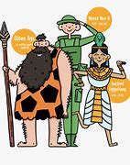
history
NOUN
Definition - the study of past events, particularly in human affairs

Slide 34
I love to study history at school.
_______

Slide 35
Let’s Practise and Apply.

Slide 36
Can you spot the spelling rule words and the challenge words?

Slide 37
In the Stone Age period of history, houses weren’t expected to last forever. People would move from place to place, building new houses as they went. Lightweight plant materials found in nature were perfect. Once they had moved they would build another house. When people began farming, they wanted to build permanent homes next to their land that would last for the future. They needed tough materials that lasted longer.

Slide 38
In the Stone Age period of history, houses weren’t expected to last forever. People would move from place to place, building new houses as they went. Lightweight plant materials found in nature were perfect. Once they had moved they would build another house. When people began farming, they wanted to build permanent homes next to their land that would last for the future. They needed tough materials that lasted longer.

Slide 39
Write this sentence as I dictate it to you.
Notes:
In the Stone Age period of history, houses weren’t expected to last forever.

Slide 40
In the Stone Age period of history, houses weren’t expected to last forever.
Did you write it correctly?
Edit your work and make sure you have it correct.
Can you underline the spelling words that we have covered in this session?

Slide 41
Year 4 - Autumn 1
Week 1 - Tuesday

Slide 42
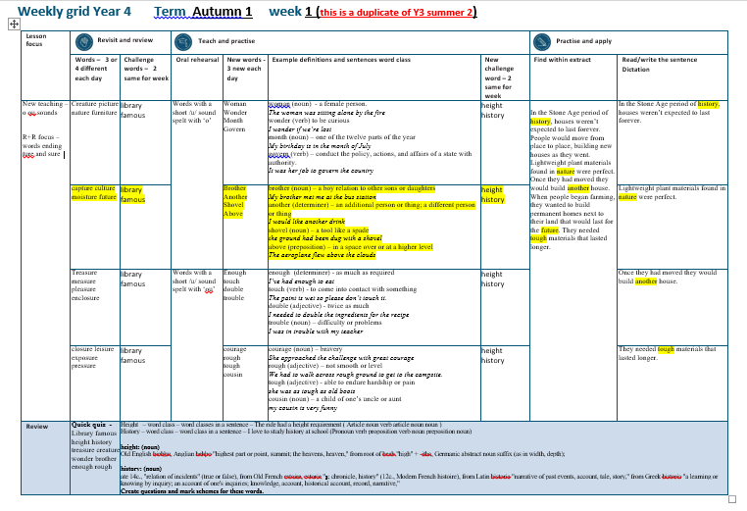

Slide 43
Let’s Revisit and Review…

Slide 44
Do you remember this challenge word?

Slide 45
library
NOUN
Definition – a building or room containing a collection of books

Slide 46
We visited the local library to pick up some new books.
_______

Slide 47
famous
ADJECTIVE
Definition – known about by a great number of people

Slide 48
It was her dream to become a famous athlete
______

Slide 49
The suffix
-ture

Slide 50
ture

Slide 51
capture

Slide 52
culture

Slide 53
future

Slide 54
moisture

Slide 55
Let’s Teach and Practise

Slide 56
Words with a short /u/ sound spelt with ‘o’

Slide 57
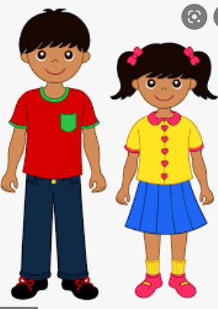
brother

Slide 58
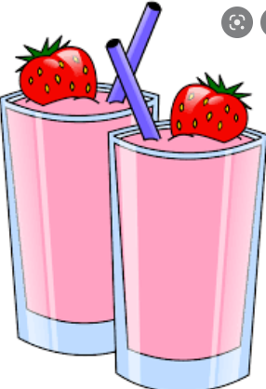
another

Slide 59

shovel

Slide 60

above

Slide 61
Definition - a boy relation to other sons or daughters
brother
(noun)

Slide 62
Definition - an additional person or thing
another
(determiner)

Slide 63
Definition – a tool like a spade
shovel
(noun)

Slide 64
Definition – in extended space over and not touching
above
(preposition)

Slide 65
My brother met me at the bus station.
_______

Slide 66
I would like another drink.
_______

Slide 67
The ground had been dug with a shovel.
______

Slide 68
The aeroplane flew above the clouds.
_____

Slide 69
New CHALLENGE words.

Slide 70
height
NOUN
Definition - the measurement of someone or something from head to foot or from base to top

Slide 71
The ride had a height requirement
______

Slide 72
history
NOUN
Definition - the study of past events, particularly in human affairs

Slide 73
I love to study history at school.
_______

Slide 74
Let’s Practise and Apply.

Slide 75
Can you spot the spelling rule words and the challenge words?

Slide 76
In the Stone Age period of history, houses weren’t expected to last forever. People would move from place to place, building new houses as they went. Lightweight plant materials found in nature were perfect. Once they had moved they would build another house. When people began farming, they wanted to build permanent homes next to their land that would last for the future. They needed tough materials that lasted longer.

Slide 77
In the Stone Age period of history, houses weren’t expected to last forever. People would move from place to place, building new houses as they went. Lightweight plant materials found in nature were perfect. Once they had moved they would build another house. When people began farming, they wanted to build permanent homes next to their land that would last for the future. They needed tough materials that lasted longer.

Slide 78
Write this sentence as I dictate it to you.
Notes:
Once they had moved they would build another house.

Slide 79
Once they had moved they would build another house.
Did you write it correctly?
Edit your work and make sure you have it correct.
Can you underline the spelling words that we have covered in this session?

Slide 80
Year 4 - Autumn 1
Week 1 - Wednesday
Notes:
Revisit and review the words from Y3 with the prefix sure and ture and challenge words – I say, we say, you say
Ask children to write words only in their spelling book
Introduce the new spelling rule of Words with a short /u/ sound spelt with ‘ou’
Children to write the new spelling rule words and challenge words into books when the sentences are shown with the spelling word missing.
Read the extract with the class as choral reading. Practise model of prosody etc.
Ask children to find the spelling words from the session in the text.
Then read allowed the chosen sentence for children to write fully in their books.
Show the extract and ask children to then edit their work to check they were correct in their dictation.

Slide 81
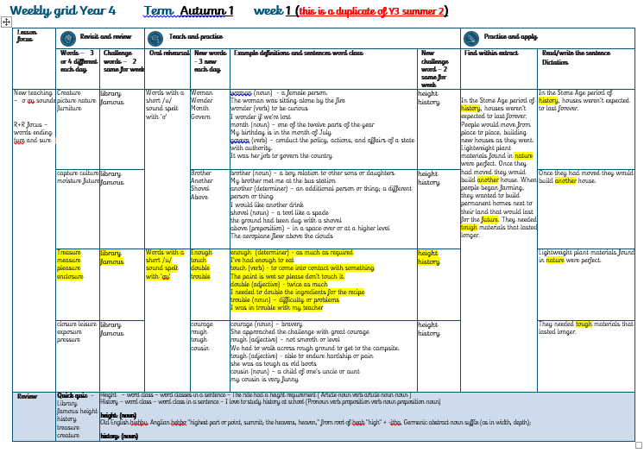

Slide 82
Let’s Revisit and Review…

Slide 83
Do you remember this challenge word?

Slide 84
library
NOUN
Definition – a building or room containing a collection of books

Slide 85
We visited the local library to pick up some new books.
_______

Slide 86
famous
ADJECTIVE
Definition – known about by a great number of people

Slide 87
It was her dream to become a famous athlete
______

Slide 88
The suffix
-sure

Slide 89
sure

Slide 90
pleasure

Slide 91
treasure

Slide 92
measure

Slide 93
enclosure

Slide 94
Let’s Teach and Practise

Slide 95
Words with a short /u/ sound spelt with ‘o’

Slide 96
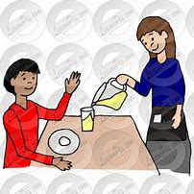
enough

Slide 97

touch

Slide 98

double

Slide 99

trouble

Slide 100
Definition – as much as required
enough
(preposition)

Slide 101
Definition - a come into contact with something
touch
(verb)

Slide 102
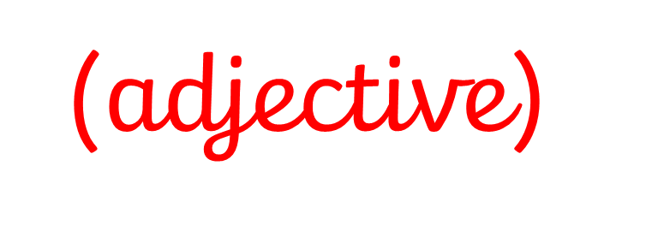
Definition – twice as much
double

Slide 103
Definition – difficulty or problems
trouble
(noun)

Slide 104
I’ve had enough to eat.
______

Slide 105
The paint is wet so please don’t touch it.
_____

Slide 106
You need to double the ingredients for the recipe.
______

Slide 107
I was in trouble with my teacher.
_______

Slide 108
New CHALLENGE words.

Slide 109
height
NOUN
Definition - the measurement of someone or something from head to foot or from base to top

Slide 110
The ride had a height requirement
______

Slide 111
history
NOUN
Definition - the study of past events, particularly in human affairs

Slide 112
I love to study history at school.
_______

Slide 113
Let’s Practise and Apply.

Slide 114
Can you spot the spelling rule words and the challenge words?

Slide 115
In the Stone Age period of history, houses weren’t expected to last forever. People would move from place to place, building new houses as they went. Lightweight plant materials found in nature were perfect. Once they had moved they would build another house. When people began farming, they wanted to build permanent homes next to their land that would last for the future. They needed tough materials that lasted longer.

Slide 116
In the Stone Age period of history, houses weren’t expected to last forever. People would move from place to place, building new houses as they went. Lightweight plant materials found in nature were perfect. Once they had moved they would build another house. When people began farming, they wanted to build permanent homes next to their land that would last for the future. They needed tough materials that lasted longer.

Slide 117
Write this sentence as I dictate it to you.
Notes:
Lightweight plant materials found in nature were perfect.

Slide 118
Lightweight plant materials found in nature were perfect.
Did you write it correctly?
Edit your work and make sure you have it correct.
Can you underline the spelling words that we have covered in this session?

Slide 119
Year 4 - Autumn 1
Week 1 - Thursday
Notes:
Revisit and review the words from Y3 with the prefix sure and ture and challenge words – I say, we say, you say
Ask children to write words only in their spelling book
Introduce the new spelling rule of Words with a short /u/ sound spelt with ‘ou’
Children to write the new spelling rule words and challenge words into books when the sentences are shown with the spelling word missing.
Read the extract with the class as choral reading. Practise model of prosody etc.
Ask children to find the spelling words from the session in the text.
Then read allowed the chosen sentence for children to write fully in their books.
Show the extract and ask children to then edit their work to check they were correct in their dictation.

Slide 120
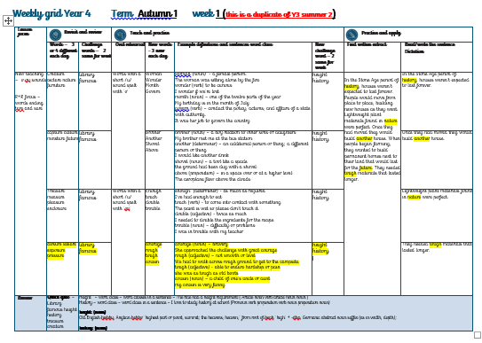
Thursday- Autumn Term Week 1

Slide 121
Let’s Revisit and Review…

Slide 122
Do you remember this challenge word?

Slide 123
library
NOUN
Definition – a building or room containing a collection of books

Slide 124
We visited the local library to pick up some new books.
_______

Slide 125
famous
ADJECTIVE
Definition – known about by a great number of people

Slide 126
It was her dream to become a famous athlete
______

Slide 127
The suffix
-sure

Slide 128
sure

Slide 129
closure

Slide 130
leisure

Slide 131
exposure

Slide 132
pressure

Slide 133
Let’s Teach and Practise

Slide 134
Words with a short /u/ sound spelt with ‘o’

Slide 135

courage

Slide 136
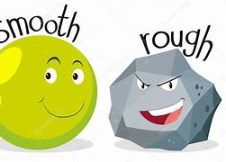
rough

Slide 137
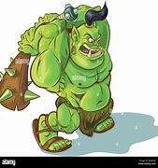
tough

Slide 138
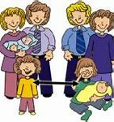
cousin

Slide 139
Definition - bravery
courage
(noun)

Slide 140
Definition - not smooth or level
rough
(adjective)

Slide 141
Definition - able to endure hardship or pain
tough
(adjective)

Slide 142
Definition - a child of one’s aunt or uncle
cousin
(noun)

Slide 143
She approached the challenge with great courage.
________

Slide 144
We had to walk across rough ground to get to the campsite.
_____

Slide 145
We she was as tough as old boots.
_____

Slide 146
My cousin is very funny.
______

Slide 147
New CHALLENGE words.

Slide 148
height
NOUN
Definition - the measurement of someone or something from head to foot or from base to top

Slide 149
The ride had a height requirement
______

Slide 150
history
NOUN
Definition - the study of past events, particularly in human affairs

Slide 151
I love to study history at school.
_______

Slide 152
Let’s Practise and Apply.

Slide 153
Can you spot the spelling rule words and the challenge words?

Slide 154
In the Stone Age period of history, houses weren’t expected to last forever. People would move from place to place, building new houses as they went. Lightweight plant materials found in nature were perfect. Once they had moved they would build another house. When people began farming, they wanted to build permanent homes next to their land that would last for the future. They needed tough materials that lasted longer.

Slide 155
In the Stone Age period of history, houses weren’t expected to last forever. People would move from place to place, building new houses as they went. Lightweight plant materials found in nature were perfect. Once they had moved they would build another house. When people began farming, they wanted to build permanent homes next to their land that would last for the future. They needed tough materials that lasted longer.

Slide 156
Write this sentence as I dictate it to you.
Notes:
They needed tough materials that lasted longer.

Slide 157
They needed tough materials that lasted longer.
Did you write it correctly?
Edit your work and make sure you have it correct.
Can you underline the spelling words that we have covered in this session?

Slide 158
Year 4 - Autumn 1
Week 1 - Friday
Notes:
Click through the slides for all the R+R words for the week (both the focus and the challenge words)
Click through the slides for all the new learning this week

Slide 159
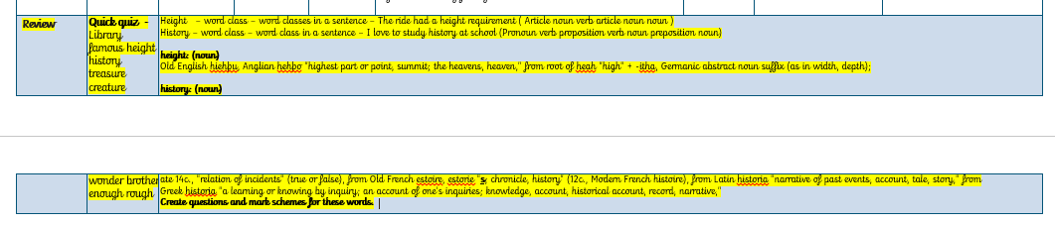

Slide 160
Old challenge words…

Slide 161
library

Slide 162
famous

Slide 163
Old spelling rule words…

Slide 164
creature

Slide 165
picture

Slide 166
nature

Slide 167
furniture

Slide 168
capture

Slide 169
culture

Slide 170
future

Slide 171
moisture

Slide 172
pleasure

Slide 173
treasure

Slide 174
measure

Slide 175
enclosure

Slide 176
closure

Slide 177
leisure

Slide 178
exposure

Slide 179
pressure

Slide 180
New spelling rule words…

Slide 181
woman

Slide 182
wonder

Slide 183
month

Slide 184
govern

Slide 185
brother

Slide 186
another

Slide 187
shovel

Slide 188
above

Slide 189
enough

Slide 190
touch

Slide 191
double

Slide 192
trouble

Slide 193
courage

Slide 194
rough

Slide 195
tough

Slide 196
cousin

Slide 197
New challenge words…

Slide 198
height

Slide 199
history

Slide 200
Quick Quiz time…
Notes:
Say these words for the quiz:
Library famous height history treasure creature wonder brother enough rough

Slide 201
Did you get them correct?
Edit your work.
Library famous height history treasure creature wonder brother enough rough
Notes:
Say these words for the quiz
unhappy undress unable actual learn mishap mistreat misprint mislead mistrust

Slide 202
Word class time…

Slide 203
The ride had a height requirement.
Notes:
Ask for these words to be classed

Slide 204
The ride had a height requirement.
Determiner noun verb determiner noun noun
Notes:
Ask for these words to be classed

Slide 205
The ride had a height requirement.
Determiner noun verb determiner noun noun
Notes:
Ask for these words to be classed

Slide 206
I love to study history at school
Notes:
Ask for these words to be classed

Slide 207
I love to study history at school
Pronoun verb preposition verb noun preposition noun

Slide 208
I love to study history at school
Pronoun verb proposition verb noun proposition noun

Slide 209
Etymology
The history of a word….

Slide 210
height: (noun)
Old English hiehþu, Anglian hehþo "highest part or point, summit; the heavens, heaven,"
from root of heah "high" + -itha, Germanic abstract noun suffix (as in width, depth);

Slide 211
history: (noun)
ate 14c., "relation of incidents" (true or false), from Old French estoire, estorie "s; chronicle, history" (12c., Modern French histoire),
from Latin historia "narrative of past events, account, tale, story,"
from Greek historia "a learning or knowing by inquiry; an account of one's inquiries; knowledge, account, historical account, record, narrative,"

Slide 212
Let’s investigate….
Can you find synonyms?
Can you create questions?

Slide 213
Synonyms of height…
High point
Peak
Elevation

Slide 214
Synonyms of history…
The past
Yesterday
Days of old

Slide 215
Investigate ways of creating questions for other children using the words height and history.
Think about a mark scheme to show if they are correct.

Slide 216
Example…
Some children have written down the word height and misspelled it.
Can you explain where these children have gone wrong with their spelling?
hieght
hiate
heitgh
heigt
heit

Slide 217
Example…
Some children have written down the word height and misspelled it.
Can you explain where these children have gone wrong with their spelling?
hieght - They have the ie the wrong way round.
hiate
heitgh
heigt - They have missed out the ‘h’ in ‘ght’
heit

