Slide 1
Spelling Y5
Mastering spellings: building on the foundations of phonics
Autumn 1
Week 2

Slide 2
Year 5 - Autumn 1
Week 2 - Monday

Slide 3
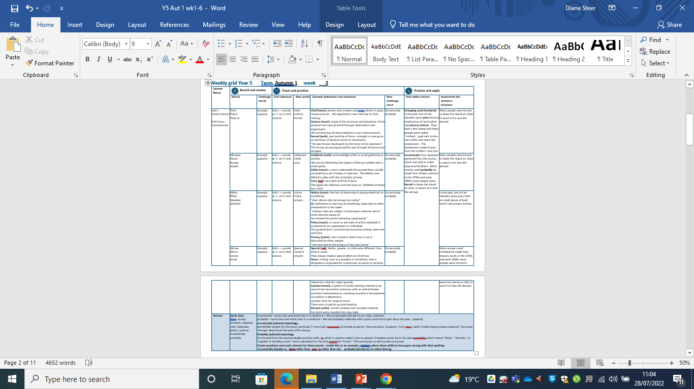

Slide 4
Let’s Revisit and Review…

Slide 5
Do you remember this challenge word?

Slide 6
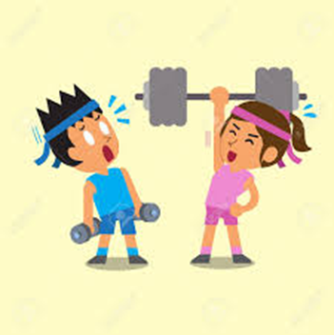
Definition - the quality or state of being physically strong.
strength
NOUN

Slide 7
The girl’s strength was incredible as she demonstrated moving the large table.
________

Slide 8
Do you remember this challenge word?

Slide 9

Definition – think or assume that something is true or probable but lack proof or certain knowledge
suppose
VERB

Slide 10
I suppose you are going to eat the last cup cake.
_______

Slide 11
Homophones

Slide 12
Homophone homo = same phone = sound
(from Ancient Greek)

Slide 13
Homophone a word that has the same sound but has a different meaning

Slide 14
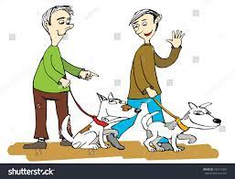
their

Slide 15
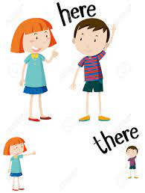
there

Slide 16
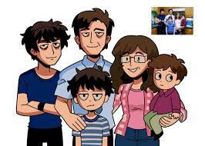
they’re
They’re altogether

Slide 17
Let’s Teach and Practise

Slide 18
Soft c

Slide 19
soft c – sh (as in chef) s (as in science)

Slide 20
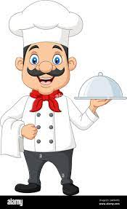
chef

Slide 21

science n

Slide 22
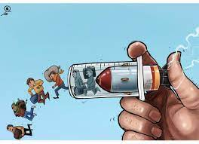
forced

Slide 23
Definition - a professional cook, typically the chief cook in a restaurant or hotel.
chef
ch + ef = chef
NOUN

Slide 24
Definition - study of the structure and behaviour of the physical and natural world through observation and experiment
science
sc + ience = science
ADJECTIVE

Slide 25
Definition - obtained or imposed by coercion or physical power / produced or maintained with effort; affected or unnatural.
forced
for + c + ed = forced
ADJECTIVE

Slide 26
Sally trained to be a chef at City College.
____

Slide 27
Science was Fran’s favourite subject in year six.
_______

Slide 28
There was no sign of a forced entry.
______

Slide 29
New CHALLENGE words.

Slide 30
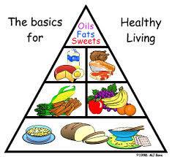
Definition - at infrequent or irregular intervals; now and then
occasionally
ADVERB

Slide 31
We eat chocolate occasionally at the weekend.
____________

Slide 32
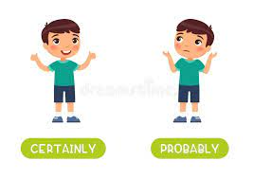
Definition - almost certainly; as far as one knows or can tell
probably
ADVERB

Slide 33
It will probably rain at the weekend as we are going camping!
_______

Slide 34
Let’s Practise and Apply.

Slide 35
Can you spot the spelling rule words and the challenge words?

Slide 36
Changing Land (Scotland)
In the past, lots of the islanders grew juicy food on small pieces of land which had privacy notices. They kept a few sheep and these people were called “crofters”, paid rent to the clan chiefs who were the landowners. The landowners made money from the crofters’ rent and occasionally from seaweed gathered from the shores, which was sold to make soap and fertilisers. More money could probably be made from sheep’s wool so in the 1700s and early 1800s many people were forced to leave the island on ships in search of a new life abroad.

Slide 37
Changing Land (Scotland)
In the past, lots of the islanders grew juicy food on small pieces of land which had privacy notices. They kept a few sheep and these people were called “crofters”, paid rent to the clan chiefs who were the landowners. The landowners made money from the crofters’ rent and occasionally from seaweed gathered from the shores, which was sold to make soap and fertilisers. More money could probably be made from sheep’s wool so in the 1700s and early 1800s many people were forced to leave the island on ships in search of a new life abroad.

Slide 38
Write this sentence as I dictate it to you.
Notes:
Many people were forced to leave the island on ships in search of a new life abroad.

Slide 39
Many people were forced to leave the island on ships in search of a new life abroad.
Did you write it correctly?
Edit your work and make sure you have it correct.
Can you underline the spelling word that we have covered in this session?

Slide 40
Year 5 - Autumn 1
Week 2 - Tuesday

Slide 42
Let’s Revisit and Review…

Slide 43
Do you remember this challenge word?

Slide 44
Definition - the quality or state of being physically strong.
strength
NOUN

Slide 45
The girl’s strength was incredible as she demonstrated moving the large table.
________

Slide 46
Do you remember this challenge word?

Slide 47
Definition – think or assume that something is true or probable but lack proof or certain knowledge
suppose
VERB

Slide 48
I suppose you are going to eat the last cup cake.
_______

Slide 49
Homophones

Slide 50
Homophone homo = same phone = sound
(from Ancient Greek)

Slide 51
Homophone a word that has the same sound but has a different meaning

Slide 52
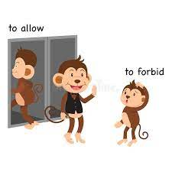
allowed

Slide 53

aloud

Slide 54

accept

Slide 55
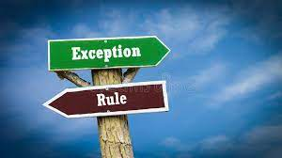
except

Slide 56
Let’s Teach and Practise

Slide 57
Soft c

Slide 58
soft c – sh (as in chef) s (as in science)

Slide 59

celebrate

Slide 60

cellar n

Slide 61
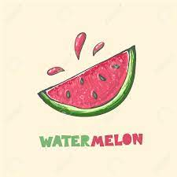
juicy

Slide 62
Definition – to acknowledge within a social gathering or activity.
celebrate
c + elebrate = celebrate
VERB

Slide 63
Definition – a room, underneath the ground floor in a house or building.
cellar
c + ellar = cellar
NOUN

Slide 64
Definition – succulent and full of juice.
juicy
jui + c + y = juicy
ADJECTIVE

Slide 65
We are all celebrating the Queen’s Platinum Jubilee with a street party.
___________

Slide 66
The elderly man filled his cellar with lots of bottles of wine.
______

Slide 67
The apple was delicious and very juicy so I dribbled all down my t-shirt.
_____

Slide 68
New CHALLENGE words.

Slide 69
Definition - at infrequent or irregular intervals; now and then
occasionally
ADVERB

Slide 70
We eat chocolate occasionally at the weekend.
____________

Slide 71
Definition - almost certainly; as far as one knows or can tell
probably
ADVERB

Slide 72
It will probably rain at the weekend as we are going camping!
_______

Slide 73
Let’s Practise and Apply.

Slide 74
Can you spot the spelling rule words and the challenge words?

Slide 75
Changing Land (Scotland)
In the past, lots of the islanders grew juicy food on small pieces of land which had privacy notices. They kept a few sheep and these people were called “crofters”, paid rent to the clan chiefs who were the landowners. The landowners made money from the crofters’ rent and occasionally from seaweed gathered from the shores, which was sold to make soap and fertilisers. More money could probably be made from sheep’s wool so in the 1700s and early 1800s many people were forced to leave the island on ships in search of a new life abroad.

Slide 76
Changing Land (Scotland)
In the past, lots of the islanders grew juicy food on small pieces of land which had privacy notices. They kept a few sheep and these people were called “crofters”, paid rent to the clan chiefs who were the landowners. The landowners made money from the crofters’ rent and occasionally from seaweed gathered from the shores, which was sold to make soap and fertilisers. More money could probably be made from sheep’s wool so in the 1700s and early 1800s many people were forced to leave the island on ships in search of a new life abroad.

Slide 77
Write this sentence as I dictate it to you.
Notes:
Many people were forced to leave the island on ships in search of a new life abroad.

Slide 78
Many people were forced to leave the island on ships in search of a new life abroad.
Did you write it correctly?
Edit your work and make sure you have it correct.
Can you underline the spelling word that we have covered in this session?

Slide 79
Year 5 - Autumn 1
Week 1 - Wednesday

Slide 80
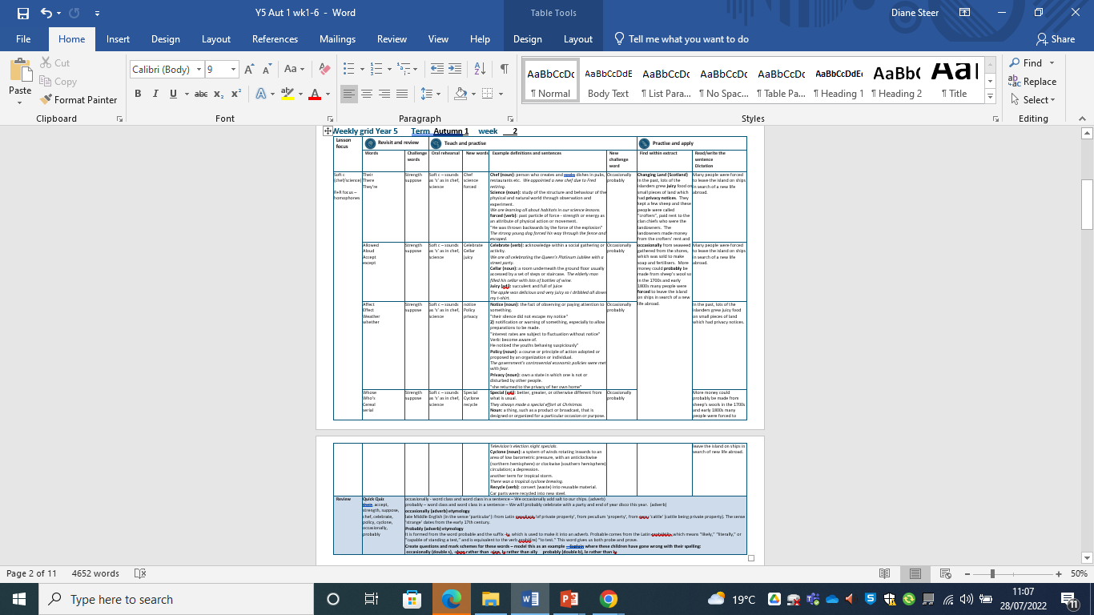

Slide 81
Let’s Revisit and Review…

Slide 82
Do you remember this challenge word?

Slide 83
Definition - the quality or state of being physically strong.
strength
NOUN

Slide 84
The girl’s strength was incredible as she demonstrated moving the large table.
________

Slide 85
Do you remember this challenge word?

Slide 86
Definition – think or assume that something is true or probable but lack proof or certain knowledge
suppose
VERB

Slide 87
I suppose you are going to eat the last cup cake.
_______

Slide 88
Homophones

Slide 89
Homophone homo = same phone = sound
(from Ancient Greek)

Slide 90
Homophone a word that has the same sound but has a different meaning

Slide 91
affect

Slide 92
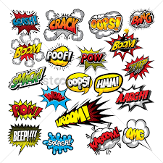
effect

Slide 93
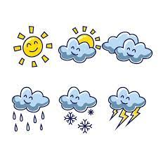
weather

Slide 94

whether

Slide 95
Let’s Teach and Practise

Slide 96
Soft c

Slide 97
soft c – sh (as in chef) s (as in science)

Slide 98
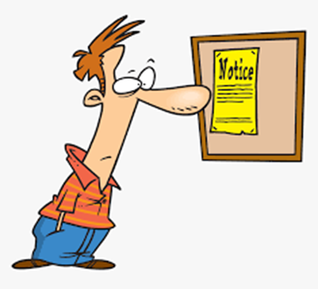
notice

Slide 99
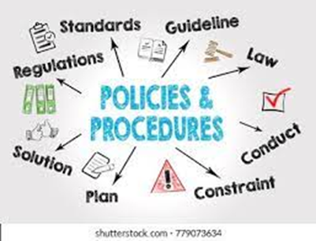
policy

Slide 100

privacy

Slide 101
Definition - notification or warning of something, especially to allow preparations to be made.
notice
noti + c + e = notice
NOUN

Slide 102
Definition - course or principle of action adopted by an organisation or individual.
policy
poli + c + y = policy
NOUN

Slide 103
Definition - own a state in which one is not or disturbed by other people.
privacy
priva + c + y = privacy
NOUN

Slide 104
The silence in the room was demanded by the notice.
______

Slide 105
The government's controversial economic policy was met with fear.
______

Slide 106
She returned to the privacy of her own home.
_______

Slide 107
New CHALLENGE words.

Slide 108
Definition - at infrequent or irregular intervals; now and then
occasionally
ADVERB

Slide 109
We eat chocolate occasionally at the weekend.
____________

Slide 110
Definition - almost certainly; as far as one knows or can tell
probably
ADVERB

Slide 111
It will probably rain at the weekend as we are going camping!
_______

Slide 112
Let’s Practise and Apply.

Slide 113
Can you spot the spelling rule words and the challenge words?

Slide 114
Changing Land (Scotland)
In the past, lots of the islanders grew juicy food on small pieces of land which had privacy notices. They kept a few sheep and these people were called “crofters”, paid rent to the clan chiefs who were the landowners. The landowners made money from the crofters’ rent and occasionally from seaweed gathered from the shores, which was sold to make soap and fertilisers. More money could probably be made from sheep’s wool so in the 1700s and early 1800s many people were forced to leave the island on ships in search of a new life abroad.

Slide 115
Changing Land (Scotland)
In the past, lots of the islanders grew juicy food on small pieces of land which had privacy notices. They kept a few sheep and these people were called “crofters”, paid rent to the clan chiefs who were the landowners. The landowners made money from the crofters’ rent and occasionally from seaweed gathered from the shores, which was sold to make soap and fertilisers. More money could probably be made from sheep’s wool so in the 1700s and early 1800s many people were forced to leave the island on ships in search of a new life abroad.

Slide 116
Write this sentence as I dictate it to you.
Notes:
In the past, lots of the islanders grew juicy food on small pieces of land which had privacy notices.

Slide 117
In the past, lots of the islanders grew juicy food on small pieces of land which had privacy notices.
Did you write it correctly?
Edit your work and make sure you have it correct.
Can you underline the spelling word that we have covered in this session?

Slide 118
Year 5 – Autumn 1
Week 2 - Thursday

Slide 119


Slide 120
Let’s Revisit and Review…

Slide 121
Do you remember this challenge word?

Slide 122
Definition - the quality or state of being physically strong.
strength
NOUN

Slide 123
The girl’s strength was incredible as she demonstrated moving the large table.
________

Slide 124
Do you remember this challenge word?

Slide 125
Definition – think or assume that something is true or probable but lack proof or certain knowledge
suppose
VERB

Slide 126
I suppose you are going to eat the last cup cake.
_______

Slide 127
Homophones

Slide 128
Homophone homo = same phone = sound
(from Ancient Greek)

Slide 129
Homophone a word that has the same sound but has a different meaning

Slide 130
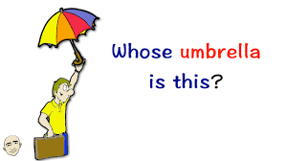
whose

Slide 131
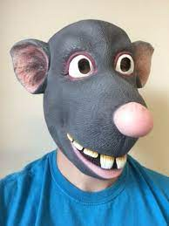
who’s
Who’s the rat?

Slide 132

cereal

Slide 133
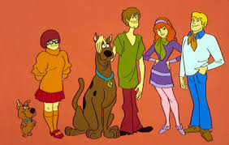
serial

Slide 134
Let’s Teach and Practise

Slide 135
Soft c

Slide 136
soft c – sh (as in chef) s (as in science)

Slide 137
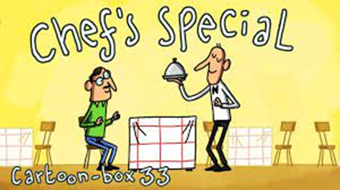
special

Slide 138
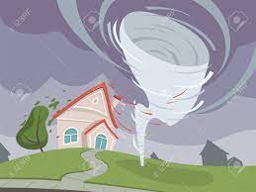
cyclone n

Slide 139

recycle

Slide 140
Definition – adjective: better, greater, or otherwise different from what is usual
special
spe + c + ail = special
ADJECTIVE

Slide 141
Definition - a system of winds rotating inwards to an area of low barometric pressure
cyclone
cy + clone = cyclone
NOUN

Slide 142
Definition - convert (waste) into reusable material.
recycle
re + cy + cle = recycle
VERB

Slide 143
They always made a special effort at Christmas.
_______

Slide 144
There was a tropical cyclone brewing.
_______

Slide 145
Car hulks were recycled into new steel.
________

Slide 146
New CHALLENGE words.

Slide 147
Definition - at infrequent or irregular intervals; now and then
occasionally
ADVERB

Slide 148
We eat chocolate occasionally at the weekend.
____________

Slide 149
Definition - almost certainly; as far as one knows or can tell
probably
ADVERB

Slide 150
It will probably rain at the weekend as we are going camping!
_______

Slide 151
Let’s Practise and Apply.

Slide 152
Can you spot the spelling rule words and the challenge words?

Slide 153
Changing Land (Scotland)
In the past, lots of the islanders grew juicy food on small pieces of land which had privacy notices. They kept a few sheep and these people were called “crofters”, paid rent to the clan chiefs who were the landowners. The landowners made money from the crofters’ rent and occasionally from seaweed gathered from the shores, which was sold to make soap and fertilisers. More money could probably be made from sheep’s wool so in the 1700s and early 1800s many people were forced to leave the island on ships in search of a new life abroad.

Slide 154
Changing Land (Scotland)
In the past, lots of the islanders grew juicy food on small pieces of land which had privacy notices. They kept a few sheep and these people were called “crofters”, paid rent to the clan chiefs who were the landowners. The landowners made money from the crofters’ rent and occasionally from seaweed gathered from the shores, which was sold to make soap and fertilisers. More money could probably be made from sheep’s wool so in the 1700s and early 1800s many people were forced to leave the island on ships in search of a new life abroad.

Slide 155
Write this sentence as I dictate it to you.
Notes:
More money could probably be made from sheep’s wools in the 1700s and early 1800s many people were forced to leave the island on ships in search of new life abroad.

Slide 156
More money could probably be made from sheep’s wools in the 1700s and early 1800s many people were forced to leave the island on ships in search of new life abroad.
Did you write it correctly?
Edit your work and make sure you have it correct.
Can you underline the spelling word that we have covered in this session?

Slide 157
Year 5 Autumn 1
Week 2 - Friday

Slide 158


Slide 159
Let’s Revisit and Review…

Slide 160
Old challenge words…

Slide 161
strength

Slide 162
suppose

Slide 163
Old spelling rule words…

Slide 164
their

Slide 165
there

Slide 166
they’re

Slide 167
allowed

Slide 168
aloud

Slide 169
accept

Slide 170
except

Slide 171
affect

Slide 172
effect

Slide 173
weather

Slide 174
whether

Slide 175
whose

Slide 176
who’s

Slide 177
cereal

Slide 178
serial

Slide 179
New spelling rule words…

Slide 180
chef

Slide 181
science

Slide 182
forced

Slide 183
celebrate

Slide 184
cellar

Slide 185
juicy

Slide 186
notice

Slide 187
policy

Slide 188
privacy

Slide 189
special

Slide 190
cyclone

Slide 191
recycle

Slide 192
New challenge words…

Slide 193
occasionally

Slide 194
probably

Slide 195
Quick Quiz time…
Notes:
Say these words for the quiz
their, accept, strength, suppose, chef, celebrate, policy, cyclone, occasionally, probably

Slide 196
Did you get them correct?
Edit your work.
their, accept, strength, suppose, chef, celebrate, policy, cyclone, occasionally, probably
Notes:
Say these words for the quiz
their, accept, strength, suppose, chef, celebrate, policy, cyclone, occasionally, probably

Slide 197
Word class time…

Slide 198
We occasionally add salt to our chips.
Pronoun adverb verb noun preposition pronoun noun
Notes:
Ask for these words to be classed

Slide 199
We will probably celebrate with a party and end of year disco this year.
Pronoun verb adverb verb preposition determiner (article) noun determiner adjective noun determiner noun
Notes:
Ask for these words to be classed

Slide 200
Etymology
The history of a word….

Slide 201
Occasionally (adverb) etymology
late Middle English (in the sense ‘particular’): from Latin peculiaris ‘of private property’, from peculium ‘property’, from pecu ‘cattle’ (cattle being private property). The sense ‘strange’ dates from the early 17th century.
Probably (adverb) etymology
It is formed from the word probable and the suffix -ly, which is used to make it into an adverb. Probable comes from the Latin probābilis, which means “likely,” “literally,” or “capable of standing a test,” and is equivalent to the verb probā(re) “to test.” This word gives us both probe and prove.

Slide 202
Let’s investigate….
Can you find words linked to occasionally and probably?

Slide 203
Words linked to occasionally…
hardly
infrequently
periodically
seldom
sometimes
sporadically
at intervals
at random
at times
every so often
from time to time
        irregularly
now and again
on occasion
once in a blue moon
once in a while
once or twice
uncommonly

Slide 204
Words linked to probably…
apparently
doubtless
no doubt
perhaps
possibly
presumably
seemingly
believably
plausibly
as likely as not
as the case may be
expediently
feasibly
imaginably
in all likelihood
in all probability
like enough
maybe
most likely
one can assume
perchance
practicably
presumptively
reasonably
to all appearances

Slide 205
Common errors with occasionally and probably:
ocassionaly (one c and double s, suffixes –al and -ly): occasionally
probabbly (double b before suffix -ly): probably

