Slide 1
JOY Entertainment
Introduction
Period : 2014-2015
Version: 0.1.8
Time : 09/2014

Slide 2
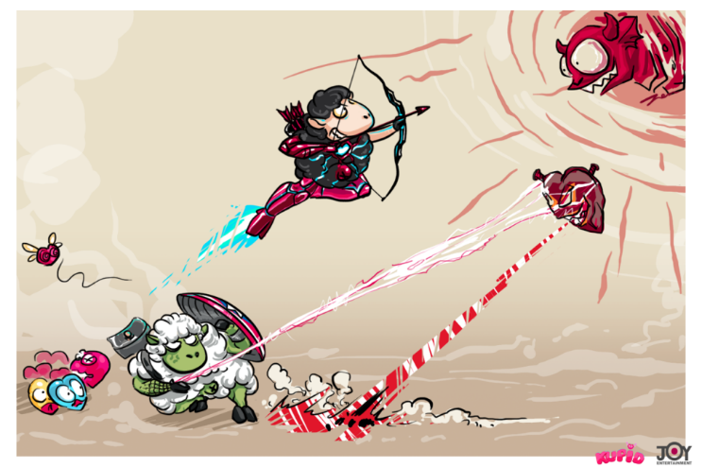
OVERVIEW
NO JOY = NO GAME
Bring JOY to your user
Focus on mobile devices
Develop our own engine
Founded in April – 2012
Joint Stock Company
2 online mobile games
4 offline games

Slide 3
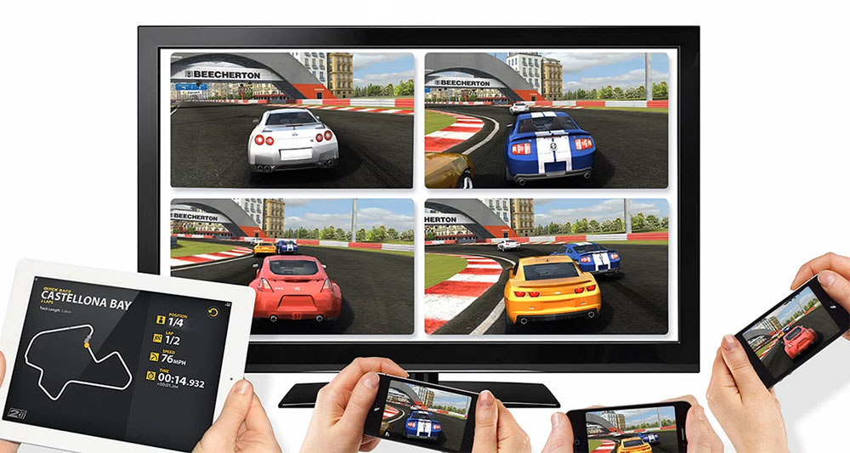
OVERVIEW
OUR VISION
TOP MOBILE GAME COMPANY IN ASIA WITHIN 2015
In term of users’ trust
In term of game quality
In term of innovation
WHY WE WILL SUCCEED
Differentiation
Creativity
Experience

Slide 4
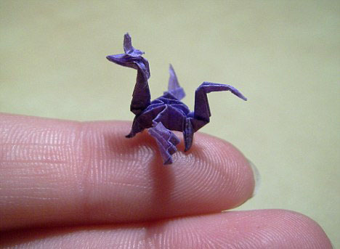
OVERVIEW
OUR APPROACH
Best way to get big is by being small
Small teams try to achieve great things
We don’t have heroes… We can be heroes
“Small is Beautiful”

Slide 5
OUR TEAM
ABOUT JOY
Passion in mobile game
Creativity, no copy – yes inspire
Unrestricted freedom
Continuously improve ourselves
Use Scrum in game dev

Slide 6
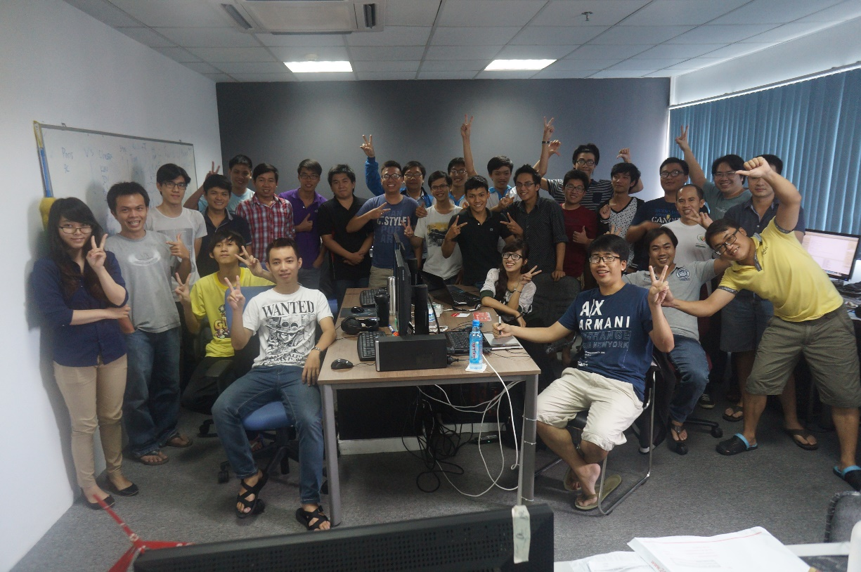
OUR TEAM
WHY US?
WE ARE EXPERIENCED
Producer and leaders of the leading mobile game companies
Shipped over 100 titles together
6+ years in video game development
Have worked together for 5+ years
Well Educated Work Force
Average age: 23

Slide 7
OUR TEAM
FOUNDERS
TRAN QUANG HUY, CREATIVE DIRECTOR
Previously a lead game designer of the only creation team of Gameloft SEA. Produced best selling title Brothers In Arms 2
Win 3 industry awards
4 years+ in video game development
LE GIANG ANH, CEO
Previously a creation team producer of Gameloft SEA
Has released more than 30 commercial games 7 years+ in video game development
Founder of Vietnam Game Developer Network
MBA

Slide 8
OUR TEAM
FOUNDERS
NGUYEN HUU LE TRONG TIN
Previously a lead programmer of the creation team at Gameloft SEA. Produced Brothers In Arms 2, Tank Battles
5 years+ in video game development
HOANG NGOC TOAN, LEAD PROGRAMMER
Previously a lead programmer of the creation team at Gameloft SEA. Produced best selling Asphalt 6, 7 in Windows Phone.
Win 2 industry awards
5 years+ in video game development

Slide 9
OUR TEAM
FOUNDERS
TRAN THI THANH HAI, CFO
Previously CFO of Appota
Was financial controller of VatGia.com (VN Price)
Built startups to hundred million dollars companies
6 years+ in accounting and finance
BUI TRUNG HIEU, LEAD ARTIST
Expert in both 2D and 3D graphics/art
Be able to use almost graphic tools for game development
Love to learn new things

Slide 10
BUSINESS MODEL

Slide 11
OVERVIEW
MOBILE GAME
Big trend around the world
This is what we do best: Exp + resources
Dream team for mobile game
Our framework and engine are stable

Slide 12
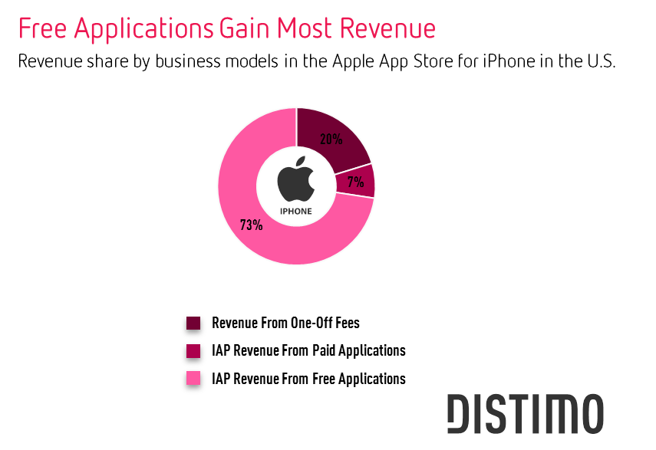
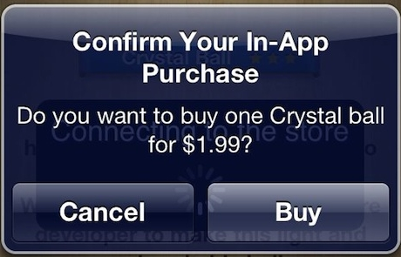
BUSINESS MODEL
IN-APP PURCHASE

Slide 13
BUSINESS MODEL
LICENSING & MINIMUM GUARANTEE
Game licensing to publishers in different market (Vietnam, China, Japan, Korea or Global)
Minimum guarantee revenue

Slide 14
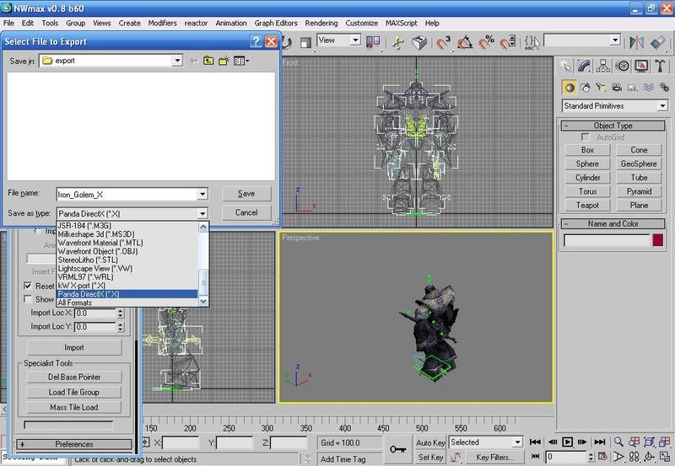
OUR PLATFORM
SKYLITCH ENGINE
Inherited the advantages from Irrlicht Engine and team experience
Strong and fast
Extremely optimized for mobile
Cross platform: PC, Mac, Linux, iOS, Android, WP8 and more.
Easy for customization
Update regularly
Ready for commercial in 2014
Notes:
popular and strong render engine

Slide 15
OUR INVESTOR

Slide 16
OUR INVESTOR
APPOTA
Biggest mobile app distributor in Vietnam and also SEA
Have offices in 5 countries
Close relationship with JOY, support for distribution & marketing

Slide 17
OUR PARTNERS

Slide 18
OUR PARTNERS
LOCAL PARTNERS

Slide 19
OUR PARTNERS
GLOBAL PARTNERS

Slide 20
What We Have In The Market Today

Slide 21
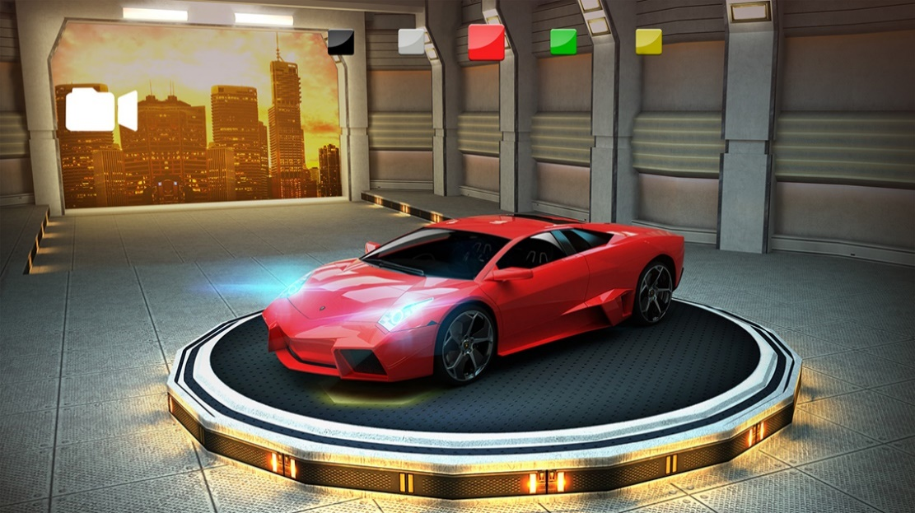
GAMES
AUTO RACING

Slide 22
GAMES
CAPTAIN STRIKE - 3D MMO TPS
First online mobile Third-person shooter game in Vietnam (also Asia) http://captainstrike.com

Slide 23
GAMES
CAPTAIN STRIKE - 3D MMO TPS
Released to Vietnam market in 9 April 2014, Cross platform (iOS, Android, PC)
500,000+ user for Vietnamese version only (from 9 April)
Release globally on Sep 2014 (Captain Strike)
Release in China soon
Based in our first 3D game engine in Vietnam

Slide 24
GAMES
AMAZING KICK – ONLINE FREEKICK
RELEASED IN JUNE 2014: http://bit.ly/AmazingKick

Slide 25
GAMES
WIP GAMES
MOBA ALL-STARS
SOLDIERS 2
(THE IMAGE’S COPYRIGHT BELOGNS TO VALVE)
(THE IMAGE’S COPYRIGHT BELOGNS TO EA)

Slide 26
WHAT’S NEXT

Slide 27
FUTURE PLAN
3D GAMES + PLATFORM
Platform and Engine development
Next MMO 3D games (MOBA, SHOOTING, RACING, RPG)
Focus to Asia concepts/markets

Slide 28
BESIDE GAMES?
MOBILE GAME SOCIAL NETWORK!
http://JSkill.com will start in End of 2014
http://JReplay.com video replays social network, also integration with JSkill

Slide 29
GAMES
CAPTAIN STRIKE - 3D MMO TPS
Released to Vietnam market in 9 April 2014, Cross platform (iOS, Android, PC)
500,000+ user for Vietnamese version only (from 9 April)
Release globally on Sep 2014 (Captain Strike)
Release in China soon
Based in our first 3D game engine in Vietnam

Slide 30
GAMES
AMAZING KICK – ONLINE FREEKICK
RELEASED IN JUNE 2014: http://bit.ly/AmazingKick

Slide 31
GAMES
WIP GAMES
MOBA ALL-STARS
SOLDIERS 2
(THE IMAGE’S COPYRIGHT BELOGNS TO VALVE)
(THE IMAGE’S COPYRIGHT BELOGNS TO EA)

Slide 32
OUR TEAMS

Slide 33
Investment
Pro-Forma

Slide 34
Insert – Financial Information
What do you plan to use the investment for
What is the expected ROI (18 months or less)
Does the investment to need to be in phases?
IF so, detail out milestones per investment

Slide 35
Insert Current Financial Report
Current Revenues per month
Current monthly expenses
Projected Capital Costs for 2015 (servers..etc)

Slide 36
THANK YOU!

