Slide 1
MANAGING TIME SENSITIVE AND ACTIVITY REQUIRED STANDARDS
Presented by:
Vince Dauro
Southeast Regional Program Manager
Dan Shaw
Great Lakes Regional Program Manager

Slide 2
Housekeeping
Restrooms
Safety Issues
Exits
Fire Alarms / Extinguishers
No Active Threat Simulations in this course
Phones on vibrate / step out to take a call
PowerPoint and related documents are available on the CALEA Conference App
All questions accepted

Slide 3
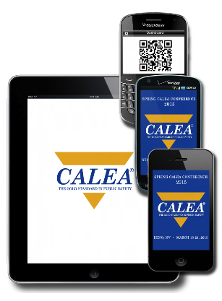
CALEA Conference App
PowerPoint Presentations
Handouts
Course Evaluations

Slide 4
Community Care Doctrine
If at any time during this program your neighbor starts falling asleep, please make sure they are comfortable.

Slide 5
Introduction

Slide 6
Types of Standards
Most Common
Written Directive
Bulleted
Conditional
Linked
Observation
Activity Required
Most Problematic
Notes:
There are 6 types of standards. The most common is a written directive, but the Activity Required (aka Time Sensitive) standards are the cause of many non-compliance findings. Which is why we have an entire course dedicated to this type of standard.

Slide 7
Standard Construction
Standard Number / Title
11.1.1 (M M M M) (LE1) Description of Organization
A written directive describes the agency's organizational structure and functions and is available to all personnel.
Commentary
The agency may determine its own organizational structure. In organizing/reorganizing, the agency should consider applicable standards within the various chapters of the standards manual. The intent of this standard is to provide a written description of the agency's organization. The agency's organizational chart (see standard 11.1.2) should coincide with this description.
Functional responsibility may be assigned to an individual position or a component specifically created and staffed (subchapter 16.1 Allocation and Distribution of Personnel). Functional responsibility for several activities could also be assigned to a single position or component, as needed. (M M M M) (LE1)
Standard Statement
GUIDANCE and
SUGGESTIONS
NON-BINDING
Commentary
Compliance Level
Basic LE Standard

Slide 8
Activity Required Standards
12.2.1 (LE1) The Written Directive System
The agency has a written directive system that includes, at a minimum, the following: (bullets a – i)
Commentary
…Each agency has the latitude to use a variety of types of written directives. However, the agency should make it clear what level of authority is required to issue each type of directive, e.g., only the CEO may issue rules and regulations, division commanders may issue standard operating procedures. The agency should also make it clear that a written directive pertaining to a subordinate component may not contradict a directive issued by a higher level authority, e.g., a division procedures manual may not contradict an agency-wide regulation. Every written directive should be reviewed annually by the issuing authority to determine if changes should be made because of changed circumstances or occurrences during the previous year. (M M M M) (LE1)
Every written directive should be reviewed annually by the issuing authority to determine if changes should be made because of changed circumstances or occurrences during the previous year.
Notes:
When the STANDARD STATEMENT indicates there must be an activity performed, such as report, review, analysis, inspection, test, survey, audit and/or inventory, the standard is considered an Activity Required Standard

Slide 9
Activity Required Standards
An Activity Required Standard:
Requires that a specific activity occurs
Test
Survey
Report
Audit
Inspection
Review
Analysis
Notes:
When the STANDARD STATEMENT indicates there must be an activity performed, such as report, review, analysis, inspection, test, survey, audit and/or inventory, the standard is considered an Activity Required Standard

Slide 10
Activity Required Standards
Training 6.2.2
The academy performs a needs assessment to determine what training to provide.
Notes:
In this example from the Public Safety Training Academy standards, an activity is required, but a specific time period is not noted. In addition, a written directive is not required for compliance.

Slide 11
Activity Required Standards
An Activity Required Standard:
Requires that a specific activity occurs
May or may not require a written directive
Notes:
Activity required standards may or may not require the creation of a written directive.

Slide 12
Activity Required Standards
Law Enforcement:
72.4.11 A written directive requires a documented report of all incidents that threaten the facility or any person therein.
Notes:
This is an example an activity required standard which requires a written directive.

Slide 13
Activity Required Standards
Communications:
6.8.5 A documented inspection of the computer records and security system is conducted on all passwords or access codes for violations and improper use at least quarterly.
Notes:
In this example from the Communications standards, a written directive is not required for this time sensitive standard.

Slide 14
Activity Required Standards
WARNING
“If its not in policy… it won’t happen”
Notes:
Though many standards do not require a written directive, many agencies have had difficulties with time sensitive standards after a change in personnel or change in procedure. The required activity will not get done if the person required to complete it does not know it is required.

Slide 15
Activity Required Standards
“Be cautious of exceeding the standard!”
Agency directives/practices must comply with CALEA Standards, but personnel comply with agency directives.
Notes:
Also, agencies may exceed the standard timing requirements. For example, an agency may elect to conduct a standards required semi-annual inspection on a quarterly basis. However, be cautious when doing so, as if the requirement is documented in the agency’s written directive, it in effect becomes the standard. In the example provided, if the agency failed to complete all of the quarterly inspections, it may be found in non-compliance even though it may be in compliance with the semi-annual aspect of standard.

Slide 16
Activity Required Standards
What should be included in the written directive?
What
When
Who
Why
How
Notes:
Many agencies create a written directive to direct its personnel in the process of complying with activity required standards. Many agencies use written directives as training documents for reassigned or promoted personnel to ensure activities continue to be completed as required. Directives should provide necessary details to provide adequate guidance for personnel, including what, when, who, why and how the activity is to be completed.

Slide 17
Activity Required Standards
An Activity Required Standard:
Requires that a specific activity occurs
May or may not require a written directive
Many require the activity to be accomplished within a specific period (aka “Time Sensitive Standard”)
Notes:
Activity Required standards may require the activity to be accomplished within a specific period of time.

Slide 18
Time Sensitive Standards
Campus Security:
23.2.4 A documented survey of campus community perceptions and opinions is conducted at least once every three years with respect to…..
Notes:
This is an example of the longest timeframe for any time sensitive standard. You need to be aware of these so that you can show the team you have conducted the task or at least show them you are preparing for it.

Slide 19
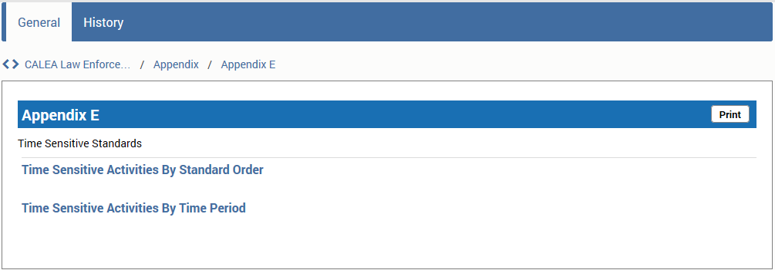
Time Sensitive Standards
Where can you find a listing of Time Sensitive Standards? APPENDIX E
Notes:
The appendixes are very helpful for identifying time sensitive standards, and determining the number of proofs for each timeframe. Each manual has an Appendix E. The appendix lists all the time sensitive standards in standard order or by time period. (Example shown is by standard order) This appendix will be a starting point for tracking purposes and should be used as a quick reference for the accreditation manager. Keep in mind if the agency decides to make a standard time sensitive you need to add it to this list for reference.

Slide 20
Timeframe Definitions
Term | Definition
Annual: | Once a year / every 12 months
Triennial: | Every three years
Semi annual: | Every six months / twice a year
Quarterly: | Every three months
Biennial: | Every two years
Monthly: | Once a month / every 30 days
Weekly: | Once a week / every 7 days
Per Incident: | Each occurrence
Notes:
Time sensitive standard statements will indicate the required timeframe by using one of these terms. Agencies need to understand what these terms mean in CALEA definition. The most misunderstood is Annual. Annual means the activity must occur once every year, or more specifically, once every twelve months. It does not mean once within a calendar year!
The agency must make sure they have in place the person or position responsible for the occurrence. It’s best not to indicate who is responsible in the directive unless the standard requires it. Again, knowing who is responsible is critical in tracking the task. The timeframes also let you know how many proofs should be in the file. We will talk about that more in just a minute, but Appendix G give guidance on proofing time sensitive files.

Slide 21
True or False?

Slide 22
True or False?
Of the 8 types of standards, time sensitive standards are the most common.
Notes:
Of the 8 types of standards, time sensitive standards are the most common.

Slide 23
True or False?
Of the 8 types of standards, time sensitive standards are the most common.
FALSE
Written Directive standards are the most common, but time sensitive standards are the cause of many non-compliance findings.
Notes:
Of the 8 types of standards, time sensitive standards are the most common.

Slide 24
True or False?
If the agency’s written directive exceeds the timeframe required by the standard, the directive takes priority over the standard statement.
Notes:
If the agency’s written directive exceeds the timeframe required by the standard, the directive takes priority over the standard statement.

Slide 25
True or False?
If the agency’s written directive exceeds the timeframe required by the standard, the directive takes priority over the standard statement.
TRUE
Remember, an agency’s written directive needs to be in compliance with CALEA standards, but agency personnel need to follow the agency’s written directives.
Notes:
If the agency’s written directive exceeds the timeframe required by the standard, the directive takes priority over the standard statement.

Slide 26
The Commentary may also provide required timeframes for time sensitive standards.
True or False?
Notes:
The Commentary can also give you binding timeframes for time sensitive standards.

Slide 27
The Commentary may also provide required timeframes for time sensitive standards.
True or False?
FALSE
The Commentary is provided as explanation and guidance for agencies to consider; however, it is not binding on the agency. Only the standard statement is binding.
Notes:
The Commentary can also give you binding timeframes for time sensitive standards.

Slide 28
Specific Activities

Slide 29
Activity Required Standards
Report
Review
Test
Survey
Inspection
Audit
Analysis
Notes:
Activity Required standards require some type of activity, such as a report, review, analysis, inspection, test, survey, audit and/or inventory. The activity may or may not require a written directive. Many are time sensitive standards that require the activity to be accomplished at specific periods. When the standard statement indicates there must be an activity performed by a specified timeframe the standard is classified as being time sensitive. The commentary does not make the standard time sensitive only the standard statement is binding. An agency must be aware of which applicable CALEA standards are time sensitive. If an agency makes the standard time sensitive according to procedures/directives then they must abide by what they have implemented. For example, the CALEA statement my indicate a report should be generated monthly, but the agency policy indicates it will be generated per incident. If this is the case then the agency must be in compliance with agency policy and not the CALEA standard. This is going above the standard requirements.

Slide 30
Report
Written documentation of some type of activity.
Examples:
Incident Report
Use of Force Report
Liability Report
After Action Report

Slide 31
Review
To examine or study an activity or process. Less formal than a formal analysis.
Examples:
Review of Performance Evaluation
Review of Use of Force Report
Review of Procedure / Process (Suspicious Incidents)

Slide 32
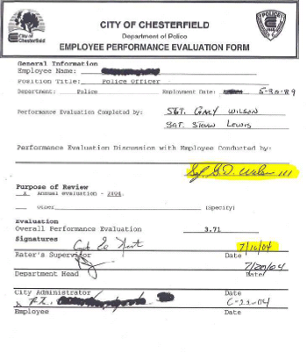

Slide 33
Administrative Review
A DOCUMENTED review of an incident or occurrence prepared by or for the CEO or his/her designee. The review should indicate whether policy, training, equipment, or disciplinary issues should be addressed.
Examples:
Admin Review of Agency Practices (Bias Based Profiling)
Admin Review of Pursuits
Admin Review of Internal Affairs

Slide 34
Evaluation
A careful appraisal and study to determine the significance and/or worth or condition, and to draw conclusions pertaining to an item, project, or activity.
Examples:
Performance Evaluation
Rater Evaluation
Evaluation of Personal Early Warning System

Slide 36
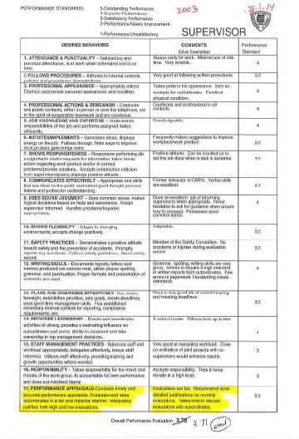

Slide 37
Survey
Community Survey – Survey of residents of the community
Contact Survey – Survey of people having contact with agency
Scientific Survey - A survey conducted using methods expected to provide reliable and valid information
Examples:
Citizen Survey
Perceptions of Safety Survey

Slide 38
Inspection
A careful and critical examination; a formal review of all components of a particular requirement and an examination of their application.
Maintained Properly
Adherence to Procedures
Integrity of Property

Slide 39
Audit
A complete and careful examination of the financial records of a business or person
Examples
Password Audit
Cash Fund Audit
Property / Evidence Audit

Slide 40
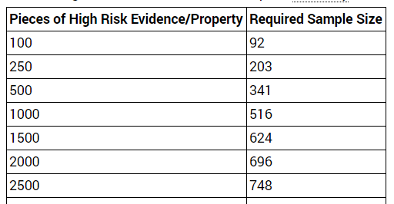
Audit
Standard 84.1.6b – Custodian Change Audit
A documented accounting of high-risk items (e.g. cash, precious metals, jewelry, firearms, and drugs) and other evidence and non-agency property to establish that all property is accounted for and records can reasonably be assumed correct.
Appendix I

Slide 41
Audit
Standard 84.1.6c – Annual Audit
A significant representative sampling of property including high-risk items.
Conducted by Property Custodian or designee (person with functional responsibility) using Appendix K
100 or less items = Sample all items
101 or more items = Sample of 100 items
100 or more high risk items
Representative Sample up to 100 items

Slide 42
Analysis
A systematic, structured process for dissecting an event into its basic parts in order to identify essential elements.
An analysis should reveal patterns or trends that could be predictive, indicate program effectiveness, or identify the need for additional training, equipment upgrade and policy modification.

Slide 43
Standards Requiring Analysis
6
4
3
6
Use of Force
Job Task (O)
Grievances
Recruitment Plan
Pursuit
Campus Risk Assessment
Liability Incidents
Job Task (O)
Grievances
Recruitment Plan
Training Needs
Grievances
Recruitment Plan
Use of Force
Job Task (O)
Grievances
Recruitment Plan
Risk Assessment
Incident Analysis
Notes:
In the LE, TA, and CS program Task analysis is not listed in App. E. Also not listed for programs:
LE 15.3.1 Crime analysis
CS 7.3.1 Incident Analysis

Slide 44
Purpose of Analysis
To validate performance and professionalism
A tool for agency resource allocation based on:
Trends
Patterns
Effects on the Agency / Personnel

Slide 45
Analysis Process
Collect
Event/Element
Data
Document and
report findings
Identify cause
and/or effect of
Patterns/ Trends
Collate
Event/Element
Data
Identify
Patterns/ Trends

Slide 46
Analysis Process
Collect
Event/Element
Data
Notes:
In order to analyze data, it must first be collected.

Slide 47
Collect Event/Element Data
Collect the data or data set
Calls for Service
Custodial Arrests
Define the data elements
Location
Time of Day
Document the source
Federal Bureau of Investigation
CAD Records
Collection period
January 1, 2014 – December 31, 2014
July 1, 2015 – June 30, 2016
Notes:
List what the data is (i.e., Calls for Service based on location, time of day, type of response, photographs, etc.). You also need to provide the source of the data or where you obtained it from (i.e., CAD system, UCR, Citizen Survey, etc.) and the time period in which the data is collected, (i.e., January 1, 2014 to December 31, 2014, 0800 hours through 1600 hours, etc.).

Slide 48
Analysis Process
Collect
Event/Element
Data
Collate
Event/Element
Data
Notes:
Once the data has been collected, it needs to be collated or arranged so that It can be easily reviewed.

Slide 49
Collate Event/Element Data
Grievances Analysis for 2012:
Grievance Type | Grievance Total
Work Schedule | 2
Supervisor | 1
Discipline | 4

Slide 50
Collate Event/Element Data
Put the data in some type of order so that it can be reviewed.
NOT AN ANALYSIS !!!
This is a Visual Representation of Data
Notes:
This may be in the form of a table or graphical chart. But remember, data tables and graphical charts are not an analysis!

Slide 51
Analysis Process
Collect
Event/Element
Data
Collate
Event/Element
Data
Identify
Patterns/ Trends
Notes:
After the data has been collated, critically review the data to identify patterns or trends.

Slide 52
Identify Patterns / Trends
Identify the W’s
What
Where
When
Who
Why
Notes:
Raw data does not explain anything and is open to interpretation. As such, carefully review the data to identify any significant patterns or trends by identifying the W’s: What pattern/trend is occurring? Is property crime increasing or the number of grievances decreasing? Where does the patter/trend occur? Is there a specific location that is experiencing a sharp increase in injury accidents? When does the patter/trend occur? Did grievances increase in one year, but not the others during the accreditation period? Who is working when the patter/trend is occurring? Is the deployment of a Taser more prevalent with specific officers? Why is this pattern/trend occurring? There may be valid reasons for the pattern or trend.

Slide 53
Analysis Process
Collect
Event/Element
Data
Identify cause
and/or effect of
Patterns/ Trends
Collate
Event/Element
Data
Identify
Patterns/ Trends
Notes:
Once you’ve identified patterns or trends, you need to identify the cause or effect it has on the agency.

Slide 54
Identify Cause and Effect
What harm may result from the pattern/trend?
Who is directly affected by the pattern/trend?
Potential Areas to Review:
program effectiveness, training, equipment, and policies
Notes:
It is this information that has critical importance to the agency. Has the number of grievances increased just prior to contract negotiations? Is there a particular shift or district which experiences the highest number of pursuits?

Slide 55
Analysis Never Stops
Collect
Event/Element
Data
Document and
report findings
Identify cause
and/or effect of
Patterns/ Trends
Collate
Event/Element
Data
Identify
Patterns/ Trends
Notes:
With the data collected and collated, trends identified, and impact or effect on the agency reviewed, the final step is to document and report your findings.

Slide 56
“If it’s not in writing…
It didn’t happen”
Notes:
As taught in the Police Academy, if its not in writing, it didn’t happen.

Slide 57
Suggested Analysis Format
Purpose
Methodology
Summary
Collected Data
Explanation of the Data
Findings
Patterns or Trends Identified
Recommended Actions

Slide 58
No Data?
Analyze the agency’s
Policy
Practice and
Training Activities.
Notes:
All analyses should include recommendations for action based on the data and information reviewed.

Slide 59
Timeframe
Data collected over 12 consecutive months (annual) or 36 months (triennial) and compared to the same months each year.
Documented analysis must be completed within 6 months of data collection.

Slide 60
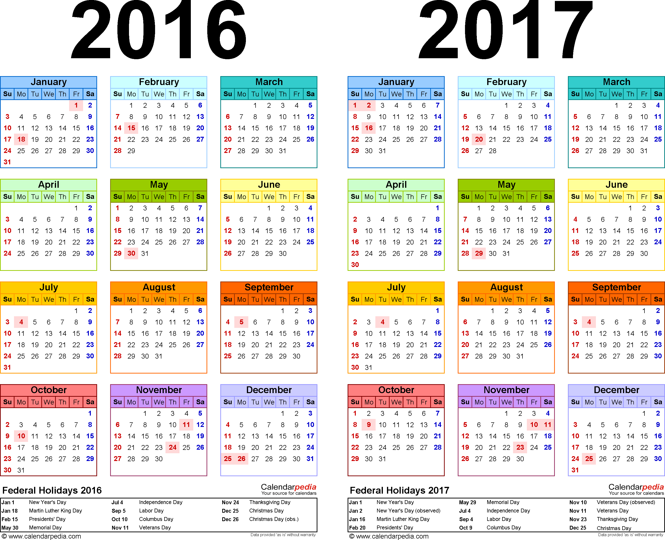
Timeframe

Slide 61
Commission Expectations
A DOCUMENTED analysis which reviews the data, policies and procedures that offers recommendations and conclusions based upon the information reviewed.
Completed within the required timeframe (i.e. annual, triennial, etc.).
An actual analysis each year… Do not simply copy and change dates.

Slide 62
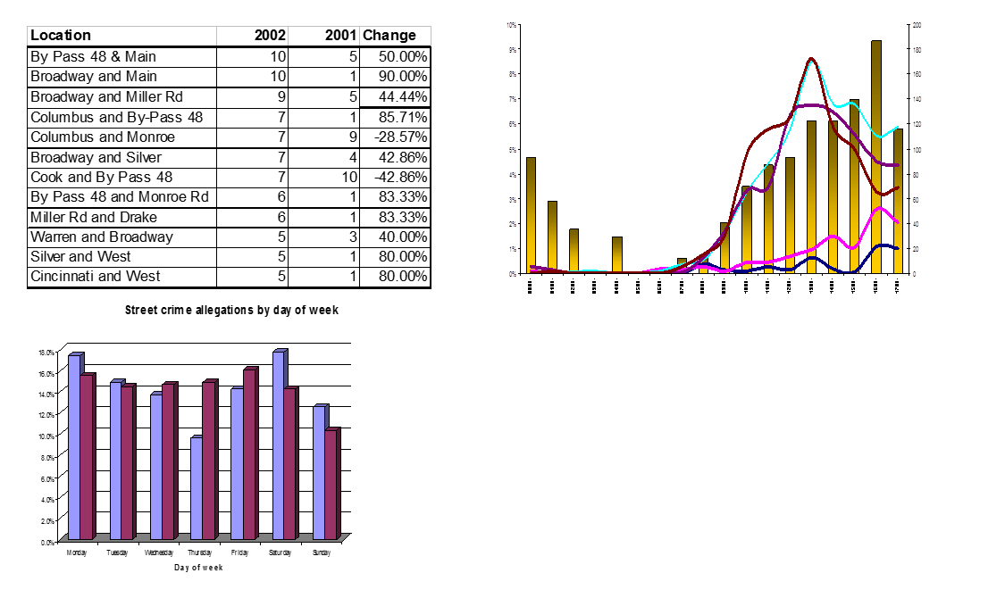
Common Errors
Just reporting raw data, no Narrative

Slide 63
Common Errors
Basic one or two sentence summary,
only restating what data is reporting
Grievances Analysis for 2012:
Grievance Type | Grievance Total 2012
Promotion | 0
Work Schedule | 0
Supervisor | 0
Discipline | 1
The results of the Grievances Analysis for 2012 revealed a total of one grievance.

Slide 64
“PROOFING” ACTIVITY REQUIRED STANDARDS

Slide 65
Considerations
The proof(s) presented must show continued compliance throughout the three-year (or four-year) assessment period OR for the time period the standard is applicable to the agency.
Unless otherwise indicated, when a new standard is created, agencies have one year from the date approved by the Commission to come into compliance.

Slide 66
Considerations
INITIAL ACCREDITATION
After the agency’s enrollment date; and
After the agency has come into compliance with a standard through written directive or practice (i.e. effective date).

Slide 67
Considerations
REACCREDITATION
Proofs are valid from:
The end of an assessment (web-based or site-based) through the start of the next assessment (web-based or site-based) . 4-Year Model
The end of an onsite assessment through the start of the next assessment. 3-Year Model

Slide 68
How Many Proofs?
Appendix G provides guidance regarding the number of proofs.
Assessors can always ask for more documentation if what is provided in the file does not satisfactorily verify compliance

Slide 69
Recommended Minimum Proofs
Frequency | Per Year | Per File (3 Year) | Per File (4 Year)
Per Incident | 1 | 3 | 4
Daily | 1 | 3 | 4
Monthly | 2 | 6 | 8
Quarterly | 2 | 6 | 8
Semi-Annual | 1 | 3 | 4
Annual | 1 | 3 | 4
Biennial | 1* | 1 or 2 | 2
Every 3 Years | 1* | 1 | 1 or 2
*May not be applicable if not enough time has elapsed.

Slide 70
Exercises
Notes:
The accreditation process is designed so an agency will show compliance over a three year period. The standard (or agency policy) will determine how many proofs should be in the file. The Commission adopted Appendix G to give instruction and guidance on how to provide proof. The appendix indicates the minimum number of proofs that should be in the file. CALEA strongly recommends agencies to use Appendix G to determine the amount of proofs for the file. The Appendix also provides a chart that specifically addresses time sensitive proofs. Again, agencies should use the chart to determine the number of time sensitive proofs.
We will look at the appendix together during the session.

Slide 71
Law enforcement
84.1.6 In order to maintain a high degree of evidentiary integrity over agency controlled property and evidence, the following documented inspections, inventory, and audits shall be completed:
a. an inspection to determine adherence to procedures used for the control of property and evidence is conducted semi-annually by the person responsible for the property and evidence control function or his/her designee;

Slide 72
The Anywhere Sheriff’s Office implemented a written directive in July 2015 requiring semi-annual inspections of its property room.
How many proofs of compliance should be included in their file for its assessment in December 2016?

Slide 73
At least THREE
1 - 2015
2 - 2016

Slide 74
Communications
6.4.3 The agency has an alternate source of electrical power that is sufficient to ensure continued operation of emergency communication equipment in the event of the failure of the primary power source. The agency conducts and documents the following:
a. testing monthly or in conformance with manufacturer recommendations;
b. quarterly testing under full load; and
c. annual preventive maintenance inspection.

Slide 75
The Any City Police Communications Center signed a CALEA contract in January 2016. The agency has been Law Enforcement accredited for many years, so the center had all policies and procedures in place when they signed the contract. The agency conducted their initial assessment in October 2016.
According to Appendix G, how many proofs should be in the file?

Slide 76
3 (all 10 available)
Monthly Tests –
Quarterly Full-load Tests –
Annual Maintenance Inspection -
3
1

Slide 77
Training Academy
9.1.7 The safety officer has written policies or procedures that are annually reviewed and approved by the academy that address the issues in standard 9.1.6. (M)

Slide 78
The Anytown Training Academy was reaccredited during the March 2014 CALEA Conference. According to Appendix G how many proofs should be in their file for standard 9.1.7 for the next assessment in December 2016?

Slide 79
The Anytown Training Academy was reaccredited at the March 2014 CALEA Conference. According to Appendix G how many proofs should be in their file for standard 9.1.7 for this assessment period?
Three – one for each year in this assessment period.

Slide 80
Resources
CALEA Regional Program Manager
Appendix E, I, K
International Association of Crime Analysts
International Assn. of Law Enforcement Intelligence Analysts
Justice Research and Statistics Association

Slide 81
Vendors
Please take time to visit the vendors present at this conference.
They’re support is critical to keeping the costs of the conference as low as possible for attendees.

Slide 82
Course Evaluation
Please go to the CALEA Conference App and evaluate this course.
We do take your comments into consideration as we prepare for future conferences.

Slide 83
Contact Information
Daniel Shaw
Regional Program Manager
dshaw@calea.org
(703) 352-4225 ext. 53
(231) 683-4544 direct
Vince Dauro
Regional Program Manager
vdauro@calea.org
(703) 352-4225 ext. 24
(703) 468-4590 direct

Slide 84
Questions

