Slide 1

2024 →2025
VCE Health and Human Development
Transition
Units 3&4

Slide 2



What will I study in this subject?
Unit 3: Australia’s health in a globalised world
This unit delves into health and wellbeing, disease and illness and the benefits of optimal health and wellbeing as a resource. Students will explore a range of health status indicators, such as life expectancy, as well as factors that contribute to Australia's health status, including variations in health status between population groups. Students will also examine the progression of public health in Australia since 1900, exploring influences such as the Ottawa Charter for Health Promotion. Students will evaluate initiatives used to promote healthy eating in Australia and investigate the Australian health system and its role in promoting health and wellbeing.

Slide 3


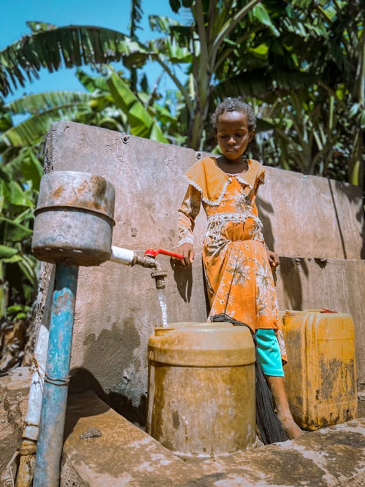
What will I study in this subject?
Unit 4: Health and human development in a global context
This unit explores health and human development in a global context. Students examine the health status and human development of different countries, exploring factors that contribute to health inequalities between and within countries, such as access to safe water and poverty. Students investigate worldwide trends that influence health and wellbeing and human development including climate change, conflict and digital technologies. Students also explore global action to improve health and human development, including the United Nations’ (UN’s) Sustainable Development Goals (SDGs) and the priorities of the World Health Organization (WHO). Students also spend time evaluating the effectiveness of aid programs and how individuals can take action to promote health and human development.

Slide 4
How will I be assessed?
Unit 3 SACs | Marks allocated | Percent contribution to study score
Outcome 1 | 50 (may be split into 2 x 25-mark SACs) | 12.5%
Outcome 2 | 50 (may be split into 2 x 25-mark SACs) | 12.5%
Unit 4 SACs | Marks allocated | Percent contribution to study score
Outcome 1 | 50 (may be split into 2 x 25-mark SACs) | 12.5%
Outcome 2 | 50 (may be split into 2 x 25-mark SACs) | 12.5%
End of year exam | Marks allocated | Percent contribution to study score
All Units 3&4 content | Yet to be determined - most likely 90 marks | 50%

Slide 5


Achieving success in vce hhd
How do I ensure I achieve an 'S' for this subject?
You must achieve an 'S' in each of the outcomes to pass this subject and obtain your study score. In order to do this, you need to ensure the following:
- You complete all SACs.
- You maintain high levels of class attendance.
- You complete set coursework such as assigned textbook questions and homework.
What is our holiday homework?
Over the holidays you must complete the following:
- All sections of the Transition Booklet.
- The assigned Textbook Questions.
- Notes on the first two key knowledge points - 3.1.1 and 3.1.2.

Slide 6
Transition timeline
Unit, Area of Study and Outcome | Week | Key knowledge | Key Skills | Coursework and Assessment tasks
Unit 3 - Australia’s health in a globalised world Area of Study 1 - Understanding health and wellbeing Outcome 1 | 1 and 2 | Concepts of health and wellbeing (physical, social, emotional, mental and spiritual dimensions), illness, and the dynamic and subjective nature of these concepts Benefits of optimal health and wellbeing and its importance as a resource individually, nationally and globally | Explain the dynamic and subjective nature of the concepts of health and wellbeing and illness Describe the relationship between dimensions of health and wellbeing Explain the individual, national and global importance of health and wellbeing as a resource | Holiday homework: Complete Transition Booklet and Textbook Questions

Slide 7

Unit 3
Area of study 1 OUtcome
On completion of this unit, the student should be able to explain the complex, dynamic and global nature of health and wellbeing, interpret and apply Australia’s health status data, and analyse variations in health status.

Slide 8

Key knowledge and skills – 3.1.1
Key knowledge point
Concepts of health and wellbeing (physical, social, emotional, mental and spiritual dimensions), illness, and the dynamic and subjective nature of these concepts
Key skills
Explain the dynamic and subjective nature of the concepts of health and wellbeing and illness
Describe the relationship between dimensions of health and wellbeing

Slide 9
What is health and wellbeing?
Five dimensions
Equilibrium in which the individual feels happy, healthy, capable and engaged
Health and wellbeing
Description: Health and wellbeing relates to a person’s physical, social, emotional, mental and spiritual existence, and is characterised by an equilibrium in which the individual feels happy, healthy, capable and engaged.
Not long ago, we referred to just ’health’ and not ‘health and wellbeing’, however in this course, we consider health and wellbeing to be one concept. Wellbeing is an implicit element of health, it is a complex combination of all dimensions of health, characterised by a state of equilibrium in which the individual feels happy, healthy, capable and engaged.

Slide 10
What are the dimensions of health and wellbeing?
Physical
Mental
Emotional
Social
Spiritual
'Physical MESS'
The concept of health and wellbeing has evolved over time, in the past, there was a greater focus on just the physical aspect of health and wellbeing, but as society has evolved, we have come to understand that all of the various dimensions of health and wellbeing are important and play a role in maintaining high levels of overall health and wellbeing. It is important to acknowledge that these five dimensions of health a​re not isolated but are interrelated and influence each other.
Physical MESS is a useful mnemonic to remember the five dimensions of health and wellbeing.

Slide 11

What is optimal health and wellbeing?
Optimal health and wellbeing is not necessarily having high levels of all of the five dimensions at once. It is much easier to give one example at a time. Therefore, if a question asks about how something might promote optimal health and wellbeing, make sure you link to high levels of a specific dimension using an example.
For example, regular exercise might help an individual to promote a well-functioning body and systems, and this would be an example of optimal physical health and wellbeing.
To properly consider what optimal health and wellbeing is, we first need to look at the five dimensions of health and wellbeing and examples of each.

Slide 12

What is physical health and wellbeing?
Description: Physical health and wellbeing relates to the functioning of the body and its systems and it includes the physical capacity to perform daily activities or tasks.
Physical health and wellbeing is supported by factors such as regular physical activity, consuming a balanced diet, having appropriate rest/sleep, maintaining an ideal body weight, and the absence of illness, disease or injury.
On the next slide, the examples of the physical dimension of health and wellbeing demonstrate characteristics or ‘key phrases’ that you include in your answers when making links to physical health and wellbeing.

Slide 13
What is optimal physical health and wellbeing?
Optimal physical health and wellbeing
Well-functioning immune system
Adequate energy levels
Healthy body weight
Able to complete daily physical tasks
Adequate levels of fitness
Absence of disease and illness
Well-functioning body and systems

Slide 14

What activities can promote physical health and wellbeing?
When referring to this dimension, it is useful to think about how to use examples of optimal physical health and wellbeing in an answer, as this demonstrates that you are making a clear link to the dimension.
Consider how the two examples of participating in a sports team and eating a healthy diet can promote the physical dimension of health and wellbeing.
Sports team: Participating in sport regularly might help to maintain adequate levels of fitness for an individual, thus helping to promote optimal physical health and wellbeing.
Eating a healthy diet: Eating a diet that includes adequate food from the five food groups such as fruit and vegetables, will help to promote a well-functioning immune system (optimal physical health and wellbeing).

Slide 15
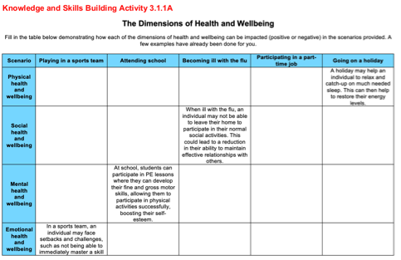
Complete the Knowledge and skills building activity 3.1.1a in your booklet
Complete the first row of the table in your booklet regarding how the physical dimension of health and wellbeing can be impacted in the scenarios provided.

Slide 16

What is social health and wellbeing?
Description: Social health and wellbeing relates to the ability to form meaningful and satisfying relationships with others and the ability to manage or adapt appropriately to different social situations.
Social health and wellbeing also includes the level of support provided by family and within a community to ensure that every person has equal opportunity to function as a contributing member of the society.
Social health and wellbeing is supported by strong communication skills, empathy for others and a sense of personal accountability.
On the next slide, the examples of the social dimension of health and wellbeing demonstrate characteristics or ‘key phrases’ that you include in your answers when making links to social health and wellbeing.

Slide 17
What is optimal social health and wellbeing?
Optimal social health and wellbeing
Well-functioning network of family and friends
Able to clearly communicate with others
Able to manage or adapt to different social settings
Able to develop and maintain relationships with others
Positive contributions to social groups and the community

Slide 18

What activities can promote social health and wellbeing?
When referring to this dimension, it is useful to think about how to use examples of optimal social health and wellbeing in an answer, as this demonstrates that you are making a clear link to the dimension.
Consider how the two examples of attending school and having a part time job can promote the social dimension of health and wellbeing.
Attending school: At school a student may learn the skills required to communicate effectively while preparing for an oral presentation, such as clear communication skills.
Part time job: Whilst working at a part-time job, an individual may make friends with their colleagues, and develop meaningful and satisfying relationships with these people.

Slide 19
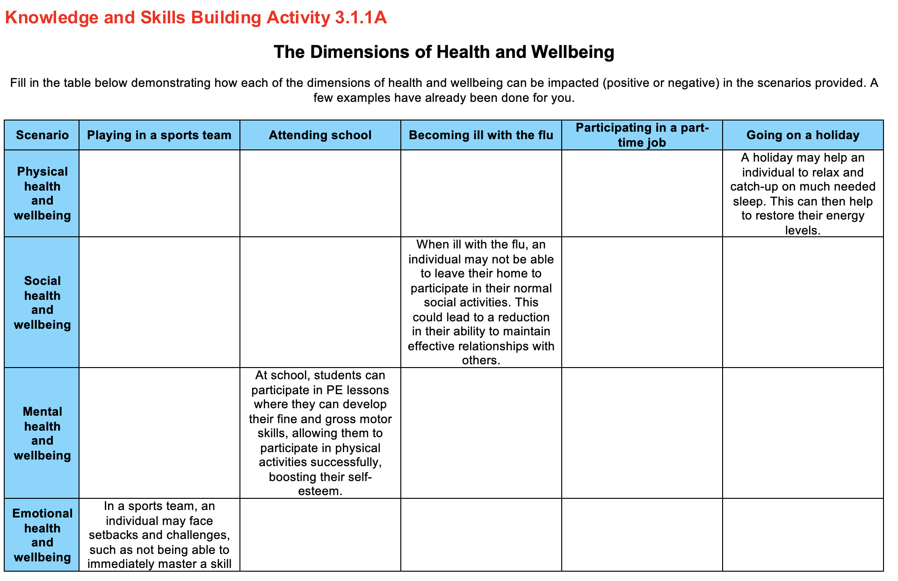
Complete the Knowledge and skills building activity 3.1.1a in your booklet
Complete the second row of the table in your booklet regarding how the social dimension of health and wellbeing can be impacted in the scenarios provided.

Slide 20
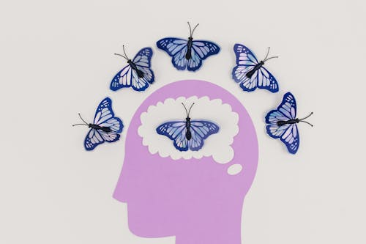
What is mental health and wellbeing?
Description: Mental health is the current state of wellbeing relating to the mind or brain and it relates to the ability to think and process information. A mentally healthy brain enables an individual to positively form opinions, make decisions and use logic.
Mental health is about the wellness of the mind rather than illness. Mental health is associated with low levels of stress and anxiety, positive self-esteem, as well as a sense of confidence and optimism.
On the next slide, the examples of the mental dimension of health and wellbeing demonstrate characteristics or ‘key phrases’ that you include in your answers when making links to mental health and wellbeing.

Slide 21
What is optimal mental health and wellbeing?
Optimal mental health and wellbeing
Confidence in yourself and your abilities
Able to reason and form opinions and make decisions
Optimistic and have positive thought patterns
Low levels of anxiety and stress
Able to think logically and problem solve
High levels of self-esteem

Slide 22

What activities can promote mental health and wellbeing?
When referring to this dimension, it is useful to think about how to use examples of optimal mental health and wellbeing in an answer, as this demonstrates that you are making a clear link to the dimension.
Consider how the two examples of attending music lessons and regularly meditating can promote the mental dimension of health and wellbeing.
Attending music lessons: By attending music lessons an individual may learn to play an instrument which could build their confidence and self-esteem in their musical ability and promote their mental health and wellbeing.
Regularly meditating: By regularly meditating each night this may act as an outlet to relieve the stress and anxiety that an individual may have built up during a busy day, thus promoting their mental health and wellbeing.

Slide 23
Complete the Knowledge and skills building activity 3.1.1a in your booklet
Complete the third row of the table in your booklet regarding how the mental dimension of health and wellbeing can be impacted in the scenarios provided.

Slide 24

What is emotional health and wellbeing?
Description: Emotional health relates to the ability to express feelings in a positive way. Emotional health is about the positive management and expression of emotional actions and reactions, as well as the ability to display resilience.
Emotional health is the degree to which you feel emotionally secure and relaxed in everyday life.
On the next slide, the examples of the emotional dimension of health and wellbeing demonstrate characteristics or ‘key phrases’ that you include in your answers when making links to emotional health and wellbeing.

Slide 25
What is optimal emotional health and wellbeing?
Optimal emotional health and wellbeing
Able to display resilience
Able to recognise and understand a wide range of emotions in others
Able to respond to and manage your own emotions appropriately
Able to experience appropriate emotions in a range of different scenarios

Slide 26
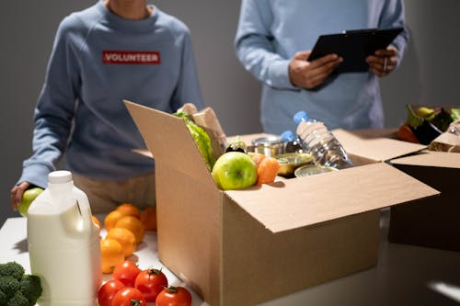
What activities can promote emotional health and wellbeing?
When referring to this dimension, it is useful to think about how to use examples of optimal emotional health and wellbeing in an answer, as this demonstrates that you are making a clear link to the dimension.
Consider how the two examples of being part of a friendship group and volunteering can promote the emotional dimension of health and wellbeing.
Being in a friendship group: Over time you may encounter personal challenges such as being unsuccessful at a job application, but you may learn to overcome these set-backs and challenges with the support and advice of your friends. This can help to build your resilience and promote your emotional health and wellbeing.
Volunteering: By regularly volunteering, you may encounter a range of challenging scenarios with clients that put your emotional regulation to the test, such as dealing with anger and frustration. However, you may have colleagues that role model how to respond appropriately to these challenges by discussing their feelings, helping you to develop and promote your emotional health and wellbeing.

Slide 27
Complete the Knowledge and skills building activity 3.1.1a in your booklet
Complete the fourth row of the table in your booklet regarding how the emotional dimension of health and wellbeing can be impacted in the scenarios provided.

Slide 28

What is spiritual health and wellbeing?
Description: Spiritual health is not material in nature, but relates to ideas, beliefs, values and ethics that arise in the minds and conscience of human beings. Spiritual health includes the concepts of hope, peace, a guiding sense of meaning or value, and reflection on your place in the world.
Spiritual health can be highly individualised, for example, for some spiritual health may relate to organised religion, a higher power and prayer, whilst for others it can relate to morals, values, a sense of purpose in life, connection and/or belonging.
In the next slide, the examples of the spiritual dimension of health and wellbeing demonstrate characteristics or ‘key phrases’ that you include in your answers when making links to spiritual health and wellbeing.

Slide 29
What is optimal spiritual health and wellbeing?
Optimal spiritual health and wellbeing
A sense of meaning and purpose in life
Living by a set of values and beliefs
A sense of hope for a positive future
A sense of belonging and connection to something greater than yourself
Being at peace and reflecting on your place within the world

Slide 30

What activities can promote spiritual health and wellbeing?
When referring to this dimension, it is useful to think about how to use examples of optimal spiritual health and wellbeing in an answer, as this demonstrates that you are making a clear link to the dimension.
Consider how the two examples of running a business and being involved in an organised religion can promote the spiritual dimension of health and wellbeing.
Running a business: Being responsible for running a business may give an individual a sense of meaning and purpose in their life, helping them to stay motivated to embrace each day.
Being involved in an organised religion: By participating in an organised religion, this may help individuals to develop a set of morals and values to help guide their daily lives, helping to promote their spiritual health and wellbeing.

Slide 31
Complete the Knowledge and skills building activity 3.1.1a in your booklet
Complete the fifth row of the table in your booklet regarding how the spiritual dimension of health and wellbeing can be impacted in the scenarios provided.

Slide 32
Exploring relationships between the dimensions of health and wellbeing
As mentioned previously, the five dimensions of health a​re not isolated but influence each other. You need to be able to demonstrate relationships between the dimensions of health and wellbeing. Consider the examples on the next slide.
Social health and wellbeing
Emotional health and wellbeing
Mental health and wellbeing
Physical health and wellbeing
Spiritual health and wellbeing

Slide 33
Exploring relationships between the dimensions of health and wellbeing
Regularly participating in a sports team can allow you to develop meaningful and satisfying relationships with your teammates (social health and wellbeing).
These relationships may act as an outlet for you to vent your frustrations about day-to-day life and relieve daily stresses and anxieties you may have (mental health and wellbeing).
Having a part-time job may improve your ability to work as part of a team and communicate effectively about your ideas (social health and wellbeing).
Having strong communication skills may help you to express your emotions when you are feeling sad or frustrated, helping you to manage these emotions effectively (emotional health and wellbeing).

Slide 34
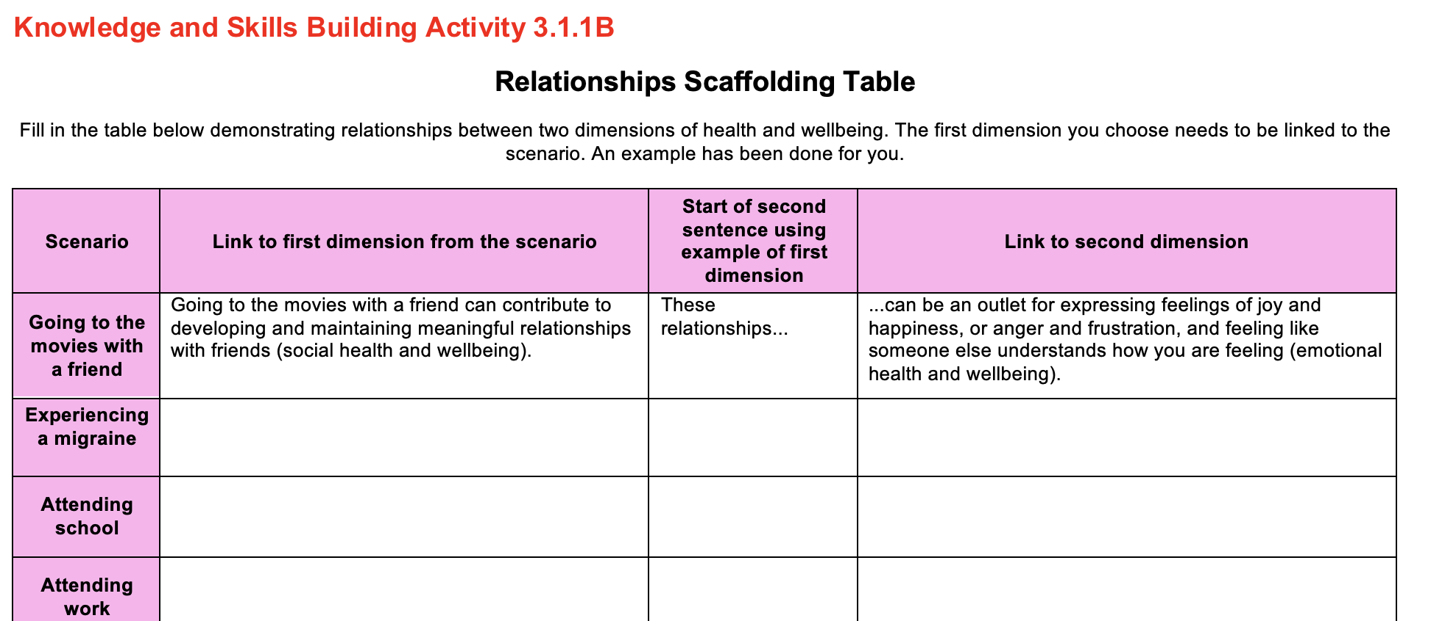
Complete the Knowledge and skills building activity 3.1.1B in your booklet
Complete the Relationships Scaffolding Table in your booklet demonstrating relationships between the dimensions of health and wellbeing. The first dimension you choose needs to be linked to the scenario provided.

Slide 35

What do the terms dynamic and subjective mean?
In this course, the term dynamic refers to something that is constantly changing or can change quickly.
The term subjective refers to something that can be viewed differently by different people.
Health and wellbeing and illness, are both dynamic and subjective.

Slide 36
Health and wellbeing is dynamic
The health and wellbeing experienced by an individual is dynamic, meaning that it is constantly changing or can change quickly. When describing this concept, ensure you always show the change in health and wellbeing that has occurred. Consider the following two examples related to this concept:
A person may start playing a game of sport pain free and in full physical fitness. They may then be involved in an incident on the field where they break their leg, resulting in significant pain and discomfort and an inability to continue playing.
An individual may feel like they lack direction and purpose in their life. They may then get an opportunity to volunteer regularly for an organisation that helps others in need, and this may provide them with a clear sense of purpose.

Slide 37
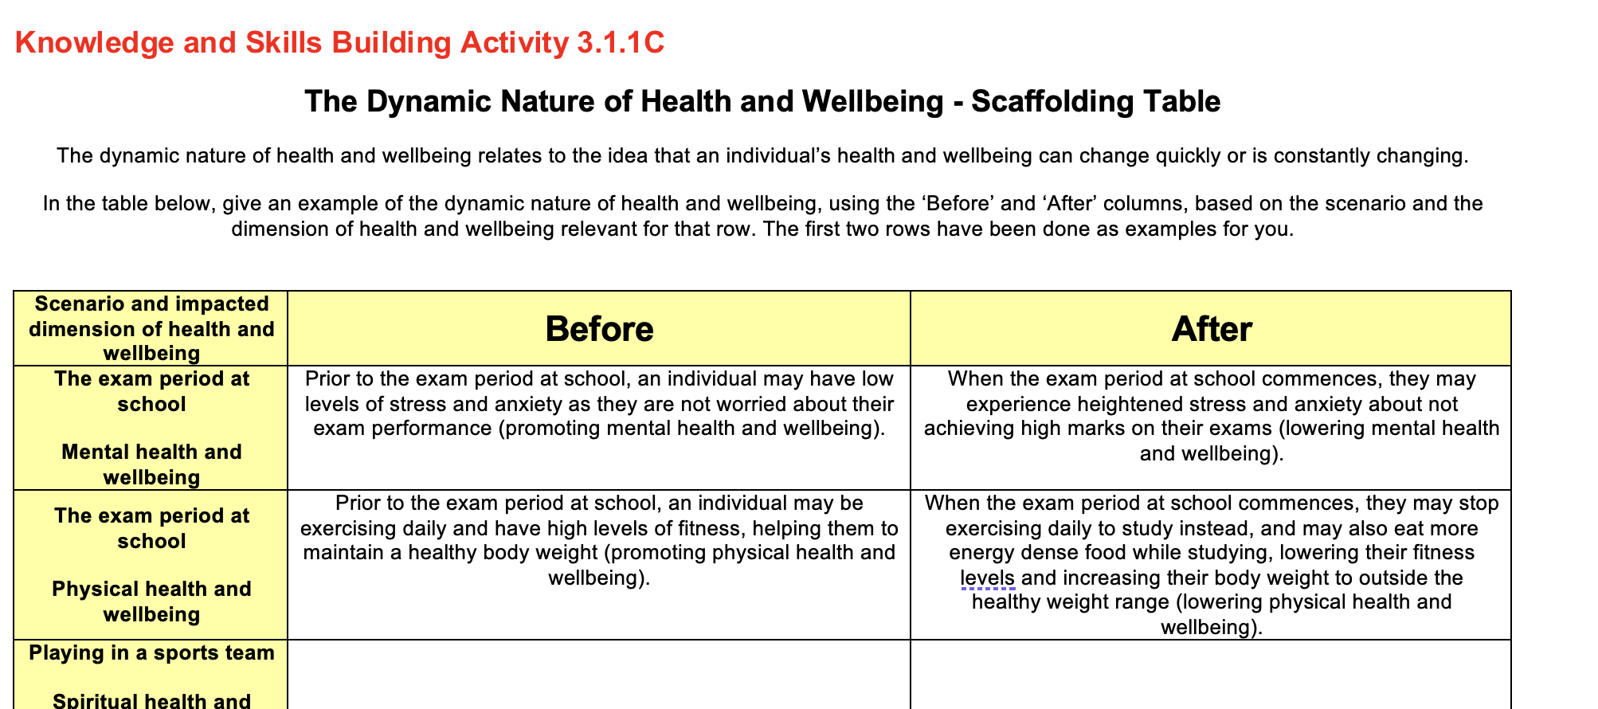
Complete the Knowledge and skills building activity 3.1.1C in your booklet
Complete the Dynamic Nature of Health and Wellbeing - Scaffolding Table in your booklet.

Slide 38
Health and wellbeing is subjective
The concept of health and wellbeing can be viewed in many different ways and is therefore said to be subjective. There are a range of different factors that can influence how people may view health and wellbeing, and this includes education level, age, culture and life experiences such as having a disability or health condition. Consider the following two examples related to this concept:
An older person may consider good health and wellbeing as the absence of any chronic diseases and the ability to live independently and look after themselves without help from others. A younger person may view good health and wellbeing as high levels of physical fitness and having a healthy body weight.
One person may consider having a large group of close old high school friends that they see regularly, as good social health and wellbeing, whereas another person may consider having two close work friends who they go away on a weekend with twice a year, as having good social health and wellbeing.

Slide 39
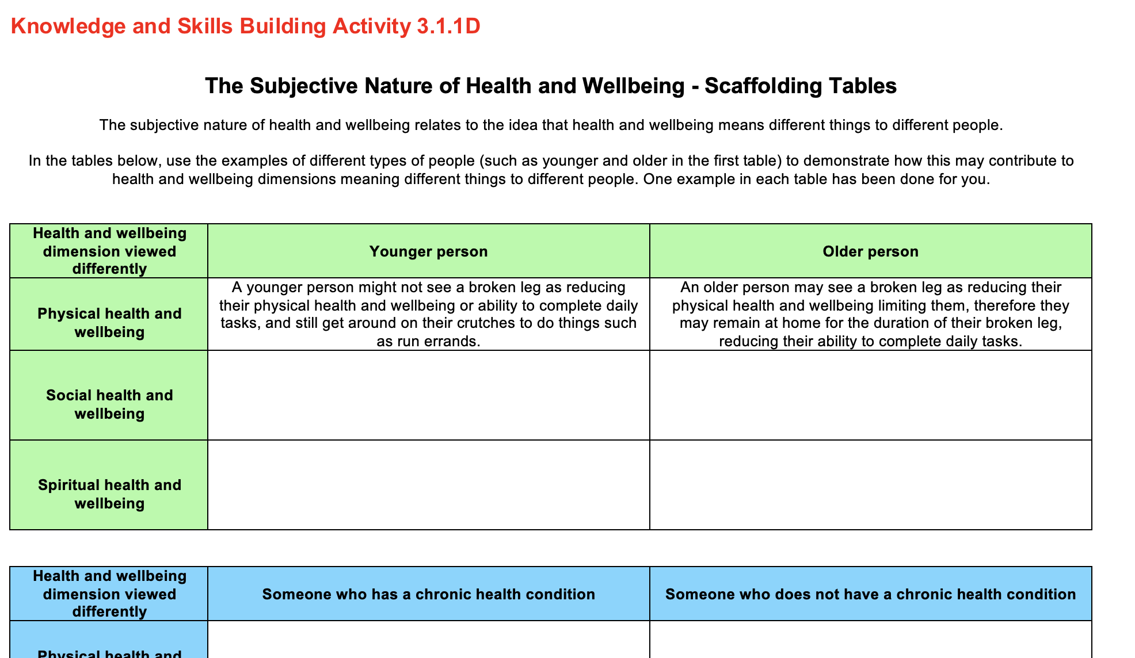
Complete the Knowledge and skills building activity 3.1.1D in your booklet
Complete the Subjective Nature of Health and Wellbeing - Scaffolding Tables in your booklet.

Slide 40
What is illness and what is disease?
Description: Illness is a subjective concept related to personal experience of a disease. e.g. Feeling ill due to having influenza.
Description: Disease is a physical or mental disturbance involving symptoms, dysfunction or tissue damage. e.g. Being diagnosed with the disease cancer.
Illness is different to disease, as illness relates to how someone feels about or experiences having a disease.
Illness
Disease

Slide 41

illness is dynamic and subjective
Just like health and wellbeing, illness is dynamic because it can change quickly and constantly evolves as a person experiences disease. Often the initial onset of a disease can cause the most pain and discomfort, but over time with treatment and rest, there is often a change in the experience of a disease, and it may resolve or get better with a reduction in pain and discomfort.
Illness is also subjective, as different people will experience disease in different ways. There are a range of factors that can influence this, such as past experiences with disease, age and access to supports.
For example, two people may have the same disease however one person may have lived with it and managed it for a long period of time, and therefore not consider themselves to be ill. Another person may have been newly diagnosed with the disease, and not be managing it well, and consider themselves very ill.

Slide 42
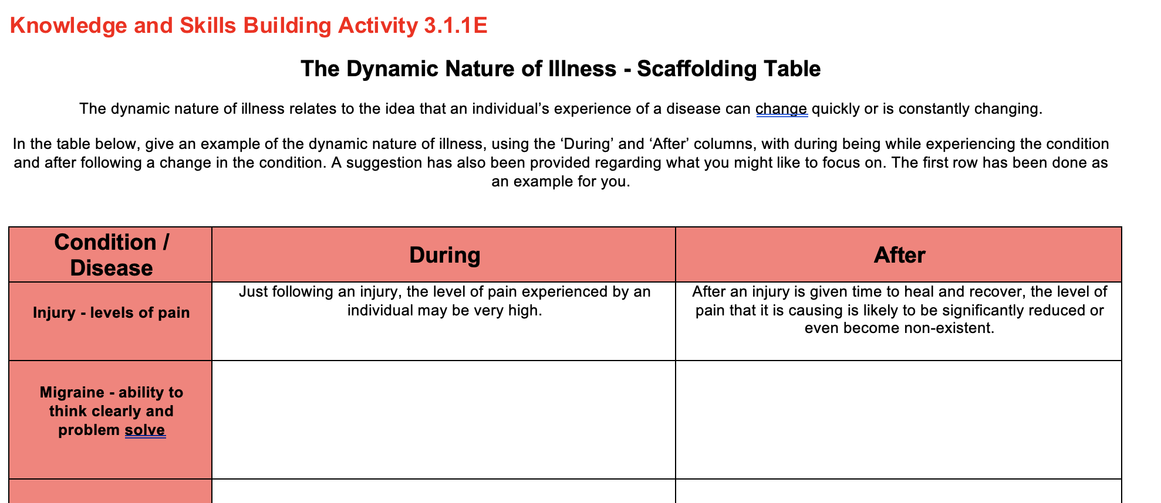
Complete the Knowledge and skills building activity 3.1.1E in your booklet
Complete the Dynamic Nature of Illness - Scaffolding Table in your booklet.

Slide 43
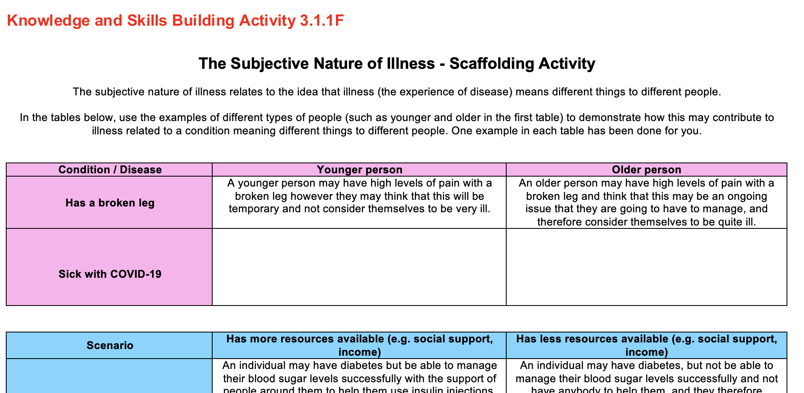
Complete the Knowledge and skills building activity 3.1.1f in your booklet
Complete the Subjective Nature of Illness - Scaffolding Table in your booklet.

Slide 44

Assessment tips
If a question asks about ‘health and wellbeing’, you should be referring to one or more dimensions of health and wellbeing in your answer.
If a question asks about ‘optimal health and wellbeing’, you should be referring to high levels of one or more dimensions of health and wellbeing in your answer.
You should use the style of question and the number of marks allocated to help guide the level of depth you provide in your answers.
From the Study Design: ‘For the purposes of this study, the term ‘health’ is a broad, overarching term that includes the concepts of health and wellbeing, health status and associated health outcomes.’ Therefore, if a question asks how something may influence or promote health or health outcomes, you should be referring to one or more dimensions of health and wellbeing or health status indicators in your answer.
Remember, you should always write a term such as health and wellbeing out in full before abbreviating this to something such as ‘H&W’. Only abbreviations found in the Study Design are not required to be written out in full before being used as an abbreviation. e.g. HALE

Slide 45

Key skills and common questions
The key skills for this section of the course are:
Explain the dynamic and subjective nature of the concepts of health and wellbeing and illness
Describe the relationship between dimensions of health and wellbeing.
Therefore, common questions may include:
- A case study/scenario where you are asked to identify an example of the dynamic or subjective nature of health and wellbeing or illness, and then explain how your example represents the concept.
- A case study/scenario where you are asked to describe how the dimensions of wellbeing are connected to one another, using information from the stimulus material as the basis of your response.

Slide 46

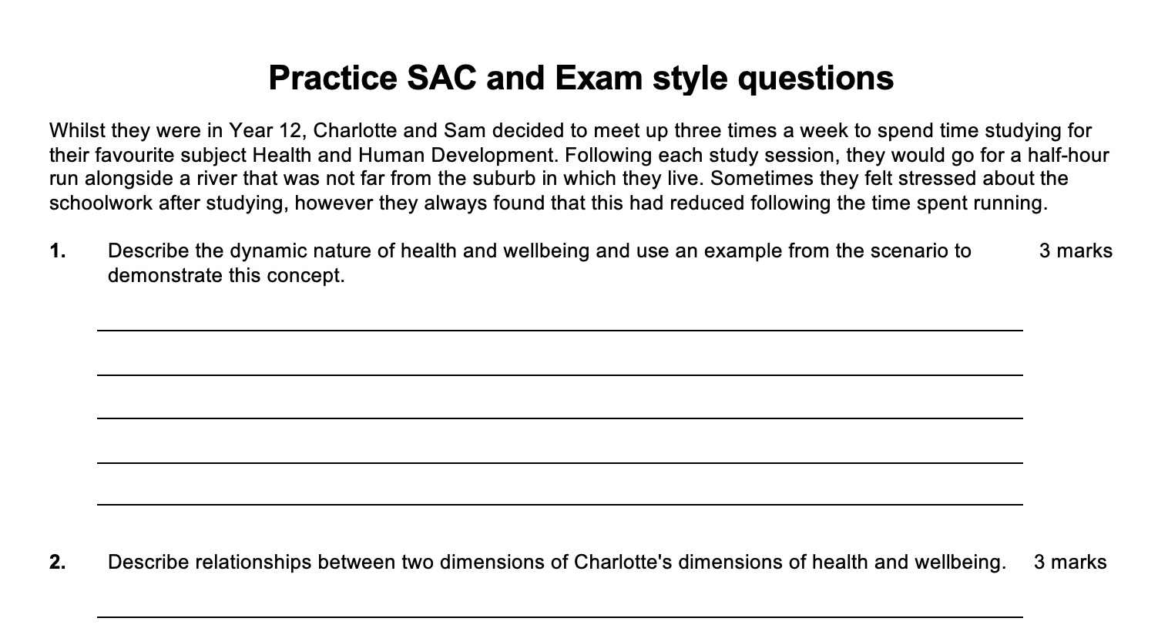
Complete the practice sac and exam style questions in your booklet
Complete the practice SAC and Exam style questions in your booklet.

Slide 47
Key knowledge and skills – 3.1.2
Key knowledge point
Benefits of optimal health and wellbeing and its importance as a resource individually, nationally and globally
Key skill
Explain the individual, national and global importance of health and wellbeing as a resource

Slide 48
What is a resource and how is optimal health and wellbeing a resource?
Individually
Nationally
Globally
A resource is typically thought of as something that can be drawn upon as required.
We have previously considered that optimal health and wellbeing is when we are experiencing high levels of one or more of the dimensions of health and wellbeing.
When this occurs, we are able to draw on our health and wellbeing to engage in a variety of activities, many of which benefit us as individuals, in addition to our nation and the world. Thus, optimal health and wellbeing can be considered as a resource individually, nationally and globally.

Slide 49
Optimal health and wellbeing as a resource individually
Importance of optimal health and wellbeing for individuals.
It allows someone to…
Attend school and gain an education
Play sport and maintain high levels of fitness
Spend time with friends and maintain satisfying relationships
Attend work and earn an income
Care for and raise a family
Sleep well and restore energy levels
Work towards their purpose in life
For individuals, there are many ways that optimal health and wellbeing acts as a resource, that is, things it allows them to do.
Each day, most people either attend some form of formal education or attend work, and this would be difficult to do if they were not experiencing high levels of health and wellbeing. In addition to this, optimal health and wellbeing allows us to partake in sporting and leisure activities and spend time with our friends. There are many different examples that could be given, as indicated in the flow chart to the right.
If a question asks how optimal health and wellbeing can act as a resource for an individual, it would be a good idea to link this back to a dimension of health and wellbeing. For example, you might state ‘Optimal health and wellbeing means an individual is well enough to participate in a sporting team and maintain a healthy body weight and high levels of fitness’.

Slide 50
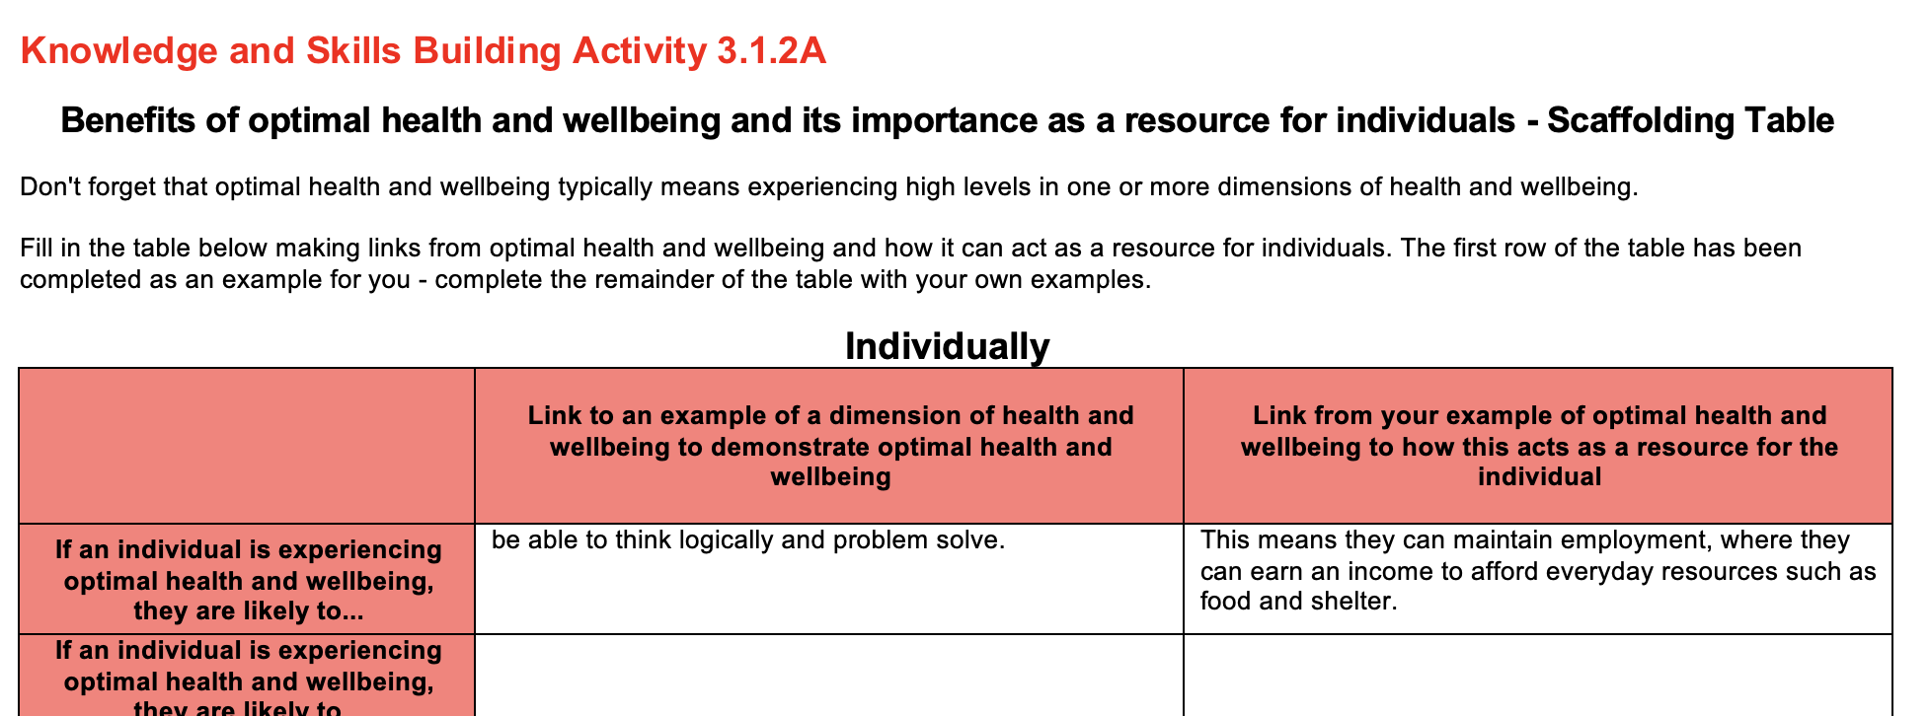
Complete the Knowledge and skills building activity 3.1.2a in your booklet
Complete the scaffolding table related to optimal health and wellbeing as a resource for individuals.

Slide 51
Optimal health and wellbeing as a resource nationally
Importance of optimal health and wellbeing nationally
More people can attend work and contribute tax revenue to the government to spend on national priorities
More people can engage in the community in groups and activities such as volunteering
Less people in the health system provides more space and opportunities for others who are unwell to be treated
Less people are relying on social security and funds saved can be redirected to other national priorities
More people are well enough to consider engaging in the defence of the nation as needed
There are many benefits to a country or nation as a result of its citizens experiencing optimal health and wellbeing.
For example, when people within a country are well, they are less likely to spend time in hospital, freeing up healthcare places and funds can be directed towards other people in the country who are unwell. In addition, when people are well and attending work, the government is able to collect tax revenue that can be directed towards national infrastructure or education programs that can benefit the country.
You should know a number of examples similar to these as well as those in the diagram to your right.

Slide 52
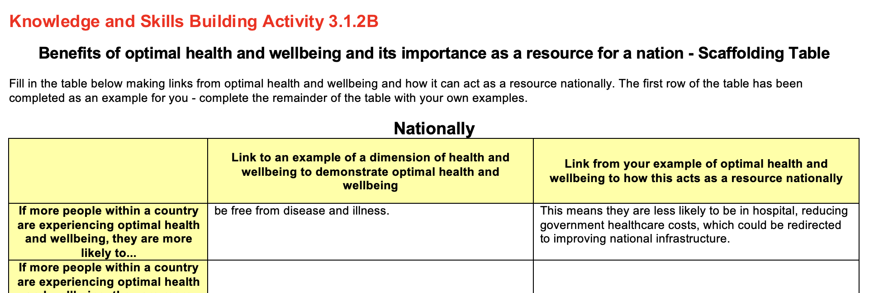
Complete the Knowledge and skills building activity 3.1.2B in your booklet
Complete the scaffolding table related to optimal health and wellbeing as a resource nationally.

Slide 53
Optimal health and wellbeing as a resource globally
Importance of optimal health and wellbeing globally
People can work together on global challenges such as climate change
Contributes to global peace and stability as people are less likely to feel desperate and unfairly treated
People are more likely to be able to attend work and contribute to global trade and economic development
Reduces the risk of disease transmission between countries
The world or globe benefits when people are experiencing optimal health and wellbeing.
For example, when more people across the world have optimal levels of health and wellbeing, they can attend work which can contribute to increasing levels of global trade and economic development. This means more people are earning an income, which in turn helps to reduce global levels of poverty.
In addition to this, there is a reduced risk of disease transmission across borders and between countries when more people are experiencing high levels of health and wellbeing globally.
You should know a number of examples similar to these as well as those in the diagram to your right.

Slide 54
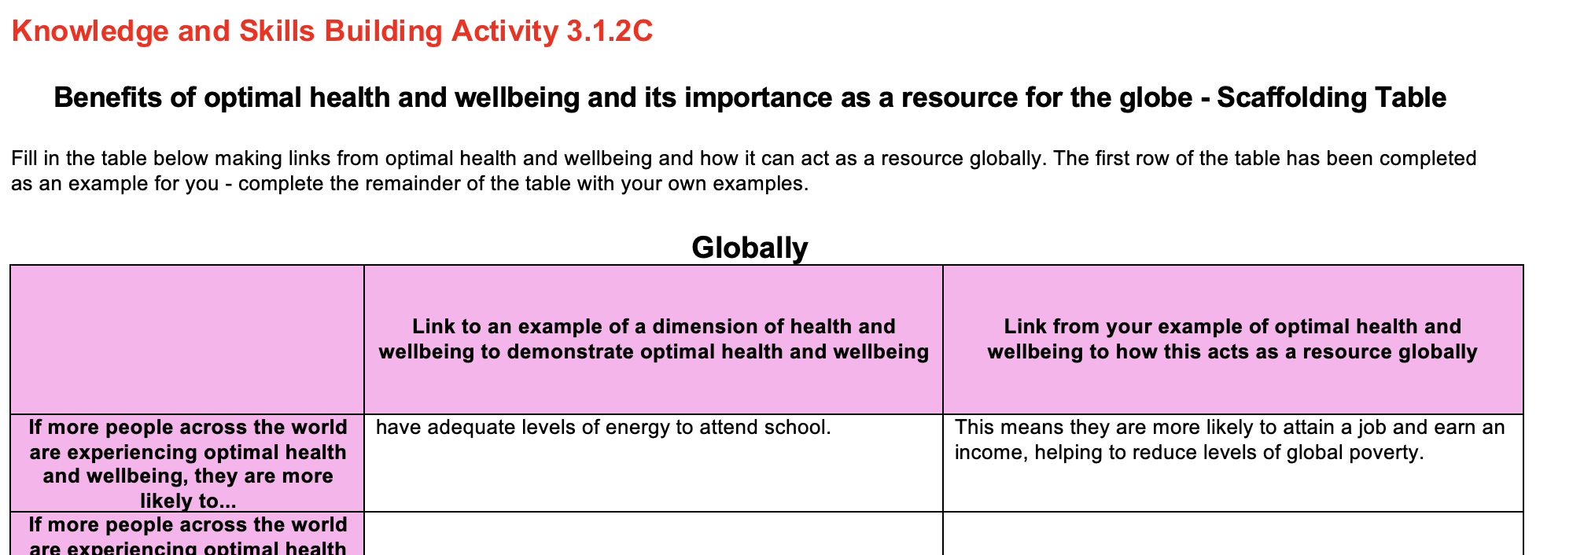
Complete the Knowledge and skills building activity 3.1.2C in your booklet
Complete the scaffolding table related to optimal health and wellbeing as a resource globally.

Slide 55
Assessment tips
This key knowledge point is related to ‘optimal’ health and wellbeing as a resource. So, when a question is asking about this aspect of the course, think to yourself, how is the example I am providing making a link to optimal health and wellbeing?
When appropriate, start your answer with ‘…… contributes to more/less people experiencing optimal/improved health and wellbeing…’, from here, you can then link in to how this will benefit either the individual, nation or globe.
Consider the sample question and answer below.
Question:
Explain how a reduction in people suffering from lung cancer in Australia act as a resource nationally. (2 marks)
Sample answer:
A reduction in lung cancer contributes to more people experiencing improved health and wellbeing. Therefore, these people are then more likely to be well enough to attend work and earn an income, whereby the government can collect more tax revenue to invest in national infrastructure.

Slide 56
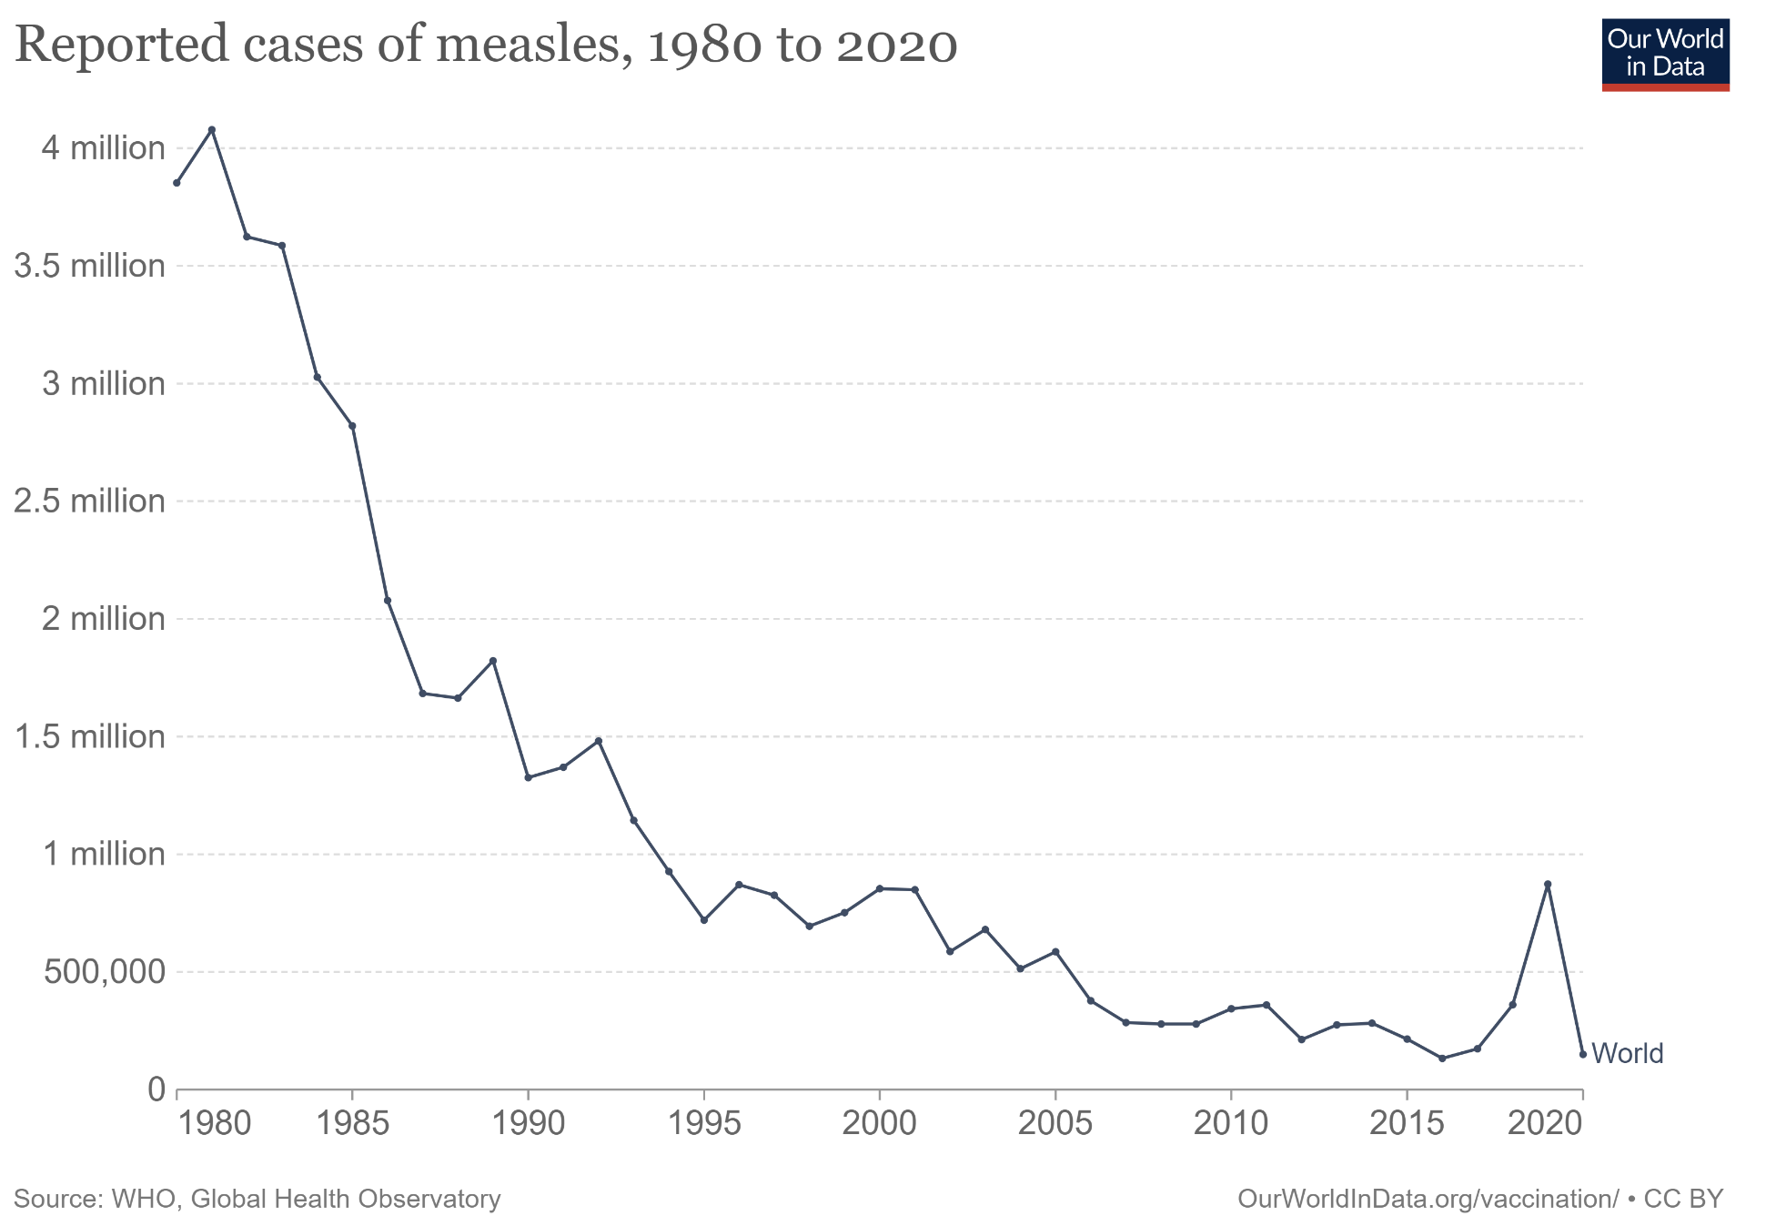
Key skills and common questions
The key skill for this section of the course is:
Explain the individual, national and global importance of health and wellbeing as a resource
Other than just being able to give examples of how optimal health and wellbeing can act as a resource individually, nationally and globally, you could be asked to consider some data or a case study/scenario and explain how the information provided could be linked to the individual, national and global importance of health and wellbeing as a resource. Consider the data and sample question on the right.
Question: Explain how the overall change in the reported cases of measles in the graph from 1980 to 2015 may have acted as a resource globally. (2 marks)
Similar to what was discussed on the previous slide, less people experiencing measles from 1980 to 2015 means more people were likely to be experiencing optimal health and wellbeing across the world. From here, you can then link this to how it could act as a resource globally.

Slide 57
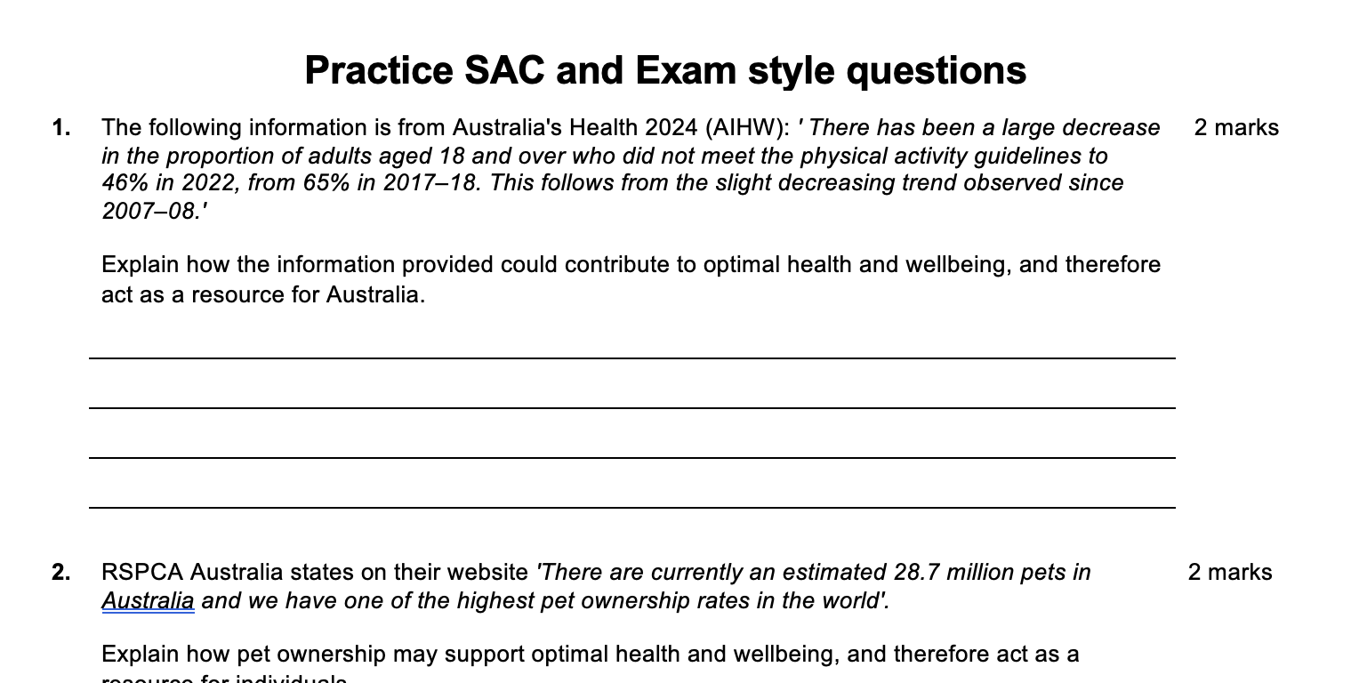
Complete the practice sac and exam style questions in your booklet
Complete the practice SAC and Exam style questions in your booklet.

