Slide 1
Finding Happiness in the Simple Things
Miss Zeleznik
Inspired by: Suzanne Dailey

Slide 2
Lesson Objective
Today, we are going to learn how to make small shifts in our thinking to become happier people!
This Photo by Unknown Author is licensed under CC BY-NC

Slide 3
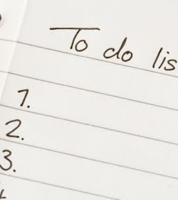
Accomplishing Tasks Happier
This Photo by Unknown Author is licensed under CC BY-NC

Slide 4
Everyone has a routine, even Mr. Bean!!!

Slide 5
What are some routines that you accomplish daily?

Slide 6
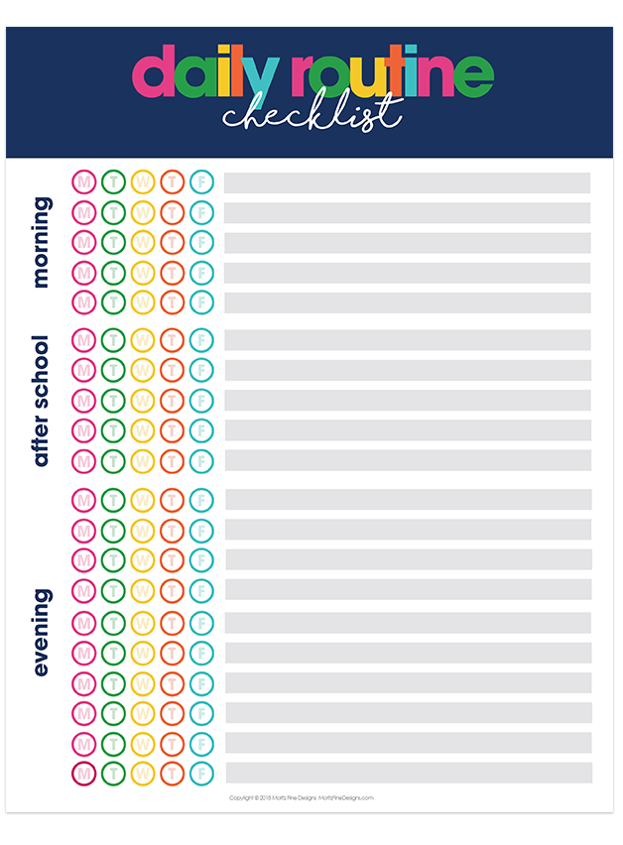
Our Routine Responsibilities are the Boss of Us
We cannot take away some of our routines.
Examples: Clearing the table after dinner, walking our dog, doing our homework
There is, however, a strategy to make the less desirable responsibilities a little bit more enjoyable!

Slide 7
Pair the Routine with Something that Makes You Happy!
In other words, accomplish the task happier!
For example, while you are clearing the table for your family listen to music!
Or, while you are cleaning your room watch the next episode of your favorite Netflix show on your iPad or television!
This Photo by Unknown Author is licensed under CC BY-SA

Slide 8
If You Can’t Change the Situation…Change the Way You Approach It!
You cannot change the task that you have to accomplish, but you can change the way approach it and the things that surround it!
Doing this makes you accomplish the task happier!!!

Slide 9
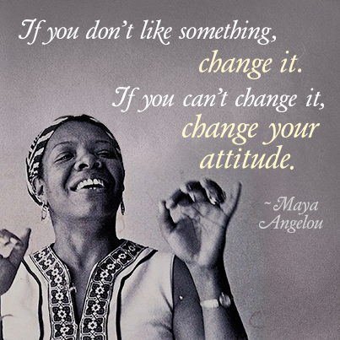

Slide 10
You’re invited to think about your daily routines and accomplish tasks happier!
Open Microsoft Word and title the document Daily Routines.
Write down your daily routines from the time you wake up until the time you go to bed.
Example: Brush my teeth, get dressed for school, eat breakfast, pack my school bag…
Pick a routine that you can pair with something positive, such as music or a TV show.
Type what you are going to pair the routine with.
Save the document in your Social Emotional Wellness folder.
Try pairing the routine!

