Slide 1
Finding Happiness in the Simple Things
Miss Zeleznik
Inspired by: Suzanne Dailey

Slide 2
Lesson Objective
Today, we are going to learn how to make small shifts in our thinking to become happier people!
This Photo by Unknown Author is licensed under CC BY-NC

Slide 3
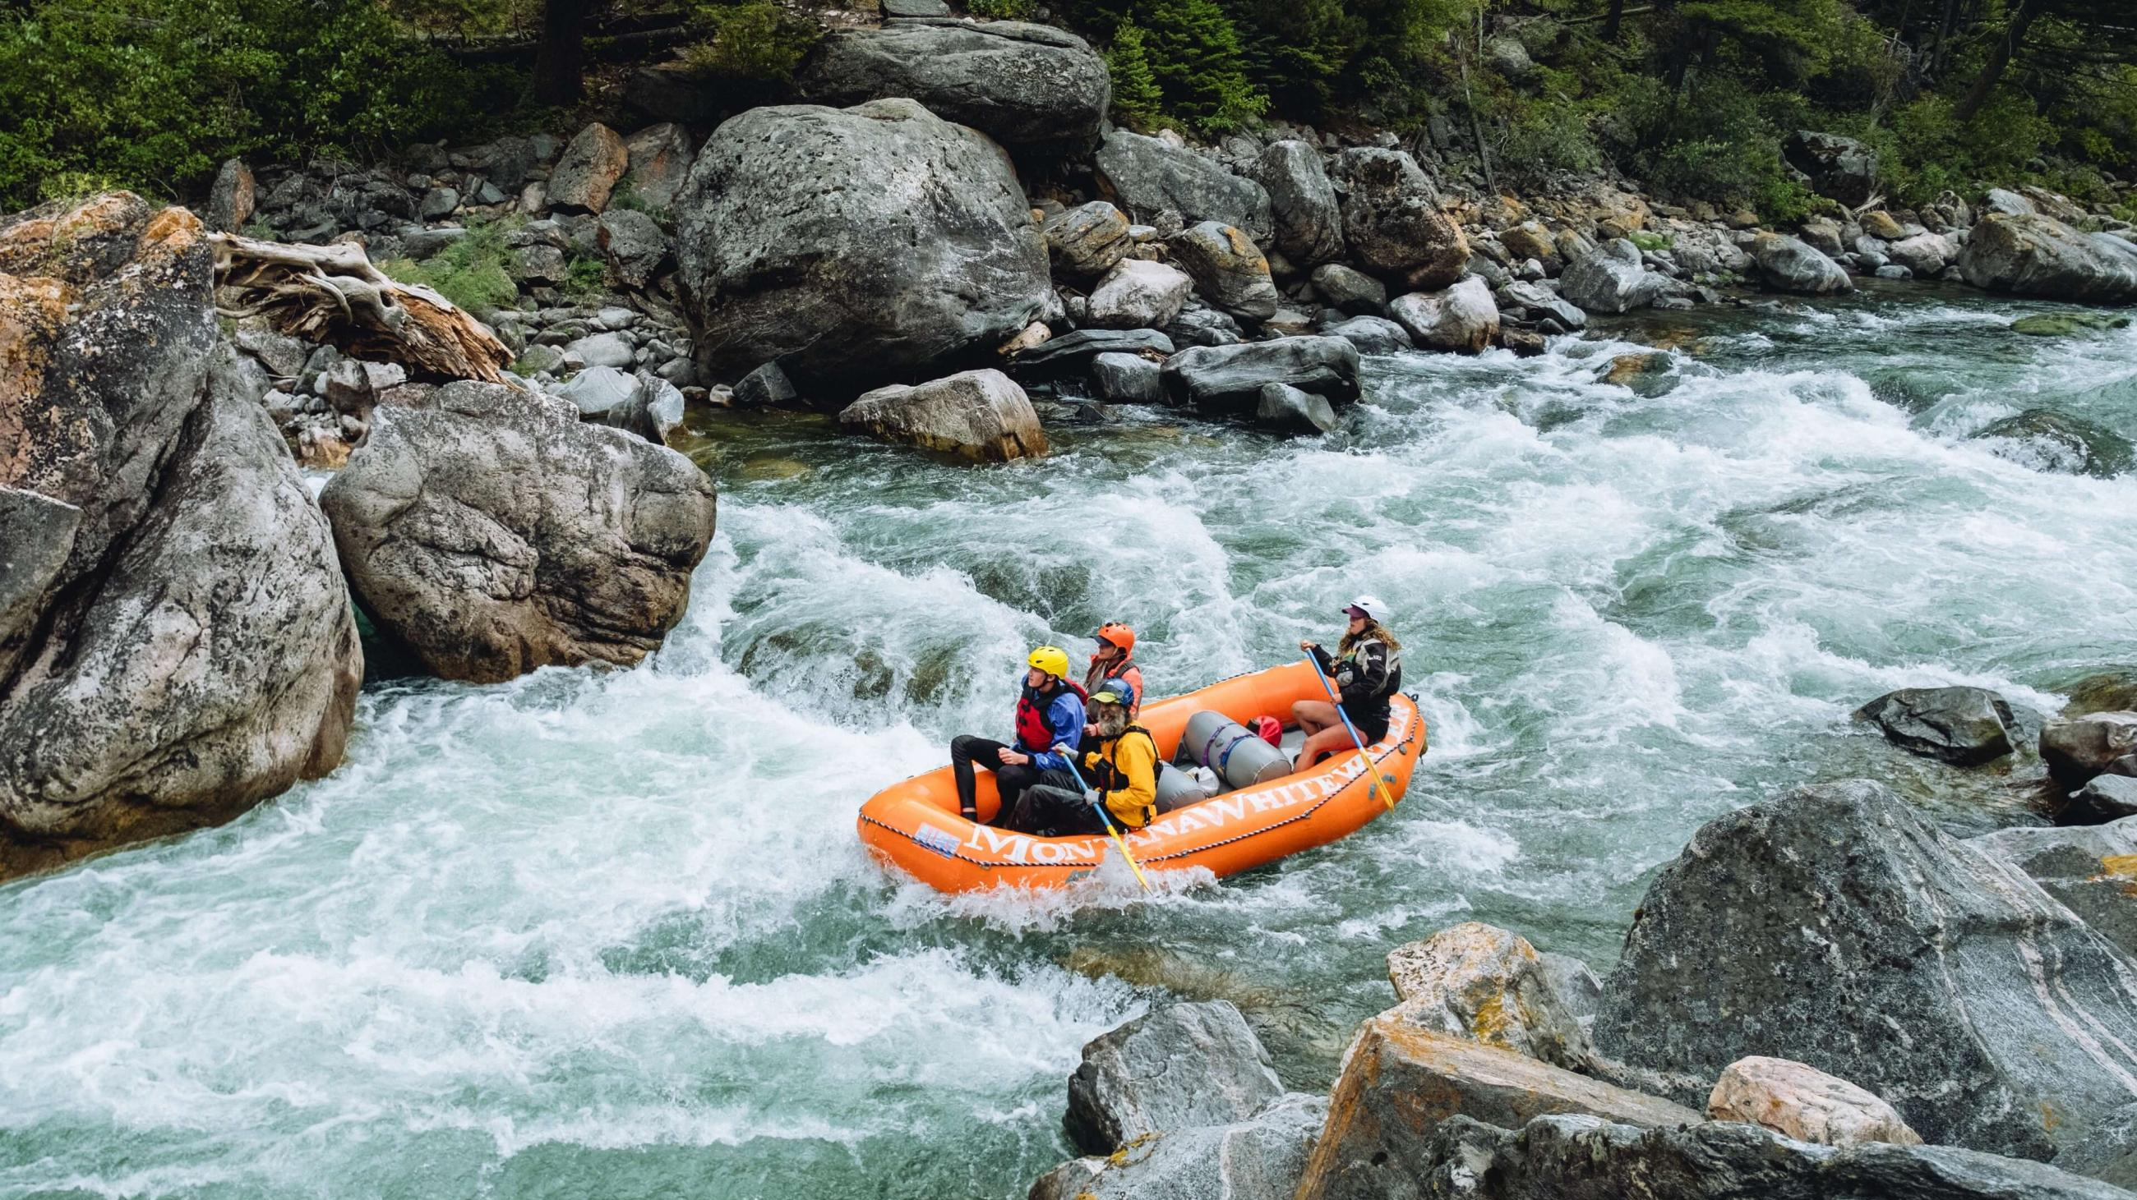
Be Your Own Rescue

Slide 4
Have you ever been white water rafting?
Notes:
Strong social relationships!

Slide 5
How do many white water rafters get rescued after an incident?
Notes:
Strong social relationships!

Slide 6
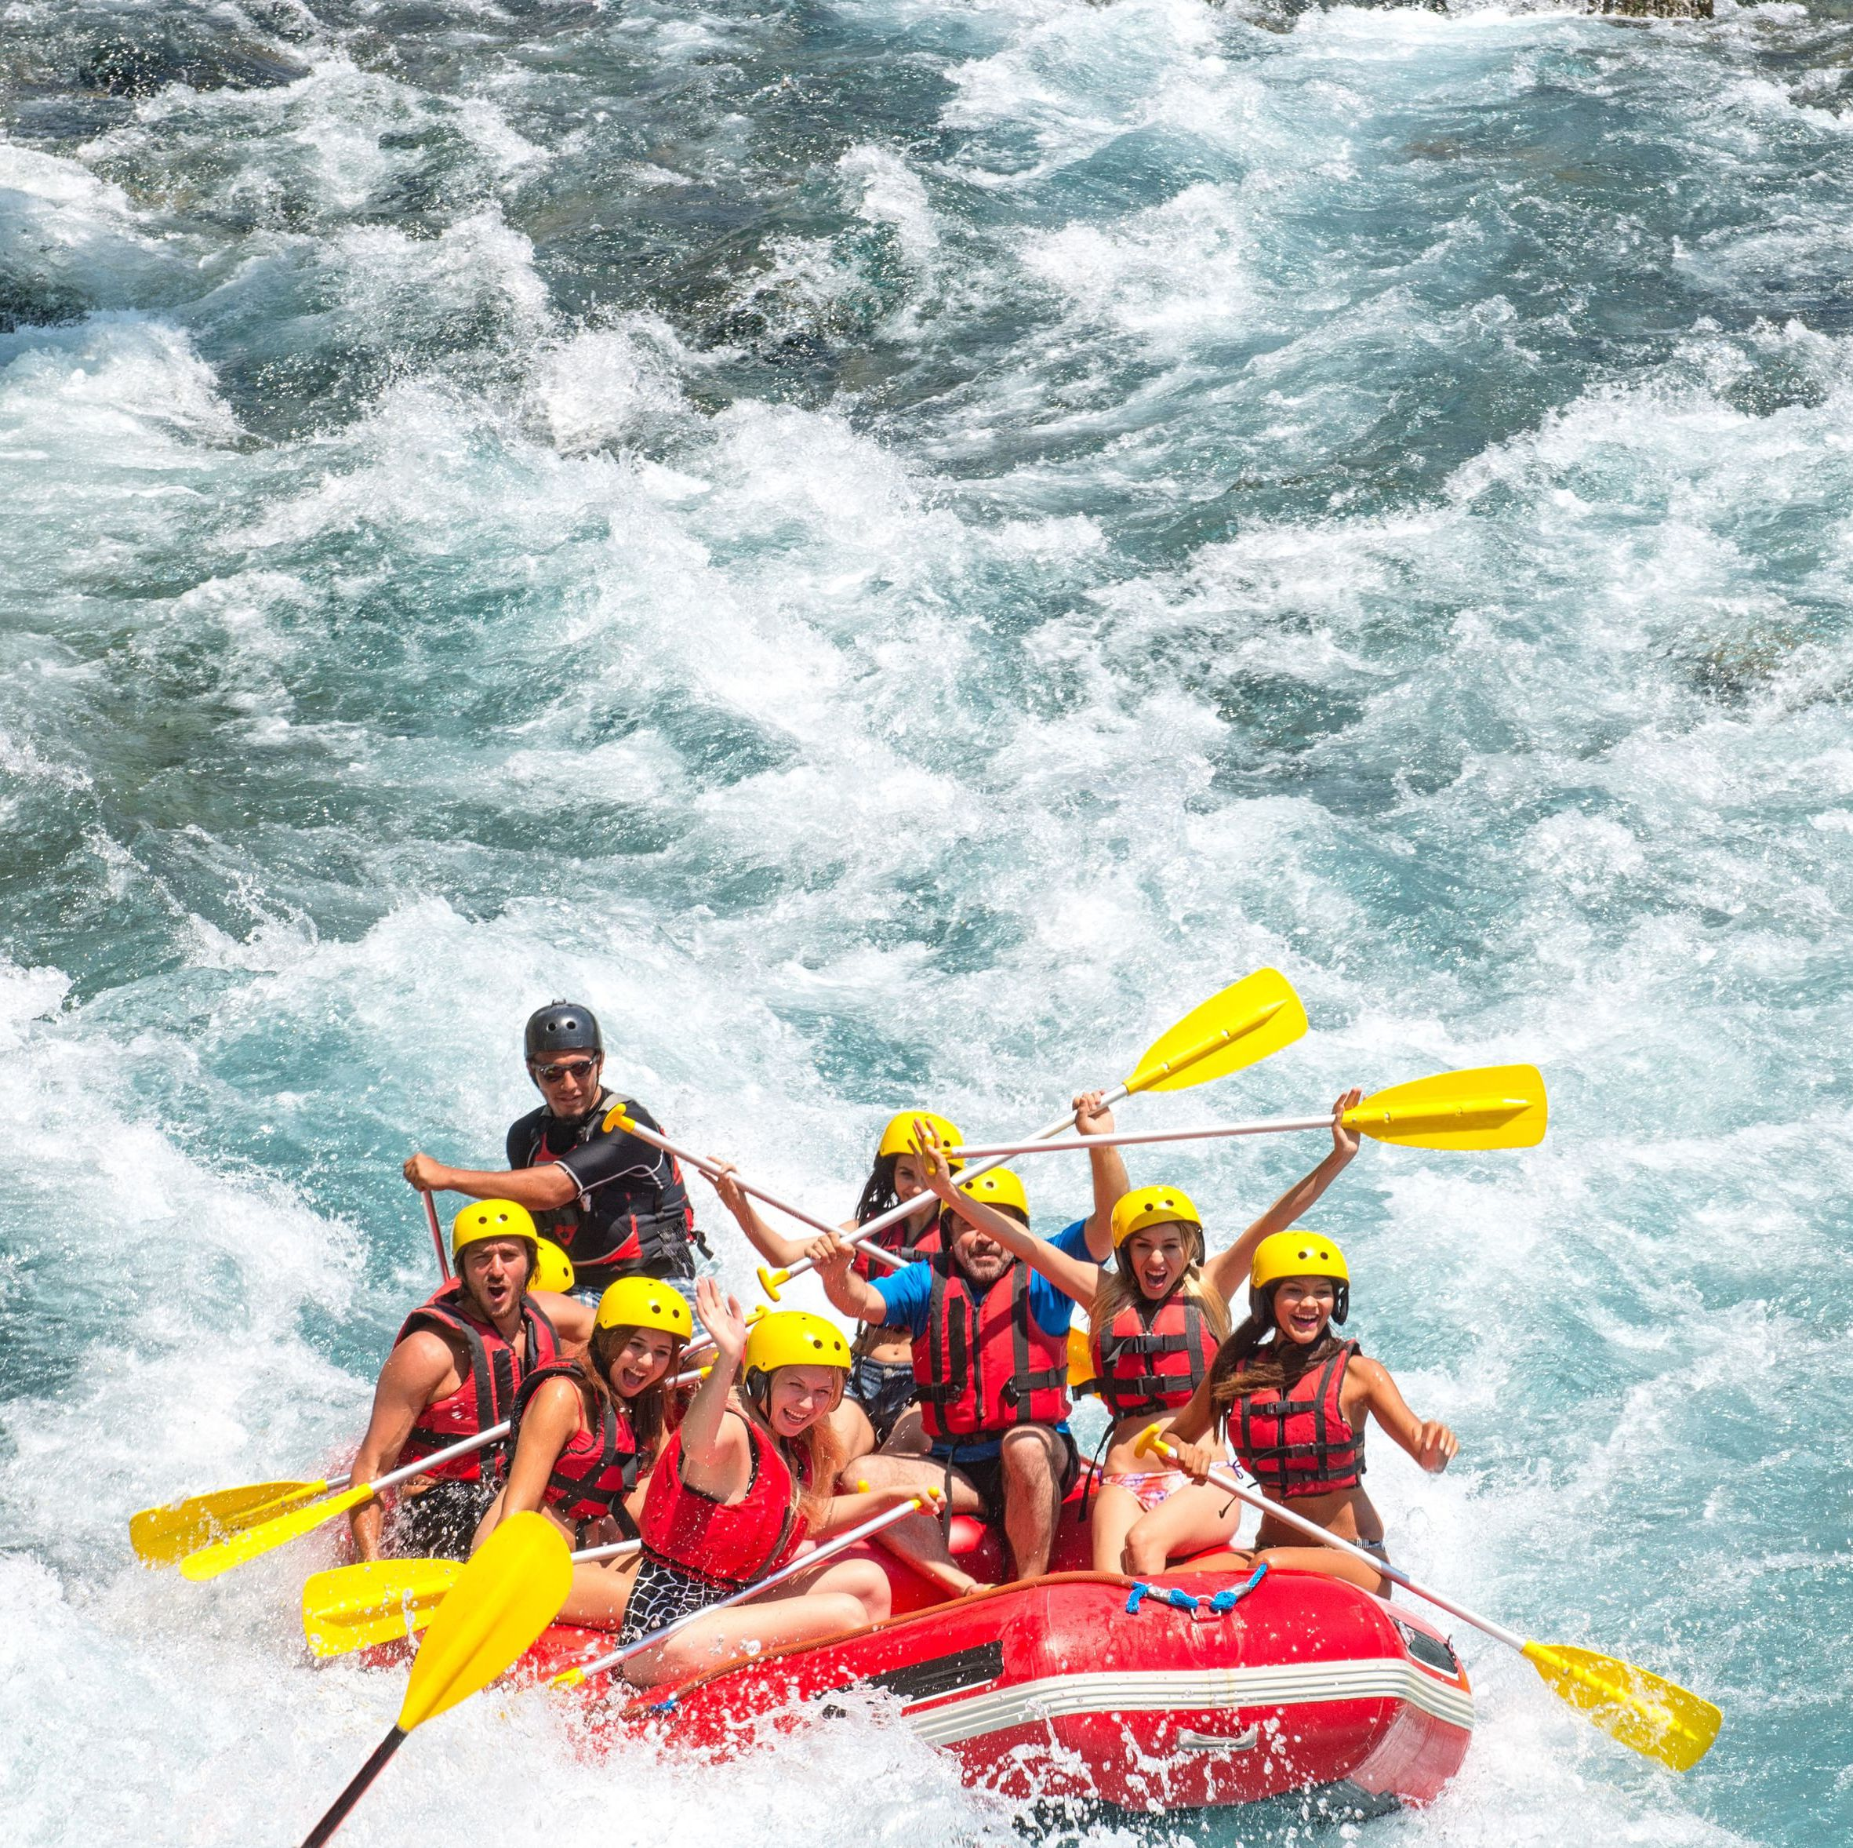
The First Rule
The first rule in white water rafting is that if you end up off the raft is be a part of your own rescue.
This is a great metaphor for our lives!

Slide 7
How does this relate to our lives?
Do you ever have a day where you feel like your life is just completely overwhelming?
Example: You have a couple of tests to study for, soccer practice, places to go with your family, and no time to study.
At this point, you are just about ready to give up and call it a day!

Slide 8
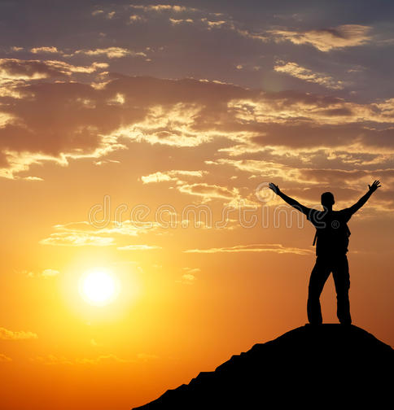
Who Should Help Us?!?!
When we get off course, and we are having a really rough day, we need to be a part of our own rescue (just like the white water rafters)!
Even though we don’t need a paddle, we need to do something!
For example, if you have a million things going on, you might need to find some time at the end of the day to take time for yourself.
Or, if you are having a hard time finding time to study, then you need to set aside a specific time to study in between all of the other craziness!

Slide 10
You’re invited to be your own rescue!
Log into your computer!
Title your document as Be Your Own Rescue
When you are having a crazy day, and you need a moment to decompress, explain how you can be a part of your own rescue!
Will you set aside time to read a book?
Listen to music?
Take a walk?

