Slide 1

Finding Happiness in the Simple Things
Miss Zeleznik
Inspired by: Suzanne Dailey

Slide 2

Lesson Objective
Today, we are going to learn how to make small shifts in our thinking to become happier people!
This Photo by Unknown Author is licensed under CC BY-NC

Slide 3

Choose Your Hard

Slide 4
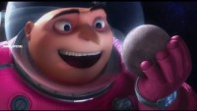
What decision does Gru have to make?
Notes:
Strong social relationships!

Slide 5
Have you ever had to make a tough decision before?
Notes:
Strong social relationships!

Slide 6
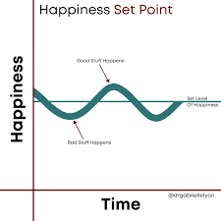
Happiness Baseline
Everyone has a different happiness baseline.
Happiness is a discipline, and it often takes work to increase our happiness.
Depending on our current situation it can be hard to increase our happiness.

Slide 7

Choosing Happiness
Telling someone to choose happiness feels like toxic positivity.
  If it was that easy, we all would choose happiness (duh!!!)
We know that there are practices based in positive psychology that help increase our happiness.
  Examples: Performing conscious acts of kindness, practicing gratitude, time for stillness.
  All of these practices take time, effort, and energy

Slide 8

Choosing Your Hard
On Glennon Doyle’s Podcast “We Can Do Hard Things”, she talks about how happiness can be hard.
But, we get to choose our hard.

Slide 9

Choosing Your Hard Examples
Being out of shape is hard, but being in shape is hard – choose your hard!
Studying for a test is hard, but the feeling of failing a test is hard – choose your hard!
Change is hard, but doing the same thing over and over is hard – choose your hard!
Nurturing relationships is hard, but not having relationships is hard – choose your hard!
Waking up early is hard, but waking up late and rushing is hard – choose your hard!

Slide 10

Life
Part of the price of admission to life is understanding that it is hard!
But, there are things within our realm of influence and control.
  We need to lean into those things.
Sometimes that takes a little more time, effort, and energy.
It can be hard, but it is worth it!
When making hard decisions, big or small, we should consider which hard thing has the potential to bring us the most amount of happiness.

Slide 11
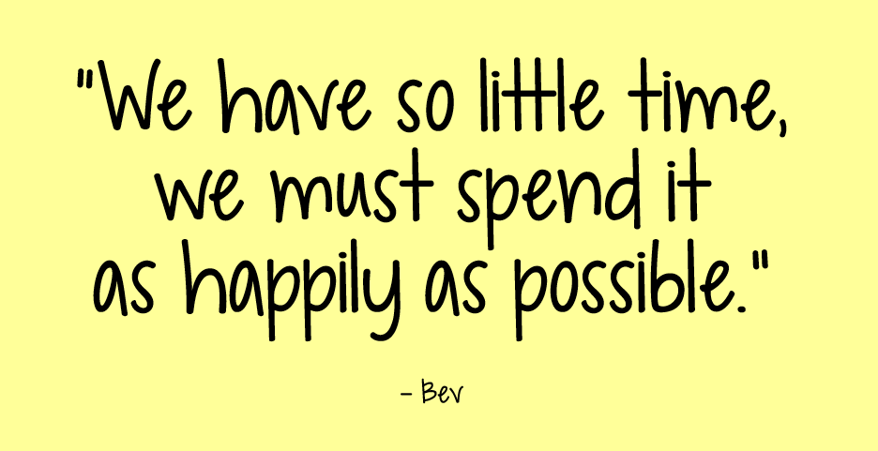

Slide 12

You’re invited to choose your hard!
Write your name and date at the top of your paper.
Title your paper as “Choose Your Hard”
Make a list of two examples where you have to choose your hard, and pick which option you would choose that will make you happy!
Examples:
  Waking up early is hard, but waking up late and rushing is hard – choose your hard!
  Studying for a test is hard, but the feeling of failing a test is hard – choose your hard!
You will have an opportunity to share some of your choices with the class!

