Slide 1
Finding Happiness in the Simple Things
Miss Zeleznik
Inspired by: Suzanne Dailey

Slide 2
Lesson Objective
Today, we are going to learn how to make small shifts in our thinking to become happier people!
This Photo by Unknown Author is licensed under CC BY-NC

Slide 3
For Right Now

Slide 5
When you feel sad, or anxious, does it ever feel like you are stuck in that emotion?

Slide 6
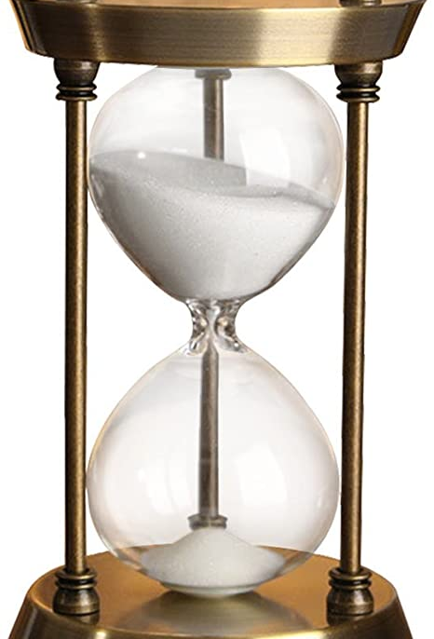
Let’s Try Something New!!!!
What would happen if we declared how we are feeling, but also acknowledged that the feeling was temporary?

Slide 7
Small Shift
All you have to do is add three words when describing our emotions.
FOR RIGHT NOW.
By adding the phrase FOR RIGHT NOW to whatever we are feeling it can actually change our perspective and overall outlook.

Slide 8
Let’s Give it a Try!
I’m frustrated…for right now.
I’m really sad…for right now.
I’m overwhelmed…for right now.
Do you see the shift?
When we add for right now, we understand that the uncomfortable feelings we are having are temporary.
Better times are coming!

Slide 9
What About Positive Thoughts?
I’m joyful…for right now.
I’m so excited…for right now.
I’m grateful…for right now.
When we add for right now for the positive feelings, we actually get to savor the moment a bit more.
It can help us appreciate it while it is here!

Slide 10
For Right Now
Whether we are sad, happy, or something in between, when we add the phrase “for right now”, we can zoom out of our emotions and see the bigger picture.
This feeling won’t last forever, and it is part of the journey we will inevitably experience!

Slide 11
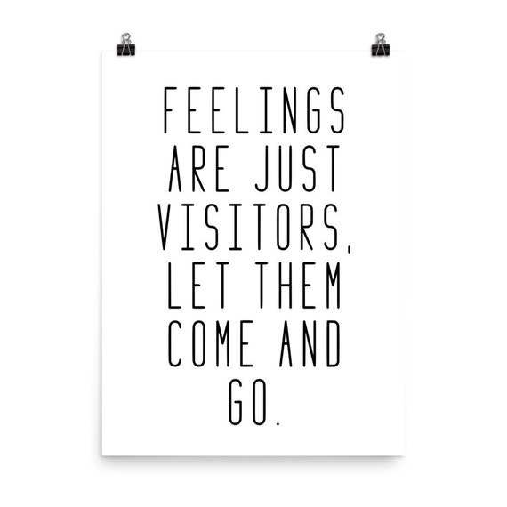

Slide 12
You’re invited figure out which emotion you’re feeling FOR RIGHT NOW!!
Please complete the Microsoft Forms Survey
Title: “For Right Now” Survey
Link to Survey
Remember:
For right now, helps to remind us that uncomfortable feelings are only temporary!
It also helps us savor positive emotions!

