Slide 1

Finding Happiness in the Simple Things
Miss Zeleznik
Inspired by: Suzanne Dailey

Slide 2

Lesson Objective
Today, we are going to learn how to make small shifts in our thinking to become happier people!
This Photo by Unknown Author is licensed under CC BY-NC

Slide 3

Here Comes the Sun

Slide 4
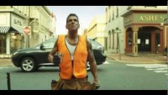
How do these acts of kindness make people feel?
Conscious Acts of Kindness
Notes:
Play first minute and a half of clip

Slide 5
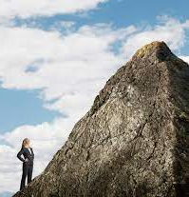
Shawn Achor’s Study
Shawn Achor shares a study in his book Big Potential.
He had people look at a hill and give their perception of the slope of the hill.
Then, he had the same people look at the same hill again with someone they trusted standing next to them.
This time the hill looked 10-20% less steep.

Slide 6

Here Comes the Sun
Mrs. Dailey had a friend who got sick. During this time, she felt the warmth and love from others supporting her during this challenging time.
She related it to the times when the sun goes behind the clouds, and then all of a sudden it just comes out and you feel its warmth all around you.
When people were helping her, it made her feel warm, safe, and supported.

Slide 7

Strong Social Relationships
We have learned that 100% of happy people have the same thing in common – STRONG SOCIAL RELATIONSHIPS.
Conscious acts of kindness help your friends feel supported and warm during hard times.

Slide 8
How has a friend helped you in the past when you needed it the most?

Slide 9
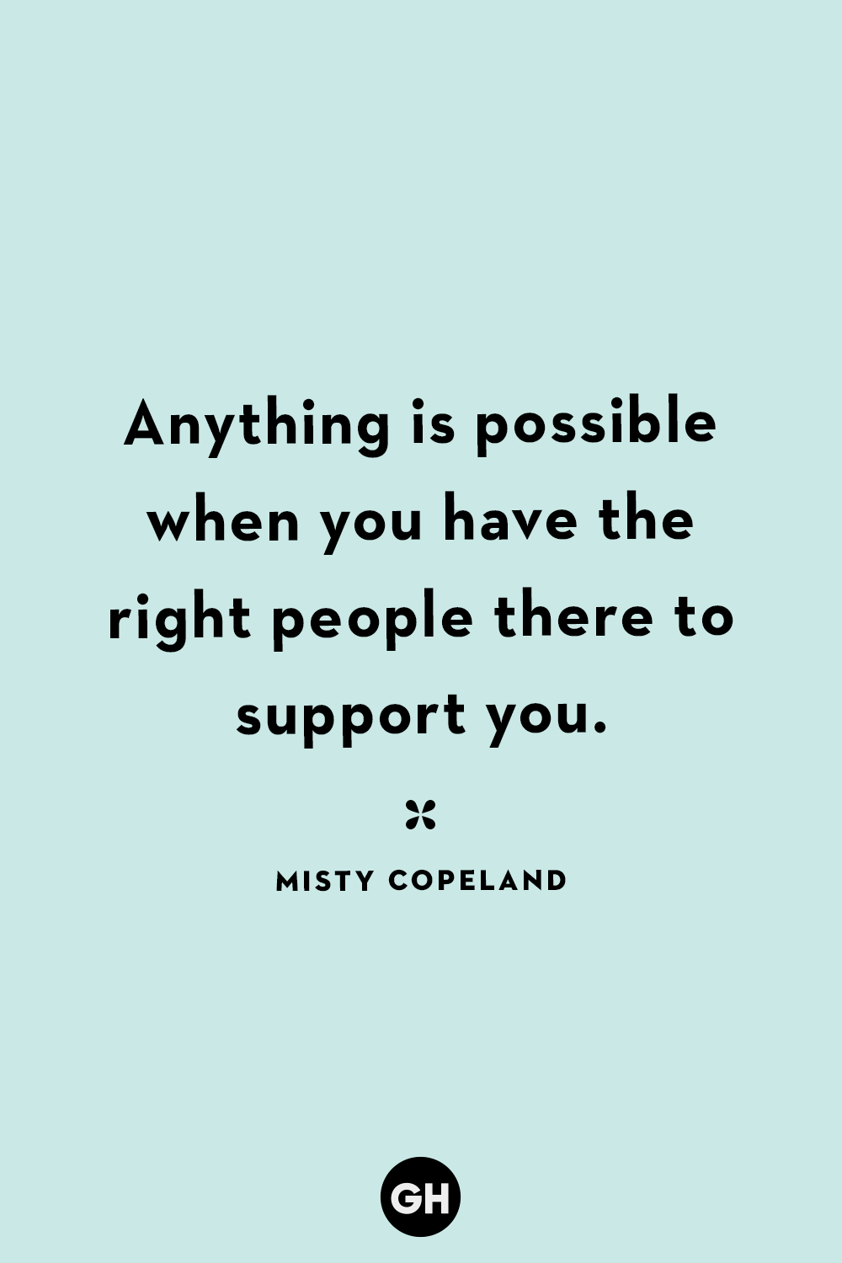

Slide 10

You’re invited to be the sunshine for someone else!
Open to the back of your happy book!
Sometimes it’s important to help people feel warm, safe, and supported during a hard time.
Think of someone you can perform a conscious act of kindness for that you know is experiencing a rough time right now, or someone who needs a little extra support.
In your happy book write down how you are going to help the person feel a little better!
  Examples:
    Eat lunch with a friend
    Play with them at recess
    Call them to check in at night
    Invite them over
    Write them a nice note

