Slide 1

Finding Happiness in the Simple Things
Miss Zeleznik
Inspired by: Suzanne Dailey

Slide 2

Lesson Objective
Today, we are going to learn how to make small shifts in our thinking to become happier people!
This Photo by Unknown Author is licensed under CC BY-NC

Slide 3

It’s Nice to Point to Others

Slide 4

What do you notice Abby Wambach does right after the scores a goal?
Abby Wambach Goal
Notes:
Play first minute and a half of clip

Slide 5
Can you identify someone who has been a part of your success and happiness this school year?

Slide 6

Pointing at Others
Have your parents ever told you that it’s not nice to point at other people?

Slide 7

Point and Run
This week’s story will invite us to point at other people!
Abby Wambach, a retired professional soccer player, used a philosophy called “Point and Run”.
Any time Abby scored a goal, she started pointing to the person who assisted the goal, or the coach who called the play, or the teammate who defended another player.
In other words, when she succeeded, she honored all those around her who supported that success.

Slide 8

It’s Okay to Point!
Strong relationships are the most important things in our lives that help us maintain high levels of happiness.
Pointing to others may once have been considered rude, but doing it though Abby’s philosophy is considered an honor.
Point out the people around you who contribute to your overall happiness and success!

Slide 9
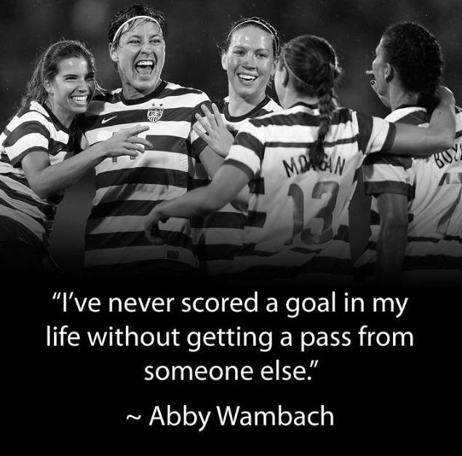

Slide 10

You’re invited to point at someone around you!
Open your e-mail!
Sometimes it’s important to point out the people who have contributed to your overall happiness and success this school year.
Write an e-mail to a person who has contributed to your happiness and success this school year and tell them what they did in 2-3 sentences.
  People you could e-mail:
    Parents
    Teacher (homeroom, gym, music, art, library, etc.)
    Coach
    Grandparents
    Sibling

