Slide 1

Finding Happiness in the Simple Things
Miss Zeleznik
Inspired by: Suzanne Dailey

Slide 2

Lesson Objective
Today, we are going to learn how to make small shifts in our thinking to become happier people!
This Photo by Unknown Author is licensed under CC BY-NC

Slide 3
Optimistic Outlook Lesson #4: Lifting Everyone Up

Slide 4

Feeling Stuck
Do you ever feel stuck?
  Stuck in a daily routine
  Stuck in the middle of winter
  Stuck in school with no breaks in sight

Slide 5
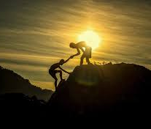
How do we get unstuck? Unstick someone else!
We are often praised for our own accomplishments, which makes us happy.
  Examples: Good grades or winning a game
But, the way we interact with others determines how happy we are!

Slide 6

GUESS WHAT?!?!
The happiest, highest performing students all have one thing in common!
  STRONG SOCIAL RELATIONSHIPS!

Slide 7

Fill in the blank: _______ acts of kindness

Slide 8

How do we form strong social relationships?
By performing acts of kindness!
These acts of kindness are not random acts of kindness; they are conscious acts of kindness.

Slide 9
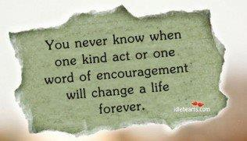
Conscious Acts of Kindness
These acts of kindness are purposeful, conscious, and intentional.
They lift someone else up!
Examples:
  Holding the door for the person behind you coming in a building.
  Writing a nice note or letter to someone who means a lot to you.

Slide 10

Take 60 seconds to think of a time when you lifted someone else up? How did you feel?
End
1
2
3
4
5
6
7
8
9
10
11
12
13
14
15
16
17
18
19
20
21
22
23
24
25
26
27
28
29
30
31
32
33
34
35
36
37
38
39
40
41
42
43
44
45
46
47
48
49
50
51
52
53
54
55
56
57
58
59
60

Slide 11

Is it possible that lifting someone else up can increase our own happiness too?
YES, YES, YES!
When we lift someone else up, it increases our own happiness!

Slide 12


Conscious Acts of Kindness: Lifting Others Up!

Slide 13

You’re invited to strengthen your relationships with conscious acts of kindness!
Log into Canvas.
Go to Homeroom and click the “Finding Happiness in the Simple Things – Lesson #4” module.
Read the objective to remind yourself about why this small shift is so powerful!
Click the “Optimistic Outlook – Lesson #4” activity!
I can’t wait to read your submissions!

