Slide 1
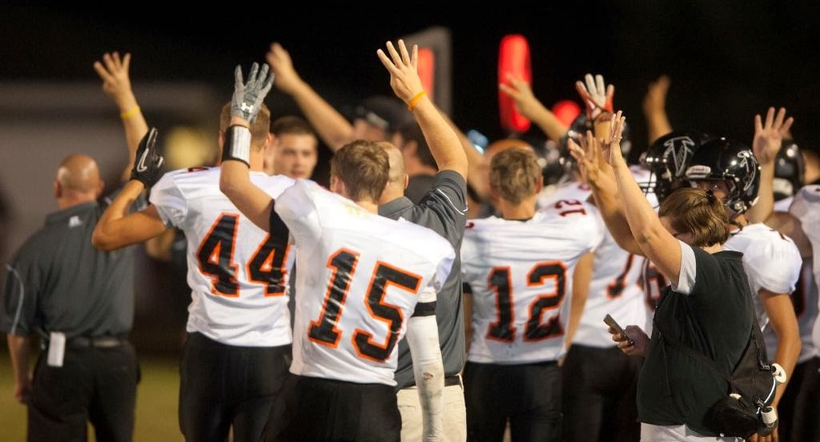

Slide 2
Finding Happiness in the Simple Things
Miss Zeleznik
Inspired by: Suzanne Dailey

Slide 3
Lesson Objective
Today, we are going to learn how to make small shifts in our thinking to become happier people!
This Photo by Unknown Author is licensed under CC BY-NC

Slide 4
Optimistic Outlook Lesson #10: The Fourth Quarter is Ours!

Slide 5
Fill in the Blank
Happiness is a ___________________.

Slide 6
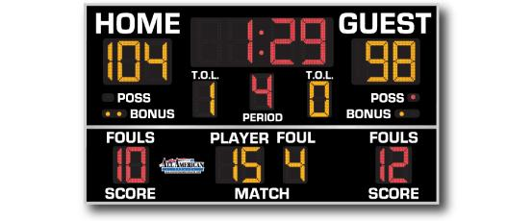

Slide 8
How do we enter the fourth quarter with disciplined happiness?
Keep your eyes on your own paper!
We can easily hyper focus on our perceived shortcomings, but we are invited to scan for our strengths!
Example: All year, I haven’t been able to find a book I enjoy reading.
Recently, I found myself buried in a book that I absolutely love!
We have a say in how we will end our year as a class!

Slide 10
How can we finish this year strong?

Slide 11
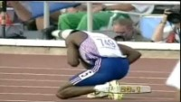
Video Link

Slide 12
You’re invited to make the fourth quarter yours!
Complete the Forms reflection!
The Fourth Quarter is Ours! Forms Survey

Slide 13
How can you finish this year strong?
Student Responses

