Slide 1
Finding Happiness in the Simple Things
Miss Zeleznik
Inspired by: Suzanne Dailey

Slide 2
Lesson Objective
Today, we are going to learn how to make small shifts in our thinking to become happier people!
This Photo by Unknown Author is licensed under CC BY-NC

Slide 3
The Most Impactful 10 Seconds of the Day

Slide 4
Have you ever made a list before?

Slide 5
We All Have Ten Seconds in Our Day to Spare!
We are going to start a “Happiness Book” or a “Gratitude Journal”.
Mrs. Dailey and I do it every day, and it takes 10 seconds or less!
This 10 second practice reinforces that good things happen to us every single day!
This will help our brain to scan all day long for what is going well!

Slide 6
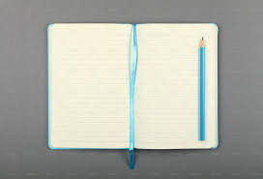
Happiness Books
What do you write in your happiness book?
You write 1-2 things that made you happy that day!
Examples: A weeknight backyard campfire with your family.
A great game of soccer during recess!
A math lesson that you felt really good about!
Finishing your 10th independent reading book!

Slide 7
What About the Tough Days?
Sometimes you have to dig down deep to find something (anything that was a bright spot in that day)!
Honestly, these are the days you need the happy book the most!
Now that it is Mrs. Dailey and my fourth year writing in our journals, we get to read the happiest moments from the past four years on this date!!!
It lifts us up on our toughest days!

Slide 8
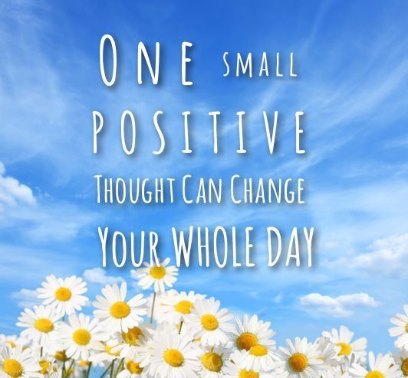

Slide 9
There is so much to be happy about!

Slide 10
You’re invited to decorate the cover of your happy book!!
Take your time!
Write your name on the cover of your book!
Decorate your book with things that interest you!
You can use some of my examples to get you started!
We will use this every day, so please put this book in your desk!

Slide 11
October 20, 2021 – Day #1
1. I got to watch my class decorate their own happy books today!

