Slide 1
Finding Happiness in the Simple Things
Miss Zeleznik
Inspired by: Suzanne Dailey

Slide 2
Lesson Objective
Today, we are going to learn how to make small shifts in our thinking to become happier people!
This Photo by Unknown Author is licensed under CC BY-NC

Slide 3
Optimistic Outlook Lesson #11: Find the Good Old Days! Today!

Slide 4
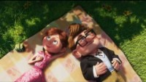
What is Carl doing in this clip from Up?

Slide 5
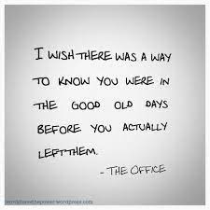

Slide 6
What would you consider the good old days?

Slide 7
Think Back…
We can all look back at a moment in our life and smile.
We recognize that those were “the good old days”.
But, did you know it in that moment?

Slide 8
Believe it or not…
We are in the “good old days” right now!
One day you will look back on this time with gratitude and happiness.

Slide 9
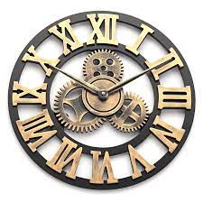
Positive Psychology
Any given moment is either minimized or maximized by how much attention we give it.
We need to start paying attention to the good stuff!

Slide 10
You’re invited to maximize the good moments!
On a piece of paper or a Word Document brainstorm your thoughts about right now!
We are going to find the “good old days” today!
Title the document “These are the days of…”
Brainstorm ideas about things that you are experiencing right now!
Example: Spending quality time with your family.

