Slide 1
Finding Happiness in the Simple Things
Miss Zeleznik
Inspired by: Suzanne Dailey

Slide 2
Lesson Objective
Today, we are going to learn how to make small shifts in our thinking to become happier people!
This Photo by Unknown Author is licensed under CC BY-NC

Slide 3
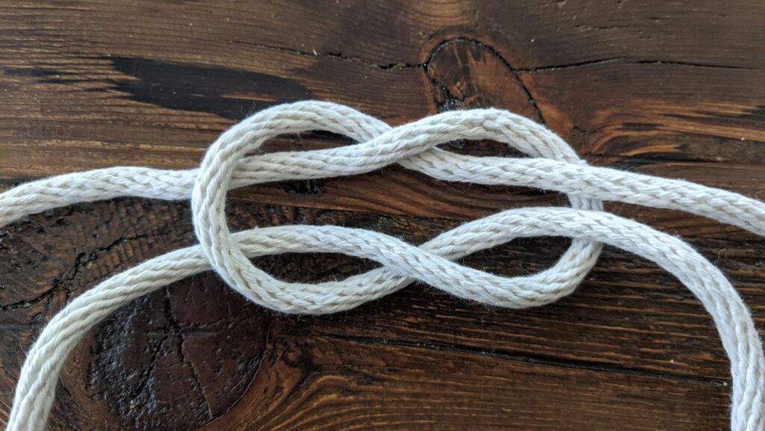
Weak Ties Make us Stronger
This Photo by Unknown Author is licensed under CC BY-SA

Slide 4
Have you ever known someone that you just say, “Hi, how are you?” when you pass them, but they aren’t your close friend?

Slide 5
Casual Friends
We all have our people!
We also have other people – who are more like casual, surface level kind of relationships.
These are the people who get, “Hey, how are you?” in the hallway. We don’t see them very often.

Slide 6
Weak Tie Relationships
According to Mark Granovetter, a sociology professor at Stanford University, it’s not just the quality of a few close deep relationships, quantity also has something to do with it.
Research shows us that building weak tie relationships actually boosts happiness, knowledge, and sense of belonging.

Slide 7
Weak Ties and More Happiness
Psychologist Gillian Sanstrom asked a group of people to keep a record of all their interactions over a week.
She found that participants with larger networks of weak ties tended to be happier over all.
And when a participant had a greater number of interactions with these weak tie relationships, they experienced more happiness and a greater sense of belonging.

Slide 8
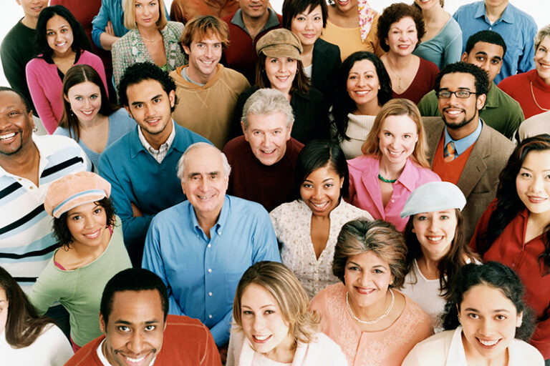
The More Weak Ties – The Better!
Granovetter went on to say that people who we spend a lot of time with probably swim in the same pool of information as you do.
So, we depend on friendly outsiders to bring us news or opportunities from beyond our immediate circle.
The more of these acquaintances we have – the better!

Slide 9
How do you think the weak ties that the mailman formed made him feel?
Weak Ties
Notes:
Play first minute and a half of clip

Slide 10
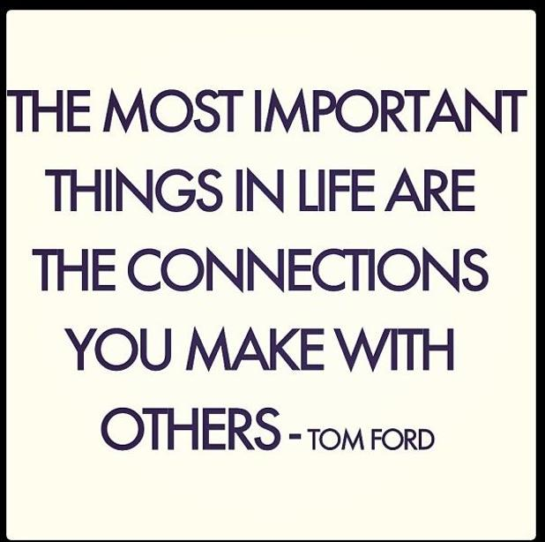

Slide 11
You’re invited to consider your weak ties!
Open to the back of your happy book!
It’s important to recognize the strength that weak ties bring to our lives.
In your happy book write down 5 weak ties that you have. Then, star 3 of them that you would like to interact with in the next week!
Examples:
Teacher in the building
Student in another class
Person on your sport team
Custodian in the building
Secretary in the office

