Slide 1

Finding Happiness in the Simple Things
Miss Zeleznik
Inspired by: Suzanne Dailey

Slide 2
Optimistic Outlook:
What can go right?

Slide 3

Lesson Objective
Today, we are going to learn how to make small shifts in our thinking to become happier people!
This Photo by Unknown Author is licensed under CC BY-NC

Slide 4
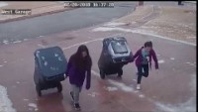
How do you think the girl felt after making up the driveway?

Slide 5
Have you ever thought to yourself, can anything else go wrong today?

Slide 6

How about thinking, what could go right?
A simple change in thinking can do so much!
When we have bad days, we start to think to our self, “Oh man, what else can go wrong?
But, what if you change your thinking to “What can go right?”

Slide 7
Think About It Like This…
Any set of circumstances is a mix of outer facts and inner attitude.
Your attitude can change everything!
On a bad day, or even a good day, thinking, “What else can go right?” can help you focus on the positive moments in your day!

Slide 8
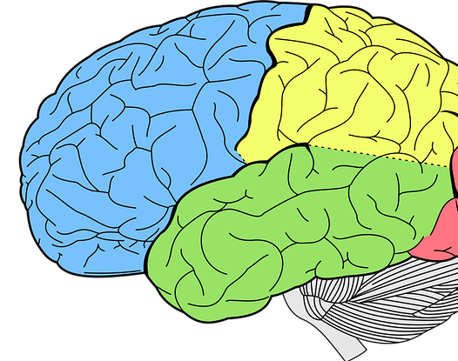
Our Brain is Malleable
Every experience or thought changes our brain!

Slide 9
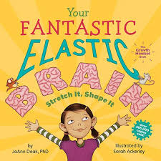
The Fantastic Elastic Brain

Slide 10

Let’s Share!
Think of a time when you could have used the phrase “What can go right?”

Slide 11


Slide 12

You’re invited to reflect on what can go right today!
Log into your e-mail.
Complete the Microsoft Forms Reflection.
  Reflection Link
Be ready to share your thoughts with the class!

