Slide 1
Finding Happiness in the Simple Things
Miss Zeleznik
Inspired by: Suzanne Dailey

Slide 2
Lesson Objective
Today, we are going to learn how to make small shifts in our thinking to become happier people!
This Photo by Unknown Author is licensed under CC BY-NC

Slide 3
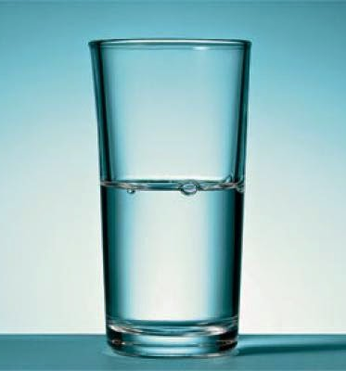
Optimistic Outlook
Optimistic: Hopeful and confident about the future
Vs.
Pessimistic: Tending to see the worst aspect of things or believing that the worst will happen

Slide 4
Kid President “How to Change the World” Optimism in action!!!!

Slide 5
Change your thoughts from “What if…” to “Even if…”
A simple change in thinking can do so much!
“What if..” Example: “What if I forget my independent book for reading today? I will have nothing to read!”
Change your thinking to…
“Even if I forget my independent reading book for reading today, I can pick a new book to start reading!”

Slide 6
Do you see how easy this shift in thinking can be?!?!
And, without even realizing it…you are looking at the BRIGHT side of situations!
Let’s look at a few more examples!
“What if the math test is really hard, and I don’t understand a few problems?”
“Even if the math test is really hard, I will try my best on all of the problems!”
“What if we have a snow day, and I can’t get on the internet to complete my assignments?”
“Even if we have a snow day and I can’t get on the internet to complete my assignments, they will get done by the end of the week!”

Slide 7
The Whatifs by Emily Kilgore and Illustrated by Zoe Persico

Slide 8
You’re invited to change your thinking from “What if…” to “Even if…”!!!
Today, we are going to put the shift in thinking from "What if..." to "Even if..." to the test!
I would like you to think of an example of how you can shift your thinking from "What if..." to "Even if..." and display it through a comic!
Example:
What if my cat, Reese, meows and wakes me up, and then I can't fall back to sleep?
Even if my cat, Reese, meows and keeps me up all night, I will get a better night sleep tomorrow!

Slide 10
