Slide 1
Finding Happiness in the Simple Things
Miss Zeleznik
Inspired by: Suzanne Dailey

Slide 2
Lesson Objective
Today, we are going to learn how to make small shifts in our thinking to become happier people!
This Photo by Unknown Author is licensed under CC BY-NC

Slide 3
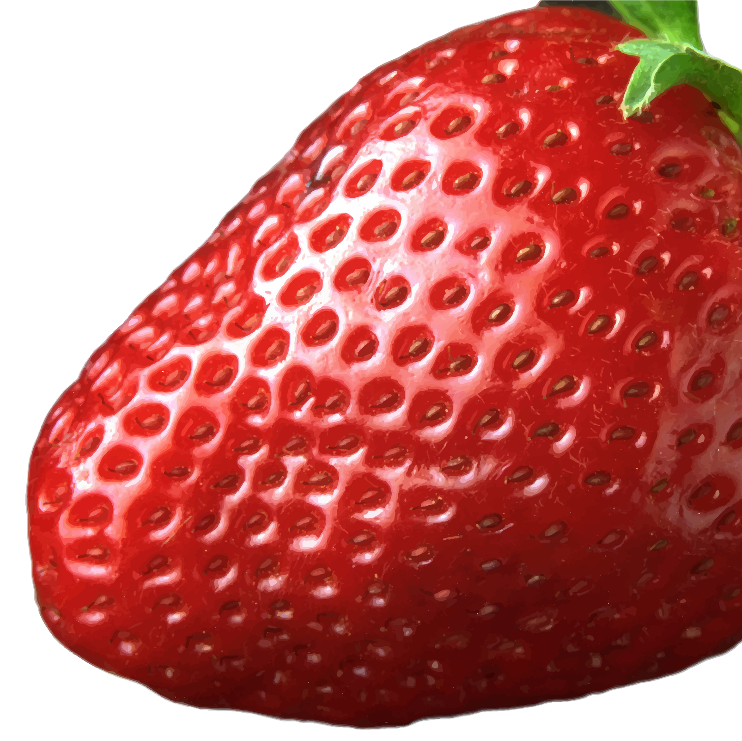
What happens when you leave a moldy strawberry in a container for too long?

Slide 4
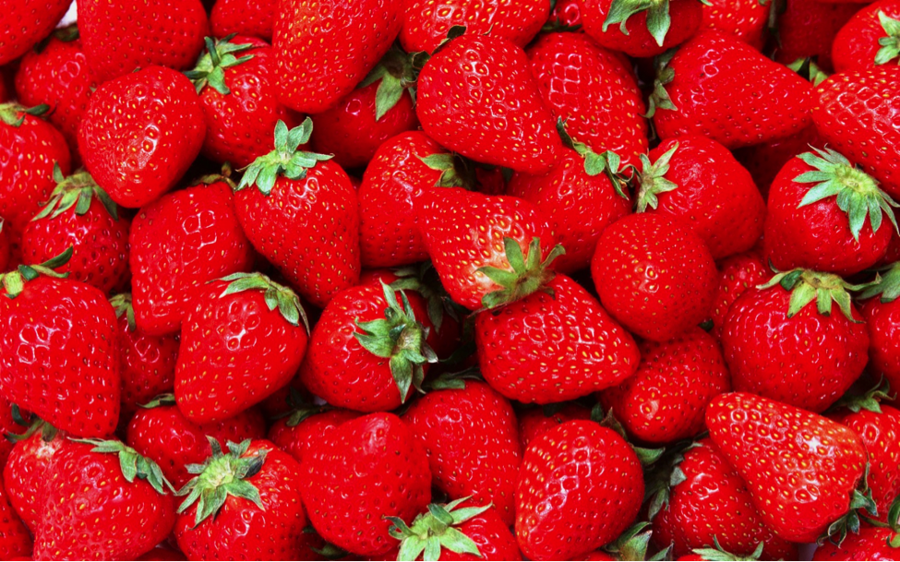
You Are Not a Strawberry!!!!
This Photo by Unknown Author is licensed under CC BY-NC

Slide 5
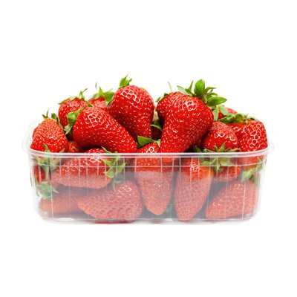
The Moldy Strawberry is Within Our Control!
If we allow ourselves to be surrounded by negative people (like the moldy strawberry) their energy is just going to move towards us!
There is too much going on in our world to allow this to happen.

Slide 6
Choose Your Circle Wisely!
You cannot control everything going on around you.
But, you can control who you choose to spend your time with!
Choose to spend time with people who support you and leave you feeling good!

Slide 7
Remember, you are not a strawberry!!!!
You may not be able to choose who is in your class or who is close to you at all times.
However, you can choose who takes up a lot of time in your mind, heart, and life.
Pay attention to who you are with when you are feeling your best!
Who is good to you? And, who is good for you?

Slide 8
How did Jack and Auggie make each other feel in this scene?

Slide 9
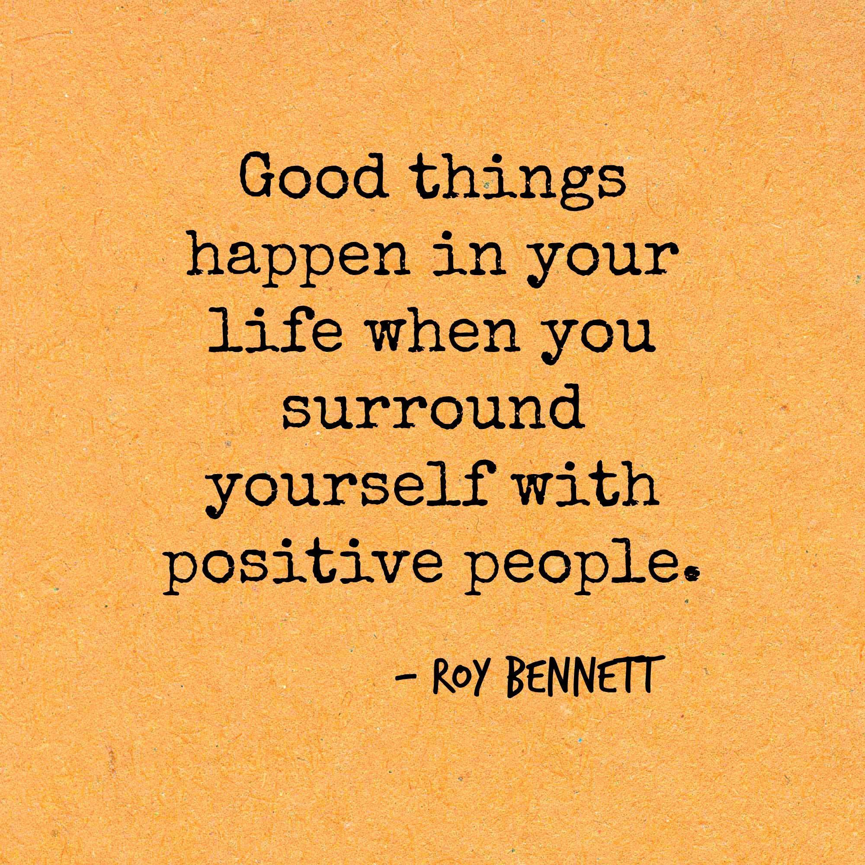

Slide 10
You’re invited to identify what makes a good friend!
Open Microsoft Word.
Title the document Character Traits.
Type 10 character traits that you think make a great friend.
Examples: Honest, caring, kind, helpful
Save it in your Social Emotional Wellness folder as “Character Traits”.
We are going to make a Wordle as a class when you are finished!

