Slide 1
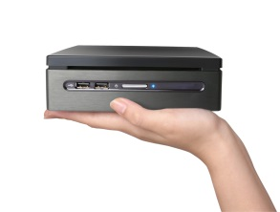

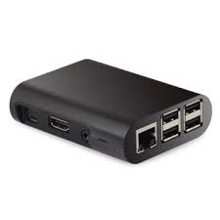
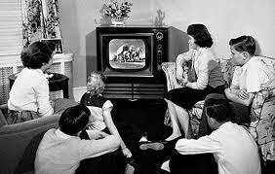
MaxVision
MAX OP ANYWHERE
Wi-Max
“Bring the vision back into television, take the personal out personal computer now the cell phone”
“Unify the world; one family one business at a time”
Some Slogans and Mission Since 1999.

Slide 2
Brief Synopsis
The Max Consortium is a program of great magnitude.
The 3 Phase Development encompasses a vast array of various derivatives/spinoffs.
Predicated upon its founding members within the scope of the IB industry, i.e. maxwellrand.com
The purpose of this presentation is to establish a clear concise depiction of just one product line. Notwithstanding all integrative processes derived from MaxBox and miniMax

Slide 3
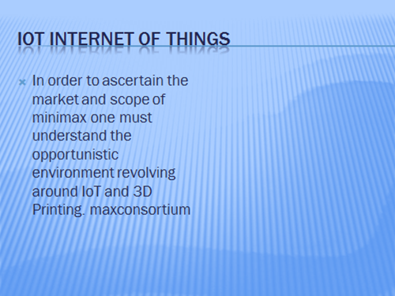
Max iot
You heard of GE right, I quote: “Meanwhile, General Electric believes the Internet of Things will touch half the world economy... and John Chambers, the CEO of Cisco Systems, is on record predicting a $19 trillion explosion (that's practically the size of the entire US economy).

Slide 4
Minimax top 10 simple why people want
1. Freedom of Choice – watch anything you want, anytime you want, you’ll literally find every movie and television show ever made, new or old it’s all there!
2. No More Popups – unlike streaming web sites, you’ll never be bombarded with popups within MMC. Probably the fastest PC you have ever seen to date.
3. Zero Cost – MMC and so many other elements are totally free, no monthly cost whatsoever, enough said.
4. Live Channels – you’ll get access to more live television channels than you could possibly imagine, live sports, games that you wouldn’t be able to get on regular cable and more.
5. Simplicity – just click and watch, so easy even your grandmother can use it.
6. Hardware Options – MaxBox PCTV “Brings the vision back into television takes the personal out of personal computer PC and cell phone CP but connects them all”
7. International TV – it doesn’t matter where you’re from or what language you speak, you can watch movies, television shows or even live television from anywhere in the world.
8. Risk Free – Read Getting Started.
9. Impress Your Friends – you’ll be the star of all your friends, they’ll all be indebted to you once you show them and even earn a referral fee!
10. Community – if you’re slightly techy and want to get involved in our next paradigm shift call us for free information.
Minimax Free Computer, Digital Signage FEATURES AND BENEFITS include so much more! Too Much To Put On Print. Just get one. Call Us Now! “Biz and Entertain in a Box” Earn tremendous income. Or just simply enjoy FREE Music, PC, TV, Movies, TV Episodes and so much more!

Slide 5

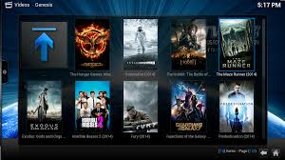
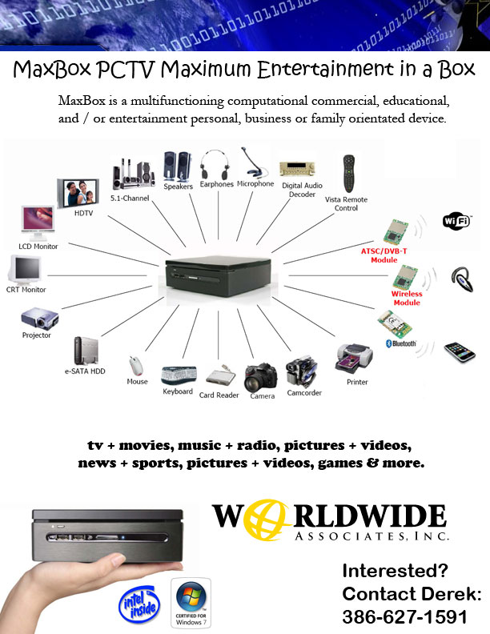


MaxBox vs miniMax
MaxBox Fixed & Variable cost over $700.00 US Currency
MiniMax
Fixed & Variable cost under $100.00 US Currency.
Depending on Climate and Culture of Community domestic and abroad Retailing at $249.00 to $499.00.

Slide 6
Minimax
POCKET SIZE TOTALLY PORTABLE FROM YOUR LIVING ROOM, BEDROOM, TO YOUR AUTO, YACHT, RV, MOTORCYCLE, YOU NAME IT ANYWHERE ANYTIME!
MAX OP ANYWHERE. (However Windows 10 Compatible) Unlike MaxBox NO Windows and Intel Inside)
miniMax your next entre into the frontal assault to, yet more paradigm shifts. Working Toward The NewNet HANSS Humanities Autonomous Networking Soluble Solutions.
Allows for our strategic partners to get their piece of the “The largest legal creation of wealth in the history of the planet”.
Strategic Partners are in the forefront of the “Third Wave Internet” The astounding greatest period of technological innovation the world has ever seen!
“Where there is no vision; the people they shall perish” (The Bible Paraphrased)

Slide 7
Lets look at some history TV
The Television is the one continuous niche solution amalgamating, converging, connecting it all, people and things. Remember Internet of Things.
The Television becomes also a money making tool with our intellectual property, hardware, apps, addons, cloud and database configurations information architectural design.
Since 1999 “Bring the vision back into television, take the personal out personal computer now the cell phone”
“Unify the world; one family one business at a time”
Another report around 2013 the Global Digital Divide. Source: United Nations, Global Development / Goals Indicators
Global Digital Divide. Source: United Nations
United Nations Reports:
TELEVISION
In the Industrialized World we are reaching close to a billion TV sets, and 98% of our households have at least one TV set, i.e. 470 million homes have television. Of those that have TV, 34% own 2 or more TV sets. When we measure the audience, we find that in the Industrialized World the total TV audience is 1.05 Billion people [88% of all who live here].
Evolution of TV
Across the Digital Divide, in the Emerging World, there are over billion TV sets in 950 million households. 73% of all households have at least one TV set and of those that do, 2% have 2 or more TV sets. The audience who watch TV in the Emerging World is 3.15 Billion people. But not smartphones yet.
When we add the numbers together for the whole world, we find that 89% of all households worldwide have television, astonishingly large number just a fraction of market penetration is fortunes. Those 1.42 Billion households have 1.6 Billion TV sets in use, serving a viewing audience of 4.2 Billion people [61% of the total population of the planet]. Now let’s talk market penetration. Ready captive audience for advertising we choose.
Max PCTV / minimax: One family, one business, one community one county and global!

Slide 8
Lets look at some history Phones
Bibliography
TELEPHONES, THE OLD LANDLINE KIND
Evolution of Telephone. Before we look at mobile phones, lets count those older types of phones, the fixed landline telephones. In the Industrialized World the number of telephones is in decline and we now have only 330 million households left [69% of households], that still have at least one telephone. Of those who still pay a fixed landline telephone bill, 25% have two phone lines at home. The population that can be reached by calling the landline [and hoping someone might answer] is 825 million people or 69% of the population in the wealthier nations of the planet.
In the Emerging World countries 680 million households have landline phones [52% of all households] and 5% of those have more than one line. The population in the less-affluent countries, that can be reached using a landline phone, is 2.9 Billion people.
When we add these together, we find the planet has 1.1 Billion total fixed landline phones, in 1 Billion households [56% of all households] and reach 3.7 Billion people.
MOBILE PHONES
Here the math gets a bit tricky. If we count actual mobile phone handsets connected and in use, we get one number. If we count mobile phone subscriptions we get another number. If we count unique mobile phone subscribers we get yet another number, and the math is even more fuddled by some of the poorest people, where families do not have a landline phone and cannot afford phones for all family members so they use one mobile phone as a family phone.
In the Industrialized World countries, 96% of households have at least one mobile phone account. For the 1.2 Billion people living there are 1.3 Billion actual mobile phone handsets with 1.6 Billion total active subscriptions. For those homes that have at least one mobile phone, the average number of phones per active mobile phone household is 2.7. The phones are not shared, so the total population that can be reached using a mobile phone is 1.05 Billion [88% of the population].
In the Emerging World, 59% of households have at least one mobile phone, and the total number of mobile phone handsets is 2.9 Billion, so there is an active phone already for 51% of the population living there. In the poorest regions [often beyond electricity] about 200 million households have one mobile phone shared as the family phone. Thus the total reach of 3.35 Billion [59%].
When we add those numbers together, we find households that have at least one mobile phone, number 1.25 Billion, and they have a total of 4.2 Billion connected mobile phones in use including those people who carry two phones. The reach of mobile phones is 4.4 Billion which includes those poor households where mobile phones are shared. (Kathy Konkle & United Nations Reports)

Slide 9
Lets look at some history PC’s
PERSONAL COMPUTERS
From broadcast media to computers, the PC penetration in the Industrialized World households is now over 70%, or hundreds of millions PC households. They are used by hundreds of millions to billions of people. In the Emerging World countries PC penetration is over 30% of all households, 500 plus million of them. They have billions of users. Worldwide we have billions of PCs in households, used by of billions people. United Nations last reported in 2011 1.4 billion users. Trillions of dollars. In 2017 PC markets continues to diminish, increased sales TV, Smart Phone, Internet Users. Minimax converges them all.
Minimax Free PC and Open Office Suite and a whole lot more, in juxtaposition with, Open Source, MaxTech intellectual property, The Internet, Smart Phone ambushing cable and with our partners ambushing and capturing a piece of the 2.2 Trillion dollar war (domestic only) for the living room. Remember Max Op Anywhere portable! All taking over TV to small 3.5 touch screen. Become a media mogul and own the customer base and more. SIMPLY CABLE COMPANIES AND BROADBAND PROVIDERS ARE IN A FRENZY FOR THE INEVITABLE. (Note: The statistical inferences herewithin, are compilations of various third party information. It is best to do research on your own also.)

Slide 10
Minimax value added services
Web Real Time Communications also known as WebRTC is the next generation compatible with the Internet of Everything (IoT). NS WebRTC is a source where integration for a Face-Time communication is a part of online workflow and presence. NS-RTC is designed for HTML5 interactive media integration. Experience NS RTC's silky, smooth, & pure HTML5, request a demo.
Including but not limited to:
Bringing real time to life.
Real-time communication is the genesis of the insightful digital transformation to digital economy, by connecting creative minds, machine intelligence, while embracing human diversity around the world.

Slide 11
Minimax value added services
SNL in one word: “indescribable”! It can only be experienced when seen. 9 out of 10 visitors walk out with “WOW” factor. Ask for a live demo.
When you require adding interactive elements into your online presence rely on iCDN Cloud. We deliver interactive real-time collaboration for your needs both as CAPEX and OPEX.
Live in 30 Seconds (L30) is the premier on-demand live streaming service to Max & Mobile, PC, MAC, & OTT devices with single or simultaneous multi-point encoding capabilities. L30 is ideal for concert and large event
broadcasting. L30 is Open Standards Media Format and RTMP compliant.

Slide 12
Minimax value added services
Get WebRTC with 1 Click. Stay connected around the world. Stream live on interactive content delivery network (iCDN).
When patients need medical attention, they no longer would have to travel distant miles to see their health practitioners. Patients may interact, via HIPAA compliant integrated video, VoIP, and instant text messaging discussing their health needs.
Everything is based on detection of each client’s device and adapts to play the video intelligently. From TV to email to cell phone. Additionally enhancing customer acquisition, increased revenues, ROI and future asset valuations of owning a customer base.

Slide 13
Minimax value added services
When Maxwell Rand, the private equity wealth management firm required to reduce travel cost with improved client relationship,
SEE and get Max
IRPRLive delivers advanced interactive communications in a seamless virtual settings.
Enjoy real-time interactivity with family and friends (Personal to Professional)
Premier SE Asia connecting people virtually, empowering moments of life shared instantly.

Slide 14
Line Items Powered By Max IOT (Current & Future R&D)
Wearables
Connected Smart Automotive
Connected Smart Homes
Connected Smart Cities
Industrial Internet
Oil & Gas
Commodities
Crypto Currency
Transportation
Healthcare
Don’t just take our word for it.
Do a search IoT, the future of TV and 3D printing.
Click maxconstortium.com
Read IoT Report Goldman Sachs
Actually download all and read it all.

Slide 15
Minimax and affiliated concerns
2007 is our earliest interactive timeline. Max Netstairs Escalation Station has been waving “interactive” flag for the longest. Today, our vision is transformed into WebRTC - an advanced yet simple to use Open System interactive social media digital broadcasting & collaboration cloud services serving a wide variety of needs. It comes with high-level engineering at infrastructure, platform and software as a service. hosted as Click-To-Video (CTV), is an interactive Cloud running on some the most robust, secured and scalable cloud services such as AWS, GCP, IBM, and Akamai CDN. CTV use and monetization is selling Time", "Bandwidth", and "Storage". We offer CAPEX and OPEX services to Platform Technology Licensees. We offer Global & Wholesale WebRTC service contracts. CTV is showcased as real-time managed hosted services:

Slide 16
In Conclusion
The simple dichotomous question is.
B2C
Do you want to save money on your cable, Internet, Electric Bill?
B2B
Do you want increased revenues, increased customer retention and increased ROI?
Obviously YES. Join the cord cutting generation. Get your miniMax Today. Become an strategic partner also (Private Labeled also Powered By MAX).

Slide 17
Disclaimer
THE PRECEDING AND FOREGOING INFORMATION IS NOT A SOLICITATION FOR AN INVESTMENT. ALL CURRENT AND FUTURE INFORMATION DISCLOSED IS FOR INFORMATIONAL PURPOSES ONLY.
This transmission (and/or the documents accompanying it) may contain confidential information belonging to the sender, which is protected by client privilege. The information is intended only for the use of the individual or entity named above. If you are not the intended recipient, you are hereby notified that any disclosure, copying distribution or the taking of any action in reliance on the contents of this information is strictly prohibited. If you have received this transmission in error, please immediately notify us by telephone and destroy the documents.
Pursuant to U.S. Treasury Department regulations, we hereby inform you that any investment and/or federal tax advice contained in this communication was not intended or written to be used, and cannot be used, for the purpose of investing or avoiding tax-related penalties that may be imposed under the Internal Revenue Code.
Please note that, including but not limited to, affiliates, joint ventures, strategic alliances, partners are subject to change. We are not responsible for third party actions. Further expression and information can be disseminated through telephonic or other means of communications.
CONFIDENTIALITY NOTICE: This message and any attachments are for the sole use of the intended recipient(s) and may contain confidential and privileged information that is exempt from public disclosure. Any unauthorized review, use, disclosure, or distribution is prohibited. If you have received this message in error please contact the sender (by phone or reply electronic mail) and then destroy all copies of the original message.

Slide 18
IB, M&A, Strategic Business Development, Finance
Jtds...
Master of Business Administration
Master of Business Administration / Entrepreneurship
Master of Business Administration / Marketing
Master of Business Administration / Human Resource Management
Master of Business Administration / International Management
worldwideassociatesinc@yahoo.com
386.290.9553 (FL Cell / Viber)
917.446.0297 (NY Cell)
386.627.1591 (FL Cell Voice)
Skype: derek.tanner33
MAX STREAM: derek.tanner33

