Slide 1
ACROSS T2D EASD 2022 symposium
Don't wait for the future: be proactive for your patients with T2D now!
Tuesday, 20th September 2022
18:00–19:00 CEST | Stockholm, Sweden

Slide 2
Welcome and introduction
John Buse

Slide 3
Example of section header

Slide 9
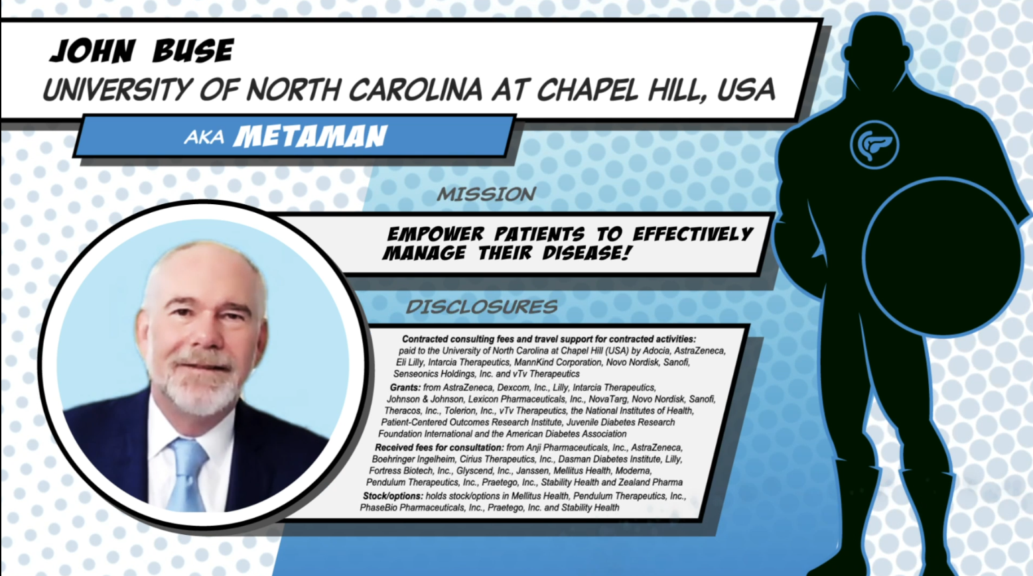

Slide 10
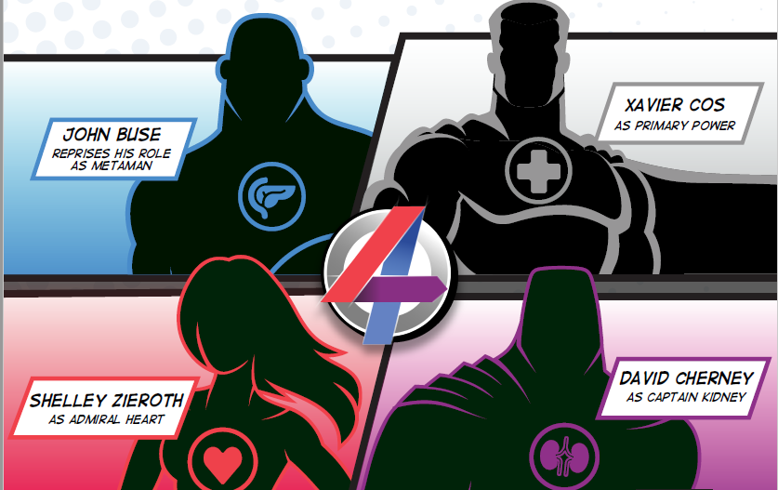
Key messages
…
…
…
…

