Slide 2
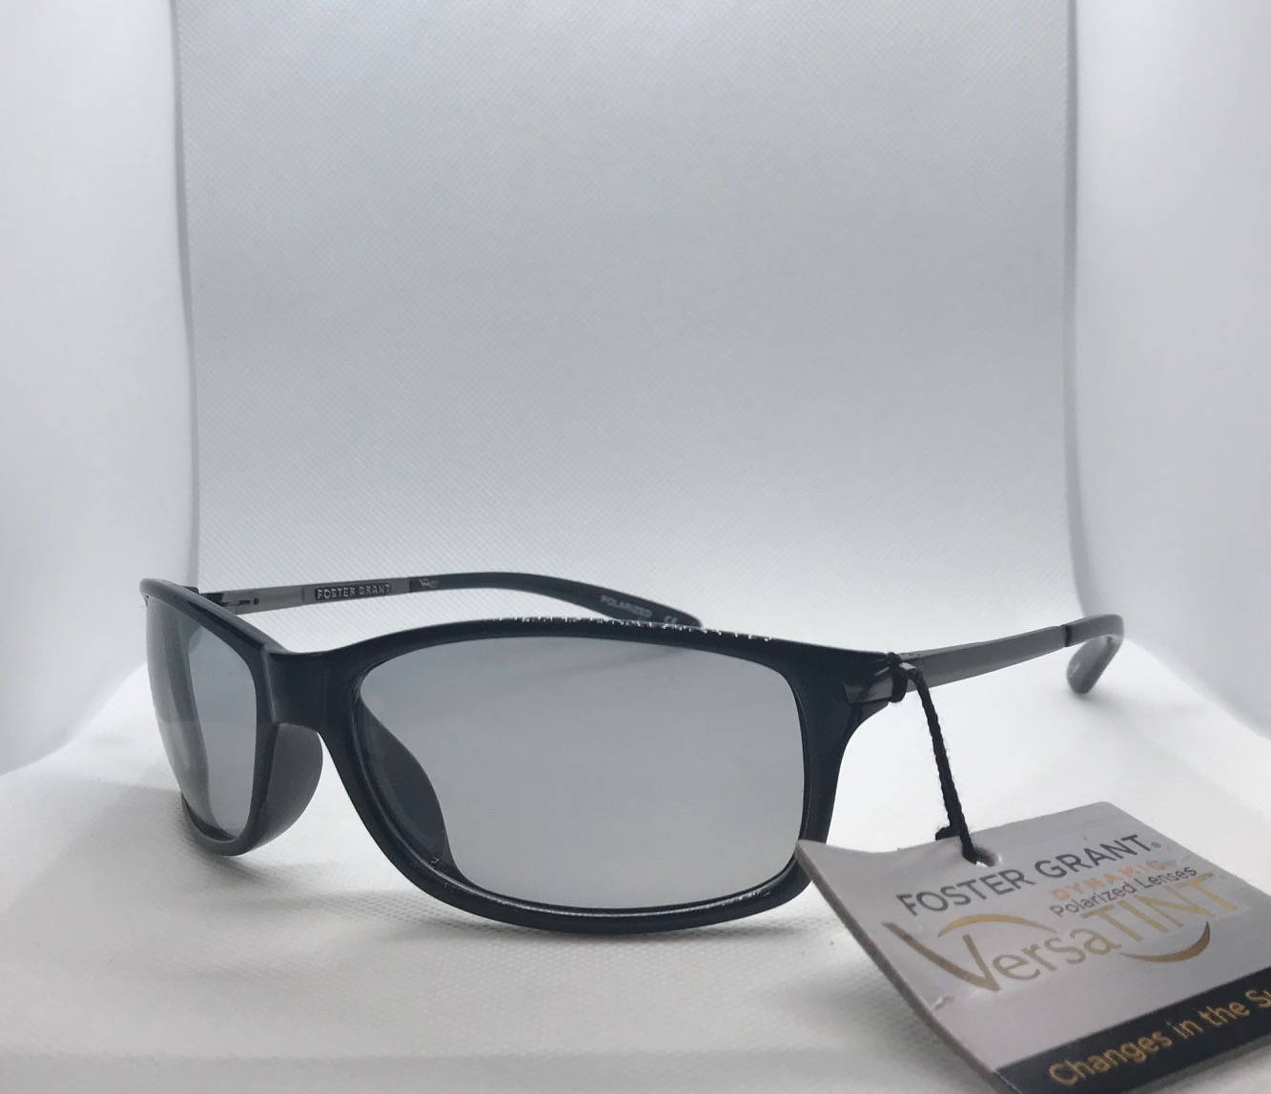
Item #: 10203761
UPC: '741919990487
Description: POLARIZED BLK plastic frame
QTY: 129
Brand: Foster Grants Versa Tint
Retail: $49.99
Cost: $3.50
FWS#: 1

Slide 3
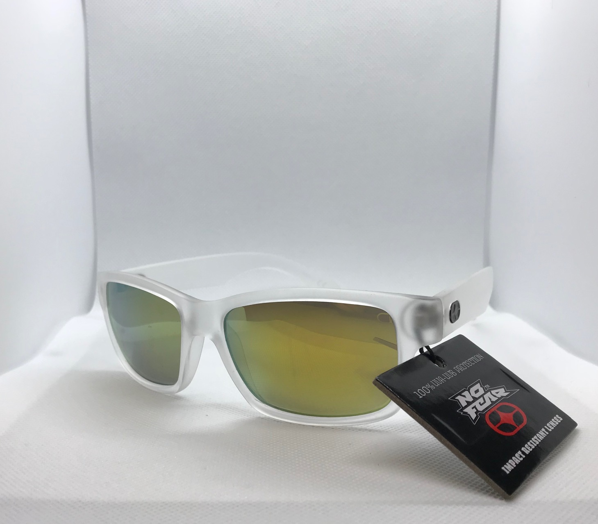
Item #: 10223917
UPC: '741919990609
Description: Clear/white plastic w/ blue lens
QTY: 413
Brand: No Fear
Retail: $29.99
Price: $2.50
FWS#: 2

Slide 4
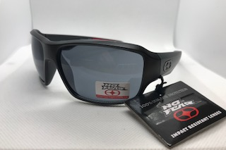
Item #: 10228780
UPC: '741919990630
Description: Black w/ rubber-plastic frame and black lens
QTY: 500
Brand: No Fear
Retail: $19.99
Price: $2.50
FWS#: 3

Slide 5
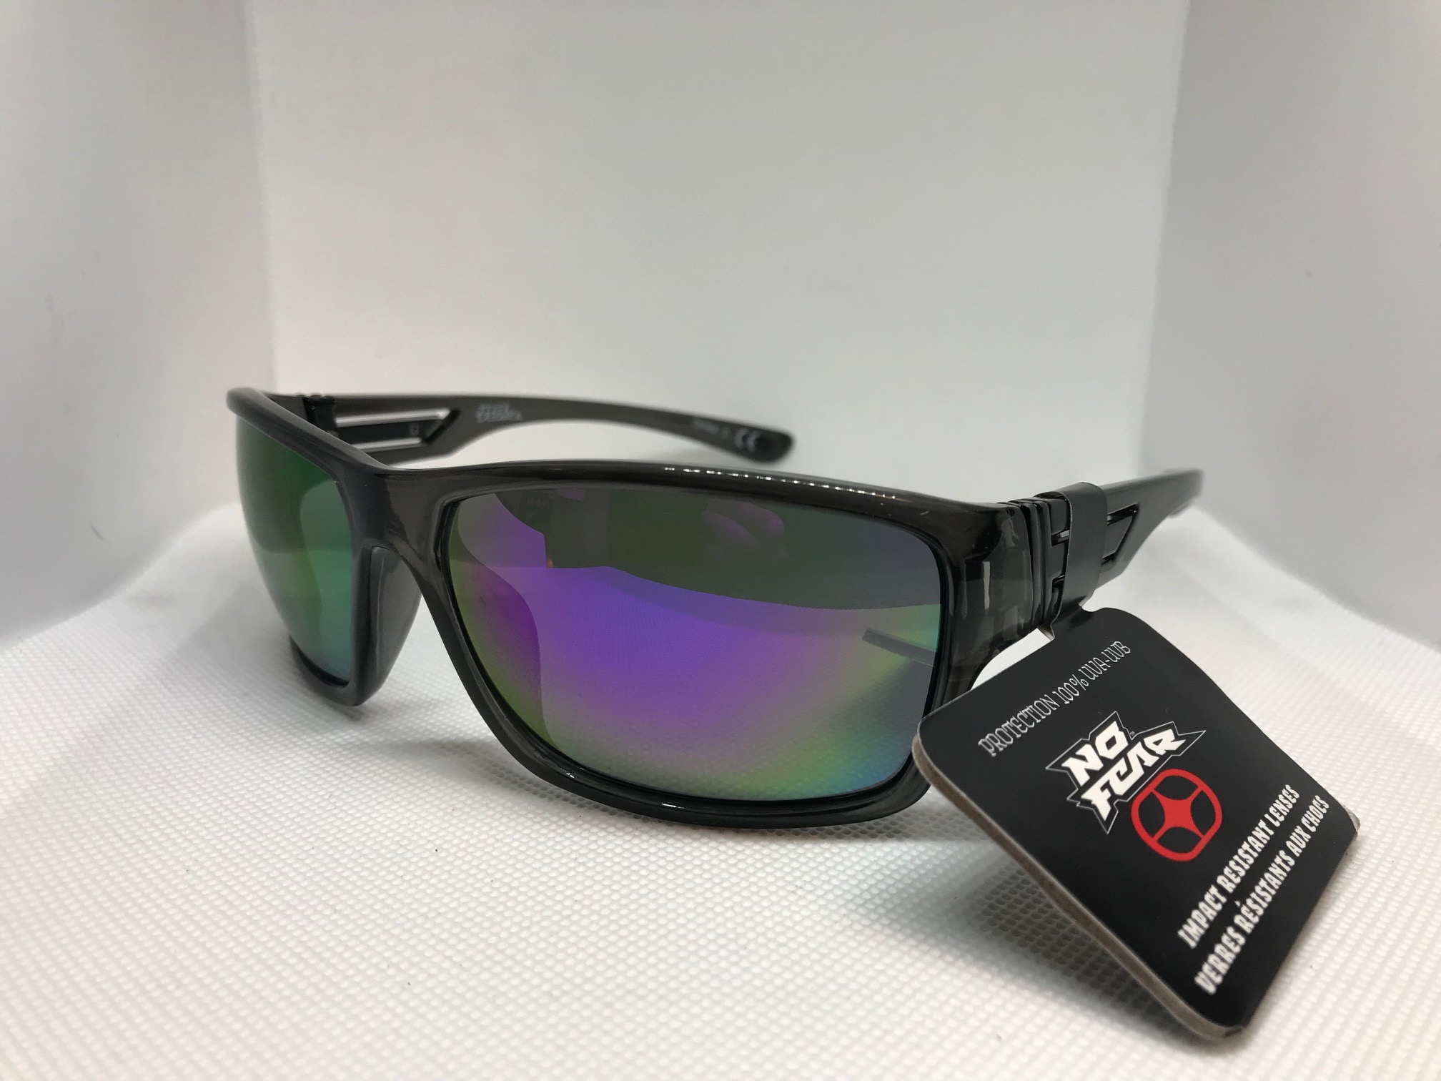
Item #: 10228778
UPC: '741919990623
Description: Black plastic frame w/ blue reflecting lens
QTY: 500
Brand: No Fear
Retail: $29.99
Price: $2.50
FWS#: 4

Slide 6
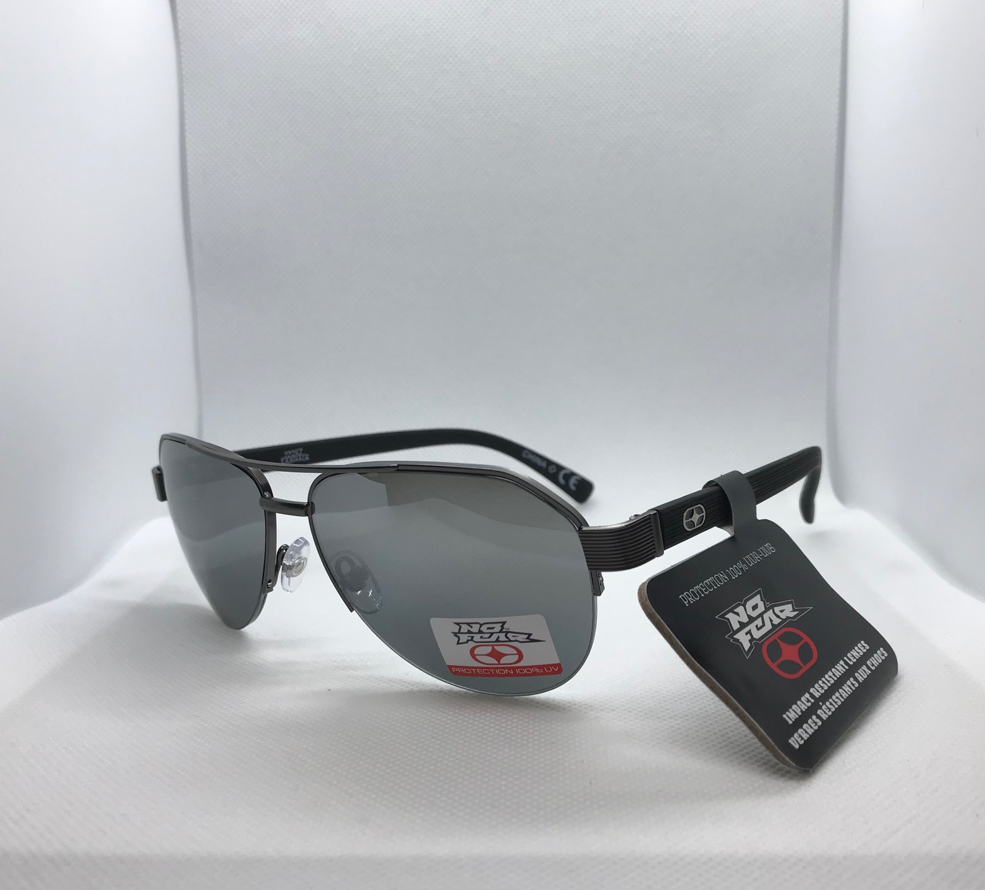
Item #: 10223925
UPC: '741919990685
Description: Black metal aviator frame w/ black lens
QTY: 363
Brand: No Fear
Retail: $29.99
Price: $2.50
FWS#: 5

Slide 7
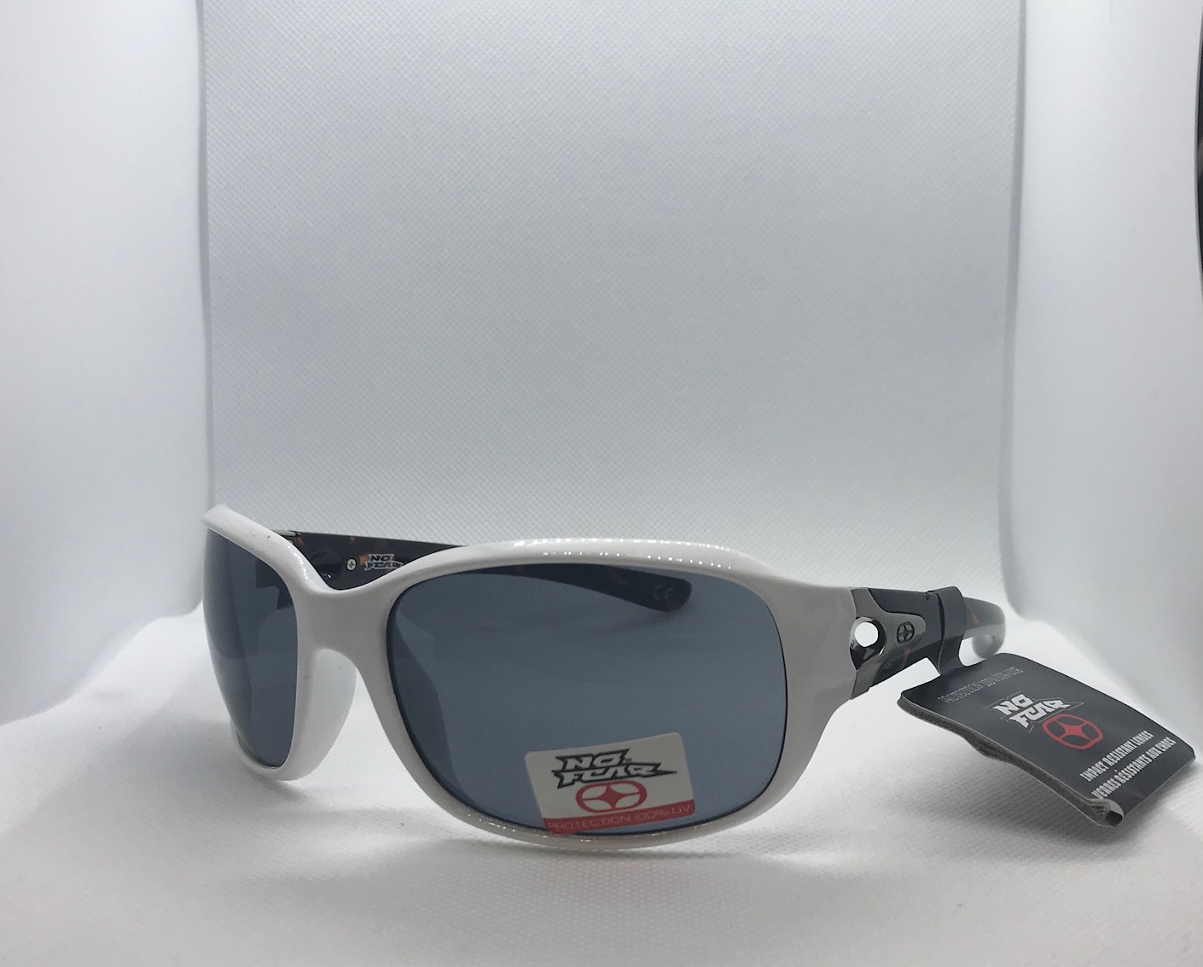
Item #:10223915
UPC: '741919990586
Description:
QTY: 388
Brand: No Fear
Retail: $29.99
Price: $2.50
FWS#: 6

Slide 8
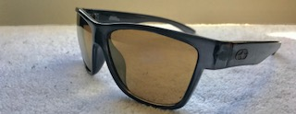
Item #: 10223916
UPC: '741919990593
Description: Black frame w/ black arms and black lens
QTY: 500
Brand: No Fear
Retail: $29.99
Price: $2.50
FWS#: 7

Slide 9
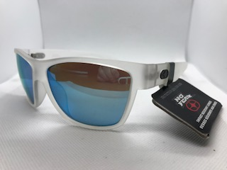
Item #: 10230417
UPC: '887661106728
Description: Clear white frame w/ clear white arms and yellow lens
QTY: 403
Brand: No Fear
Retail: $19.99
Price: $2.50
FWS#: 8

Slide 10
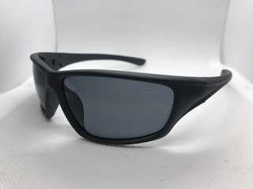
Item #: 10230416
UPC: '887661106605
Description: Black rubber-plastic frame and arms w/ black lens
QTY: 375
Brand: No Fear
Retail: $19.99
Price: $2.50
FWS#: 9

Slide 11
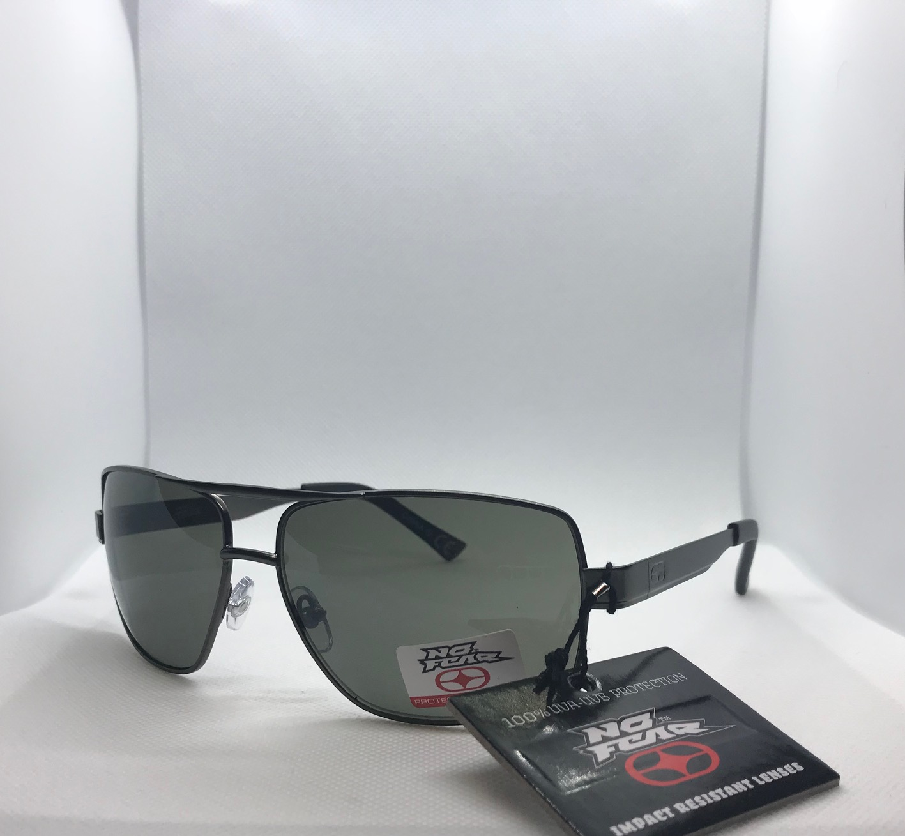
Item #: 10230418
UPC: N/A
Description: Black metal aviator frame
QTY: 100
Brand: No Fear
Retail: $19.99
Price: $2.50
FWS#: 10

Slide 12
Item #: 10230304
UPC: ‘887661101693
Description: Black Plastic frame and arms w/ purple lens
QTY: 319
Brand: No Fear
Retail: $19.99
Price: $2.50
FWS#: 11

Slide 13
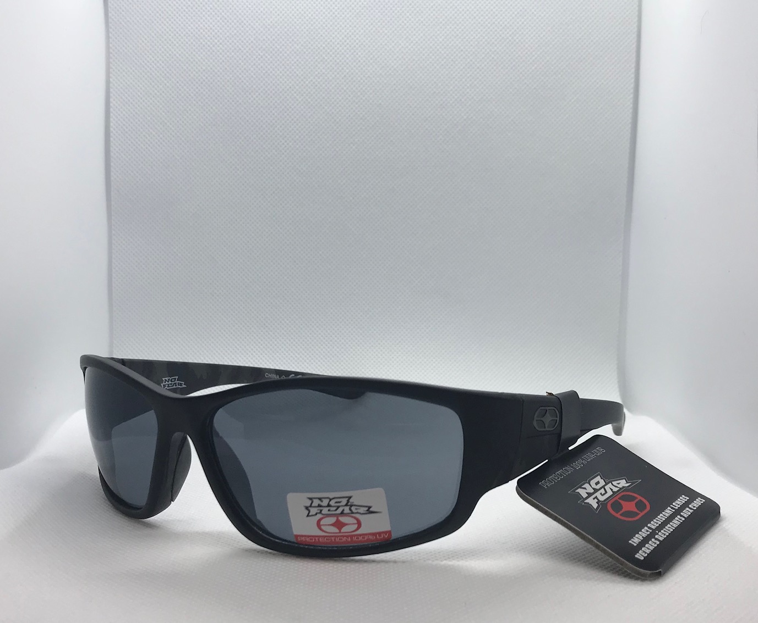
Item #:10228764
UPC: N/A
Description: Black rubber-plastic frame and arms w/ black lens
QTY: 319
Brand: No Fear
Retail: $19.99
Price: $2.50
FWS#: 12

Slide 14
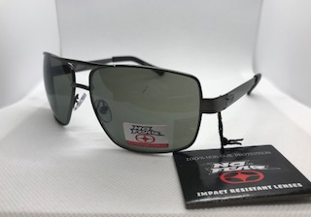
Item #: 10219194
UPC: '058619171376
Description: Black metal aviator frame w/ black lens
QTY: 500
Brand: No Fear
Retail: $29.99
Price: $2.50
FWS#: 13

Slide 15
Item #: 10230421
UPC: '887661106704
Description: Rubber-plastic black frame and arms w/ black lens
QTY: 388
Brand: No Fear
Retail: $19.99
Price: $2.50
FWS#: 14

Slide 16
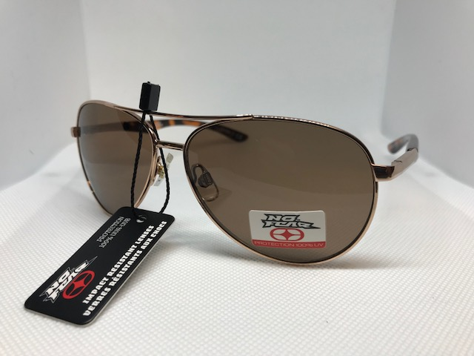
Item #: 10219197
UPC: '058619171376
Description: Gold metal frame aviator with gold and light brown arms
QTY: 500
Brand: No Fear
Retail: $29.99
Price: $2.50
FWS#: 15

Slide 17
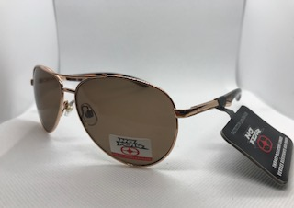
Item: 10223920
UPC: N/A
Description: Gold metal frame aviator with gold and light brown arms
QTY: 444
Brand: No Fear
Retail: $29.99
Price: $2.50
FWS#: 16

Slide 18
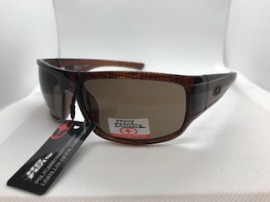
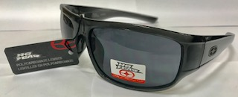
Item #: NF2001
UPC: 058619171376
Description: Black plastic square w/ logo on arm / Dark brown plastic frames
QTY: 500
Brand: No Fear
Retail: $29.99
Price: $2.50
FWS#: 17

Slide 19
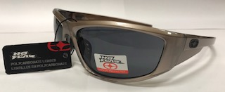
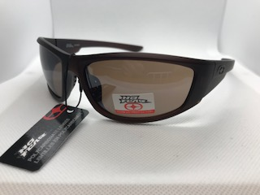
Item #: NF2003
UPC: 058619171376
Description: Light grey plastic frame w/ black lens and logo on arm/Black plastic frame and arm w/ logo on arm
QTY: 424
Brand: No Fear
Retail: $29.99
Price: $2.50
FWS#: 18

Slide 20
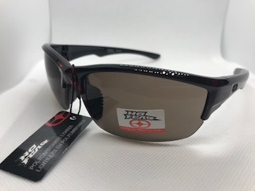
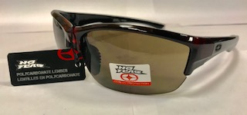
Item #: NF2004
UPC: 058619171376
Description: Transparent plastic dark blue w/ black lens/Dark brown plastic frame and arms
QTY: 210
Brand: No Fear
Retail: $29.99
Price: $2.50
FWS#: 19

Slide 21
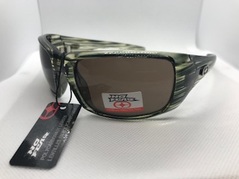
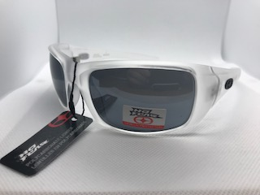
Item #: NF2005
UPC: 058619171260
Description: Clear brown frames with black stripes / Transparent white plastic frame and arms w/ black lens /
QTY: 500
Brand: No Fear
Retail: $29.99
Price: $2.50
FWS#: 20

Slide 22
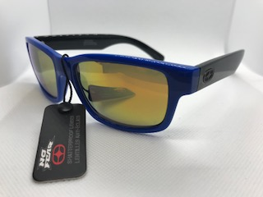
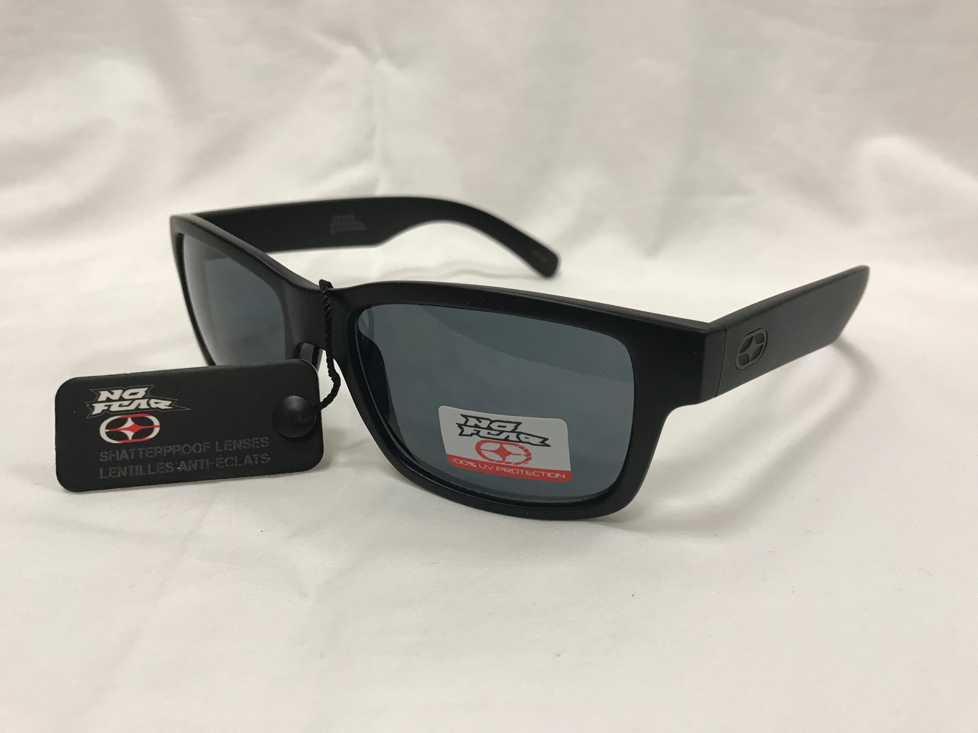
Item #: 10219205
UPC:
Description: Blue frame w/ black black arms and yellow/green lens / White frames and arms w/ blue lens / black frames and arms
QTY: 394
Brand: No Fear
Retail: $29.99
Price: $2.50
FWS#: 21

Slide 23
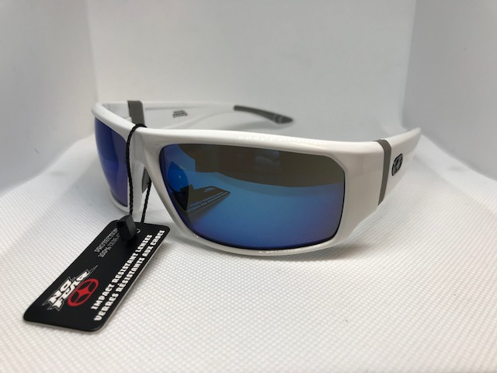
Item #: 10219181
UPC: 058619171376
Description: White frame w/ blue lens and white arms w/ No Fear logo on hinge
QTY: 6
Brand: No Fear
Retail: $29.99
Price: $2.50
FWS#: 22

Slide 24
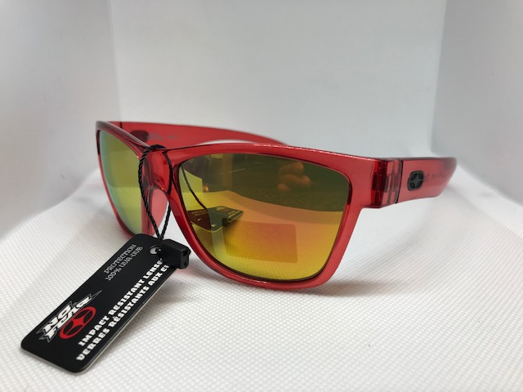
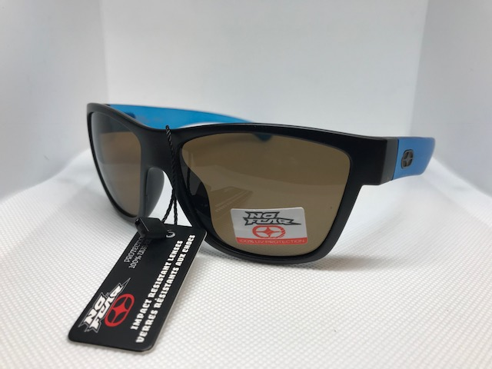
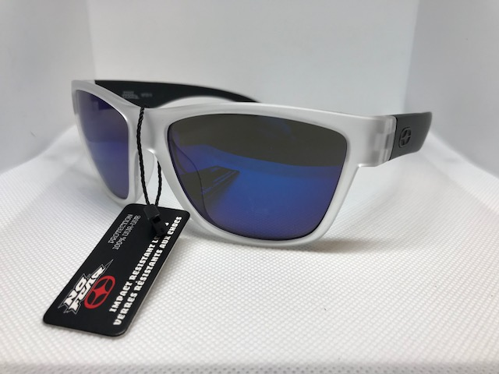
Item #:10219202
UPC: 058619171376
Description: Pic 1: Orange plastic frame and arms w/ bright orange lens / Pic 2: Black plastic frame w/ blue arms / Pic 3: White frame w/ black arms and blue lens
QTY: 81
Brand: No Fear
Retail: $29.99
Price: $2.50
FWS#: 23

Slide 25
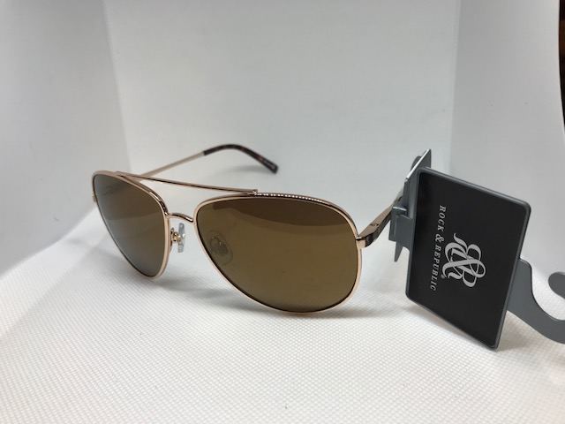
Item #: 10223610
UPC: 887661935533
Description: Gold Aviator style frame w/ brown lens
QTY: 182
Brand: Rock N’ Republic
Retail: $28.00
Price: $2.50
FWS#: 24

Slide 26
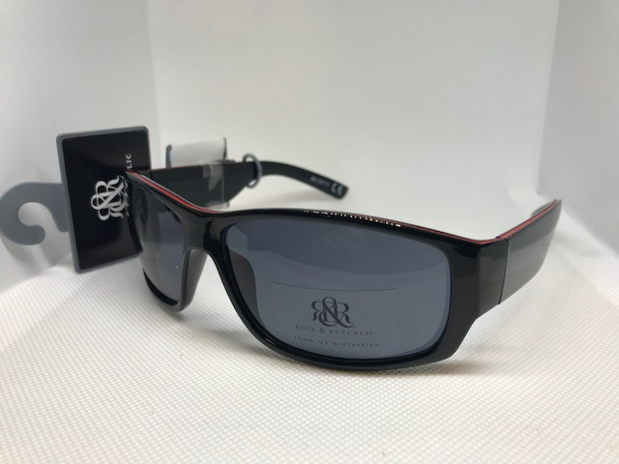
Item: 10223613
UPC: 887661934550
Description: Black frame w/ black arms and lens
QTY: 135
Brand: Rock N’ Republic
Retail: $28.00
Price: $2.50
FWS#: 25

Slide 27
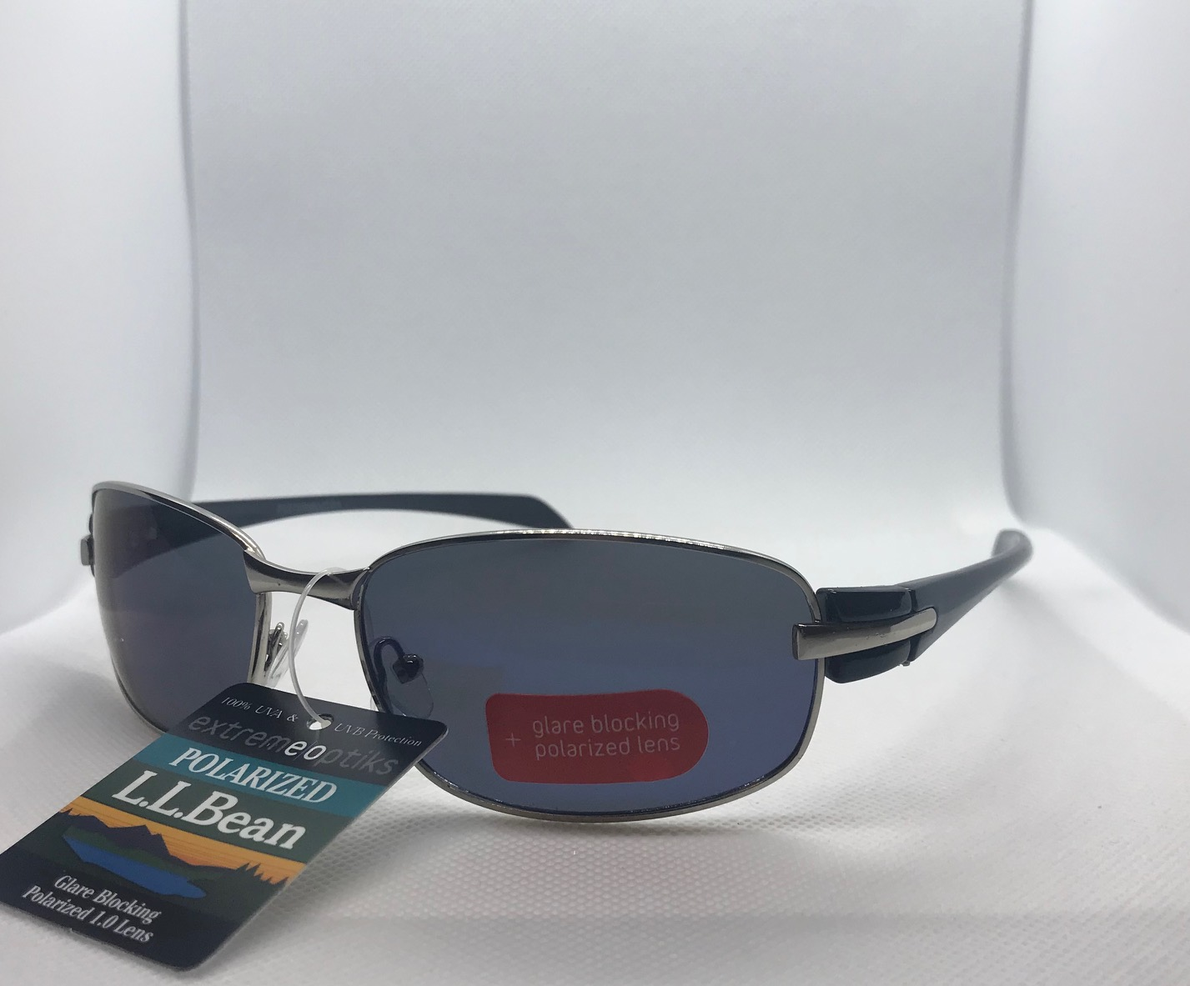
Item #: 10204695
UPC: '741919990524
Description: POLARIZED - plastic frame
QTY: 219
Brand: L.L. Bean $30.00 sticker
Retail: $30.00
Cost: $2.00
FWS#: 26

Slide 28
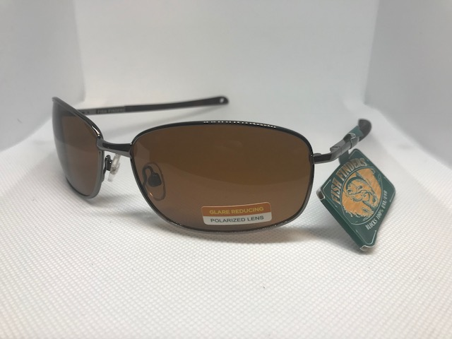
Item: 10200341
UPC: '070135519876
Description: POLARIZED - metal frame, plastic arm
QTY: 429
Brand: $24.99
Retail: Fish Finders
Cost: $2.00
FWS#: 27

Slide 29
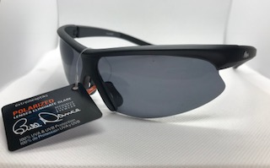
Item #: 10204244
UPC: '741919990494
Description: POLARIZED - floating frame, grey or black
QTY: 144
Brand: Bill Dance
Retail: $19.99
Cost: $2.00
FWS#: 28

Slide 30
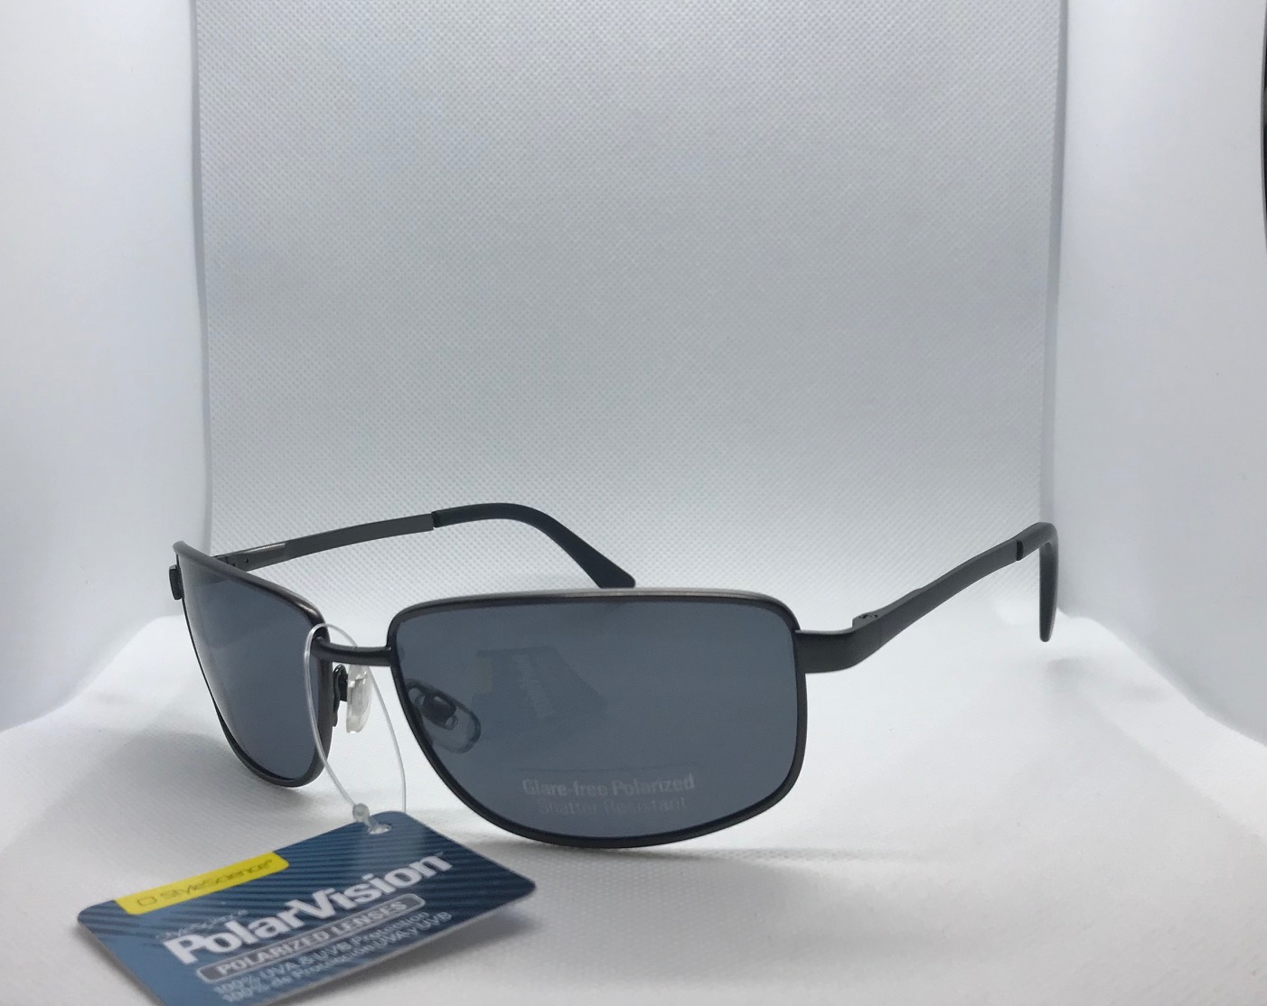
Item#: 10205533
UPC: '883019096468
Description: POLARIZED - metal frame
QTY: 14
Brand: PolarVision
Retail: $19.99
Cost: $2.00
FWS#: 29

Slide 31
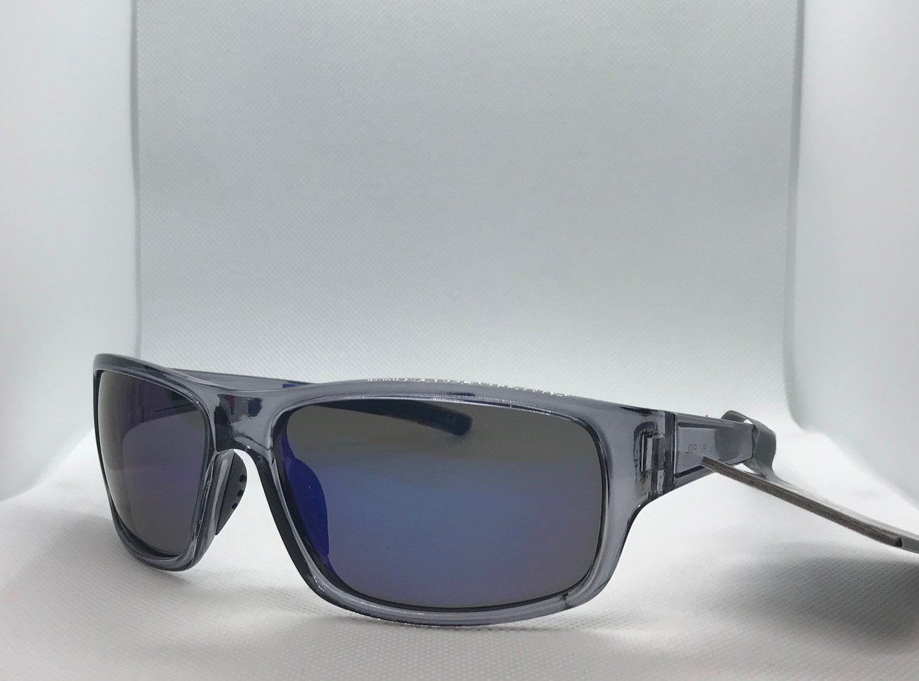
Item #: ASTSN1630-D
UPC: '887661181039
Description: POLARIZED - Plastic frame
QTY: 500
Brand: Foster Grant EO
Retail: $19.99
Price: $2.00
FWS#: 30

Slide 32
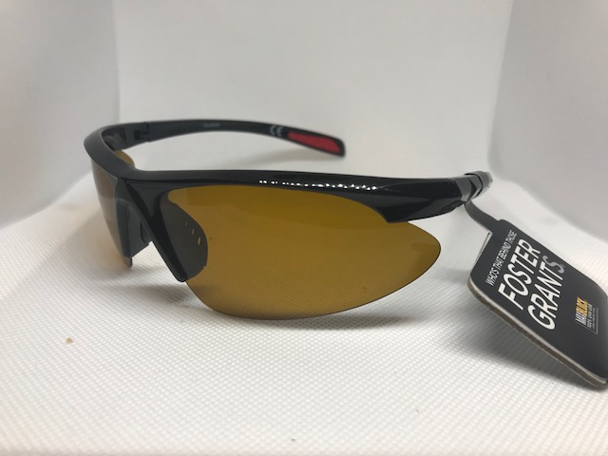
Item: ASTSN1630-B
UPC: '887661181039
Description: POLARIZED - Plastic half frame
QTY: 269
Brand: Foster Grant
Retail:$19.99
Price: $2.00
FWS#: 31

Slide 33
Item #: 10205537
UPC: N/A
Description: Metal frame w/ plastic arms
QTY: 50
Brand: Polar Vision
Retail: $19.99
Price: $2.00
FWS#: 32

Slide 34
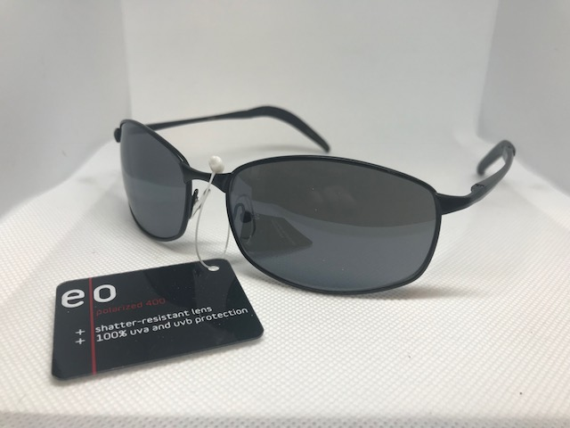
Item #: 10204279
UPC: '741919990500
Description: POLARIZED / glare blocking -Plastic frame
QTY: 500
Brand: E/O
Retail: $19.99
Price: $2.00
FWS# 33

Slide 35
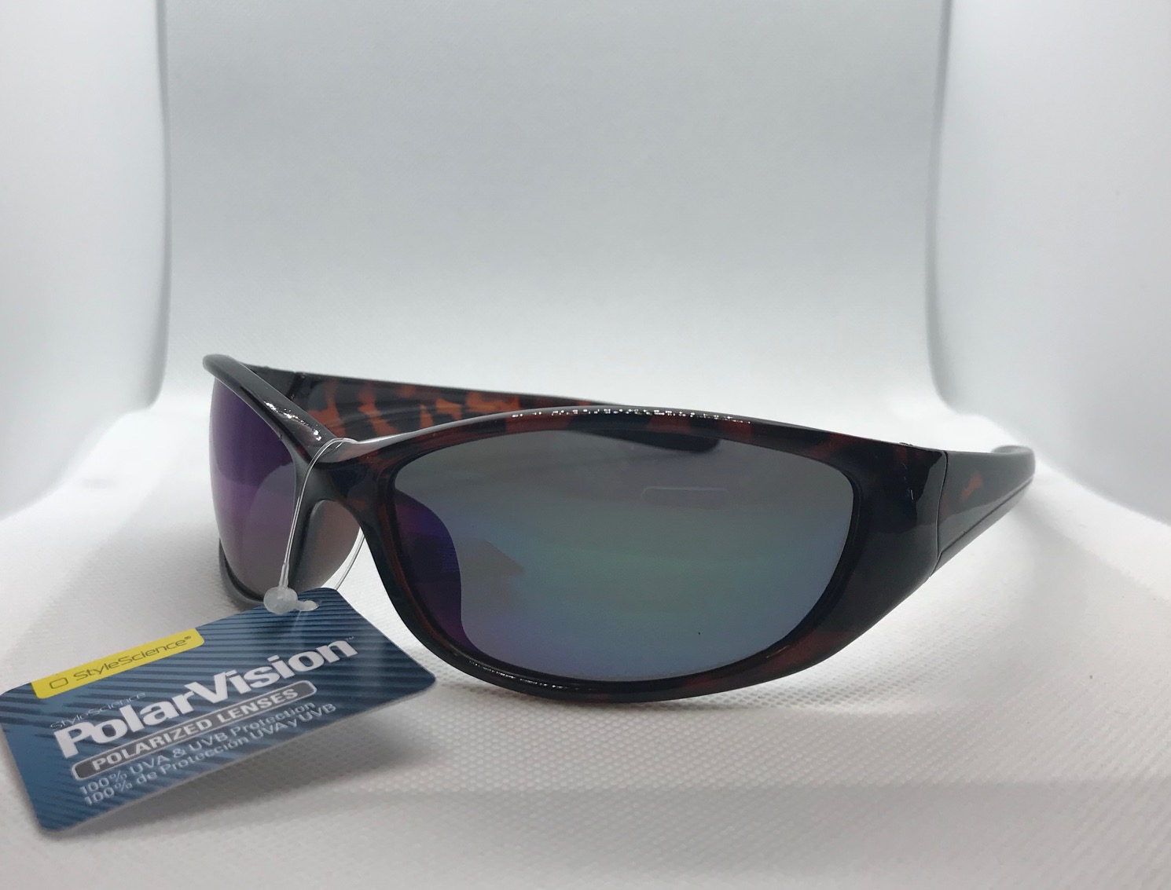
Item #: 10204482
UPC: '741919990517
Description: POLARIZED - plastic frame *mixed colors
QTY: 129
Brand: PolarVision
Retail: $19.99
Price: $2.00
FWS#: 34

Slide 37
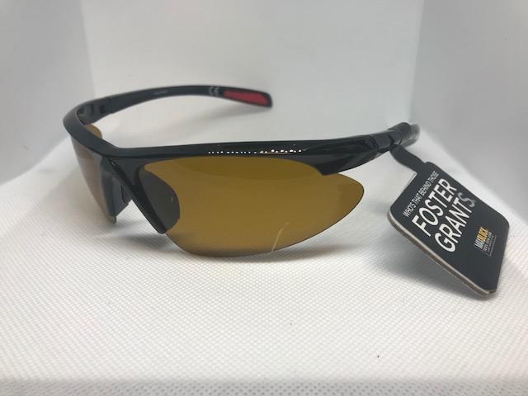
Item #: DS0514 (ASTSN1630)
UPC: '887661181039
Description: Black plastic frame
QTY: 329
Brand: Foster Grant E/O
Retail: N/A
Price: $2.00
FWS#: 36

Slide 38
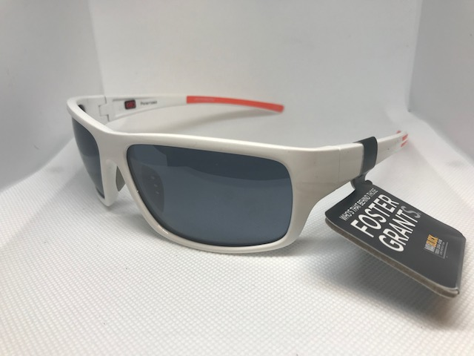
Item #: NS1014WHT (ASTSN1630)
UPC: '887661180139
Description: POLARIZED white plastic frame
QTY: 269
Brand: Foster Grant E/O
Retail: N/A
Price: $2.00
FWS# 37

Slide 39
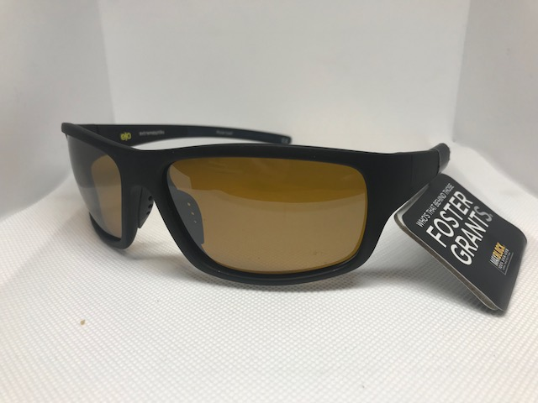
Item #: NS1014BLK (ASTSN1630)
UPC: '887661181039
Description: POLARIZED black plastic frame
QTY: 500
Brand: Foster Grant
Retail: N/A Price: $2.00
FWS#: 38

Slide 40
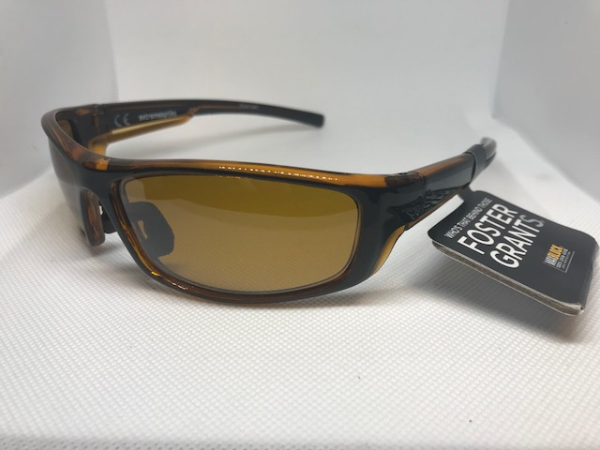
Item #: DG0414 (ASTSN1630)
UPC: '887661181039
Description: POLARIZED plastic amber frame
QTY: 179
Brand: Foster Grant
Retail: N/A
Price: $2.00
FWS#: 39

Slide 41
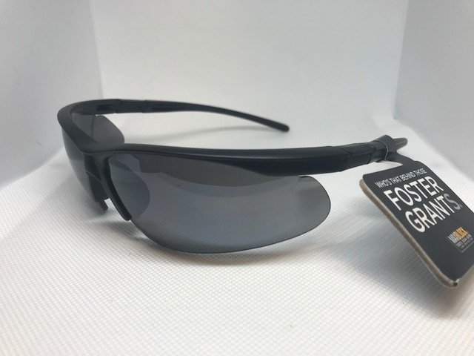
Item #: 32608 / 32484 (ASTSN1630)
UPC: '887661181039
Description: black plastic wrap frame
QTY: 500
Brand: Foster Grant E/O
Retail: N/A
Price: $2.00
FWS#: 40

Slide 42
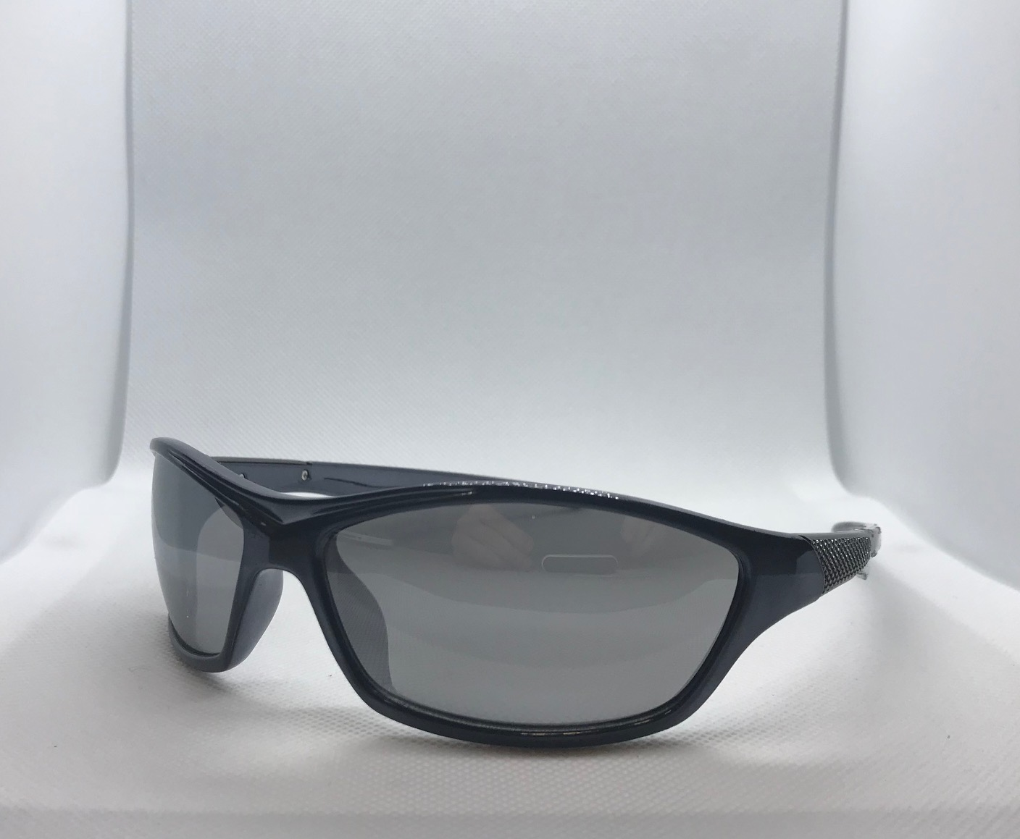
Item #:SR0114 (ASTSN1630)
UPC: N/A
Description: Plastic wrap frame
QTY: 20
Brand: Foster Grant
Retail: N/A
Price: $2.00
FWS#: 41

Slide 43
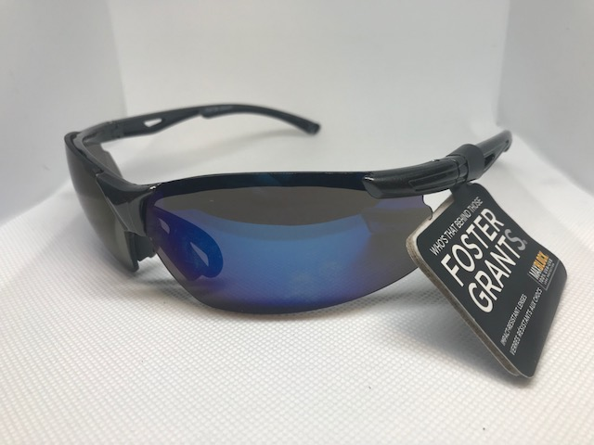
Item #: SR0116 (ASTSN1630)
UPC: '887661181039
Description: plastic wrap frame
QTY: 500
Brand: Foster Grant
Retail: N/A
Price: $2.00
FWS#: 42

Slide 44
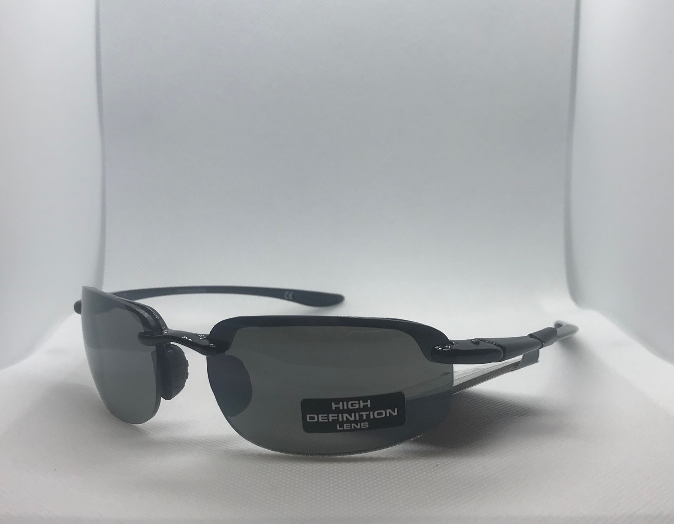
Item #: SR0414 (ASTSN1630)
UPC: N/A
Description: High Definition Lens
QTY: 175
Brand: Foster Grant
Retail: N/A
Price: $2.00
FWS#: 43

Slide 45
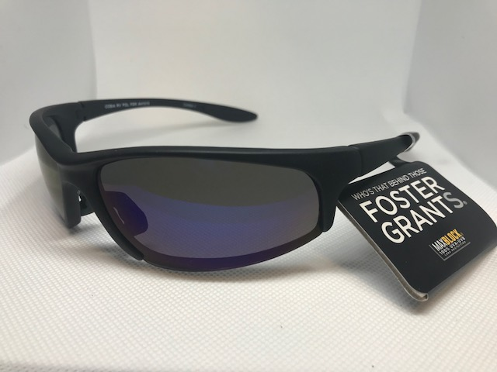
Item #: AH1015 (ASTSN1630)
UPC: N/A
Description: black plastic wrap frame
QTY: 50
Brand: Foster Grant
Retail: N/A
Price: $2.00
FWS#: 44

Slide 46
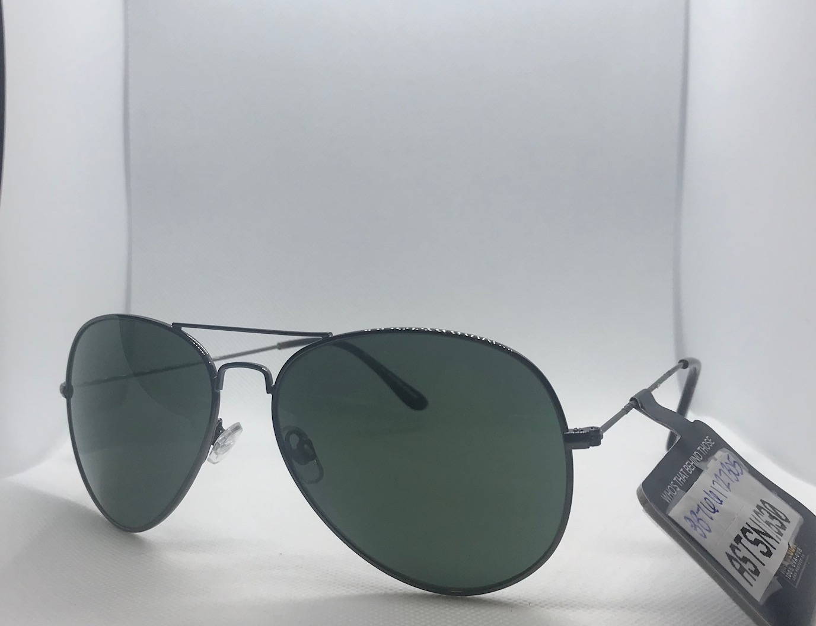
Item #: 887661727305 (ASTSN1630)
UPC: N/A
Description: Black & Tortoise aviator
QTY: 100
Brand: Foster Grant
Retail: N/A
Price: $2.00
FWS#: 45

Slide 47
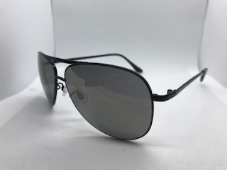
Item: #: EW1012 (ASTSN1630)
UPC: N/A
Description: Black aviator frames w/ black lens
QTY: 50
Brand: Foster Grant
Retail: N/A Price: $2.00
FWS#: 46

Slide 48
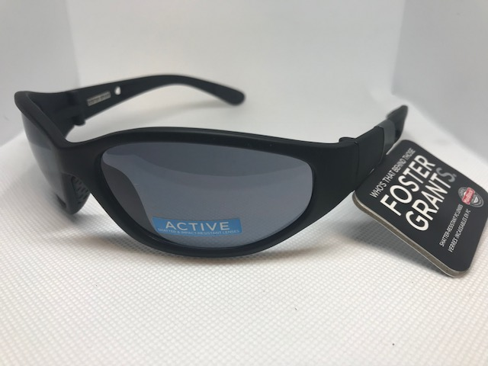
Item #: 10227803
UPC: N/A
Description: Black rubber frame w/ black lens and black arms
QTY: 200
Brand: Foster Grant
Retail: N/A
Price: $2.00
FWS# 47

Slide 49
Item #: 10218521
UPC: N/A
Description: Grey Transparent frame and arms w/ grey lens
QTY: 127
Brand: Foster Grants
Retail: N/A
Price: $2.00
FWS#: 48

Slide 50
Item #: 10222068
UPC: N/A
Description: Rainbow color lens w/ black arms
QTY: 16
Brand: Foster Grant
Retail: N/A
Price: $2.00
FWS#: 49

Slide 51
Item #: 10213100
UPC: N/A
Description: Aviator style frame w/ black lens and black arms
QTY: 125
Brand: Foster Grant
Retail: N/A
Price: $2.00
FWS#: 50

Slide 52
Item #: 10202068
UPC: N/A
Description: Black frame w/ black arms and lens
QTY: 16
Brand: Foster Grant (Max block)
Retail: N/A
Price: $2.00
FWS#: 51

Slide 53
Item #: OH0513
UPC: 887661181039
Description: Black frame w/ purple lens
QTY: 150
Brand: Foster Grant
Retail: N/A
Price: $2.00
FWS#: 52

Slide 54
Item #: NS0415BLU
UPC: N/A
Description: Blue plastic frames and arms
QTY: 40
Brand: Foster Grant
Retail: N/A
Price: $2.00
FWS#: 53

Slide 55
Item #: NS0145WHT
UPC: N/A
Description: White plastic frame w/ white plastic arms and blue lens
QTY: 30
Brand: Foster Grant
Retail: N/A
Price: $2.00
FWS#: 54

Slide 56
Item #:SR0615
UPC: N/A
Description: Black aviator style frame w/ black lens and black arms
QTY: 50
Brand: Foster Grant
Retail: N/A
Price: $2.00
FWS#: 55

Slide 57
Item: 25848
UPC: N/A
Description: Black frames w/ rainbow colored lens
QTY: 50
Brand: Foster Grant
Retail: N/A
Price: $2.00
FWS#: 56

Slide 58
Item #:DG1215
UPC: 887661181039
Description: Aviator style frame w/ black arms and lens
QTY: 469
Brand: Foster Grant
Retail: N/A
Price: $2.00
FWS#: 57

Slide 59
Item #: DG0116
UPC: N/A
Description: Black frame w/ black lens and arms
Brand: Foster Grant
QTY: 300
Retail: N/A
Price: $2.00
FWS#: 58

Slide 60
Item #: 18140
UPC: N/A
Description: Grey plastic frame w/ black lens and grey arms
Brand: Foster Grant
QTY: 75
Retail: N/A
Price: $2.00
FWS#: 59

Slide 61
Item #: SO3306
UPC: N/A
Description: Black thin frame w/ black lens and black arms
Brand: Foster Grant
QTY: 50
Retail: N/A
Price: $2.00
FWS#: 60

Slide 62
Item #:DG0513
UPC: N/A
Description: Black rubber plastic frame w/ orange lens and black arms
Brand: Foster Grant
QTY: 30
Retail: N/A
Price: $2.00
FWS#: 61

Slide 63
Item #: EG0315
UPC: N/A
Description: Black rubber frame w/ silver lens and black arms
Brand: Foster Grant
QTY: 30
Retail: N/A
Price: $2.00
FWS#: 62

Slide 64
Item #: NS1014
UPC: N/A
Description: Black plastic frame w/ black arms and purple lens
Brand: Foster Grant
QTY: 153
Retail: $19.99
Price: $2.00
FWS#: 63

Slide 65
Item #: 6W315190E
UPC: 887661900401
Description: POLARIZED - Black plastic frame w/ black lens and black arms
Brand: Solar Comfort
QTY: 153
Retail: $19.99
Price: $2.00
FWS#: 64

Slide 66
Item #: EG1014
UPC: 887661902160
Description: POLARIZED Tortoise shell frame and arms w/ brown lens
Brand: Foster Grant
QTY: 256
Retail: $24.99
Price: $2.00
FWS#: 65

Slide 67
Item #: KM1014
UPC: ’887661902153
Description: POLARIZED Bronze frame w/ black arms and brown lens
Brand: Foster Grant
QTY: 347
Retail: $24.99
Price: $2.00
FWS#: 66

Slide 68
Item #: 10207657
UPC: N/A
Description: Plastic black frame w/ green stripe design on black plastic arms
Brand: Arizona
QTY: 57
Retail: N/A
Price: $2.00
FSW#: 67

Slide 69
Item #: EGQ111
UPC: N/A
Description: POLARIZED Black frame w/ lens w/ black arms
Brand: Foster Grant
QTY: 15
Retail: $14.99
Price: $1.50
FSW#: 68

Slide 70
Item #: EG0512
UPC: N/A
Description: POLARIZED Bronze half frame
Brand: Foster Grant (Driver’s POLARIZED)
QTY: 75
Retail: $14.99
Price: $1.50
FSW#: 69

Slide 71
Item #: NS1213
UPC: 070135388113
Description: Black metal frame w/ black lens and black arms
Brand: Foster Grant
QTY: 374
Retail: $14.99
Price: $1.50
FSW#: 70

Slide 72
Item #: EQ0414
UPC: N/A
Description: Black rubber frame w/ black lens and black arms
Brand: Foster Grant
QTY: 191
Retail: $14.99
Price: $1.50
FSW#: 71

Slide 73
Item #: HO0110
UPC: N/A
Description: Black frame w/ black arms and black lens
Brand: Foster Grant
QTY: 73
Retail: $14.99
Price: $1.50
FSW#: 72

Slide 74
Item #: EGQ412
UPC: N/A
Description: POLARIZED Black rubber frame and black lens
Brand: Foster Grant
QTY: 73
Retail: $14.99 Price: $1.50
FSW#: 73

Slide 75
Item #: EG0115
UPC: ‘070135202198
Description: Bronze metal frame w/ brown lens and brown arms
Brand: Foster Grant
QTY: 215
Retail: $14.99
Price: $1.50
FSW#: 74

Slide 76
Item #: EG0414
UPC: 070135363950
Description: POLARIZED Black frames w/ black arms
Brand: Foster Grant
QTY: 293
Retail: $19.99
Price: $1.50
FSW#: 75

Slide 77
Item #: SO0478 / 28461
UPC: N/A
Description: Silver metal frame w/ silver lens and arms
Brand: Foster Grant
QTY: 50
Retail: N/A
Price: $1.50
FSW#: 76

Slide 78
Item #: 10208297
UPC: '031568530234 or 887661181039
Description: Navy plastic frame
QTY: 79
Brand: E/O $16.99 price sticker 031568530234 Foster Grant 887661181039
Retail: $16.99
Price: $1.50
FSW# 77

Slide 79
Item #: 10225788
UPC: '887661021632
Description: black frame QTY: 500
Brand: Foster Grant
Retail: $12.99
Price: $1.50
FSW#: 78

Slide 80
Item #: TD412
UPC: N/A
Description: Aviator style frame w/ black lens and black arms
Brand: Studio 35
QTY: 330
Retail: $9.99
Price: $1.50
FSW#: 79

Slide 81
Item #: 4196029
UPC: '049022450035
Description: POLARIZED silver rim aviator
QTY: 500
Brand: Studio 35 (Fashion)
Retail: $14.99
Price: $1.50
FSW#: 80

Slide 82
Item #:4034019
UPC: '049022450486
Description: Rimless
QTY: 500
Brand: Studio 35
Retail: $9.99
Price: $1.00
FSW#: 81

Slide 83
Item: 4843020
UPC: 04902246415
Description: Gold aviator w/ black rims
QTY: 500
Brand: Studio 35 Classic
Retail: $9.99
Price: $1.00
FSW#: 82

Slide 84
Item #: 2354029
UPC: '049022450219
Description: Black metal rim, black lens
QTY: 500
Brand: Studio 35 Retail: $9.99
Price: $1.00
FSW#: 83

Slide 85
Item #:4716019
UPC: '049022450257
Description: Black aviator frame w/ black lens and black arms
QTY: 500
Brand: Studio 35
Retail: $9.99
Price: $1.00
FSW#: 84

Slide 86
Item #: 10209401
UPC: '733732542462
Description: POLARIZED - plastic frame
QTY: 500
Brand: Suntastic
Retail: $8.00
Price: $1.00
FSW#: 85

Slide 87
Item #: 10201068
UPC: N/A
Description: Black plastic frame and red rubber arms
QTY: 500
Brand: N/A
Retail: N/A
Price: $1.00
FSW#: 86

Slide 88
Item #: DG1113
UPC: N/A
Description: Green lens w/ gold aviator style frame and gold arms
Brand: Studio 35
QTY: 164
Retail: $9.99
Price: $1.00
FSW#: 87

Slide 89
Item #: DG115
UPC: N/A
Description: Black metal frame w/ black lens and black arms
Brand: Studio 35
QTY: 412
Retail: $9.99
Price: $1.00
FSW#: 88

Slide 90
Item #: 10221944
UPC: N/A
Description: Black frame w/ black lens and arms
Brand: Sport
QTY: 42
Retail: $9.00
Price: $1.00
FSW#: 89

Slide 91
Item #: 10202284
UPC: '741919990678
Description: Gunmetal 1/2 rim
QTY: 500
Brand: N/A
Retail: N/A
Price: $0.75
FSW#: 90

Slide 92
Item #: 10205177
UPC: N/A
Description: Aviator
QTY: 100
Brand: N/A
Retail: N/A
Price: $0.75
FSW#: 91

Slide 93
Item #: 10201023
UPC: '070135550404
Description: Black aviator frame w/ black lens and black arms
QTY: 500
Brand: N/A
Retail: N/A
Price: $0.75
FSW#: 92

Slide 94
Item #: 10201031
UPC: N/A
Description: Silver rim aviator
QTY: 290
Brand: N/A
Retail: N/A
Price: $0.75
FSW#: 93

