Slide 1
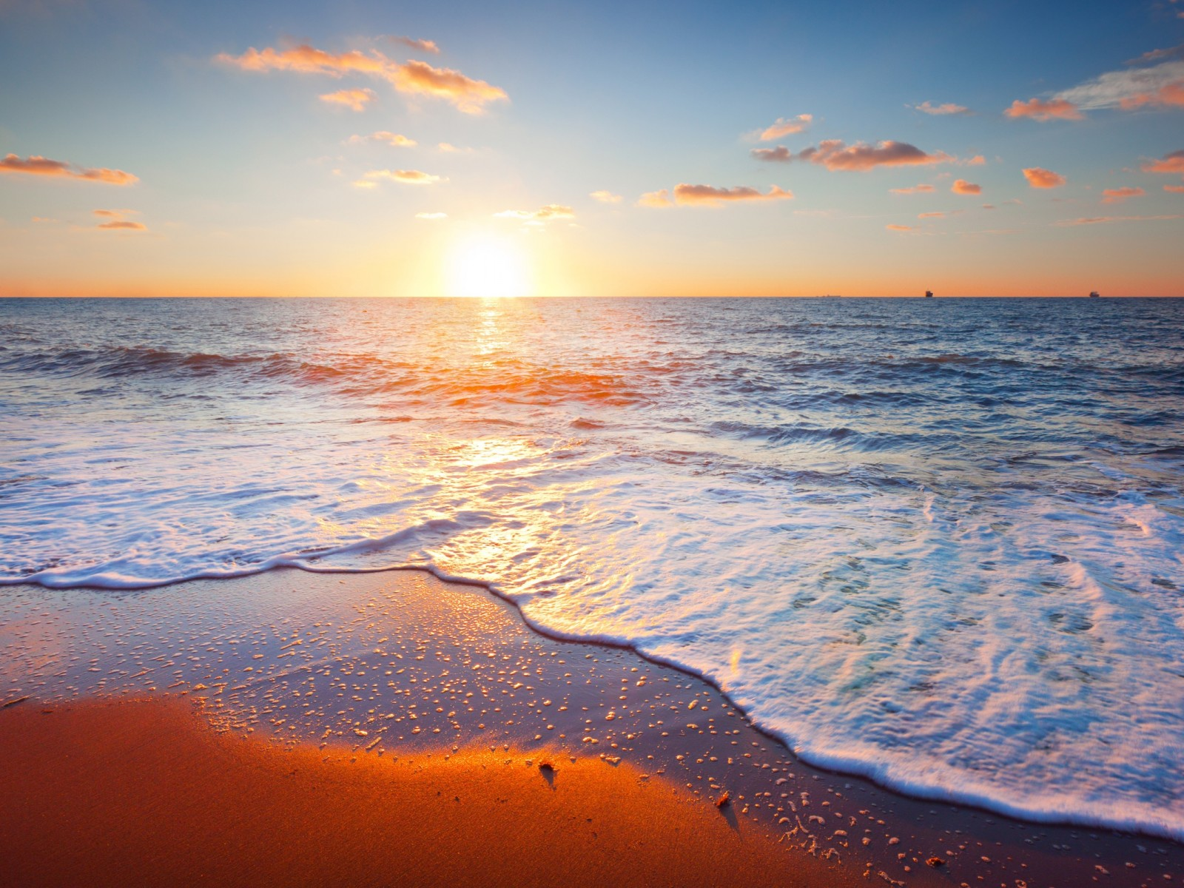
Florida Wholesale Sunglasses
now offering
Performance Sunglasses
Regular retail: $149.99 - $249.99
Florida Wholesale Sunglasses
Contact your sales rep
Phone: (941) 357-1640
Your price: $55.00/ea.

Slide 2
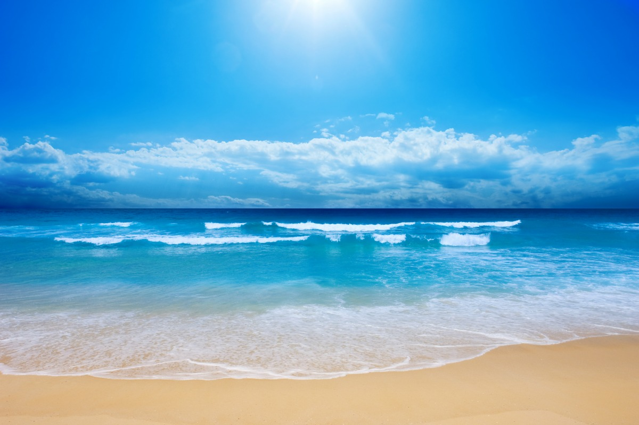
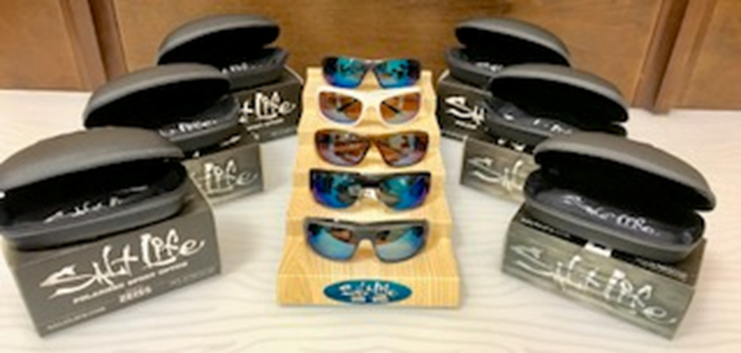
An ocean sport and beach lifestyle brand!
Embracing those that love the ocean and everything that comes with it!
Find your shade
Salt Life anti-glare optics help you see through the water even before you cast your line!
Salt Life sunglasses have full UV protection so you can enjoy a day in the sun. We use
only the best ZEISS lenses, polarized so you can watch the Salt Life in its true color.

Slide 3
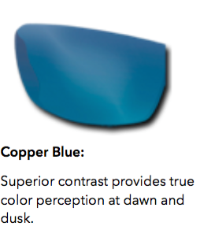
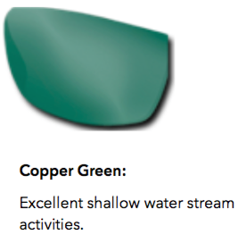
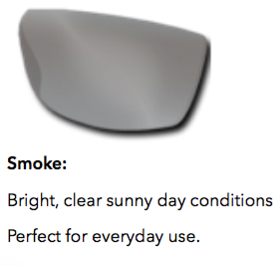
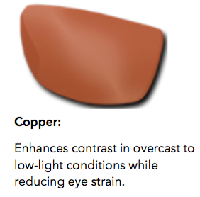
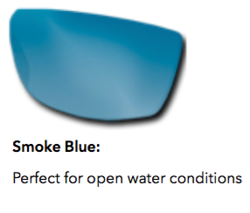
True color recognition
Lens tints created by ZEISS exclusive for Salt Life. Minimizes color distortions, giving you minimal glare while keeping your natural vision.
AR5
Reduces reflect glare Eliminates ghost images
RI-PEL
Permeant protective hydrophobic coating
Generates permeant repellant seal Creates a scratch resistant finish
Dirt, salt and dust are easily removed
For ZEISS, the focus is, and has been for over 160 years optical excellence. Each lens is certified with a "Z" to confirm authenticity of the ZEISS quality and performance guarantee. Ergonomically wrapped lenses block more light from hitting your eyes, improve comfort and provide extra protection against rain, sand and salt water.
Permanent hydrophobic Ri-Pel coating is applied, through a vacuum process to shed away dirt, dust, water and oil for the lifetime of the lens, even in extreme heat.
Premium grade polarizing film is permanently bonded into the lenses providing true color recognition, clarity and total UV-protection.

Slide 4
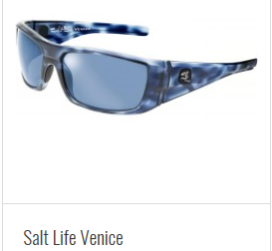
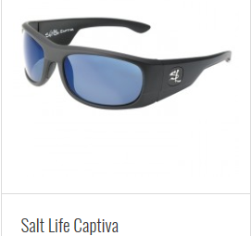
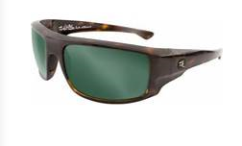
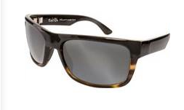
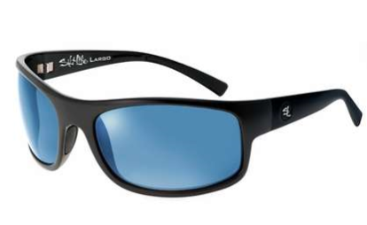
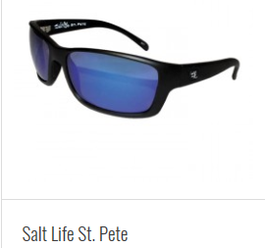
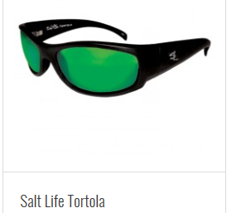
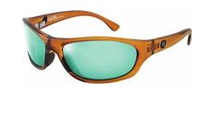
FLORIDA WHOLESALE SUNGLASSES - 2018 SALT LIFE INVENTORY
Salt Life La Jolla
Salt Life Huntington
*All styles represented but many more colors of frames and lens available
Salt Life Largo
Salt Life Fiji

Slide 5
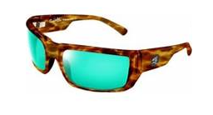
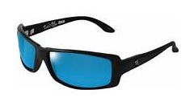
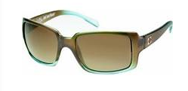
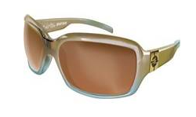
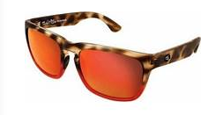
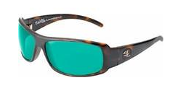
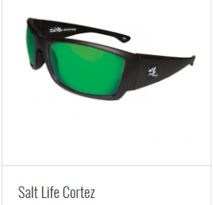
FLORIDA WHOLESALE SUNGLASSES - 2018 SALT LIFE INVENTORY
Salt Life Venice II
Salt Life Boca
Salt Life Bal Harbour
Salt Life Melrose
*All styles represented but many more colors of frames and lens available
Salt Life Samoa
Salt Life Lauderdale

