Slide 1



HELPING CHILDREN COPE
Michele A. Haynam, LPC
February 28, 2019
Dedicated to the Craft of Individual, Couples, Family and Group Therapy
11713 Jefferson Ave, Newport News, VA 23662 757.503.2819 artisancounseling.com

Slide 2

All Resources and content shared with me by …..
Thank you to Anisa!

Slide 3
Meeting Agenda
Introductions
  Child Age
  Biggest Concern/Fears
Key Message
Age Specific Guidance
Conclusions
Closing Comments / Shares
Dedicated to the Craft of Individual, Couples, Family and Group Therapy
11713 Jefferson Ave, Newport News, VA 23662 757.503.2819 artisancounseling.com

Slide 4

BE PRESENT
This Photo by Unknown Author is licensed under CC BY

Slide 5
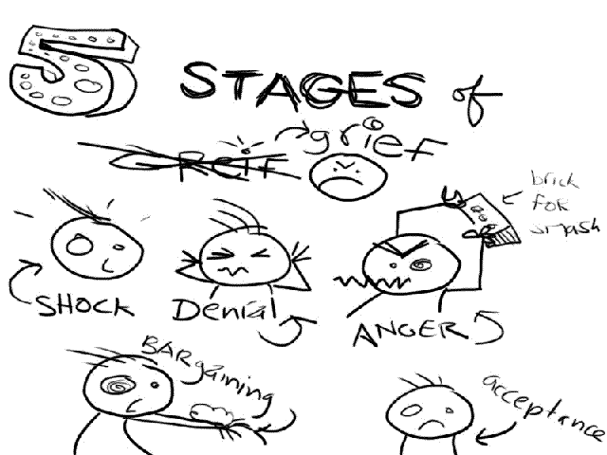
What is Important to my Grieving Child
This Photo by Unknown Author is licensed under CC BY-NC-ND

Slide 6
Consider the Following:
Children want to share their experience with adults
Don’t deceive a child to protect them; children need honesty
Allow your child to ask questions; and simply answer the question asked
Repeated questions means they are processing (this is good!)
Children want to be heard and understood
There is no right or wrong in how they feel.
We don’t grieve in steps or stages …it’s a process (not an event)
Notes:
1. You’re child’s love for the person who died is very special. They usually want to share their feelings; they do not want to be told how to feel. They want adults to listen to how they experience loss. Using open-ended questions can help you to hear what your child feels. When talking about the loved one you can ask things like, “What would you like to do for him/her?”
2. In general, children find ways to cope with sad news. It is important to refrain from using clichés, half-truths, and fairy tales that cannot explain the mystery of death. Lying, or dismissing the topic, leaves too much to their imagination. It may teach the child that we don’t have to be honest when dealing with others. Unhealthy explanations can also create fear, doubt, or anger. Remember, children think literally. Using phrases like “we lost him/her,” “he/she is sleeping with God,” “he/she went on a trip,” or “he/she is watching over you” can be confusing because of the literal meaning of the phrases, and because they do not explain what has happened. Instead, use a phrase like, “____ died. That means her heart stopped beating and her body doesn’t work anymore. She is not with us like she used to be, but we will always remember and love her very much.” This explains literally what happened and how you feel about it. Children need simple, honest answers.
3. Younger children tend to repeat the same questions, perhaps to assure themselves that the story is still the same. Each time you repeat the story honestly you are allowing the child to understand more deeply. Because you, too, are grieving, you may feel frustrated by this process. Children learn how to cope with their grief from your sincere feelings, actions, and responses to their questions. Do you best to be patient and open, and ask for help when you need it.
4. Each child’s thoughts and feelings are important and must be treated as such. Children are very sensitive to energy levels, moods, tones of voices, and choices of words. They know you are actively listening to them when you make eye contact and respond without judgment.
5. Don’t expect your child to grieve in an orderly fashion. They generally grieve in shorter bursts, with a wide range of emotions and reactions. They cannot sustain grief in the same way as adults; they grieve, then move away from the pain (and often turn to play). Each child is different and special, even when they are in the same family. The length of time a child grieves and how they show their grief depends on their emotional investment in the situation.
6. Don’t expect your child to grieve in an orderly fashion. They generally grieve in shorter bursts, with a wide range of emotions and reactions. They cannot sustain grief in the same way as adults; they grieve, then move away from the pain (and often turn to play). Each child is different and special, even when they are in the same family. The length of time a child grieves and how they show their grief depends on their emotional investment in the situation.
7. The healing process happens over time. A grieving child is unable to hurry through their emotions and get over it. Just as you will miss your loved one on special occasions like birthdays and holidays, so will your child. If they cannot communicate how they feel verbally, it is possible they will express it in their behavior.
8. Don’t expect your child to grieve in an orderly fashion. They generally grieve in shorter bursts, with a wide range of emotions and reactions. They cannot sustain grief in the same way as adults; they grieve, then move away from the pain (and often turn to play). Each child is different and special, even when they are in the same family. The length of time a child grieves and how they show their grief depends on their emotional investment in the situation.
9. The healing process happens over time. A grieving child is unable to hurry through their emotions and get over it. Just as you will miss your loved one on special occasions like birthdays and holidays, so will your child. If they cannot communicate how they feel verbally, it is possible they will express it in their behavior.

Slide 7

Grief by the Ages
This Photo by Unknown Author is licensed under CC BY-NC

Slide 8
Infants & Toddlers
Infants and toddlers generally have no concept of death.
They are more reactive to your feelings and behavior
They may exhibit more crankiness, clinginess, changes in eating or sleeping patterns, or regressions in behaviors such as potty training.
It is important to keep your daily routine as normal as you can to provide a sense of security, normalcy & comfort.
Offer physical assurances like holding and cuddling.
Dedicated to the Craft of Individual, Couples, Family and Group Therapy
11713 Jefferson Ave, Newport News, VA 23662 757.503.2819 artisancounseling.com

Slide 9
Ages 3 -5 (Hold)
Regression in behaviors / increases in nightmares.
Magical thinking about death – non permanent.
They believe their thoughts and wishes can cause things to happen. May experience irrational feelings / responsibility for the death because of thoughts or wishes they had prior to the death
Asking the same question over and over again…
Use play discuss expressions of grief (toys and/or drawing)
SEPARATION ISSUES. Discuss…Prepare…Hug, Celebrate – don’t get mad! Physical reassurances
Routine, Routine, Routine
Dedicated to the Craft of Individual, Couples, Family and Group Therapy
11713 Jefferson Ave, Newport News, VA 23662 757.503.2819 artisancounseling.com

Slide 10
Ages 6-9 (Reassure)
Meet your child where they are at!
May demonstrate fear of their own death
Their reactions can include crying, anxiety, or an unwillingness to talk about the death. Because they are just beginning their development of the concept of death and dying, they rely on your compassion and reassurance to let them know they are all right.
Interested in the process of dying and ask ‘how’ or ‘why’ things have happened. Their questioning may be repetitive.
Ghosts and monsters.
Emotions may confuse them and you (see ICEBERG)
Symbolic play can be helpful; allow them to talk, draw, or tell stories about the person.
Dedicated to the Craft of Individual, Couples, Family and Group Therapy
11713 Jefferson Ave, Newport News, VA 23662 757.503.2819 artisancounseling.com

Slide 11
Ages 9-12 (Guide)
Death to tweens is very personal and realistic. They understand that death is forever
Look for permission to show feelings and participate in honoring the deceased. Their feelings are important and need to be validated to promote healthy grieving. INVOLVE THEM
Curious about the physical aspects of death.
Concerned with how others are reacting to the death. What is the right way to react? How should they react? Laughing?
Separation Anxiety
Give honest and compassionate answers to reassure it is all right to feel the way they do.
Even older kids need to be hugged and held to give assurance that you are available and going through this with them.
Dedicated to the Craft of Individual, Couples, Family and Group Therapy
11713 Jefferson Ave, Newport News, VA 23662 757.503.2819 artisancounseling.com

Slide 12
Teenagers - LISTEN
Teens think abstractly about the implications of death / afterlife.
May become preoccupied with death, or may exhibit risk-taking behavior or the meaning of life.
Encourage communication and being available to listen about feelings will help their grieving process. Set a good example by speaking about your own feelings surrounding the death (without putting them in the role of the comforter)
Involve them…input and make choices regarding funerals, memorials, belongings, etc.
May be more traditional – extreme sadness, anger, denial. Even though they are capable of expressing grief they may chose not to.
May feel forced to act as a consoler and comforter for younger children or adults.
May be more willing to talk about grief with people outside of the family. Grief camps and support groups may be helpful.
Dedicated to the Craft of Individual, Couples, Family and Group Therapy
11713 Jefferson Ave, Newport News, VA 23662 757.503.2819 artisancounseling.com

Slide 13
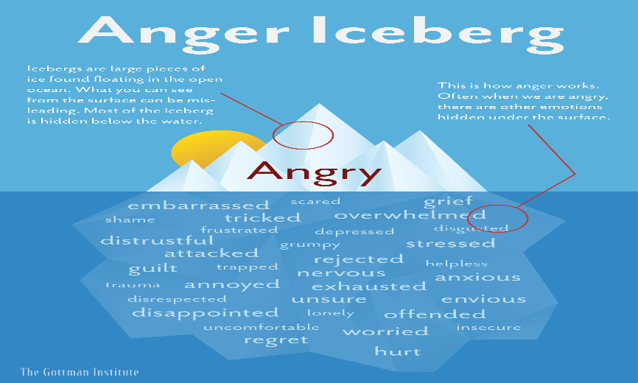
Dedicated to the Craft of Individual, Couples, Family and Group Therapy
11713 Jefferson Ave, Newport News, VA 23662 757.503.2819 artisancounseling.com

Slide 14

The greatest gifts you can Give someone
are your Time,
your love and
your attention
BE PRESENT
Dedicated to the Craft of Individual, Couples, Family and Group Therapy
11713 Jefferson Ave, Newport News, VA 23662 757.503.2819 artisancounseling.com

