Slide 1
The only constant:
Mastering adaptive capability in a world of exponential change
Bob Barbour
7 March 2018
Notes:
Let me introduce myself. My name is Bob Barbour, and I’ve recently just let go of all of one of the loves of my life, Lion, where I worked for over 25 years and led the P & C team for the last 20 of those years.
My great passion during those years has been to help create and sustain change at an individual, team and organisational level.
This was achieved by working on culture across the business and by helping people individually to change.
Lion achieved a great deal of success at a cultural and individual change level… we could always have down better of course, and there were a few setbacks in the 20+ years of the change journey
I would like to share with you some of the learnings from this change journey, and also alerts you to the new imperative we all face:
-to master adaptive capability in the world of exponential change
I would also like to share some suggestions for how we do this as an individual, organisational and societal level

Slide 2
Agenda
The Context – a world of exponential change!
Why culture matters more than ever in this world
How do we successfully change – our culture and ourselves?
So what for HR/People & Culture?
An opinion, no matter how well
formed and informed,
is at best temporary and incomplete
Notes:
Here is what I am going to cover in my presentation.

Slide 3
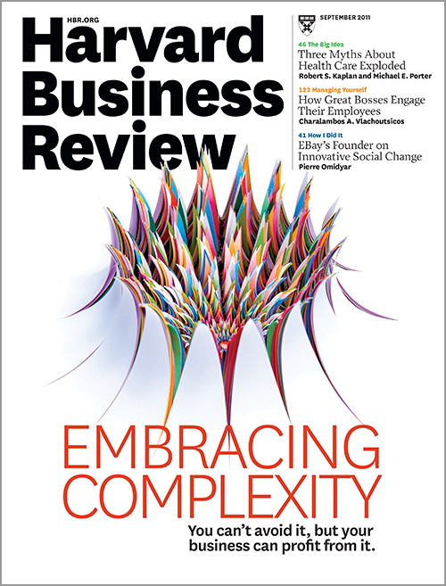
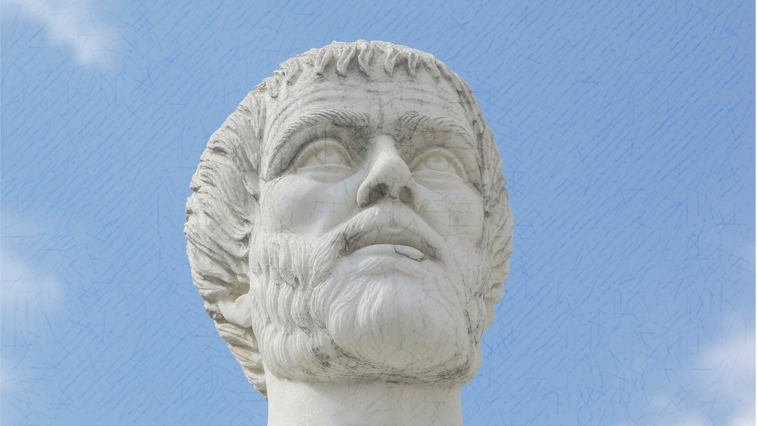
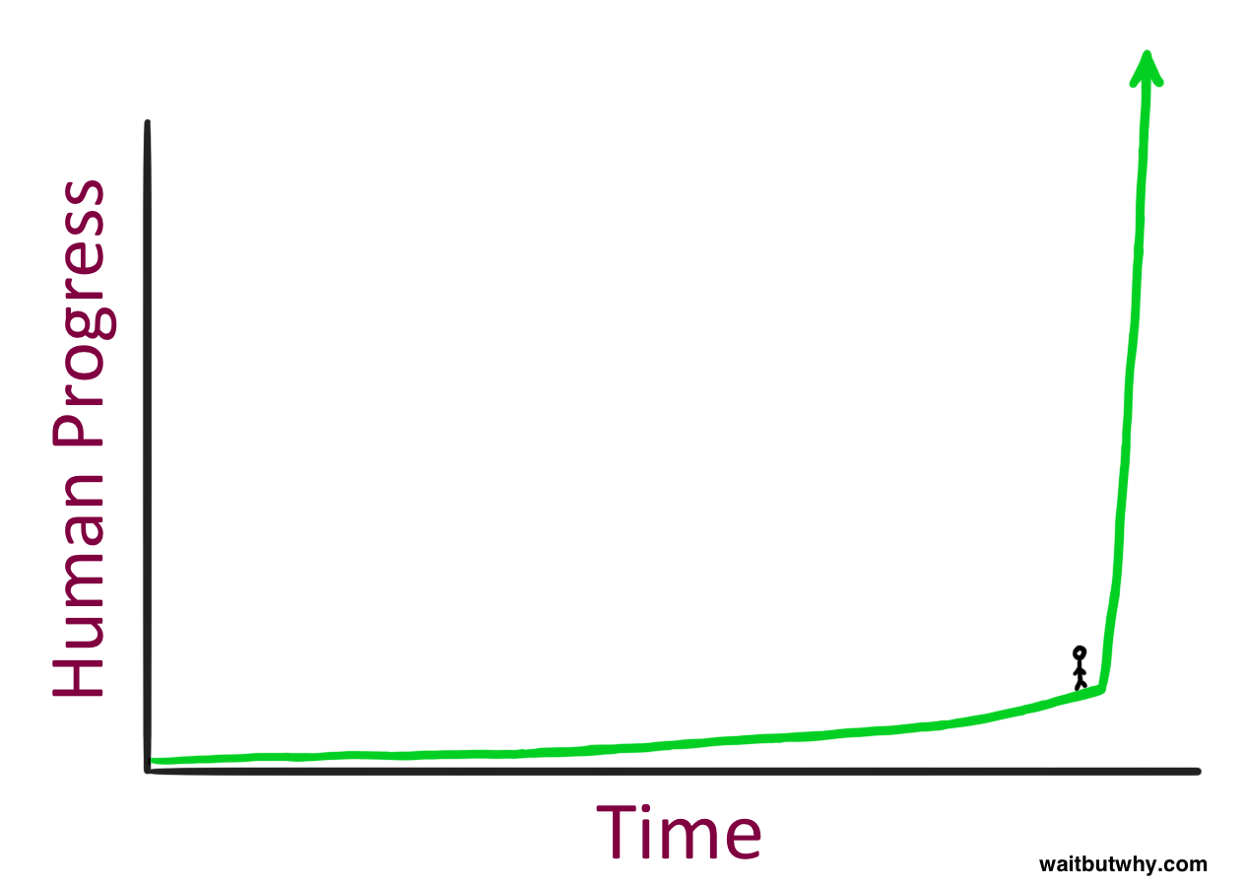
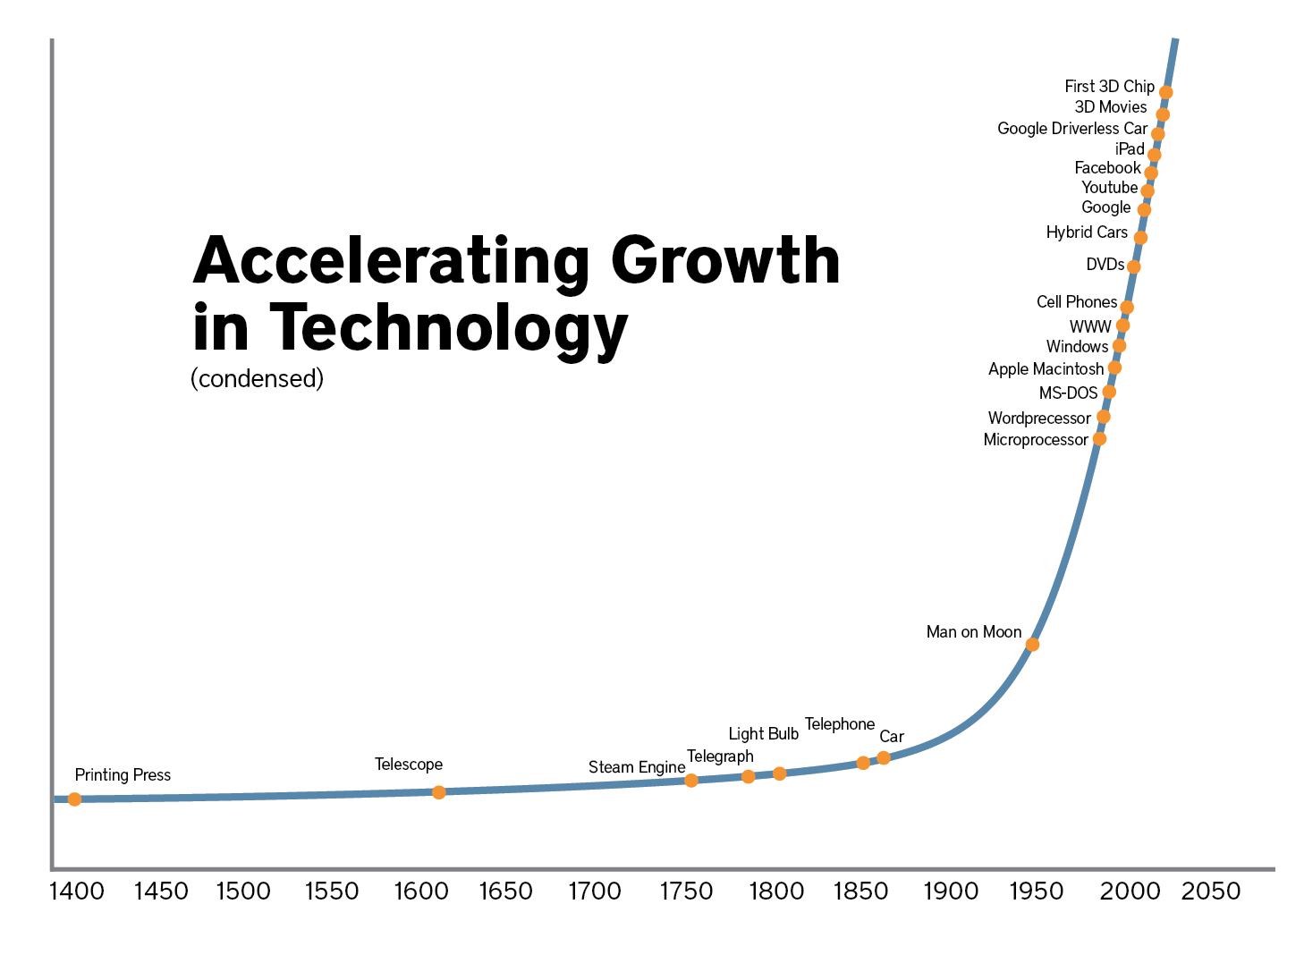
1. Life is increasingly complex, faster and more transparent…
An opinion, no matter how well
formed and informed,
is at best temporary and incomplete
…how do you survive, and flourish, in a world of exponential change?
Notes:
In case anyone is not noticed the world is becoming more complex, faster and increasingly transparent!
Anyone surprised by this news!
Well it is always being becoming more complex, faster and mostly transparent as you may well say and we have always had to change and adapt to this, haven’t we?
BUT
The new news is that the rate of change, as leading futurist Ray Kurweil states, is being governed by “The Law of Accelerating Returns” : “ A more advanced society progresses faster rate than the previous society. Why? Because they are more advanced.”
Kurzweil has attempted to articulate this rate of progress in a way that most of us will understand. He does this by referring to the substantial amount of human progress that occurred during the 20th century.
The 20th century was a period of immense change, starting with horse & cart and steam engines and concluding with jet engines, satellites and the internet. Not to mention the complete revolution in social norms and political institutions.
By the year 2000, Kurzweil estimates that the rate of human progress was five times the average rate of progress that occurred during the 20th century. In other words, by the year 2000 it only took 20 years for a 20th century's worth of change to occur. Kurzweil further estimates that between 2000 and 2014 another 20th century's worth of change occurred. And right now we are in the middle of another 20th century's worth of change that is occurring between 2014 and 2021.If this rate continues, then by around the year 2028, a 20th century's worth of change will be occurring every year. And by 2030 multiple times a year. And by 2045, multiple times a month.
Just stop and pause on this for a moment.
Within a decade a 20th century's worth of change will be occurring every year! And beyond 2030, multiple times a year!
Even if this expected rate of change is half wrong (which I doubt it is), the reality is that we are at the tipping point of unimaginable change. When things change exponentially, there is always a tipping point and we are fast approaching, or are at, that point.
So our previous approach to learning, personal growth and development, and adpatability just wouldn’t cut it in this world of exponential change
– we need to get much better at changing ourselves… at building an adaptive capacity

Slide 4
Life is increasingly complex, faster and more transparent…
An opinion, no matter how well
formed and informed,
is at best temporary and incomplete
Notes:
How to best handle this uncertain and rapidly changing world…. Clues exist in many places and are provided by many people.
Two characters and some important clues they have suggested
The first lived almost two and a half thousand years ago, and the second is much more contemporary, as you will see in a minute
First, Aristotle, 384 – 322 BC, pupil of Plato, tutor of Alexander the Great
Aristotle’s three types of knowledge
know how
know why
know what… To do in this specific situation (practical wisdom/phronesis)
Life is complex and changing fast. Any view or solution is at best temporary and incomplete
Stay open in a world of exponential change, always listen
“Temporary” is becoming shorter
need lots of feedback
Mother of newborn analogy – need to make decisions, take a view, move on but always listen
A liberating concept, life is complex but have to make choices and stay open, don’t panic

Slide 5
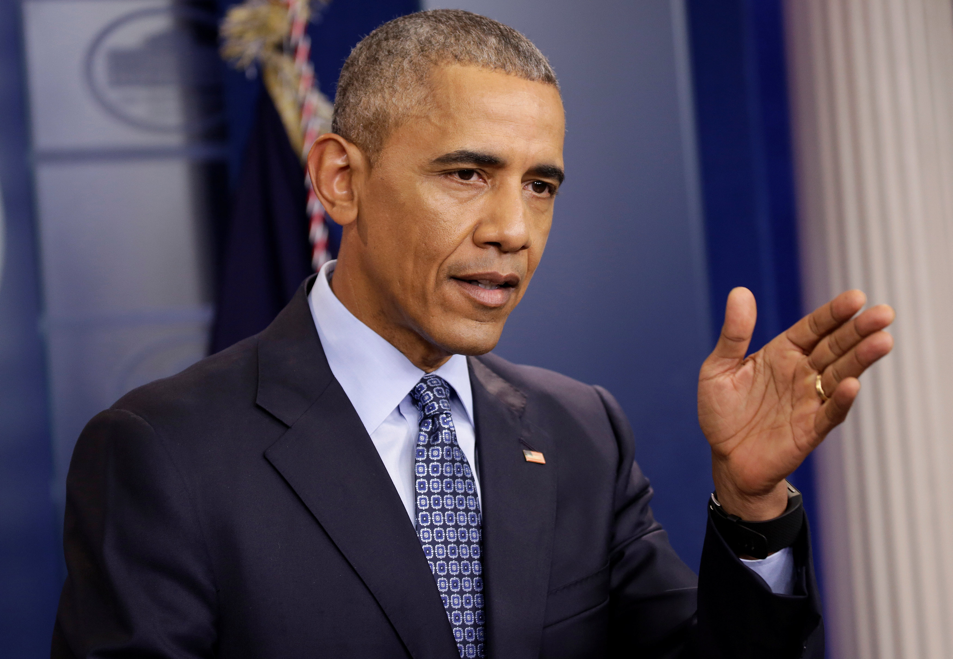
Increasingly people are responding to complexity through “retreating into bubbles” of similar thought
“For too many of us, it's become safer to retreat into our own bubbles…surrounded by people who look like us and share the same political outlook and never challenge our assumptions.
And increasingly, we become so secure in our bubbles that we accept only information, whether true or not, that fits our opinions, instead of basing our opinions on the evidence that's out there.” President Obama April 2017
Having a closed mind is one of the biggest threats to adaptivity
Notes:
Being open, actively seeking views that challenge existing held beliefs and being willing to experiment
The human mind has throughout the centuries been wired to reduce the complexity of the world around us. During and up to early adult development, our brains develop a frame through which we view the world, and this frame is designed to help protect us from the uncertainty and ambiguity of a complex world. For most people this frame, or mindset, determines what information is subconsciously let in and what information is subconsciously blocked out.
ironically new technologies, in particular social media, are not being leveraged to expand our frame and mindset. Rather they are being used to seek out information that only reinforces our frame or mindset – as Obama, in his final speech as president, eloquently highlights in the quote above.
Having a closed mind, and only seeking out views that are consistent with our own perspective, is one of the biggest threats and enemies of being adaptive. We have historically been able to get by with having a closed mind when the rate of change in the world has been slower. However being open to different perspectives, listening, being reflective, open to feedback and not being defensive, will be critical attributes of those who are able to adapt to a fast changing and complex world.
These attributes will distinguish between those who will flourish from those who will flounder

Slide 6
Life is increasingly complex, faster and more transparent…
An opinion, no matter how well
formed and informed,
is at best temporary and incomplete
…how do you survive, and flourish, in a world of exponential change?
Notes:
So this is the context: a world of increasing complexity and exponential change, and some clues from Aristotle and Obama on to how to adapt to this world

Slide 7
2. Why culture matters more than ever…
First a definition:
“Culture is telling you moment to moment what to do”
Ed Schein
Notes:
Culture guides and influences us in our thinking and behaviour… It has a critical impact on our ability to adapt fast – organisationally and individually
Culture is at the simplest level ‘the way we do things around here’. It is the behaviours that a visitor would observe.
However, to change culture you need to understand the deeper levels of why we do things the way we do. That is our values, assumptions and beliefs.
It is our shared assumptions, values and beliefs which strongly influence how people think and behave (norms).
Culture is like the personality of the organisation.
[Ed Schein – Former Professor at the MIT Sloan School of Management. A leading thinker on organisational development in many areas, including culture. Books include “Organisational Culture & Leadership (1985)]

Slide 8
”The only thing of real importance that leaders do is create and manage culture”
Ed Schein
Notes:
Now not all leaders would agree with this view but if we buy Schein’s previous quote then it provides a good challenge to leaders and professionals.
It is our job to help leaders to understand what they do to shape their culture.
In their everyday work
Help them see the link between decisions they are making, and how they make them, is shaping the culture.
As well as what they don’t do (eg tolerating poor behaviour) is also shaping culture
So perhaps the only thing of real importance that HR leaders do is to create and manage culture !

Slide 9
3. We all need to strive to build an adaptive culture in our organisations…
Start with the End in Mind
and build an integrated roadmap to get you there
Leadership Mindset
Leadership Behaviour
Culture
People Experience
Customer Experience
Sustained
Marketplace Success
…in order to survive and thrive in our world of exponential change
Notes:
So how do we successfully change – our culture and ourselves?
Change can only be achieved and sustained by operating at a whole systems level AND at an individual level
Organisations need an integrated model which articulates the strategic work at each step, sets clear goals, establishes measures and tracks progres
This is adapted from the integrated roadmap we developed at Lion – the “end in mind” will be different for different organisations (eg government organisations – outstanding service to stakeholders)

Slide 10
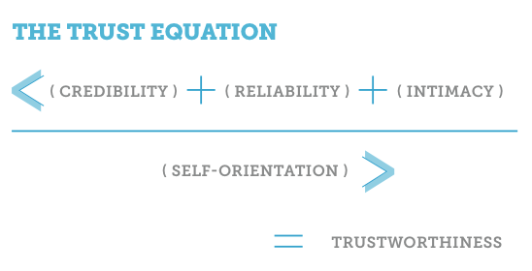
The marketplace is changing rapidly…
Credibility
The words we speak
Reliability
The actions we take
Intimacy
The safety/security we feel when we trust
Self Orientation
A person’s focus (self vs the other person)
…which has heightened the importance of building strong relationships through trust
Notes:
I am sure that we all recognise the importance of trust….. the value of having it across your team members and with external stakeholders….and the enormous handicap of not having it. At Lion we talk about “Business being about relationships,… between people and brands… and … customers and consumers… and trust is key to strong relationships… and behaviour experienced impacts trust”
Many of you will be familiar with this trust equation, and there are several other equations and models… the important thing is to break down trust into its constituent parts and operationalise them… bring life to them on a daily basis.
There isn’t a single section of the marketplace that isn’t being disrupted. Even in traditionally stable sections of the marketplace such as banking, law and FMCG disruption has arrived. In FMCG disruption has been driven by removal of barriers to entry, changing consumer preferences, small business agility and external connection.
Transparency lays the foundation of an organisation’s reputation by building trust with the consumer, customer and the community.
Digital age… What’s in food products and where they come from, what price you would pay – it’s there for all to see. [Lion – labelling example]
In our talent marketplace, platforms like Glassdoor and LinkedIn provide a candidate with a window into the culture of an organisation before they even contemplate a role.
Everything comes back to trust
Focus People, Customers and Consumers

Slide 11
Adaptive cultures don’t happen by luck, chance or magic
Notes:
Some reflections on cultural change…..
I believe that constructive cultures don’t just happen by luck chance and magic. They require a multi-pronged approach…. at a system level
and at an individual level.
Reflecting on Lion’s culture transformation one key driver that stands out is having culture at the core of our business strategy. Leader-led, not HR led.
Building strategic people goals around culture, leadership and wellbeing - measure and set goals. Visually and practically this sends a huge signal that the ‘how’ of business is just as important as the ‘what’
Secondly, hardwiring constructive behaviours into everything. This all comes down to the simple message, Behaviours x Results – being really clear that constructive behaviours help people and the business achieve.
Our role is to ‘join the dots’ for people in BxR via the “so that”.
Making behaviours core to achievement and development processes, and how leaders coach and develop their people
Setting a clear expectation that acting in a constructive way is not a nice to do. Committing to take action and hold people accountable to behaviours.
To achieve organisation-wide change in behaviours organisations also need to focus on change at an individual level and this starts with leaders.
Supporting leaders by providing them with coaching and support on their thinking and behaviours
Building a pipeline of leaders to meet future needs.

Slide 12
How do we successfully change at an organisational level: an adaptive culture is not a destination
© Human Synergistics
Notes:
Here is what we have learned at Lion
On this slide you see a snapshot of culture at Lion across 4 surveys out of the 10 we have done over nearly 20 years.
Creating an optimal Culture is not a destination – it is a complex system that constantly evolves. You don’t arrive at an optimal culture – you have to continually measure, diagnose and sometimes pivot to ensure that your culture is enabling your marketplace aspirations (eg. do you need to be more externally connected, more agile, more innovative, lower cost)
External/Internal polarity
Dial up/Dial down
Micro cultures within large organisations – communicate aspiration (path to get there might be nuanced)
In times of unprecedented change this need is amplified
Talk how shifted like for like vs demographic changes (ie 2010 to 2017 vs 2008 to 2010)
Need to figure it out for your organisation and design your approach from where you start (eg. NF low Achievement and high Passive Defensive/LN high Achievement and high Aggressive Defensive)
Aspiration may be ‘X’ but action plans must specifically address current assumptions, beliefs and the current capacity of the organisation to change
meet company where it is
Need to shape the culture at a system-wide level and at an individual level and help people to change:
Insights – compelling case
Desire – really want to change
Capacity – skills (including cognitive capacity) and tools to achieve change, how do you help people to think about themselves objectively (vs subjectively/”be subject to”) and create a space so that they can choose respond to a situation (current story/future story in development plans)
Culture is often more stable over time than engagement – while you can shift culture quickly with demonstrable changes – particularly in leadership, it can also shift slowly over time (like a glacier) so that unless you are consistently taking notice you may miss important tipping points (eg. internal vs external orientation – culture strength by marketplace outcome chart could be useful here)

Slide 13
How do we successfully change at an individual level?
Insight
Desire
Capacity
A compelling perspective that change is required and the difference that this change will make
The moment in time when someone really wants to change because the cost of not changing has become too high
Having the capacity to perceive & adapt our thoughts, emotions & behaviour to the world around us
The biggest hurdle is usually Capacity
Copyright © 2018 Stagira Consulting Pty Ltd All rights reserved
Notes:
three stages in change at individual level
Insight
on the need to change
usually comes from 360 degree feedback ( LSI, TLC)
Can be likened to IQ as you rationally “get it”
Desire
You really want to change (versus “ought to should or must”)
Intrinsic motivation versus control or persuasion by others
Coaching support can help
Can be likened to EQ as through self awareness the change required becomes emotionally attractive
Adaptive Capacity
The ability to become conscious of the ways you think and feel,
To understand how some of these are not helpful
And the wiliness to take steps to change these
“behaviour change can only come from getting two mind-set issues and working them through” (Bob Kegan)
“requires courage, a willingness to give up ”our second job” (Bob)
We call this concept Adaptive Intelligence or AQ
Most change efforts, and support for them, stops at Insight and Desire - “”just do it” or “stop it”
If you want a humorous portrayal of “stop it” google youtube videoBob Newhart Stop It

Slide 14
How do we achieve change at an individual level
We need to build the capability to seek views that challenge deeply held beliefs , and be willing to change them
Resilience, courage and heart to:
Approach tensions, development opportunities, big assumptions
Actively seek and accept feedback
Be transparent and share vulnerabilities and development opportunities
Develop a high level of awareness about ourselves and our impact on others
And the self regulating skill to:
Be mindful
Be our authentic self “more, with skills” (Goffee)
Experiment and do things differently
Keep seeking feedback and acting on it
Persevere even when the feedback is disappointing
Research indicates that it takes 3 or more rounds of 360 feedback surveys to move from primarily defensive behaviours to primary constructive behaviours
Notes:
Research conducted by Cecile de Vries 2009 to 2010 as part of her PhD study at Sydney University. Published as a White Paper by Human Synergistics (Leader reflexivity process: the Lifestyle Inventory TM transformation experience
Challenging our big assumptions, the underlying reason for why we think the way we do, is key for change to happen and to be sustained (what is it we are defending?)
Being “our authentic self more with skill “Rob Goffee” means being true to self and true to others
- you can’t look into a mirror and say “I am authentic”
Being mindful (“paying attention on purpose, in the present moment, non- judgementally”) (Jon Kabat- Zinn)
Coaching is an important supporting role to help you with the change

Slide 15
Notes:
So how to survive and flourish in this world ?
Adaptability is key to survival but very hard to do (with so many barriers)
At a personal level (through flexible thinking and learnings)
At a organisational level… open to new ideas, create a climate where the truth can be heard, risks taken…..
I referred to our Lion’s long history. While we are able to enjoy all the benefits of our rich history, learnings, relationships, culture strength….. It’s not all beer and skittles. Like every organisation with well established practices, systems and structures we need to constantly work on freeing up the organisation to be more adaptable. This is where HR play a critical role in delivering on the business strategy.
Note: This visual is from a recent HR Hackathon (Hacking HR to build an adaptabilitY ADVANTAGE). The hackathon team collaboratively developed a comprehensive list of critical enemies of adaptability—the barriers that prevent organizations from being as adaptable as they could be. They identified over 120 barriers during the sprint – prioritised the top 12.
- Any of these look familiar?
- Many ladder up to behavioural and thinking traps
So, how do organisations build an adaptability advantage? … I believe the answer lies with creating and sustaining a culture which supports people to reflect on the way they thnk and behave, and to have the courage to enact change.

Slide 16
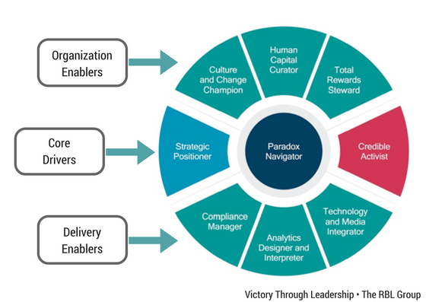
4. We need to help people and organisations to adapt to this new world
“For things to change first I must change” (Gandhi)
Notes:
4. So what for HR
Hold yourself accountable to these competencies and build your capability plan to develop higher levels of skills across them
I am a big supporter Ulrich’s competency framework. Never d before has there been a stronger need for HR practitioners to be effective paradox navigators e.g.
– Stability vs agility
– Standardisation vs customization
– cost vs growth
often in the HR world we have ongoing tension between Centres of Excellence and Business Partners (e.g. BPs need to adapt group wide initiatives to meet specific BU needs vs C of E remit of developing and deploying one best way across the group based on insights and evidence – a healthy and constructive tension but not always comfortable!
How do we help the business d and its leaders to navigate complexity, the paradoxes of the new world of work?

Slide 17
So what for HR?
Be clear on our direction and flexible on how we get there
Get comfortable working in complexity
Build external connectivity and agility
Be prepared to do things differently
Have a clear ethical compass
Be courageous in providing constructive challenge
Take part in the conversation
Be seen primarily as the paradox navigator (not the process champion)
Notes:
So what does this mean for HR?
Here is my challenge to HR, we need to be clear on the “why” we do what we do – be able to describe how what we do impacts outcomes (i.e. not activity) e.g. Trust and sustainable marketplace success
Within this new world of work, a role in HR is still to:
• attract develop and retain talent for a new world of work
• culture to life to enable people to flourish and deliver exceptional customer experiences
HR practitioners need to be clear on the direction and commercial outcomes of the business and be flexible in how they might get there
HR practitioners need to get comfortable working in complexity – try new things, collaborate, learn and adapt – be paradox navigators
Be prepared to do things differently – apply different lenses to challenges, innovate ways of working, leveraged technology
Figure it out for your organisation
HR practitioners must connect People Experience internally to customer experience externally – ultimately “why” we do all this to achieve sustainable marketplace success
We need to enable external orientation – understand it, measure it, do something about

Slide 18
Notes:
We as an HR profession need to get ahead of the game – take part in conversation
I believe we carry really make a difference in helping people navigate the rapidly changing world
By building the personal resources in our people, we also play a role that can benefit society
Our role is to help people and organisations flourish – and in doing so we will contribute to making the world better
I hope there was something in here for you to take away for your organisation
How will you help your organisation to build the adaptive capability to survive and flourish in a world of exponential change
This is something I am really passionate about . This is why, aftter 25 years at Lion, I have decided to pursue this passion around helping the world to flourish through building an ability capability, in starting a new business called Stagira Consulting. Stagira was the birthplace of Aristotle – and hence the birthplace of adaptive thinking. We thought that this the best name for a new business focused on building the adaptive capability of people and organisations
thank you very much for the opportunity to share my insights and perspectives. I would relish the opportunity to continue conversations and perspectives via my LinkedIn site, or contacting us through our website

Slide 19
Contact Details
Bob Barbour
Director, Stagira Consulting
bob.barbour@stagiraconsulting.com
linkedin.com/in/bob-barbour/
stagiraconsulting.com
Notes:
here are my contact details

