Slide 1
2025 AMA CPT Changes
Kristi Plotz, CPC, CPCO, CPCO-i

Slide 2
Telemedicine
Deleted 99441 – 99443 Audio Only Telephone Visit
New – Two sets of codes for Telehealth separated to Audio/Video New/Est and Audio Only New/Est
  New Audio/Video 98000-98003
  Est Audio/Video 98004-98007
  New Audio Only 98008-98011
  Est Audio Only 98012-98015
These can be billed by MDM or Time
Time directly correlates to the time of the OV services that Telehealth is currently being billed with
Audio Only – You must meet MDM and 10 minutes of medical discussion or Total time and 10 minutes of medical discussion
  Recommend noting the 10 minutes of medical discussion and if billing by time separate out total time and 10 minutes of medical discussion

Slide 3
Telemedicine
CPT Code | RUC Recommended Work RVU | CPT Code | Current Work RVU’s
98012 | .65 | 99212 | .70
98013 | 1.20 | 99213 | 1.30
98014 | 1.75 | 99214 | 1.92
98015 | 2.60 | 99215 | 2.80

Slide 4
Telemedicine - Medicare
CMS considers the new A/V A/O codes invalid for Medicare
Per CMS use OV with modifiers for POS (95/93)
As of now baring an act of Congress the telehealth rules will revert to their original place of service requirements on 1/1/2025
Home will no longer be an approved site of service, unless treatment for mental disorders or ESRD
Per the Final Rule CMS did make a permanent allowance for Audio Only when Telehealth is allowed
  “However, with the successive statutory extensions of the telehealth flexibilities implemented in response to the PHE for COVID-19, most recently by the CAA, 2023, and our adoption of other extensions where we have had authority to do so, we have come to believe that it would be appropriate to allow interactive audio-only telecommunications technology when any telehealth service is furnished to a beneficiary in their home (when the patient’s home is a permissible originating site) and when the distant site physician or practitioner is technically capable of using an interactive telecommunications system as defined previously, but the patient is not capable of, or does not consent to, the use of video technology.”
CMS deleted G2012 – Virtual Check-In

Slide 5
Telemedicine - APCM
Advanced Primary Care Management
3 New codes based on number of chronic problems and QMB
  G0556 – 1 or fewer chronic conditions
  G0557 – 2 or more chronic conditions
  G0558 – 2 or more chronic conditions and who are Qualified Medicare Beneficiaries
Billed per calendar month
Requirements - The code requirements that we are finalizing include consent, initiating visit, 24/7 access and continuity of care, comprehensive care management, patient-centered comprehensive care plan, management of care transitions, care coordination, enhanced communication, population-level management, and performance measurement.
Recommend reading Final Rule for further explanations on requirements as they are extensive
Also review Tables 25, 26 and 27 for bundled services, RVU’s and requirements

Slide 6
Primary Care Services - Vaccines
VCC changed to ICC – Vaccine Coding Caucus to Immunization Coding Caucus
Will now release codes 3 times a year versus semi-annually
Early release of a code can still apply based upon public health concern
New to CPT 2025 allow released in calendar year 2024
  90661 – Cell Culture Influenza Vaccine, trivalent (ccIIV3) removed word preservative
  90624 – Meningococcal ABCWY Vaccine (includes Men B-4C and conjugated Men A, C, W and Y
  90637/90638 – MRNA Influenza Vaccine based upon dosage (age appropriate)
  90684 – Pneumonia vaccine valent 21 (PCV21)
  90695 – Avian Flu Vaccine
Obsolete Codes: 90654 and 90630 deleted as they are no longer in use

Slide 7
Primary Care Services – Verbiage Clarification & Parentheses
QHP – Standardization moving so that specific codes read nonphysician qualified health care professional
Parentheses – Located in the “Instruction for Use of the CPT Codebook”
  Clarify the interpretation of parenthetical notes vs verbiage in parentheses within a code descriptor
  Parenthetical notes surrounding the codes in the code set provide instruction on code use, whereas parentheses within a code descriptor are considered part of the complete code descriptor
  CPT Assistant August 2023 gave an example

Slide 8

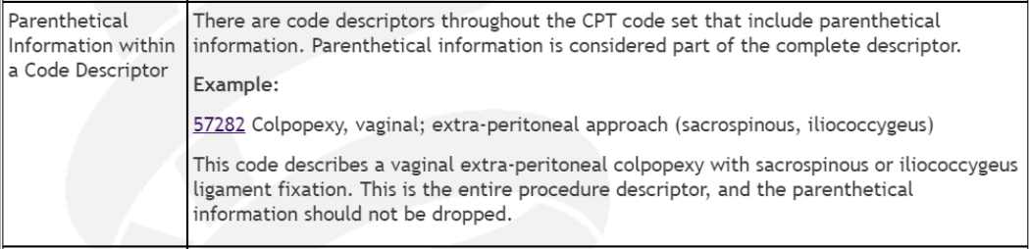



Primary Care Services – CPT Assistant Example

Slide 9
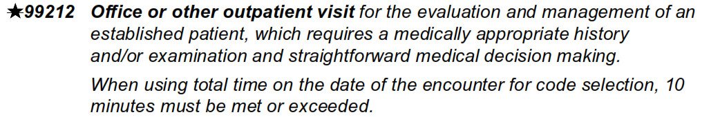
Primary Care Services – Modifier 95
Referring to Telemedicine Services the codes 99202-99205 and 99212-99215 are no longer eligible for Telemedicine
Do not use 95 modifier
See Appendix T
99211 is still eligible for 95 modifier
CMS differs from CPT

Slide 10
Pathology - Additions
Appendix O – 0020M Oncology (CNS) analysis of 30000 DNA methylation utilizing DNA extracted from tumor tissue
81515 – Infectious disease, bacterial vaginosis and vaginitis, real time PCR amplification
  This is for the Cepheid BV test, previously reported 0352U. 0352U is now deleted
81558 – Transplant medicine (allograft rejection, kidney), mRNA gene expression profiling by qPCR of 139 genes utilizing whole blood
82233 – 82234 – Beta amyloid; 1-40 and 1-42
  Parentheticals under 82150 and 86008 for use of these codes
83884 – Neurofilament light chain (NfL)
  Ex: Patient with an established diagnosis of MS, test that measures the amount of a protein in the blood that indicates nerve cell damage.
Notes:
Appendix O – 0020M Oncology (CNS) analysis of 30000 DNA methylation utilizing DNA extracted from tumor tissue
81515 – Infectious disease, bacterial vaginosis and vaginitis, real time PCR amplification
This is for the Cepheid BV test, previously reported 0352U. 0352U is now deleted
81558 – Transplant medicine (allograft rejection, kidney), mRNA gene expression profiling by qPCR of 139 genes utilizing whole blood
82233 – 82234 – Beta amyloid; 1-40 and 1-42
Parentheticals under 82150 and 86008 for use of these codes
83884 – Neurofilament light chain (NfL)
Ex: Patient with an established diagnosis of MS, test that measures the amount of a protein in the blood that indicates nerve cell damage.

Slide 11
Pathology - Additions
84393 – 84394 – Tau, phosphorylated or total
  Ex: Neurological evaluation of gradual cognitive decline looking at the Tau protein an indication of Alzheimer's
86581 – Streptococcus pneumoniae antibody (igG), serotypes, multiplex immunoassay, quantitative
  Ex: Looking for immunodeficiency in a patient with recurrent infections and previous vaccination
87594 – Pneumocystis jirovecii, amplified probe techniques
  Ex: testing the patient’s bronchoalveolar lavage specimen
87513 – H. pylori, clarithromycin resistance
87564 – Mycobacterium tuberculosis, rifampin resistance
87626 – HPV, types 16 and 18 only, includes type 45 if performed
  87624 – added “pooled result” to the code description
Notes:
84393 – 84394 – Tau, phosphorylated or total
Ex: Neurological evaluation of gradual cognitive decline looking at the Tau protein an indication of Alzheimer's
86581 – Streptococcus pneumoniae antibody (igG), serotypes, multiplex immunoassay, quantitative
Ex: Looking for immunodeficiency in a patient with recurrent infections and previous vaccination
87594 – Pneumocystis jirovecii, amplified probe techniques
Ex: testing the patient’s bronchoalveolar lavage specimen
87513 – H. pylori, clarithromycin resistance
87564 – Mycobacterium tuberculosis, rifampin resistance
87626 – HPV, types 16 and 18 only, includes type 45 if performed
87624 – added “pooled result” to the code description

Slide 12
Pathology – CAR-T Therapy
Guideline changes in the Hemic and Lymphatic Systems 38100 – 38999
  Addresses new codes and Chimeric antigen receptor therapy (CAR-T)
38225 – Chimeric antigen receptor T-cell therapy (CAR-T); harvesting of blood derived T lymphocytes for development of genetically modified autologous CAR-T cells, per day
  38226 – preparation of blood-derived T lymphocytes for transportation (eg, cryopreservation, storage)
  38227 – receipt and preparation of CAR-T cells for administration
  38228 – CAR-T cell administration, autologous
Deleted codes 0537T, 0538T, 0539T, 0540T

Slide 13
Pathology – Hereditary Cancer Disorder and Cancer Predisposition
Revision of 81432; deletion of 81433
Revision of 81435; deletion of 81436
Revision of 81437; deletion of 81438
Revisions of codes 81432, 81435 and 81437
  Some add cancer types as well as notations on panels and # of genes

Slide 14
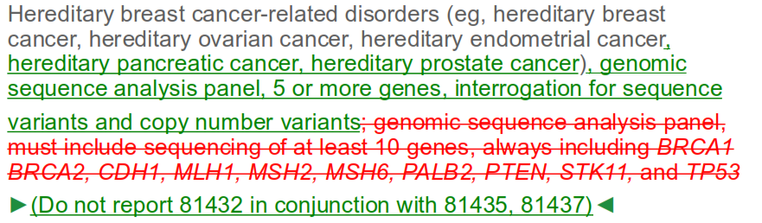
Pathology – Hereditary Cancer Disorder and Cancer Predisposition
Revision of 81432 and Deletion of 81433
  81432 added

Slide 15

Pathology – Hereditary Cancer Disorder and Cancer Predisposition
81433 was deleted and a notation was made to note to use 81479

Slide 16
Pathology – Tier 1 Molecular Procedures: Optical Genome Mapping
81195 – Cytogenomic (genome wide) analysis, hematologic malignancy, structural variants and copy number variants, optical genome mapping (OGM)
  Ex: Use an OGM system to untangle, linearize, and image the DNA, and then assemble the DNA into a genome and analyze it

Slide 17
Pathology – Immunology and Anatomical Pathology Maintenance
86327 – deleted
86155 – parenthetical note added
86490 – deleted
88388 – deleted
88387 – parenthetical note added, code verbiage changed

Slide 18
Ophthalmology – Iris Procedures & OCT
66683 Added – Category III codes deleted 0616T-0618T
66683 – Implantation of iris prothesis, including suture fixation and repair or removal of iris, when performed
  New parentheticals under the code
Optical Coherence Tomography (92132 - 92134, 92137)
  Added 92137 – includes OCT angiography now
  Revision of 92132 - 92134 – updated terminology and revised parentheticals

Slide 19
Ophthalmology - Category III Codes
0963T – Photobiomodulation Therapy of the retina
  For patients with Dry Age-related Macular Degeneration and Vision Loss
  Bilateral report with 50 modifier
  Parenthetical added under CPT 67229
0615T – Eye Movement Analysis (Revision)
  Clarifications made and parenthetical note under vestibular function test codes removed – involves different work
  Parenthetical note added to 92499 and 92700 for recording saccades with electrooculography
  Sunset date extended to 1/2029

Slide 20

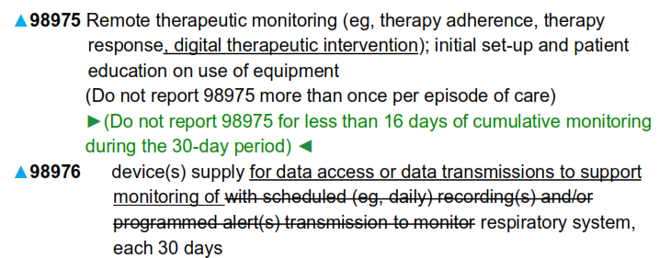
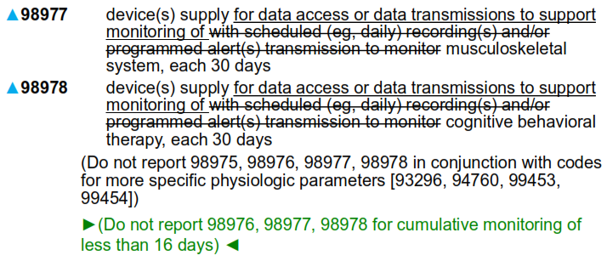
Digital Medicine – Remote Therapeutic Monitoring Services
98975 – 98978,
Guideline revisions and code revisions
Notes:
The remote therapeutic monitoring (RTM) services guidelines have been revised to specify that code 98975 may be reported for the setup and patient education on the use of any device(s) utilized for therapeutic data collection generated through digital monitoring or digital therapy.
The RTM services guidelines have been revised to specify that code 98975 may be reported for the setup and patient education on the use of any device(s) utilized for therapeutic data collection generated through digital monitoring or digital therapy.
Codes 98976-98978 have been clarified and may be used to report the supply of the device for data access or data transmissions to support monitoring. The phrase “With scheduled (eg, daily) recording(s) and/or programmed alert(s) transmission to monitor” has been removed from the code descriptors.
Guidelines have been updated so that in addition to its monitoring functionality, the device may also provide digital therapeutic intervention.

Slide 21
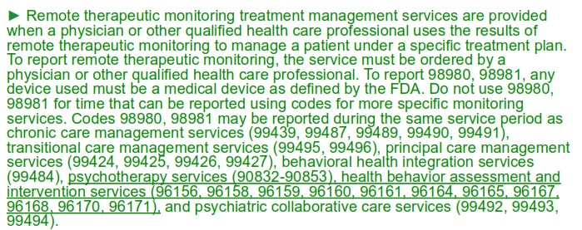
Digital Medicine – Remote Therapeutic Monitoring Treatment Management Services
98980 and 98981
Guideline revisions only
Notes:
Revisions to the guidelines have been made to include psychotherapy services and health behavior assessment and intervention services as services that may be reported during the same service period as codes 98980 and 98981.
In addition, it has been clarified that any time that is directly related to other reported services may not be counted. Examples have been identified in the guidelines.

Slide 22
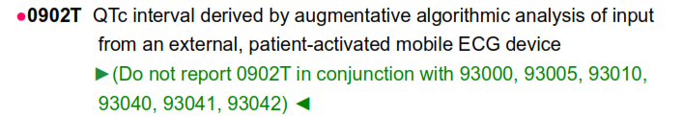
Digital Medicine – AI-Based QT Interval Monitoring
0902T Added – Report corrected QT interval derived by augmentive algorithmic analysis
  A procedure that analyzes 30 seconds of ECG that is measured from a 6-lead mobile ECG
  Parenthetic note that precludes billing 0902T with 93000, 93005, 93010, 93040-93042

Slide 23
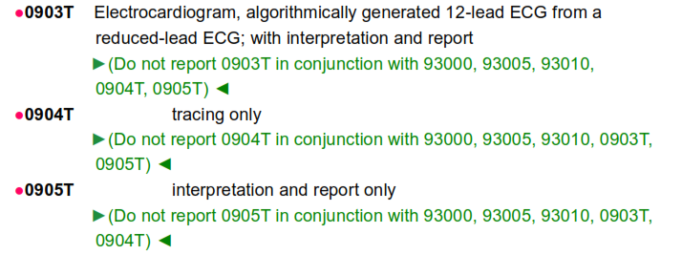
Digital Medicine – Algorithm Based ECG
0903T – 0905T Added
Algorithmically generates a 12 lead ECG from a reduced lead ECG
Parenthetical to not report with 93000, 93005, 93010, and sister T codes
Reasoning : needing a 12 lead read when a 12 lead ECG system is not available

Slide 24
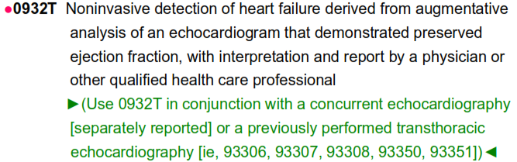
Digital Medicine – AI-Assisted Heart Failure Detection
0932T Added
Technology uses an AI platform to analyze an ECHO to assess heart failure with preserved ejection fraction
Parenthetical notes that this may be separately reported with 93306-93308, 93350 and 93351

Slide 25
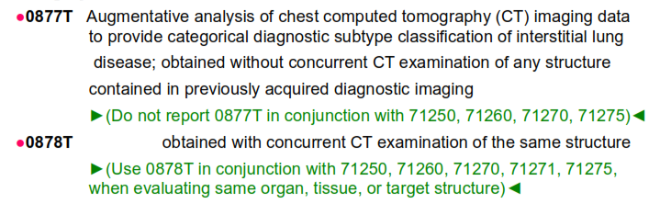
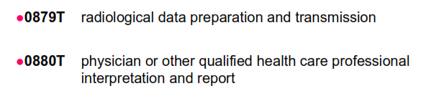
Digital Medicine – Noninvasive AI Analysis
0877T – 0880T Added
Reports augmentative analysis of a chest CT to provide a diagnostic subtype of interstitial lung disease
Parenthetical precludes reporting with 71250, 71260, 71270 and 72178

Slide 26
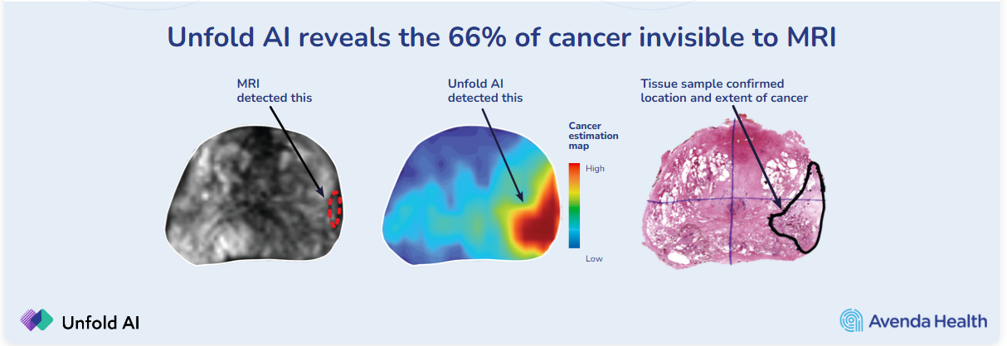
Digital Medicine – AI-Generated Prostate Cancer Mapping
0898T Added
Reports a noninvasive prostate cancer estimation mapping using AI which can help the physician in location, sizing of margin and treatment recommendations
Precludes reporting with 76376 and 76377
https://avendahealth.com/patients/learn-more-about-unfold-ai-2/

Slide 27
Digital Medicine – Computer-Aided Duplex Scan Hemodialysis Fistula
0876T Added
Report for a computer-aided limited (volume flow, diameter and depth including fistula body) duplex scan of a hemodialysis fistula
93990 already exists but it is reported to evaluate the performance, including arterial inflow, body of access and venous outflow
Parenthetical restricting use with 76376, 76377, 90951-90966 and 93990

Slide 28
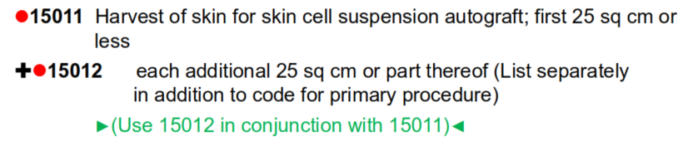
General Surgery - SCSA
Skin Cell Suspension Autograft – 8 new codes
15011 – 15018 Added for skin harvesting, autograft prep and application
  By size and procedure or size and anatomical site
For treating conditions of thermal burn wounds, traumatic avulsion, surgical excision or resection

Slide 29
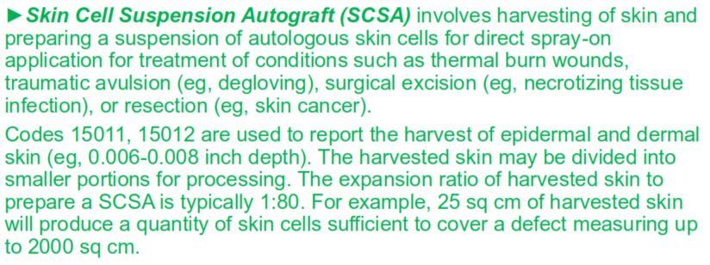
General Surgery - SCSA
Guidelines changes also added in relation to the new codes
  Revises introductory guideline
  Adds definition of SCSA
  Revises the autograft/tissue cultured autografts definition to specify “other than SCSA”

Slide 30
General Surgery – Deleted/Revised Codes
21630 Revised – “Radical resection of sternum”
  Was a parent code to 21632 and removing semicolon to be a stand-alone code
21632 Deleted - “with mediastinal lymphadenectomy”
  Due to low utilization
  Child code of 21630
  If performing in 2025 utilize unlisted code
47802 Deleted – “U-tube hepaticoenterostomy”
  Due to low utilization
  If performing in 2025 utilize unlisted code

Slide 31
General Surgery – Intra-Abdominal Tumor Excision or Destruction
49186 – 49190 Added
  Describe excision or destruction of intra-abdominal primary or secondary tumor(s) or cyst(s) via an open approach
  If a tumor(s) arises directly from an organ or soft tissue, only the organ or soft tissue resection or destruction procedure code from which the tumors arise is reported
  Reported based upon the sum of the maximum length of each tumor or cyst excised or destroyed
Guideline changes
  Measuring of tumor/cyst
49203 – 49204 Deleted
Notes:
Pre-1990: Codes 49200 and 49201 described excision or destruction by any method for intra-abdominal or retroperitoneal tumors or cysts or endometriomas
▪ Code 49201 was for “extensive” excision or destruction
▪ Later, it was revised to specify excision or destruction by open approach only
2008: Codes 49200 and 49201 were replaced with codes 49203-49205 to report an open procedure for the excision, ablation, or destruction of peritoneal tumors differentiated according to the size of the largest tumor removed during a single session
2025: With the advancement of surgical indications and techniques and with the resection of significantly larger tumors and/or numerous large and small tumors, codes 49203-49205 were deleted, and codes 49186-49190 were established to capture this work
Codes 49186-49190 describe excision or destruction of intra-abdominal primary or secondary tumor(s) or cyst(s) via an open approach
▪ Includes cytoreduction, debulking, or other methods of removal of tumor(s) or cyst(s)
• These codes are reported when the resected or destroyed intra-abdominal tumor(s) and cyst(s) do not directly arise from a resected organ
Reported based upon the sum of the maximum length of each tumor or cyst excised or destroyed
• Measure only tumor(s) and cyst(s), not the tissue (eg, mesentery) in which the tumor(s) and cyst(s) may be implanted
If only a portion of a tumor or cyst is excised or destroyed, measure only the excised or destroyed portion
Tumor(s) and cyst(s) should be measured in situ before the excision or destruction and documented in the operative report
Measurement includes only the tumor(s) and cyst(s), not the margins

Slide 32
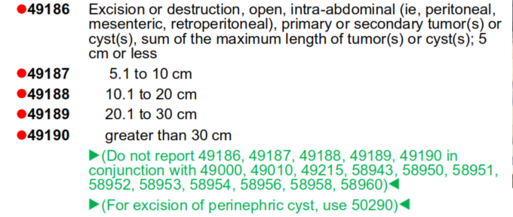
General Surgery – Intra-Abdominal Tumor Excision or Destruction

Slide 33
General Surgery – Category III Codes
TPLA – Transperineal Laser Ablation
  0714T revised
  0867T Added
Gastric Electrophysiology Mapping
  0868T Added
Peritoneal Ascites Pump Services
  0870T – 0875T Added
Endoscopic Drug-Coated GI Balloon
  0884T -0886T Added
Normothermic Liver Perfusion Services
  0894T – 0896T

Slide 34
General Surgery – Category III Codes
Concurrent Optical and Magnetic Stimulation Therapy (COMS)
  0906T – 0907T
Intraoperative Fluorescence Imaging Margin Assessment, Breast
  0945T

Slide 35
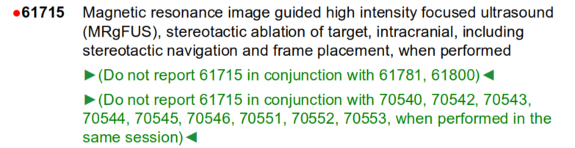
Neurology & Neurosurgery – MRI Guided High Intensity Focused Ultrasound (MRgFUS)
61715 Added
  Magnetic resonance image guided high intensity focused ultrasound (MRgFUS), stereotactic ablation of target, intracranial, including stereotactic navigation and frame placement, when performed
0398T Deleted
Parentheticals
Notes:
Magnetic resonance image guided high intensity focused ultrasound (MRgFUS), stereotactic ablation of target, intracranial, including stereotactic navigation and frame placement, when performed
(Do not report 61715 in conjunction with 61781, 61800)
(Do not report 61715 in conjunction with 70540, 70542, 70543, 70544, 70545, 70546, 70551, 70552, 70553, when performed in the same session)
Specifically, code 61715 describes a noninvasive method to ablate tissue within the skull without open surgery. It may be used to treat medically refractory movement disorders, such as essential tremors, with a noninvasive thalamotomy. The code descriptor lists all services inherently included as part of the procedure.

Slide 36
Neurology & Neurosurgery – Transcranial Doppler Studies (TCD)
93896 - 93898 Added
  Identifies separate add on tests
  Use in conjunction with 93886
Guideline Changes
93890 Deleted – “Transcranial Doppler study of intracanial arteries; vasoreactivity study”
93893 Revised – Removed “emboli”
Notes:
Use TCD study codes (93886, 93888, 93892, 93893) when a single study is performed. Use 93896, 93897, 93898, when a vasoreactivity study, emboli detection without intravenous microbubble injection, or venous-arterial shunt detection with intravenous microbubble injection is performed in conjunction with a complete TCD on the same day.
Changes to the reporting of TCD procedures were initiated following the identification of Doppler procedures described by codes 93886, 93890, and 93892 in a RUC RAW screen for codes inherently performed together.
It was determined that a coding solution was necessary to eliminate duplicate reporting of pre- and post-service work when a complete TCD study of intracranial arteries is performed with a vasoreactivity study, with emboli detection but without intravenous microbubble injection, or with venous-arterial shunt detection with intravenous microbubble injection.
To address this issue, three add-on codes have been established to report when the following are performed with a complete TCD study of intracranial arteries (93886):
• vasoreactivity study (93896),
emboli detection without intravenous microbubble injection (93897), or venous- arterial shunt detection with intravenous microbubble injection (93898).

Slide 37
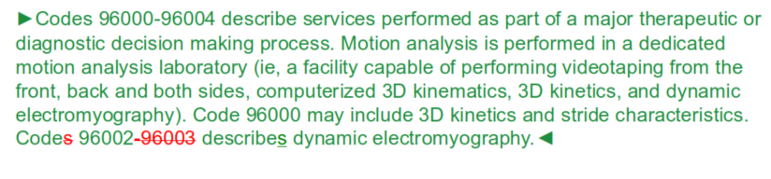
Neurology & Neurosurgery - Maintenance
96003 Deleted
  Due to low utilization

Slide 38
Neurology & Neurosurgery – Category III Codes
0908T – 0912T – Integrated Cranial Nerve Neurostimulation
0947T – MRI Guided High Intensity Focused Ultrasound blood Brain Barrier Disruption

Slide 39
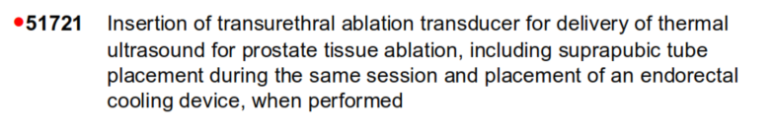


Urology – MRI Monitored Transurethral Ultrasound Ablation of Prostate
51721, 55881 and 55882 Added
Differs from CPT 55880 is for HIFU (high intensity focused U/S and is rectal approach
Notes:
Codes 51721, 55881, and 55882 are used to report transurethral ultrasound ablation of the prostate for the treatment of prostate cancer.
MRI is a proven, established imaging modality for evaluating and monitoring of transurethral ultrasound prostate tissue ablation represented by codes 55881 and 55882.
• Code 55882 combines the placement of the device and the treatment to match the work performed by the same physician
• Exclusionary parenthetical notes have been added precluding the reporting of codes 51701, 51702, 55881, 55882, 72195, 72196, 72197, 77022 in conjunction with code 51721.

Slide 40

Urology – Bladder Neck and Prostate Procedures
53865 and 53866 Added
Notes:
Separate codes have been established to describe the insertion of a temporary device to remodel the bladder neck and prostate and the removal of the temporary device.
New codes 53865 and 53866 reflect the new technology and the evolution of services currently rendered with cystourethroscopy for temporary insertion and catheterization removal.
• These codes are typically reported for the treatment of symptoms due to urinary outflow obstruction secondary to benign prostatic hyperplasia.
Instructional parenthetical notes have been added to direct users to other procedures for reporting permanent urethral stent (52282) and cystourethroscopy with the removal of temporary device (52310).
Parenthetical notes for other codes to apply for example use 52282 if insertion of a permanent urethral stent.

Slide 41
Urology – Code Maintenance
50135, 51030 and 54438 Deleted
  Due to low utilization
  Utilize unlisted code if performed 2025 going forward
51020 Revised
  Semicolon removed from descriptor since it is no longer a parent code
Parenthetical notes have been added following codes 50130, 51020, and 54437 to indicate the deletion of codes 50135, 51030, and 54438 .

Slide 42
Urology – Category III Codes
0888T – Histotripsy of malignant renal tissue, including imaging guidance
  Was effective 7/1/2024
0935T – Cystourethroscopic Renal Nerve Denervation
  Effective 1/1/2025
  Parentheticals to not use 52005 with 0935T
0941T – 0943T - Cystoscopic Prostatic Urethral Scaffold
  Insertion, Removal and replacement, and removal only
  Effective 1/1/2025
  Used for prostatic obstruction

Slide 43
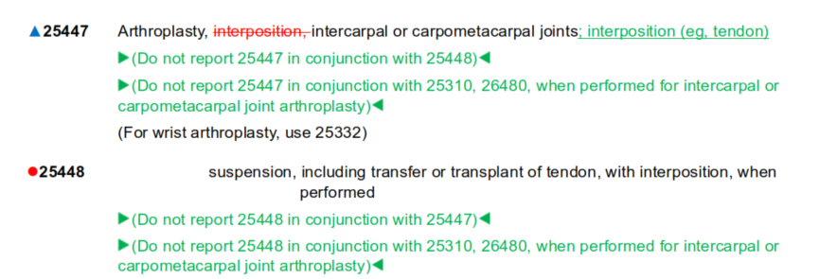
Orthopedic Surgery – Hand, Wrist and Forearm Repair and Reconstruction
25448 Added
  Arthroplasty, intercarpal or carpometacarpal joints; suspension, including transfer or transplant of tendon with interposition when performed
  Child code under 25447
25447 Revised – moving the word “interposition to after a semicolon making it a parent code
Parentheticals under 25447, 25448, 25310 and 26480
Notes:
The American Medical Association (AMA)/Specialty Society Relative Value Scale (RVS) Update Committee (RUC) Relativity Assessment Workgroup (RAW) identified arthroplasty code 25447 as a service performed by the same physician on the same date of service as codes 25310 and 26480 more than 75% of the time. In response to this analysis, code 25447 has been revised and code 25448 has been established with related instructional parentheticals throughout the code family.

Slide 44
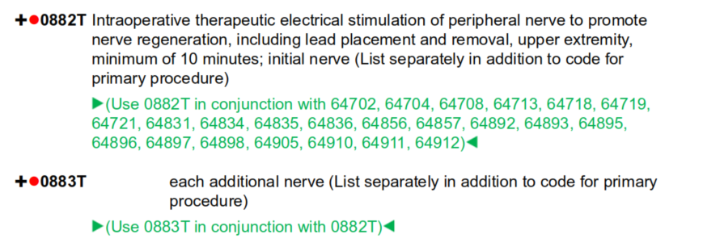
Orthopedic Surgery – Category III Codes
0869T – Bone Substitute Injection
  Parenthetical to not use 0869T with 0707T
0882T – Intraoperative Stimulation of Peripheral Nerves
  Parenthticals
Notes:
New code 0869T has been established to report the injection of bone-substitute material for bone and/or soft tissue hardware fixation augmentation.
• Performed to reduce chronic bone pain and other changes due to osteoarthritis.
• Differs from other Current Procedural Terminology (CPT®) codes in that the bone- substitute material is injected to reinforce the bone prior to affixing hardware in the affected area.
Code 0882T describes a therapeutic electrical stimulation of peripheral nerves during operation.
• Add-on code 0883T may be reported to identify the additional nerve treated.
• Placement (0883T) uses a non-implantable device that is removed subsequent to the treatment during the operation.

Slide 45
Anesthesiology & Pain Management - ETC
Additions 0887T - End Tidal Control Agent Monitoring
  Add on Code
  Parenthetical to use in conjunction with 00100 – 01999
  Control of inhaled anesthetic agent and oxygen to assist in anesthesia care delivery
Notes:
0887T - This service employs use of a device that incorporates the inhalation of anesthetic
agents and oxygen (O2) into the normal tidal flow of air (via end-tidal control)
through monitoring of the concentrations of anesthetic and O2 and the total gas
flow
➢ The concentrations are monitored via the anesthesia provider and a computer aided Device to facilitate the monitoring and configure the delivery
➢ Tidal Volume: The amount of air that moves in or out of the lungs with each respiratory cycle, while a person is at rest
➢ Tidal Control: A preset tidal volume delivered at a set rate, primarily used when the patient has no spontaneous breathing

Slide 46
Anesthesiology & Pain Management – Facial Plane Blocks
New - 64466 – 66469
  Thoracic fascial plane block unilateral and bilateral by injection or infusion
New - 64473 and 64474
  Describe lower extremity facial plane blocks, unilateral by injection or infusion
64486 – 64489
  Codes specifically identified Transverse abdominis plane (TAP) blocks
Parenthetical added for reporting
All include with imaging guidance for needle placement
Notes:
➢ Fascial plane blocks – regional anesthesia injection/infusion techniques that use administration of local anesthetic for post-operative pain control and analgesia within a specific anatomical location (ie, anatomy that may be accessed within the
The “plane” is the space between discrete fascial layers
This is where the needle for anesthetic injection/infusion is inserted▪
Affects nerves and tissue accessible within that layer▪
Imaging (commonly ultrasound) is used to guide the needle to the correct fascial plane)
▪ Parenthetical notes added thorough out the set to restrict reporting in conjunction with imaging codes as imaging is already included as part of the service

Slide 47
Anesthesiology & Pain Management – Acupuncture/Electroacupuncture
Revised - 97810 and 97811
  Acupuncture w/o electrical stimulation
  97811 – without stimulation, each additional 15 minutes of personal one-on-one contact with the patient ,with insertion of needles
Revised - 97813 and 97814
  Acupuncture with electrical stimulation
    Adds the word re-insertion to 97813
    97814 – with electrical stimulation each additional 15 minutes of personal one-on-one contact with the patient, with insertion of needles

Slide 48
Radiology & Interventional Radiology – MR Safety Procedures
New – CPT Codes 76014 -76019
New Subsection Guidelines
Codes identify
  Planning services performed in advance of the date (76014 – 76016)
  Planning performed on the day of the procedure (76017 – 76019)
Written report must be documented
Two time-based codes 76014 and 76015
  These codes are for staff time
CPT 76016 is reported for QHP or physician
Same Day Services 76017 – 76019
  QHP or physician
  Modifier 51 exempt
Notes:
• A new subsection, Magnetic Resonance (MR) Safety Implant/Foreign Body Procedure, has been established.
• Identifies the work associated with assessing and providing safety services related to performing MR examination in the presence of implanted medical devices or foreign bodies
• These services are not evaluation and management (E/M) services• Six new codes and introductory language• Codes may be broken down in a variety of ways to better understand how they are to be reported.

Slide 49
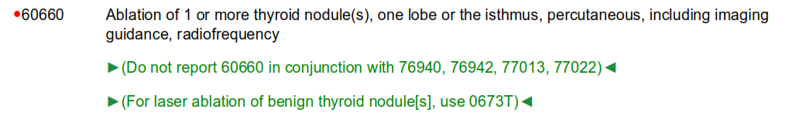
Radiology & Interventional Radiology – Percutaneous RF Ablation
New CPT 60660 and 60661
Notes:
• Code 60660 has been established for reporting percutaneous RF ablation of one or more thyroid nodule(s) in one lobe or in the isthmus, which includes imaging guidance.
• Add-on code 60661 has been established to report percutaneous RF ablation of one or more thyroid nodule(s) in an additional lobe and includes imaging guidance for the procedure.
Several parenthetical notes have been added to provide guidance for appropriate reporting of new codes 60660 and 60661.

Slide 50

Radiology & Interventional Radiology – New Technology Codes
New 0901T – Bone Marrow Biopsy Implant
New 0944T – Percutaneous Ablation Treatment Services
New 0946T – CT Guided Implant Movement Analysis
Notes:
• A new Category III code (0901T) has been established to report the placement of a port for bone marrow sampling, with imaging guidance.
• This is a new procedure that will aid with treating patients with leukemia, multiple myeloma, and other forms of bone marrow disorders when needing frequent bone marrow sampling to monitor for effectiveness of the treatment. In addition, this new device can help improve sample quality and patient experience by significantly reducing the pain associated with bone marrow sampling.
• To provide additional guidance on the addition of new code 0901T, a parenthetical note has been added to restrict reporting code 0901T in conjunction with codes 77002 (fluoroscopic guidance for needle placement) and 77012 (CT guidance for needle placement).
0944T
• Category III code 0944T has been established report three-dimensional (3D) contour simulation of liver lesion(s) and margin(s) for image-guided percutaneous microwave ablation.
• New guidelines have also been added to provide education regarding how this service is performed and the significant elements necessary to perform this procedure. In addition, these guidelines direct users to report code 0944T only once, regardless of the number of tumors ablated.
• New parenthetical notes have been added to reflect the appropriate reporting of code 0944T once per liver microwave ablation procedure and to restrict reporting with ultrasound imaging for codes 76376 and 76377.
0946T
• New Category III code (0946T) has been established to report CT-guided orthopedic implant movement analysis using a paired CT method.
• Two CT scans are acquired at an endpoint of possible movements, such as maximal internal and external rotation, for a hip examination or maximal flexion and extension over the relevant segment for a spine examination. A physician uses these two induced -displacement CT volumes to perform an implant movement analysis to identify whether there is a loose implant or pseudarthrosis and to see exactly how and where the implant is moving.
An exclusionary parenthetical note has been added to instruct users not to report the CT scan of the extremity or joint separately.

Slide 51
Radiology & Interventional Radiology – Revision of Vascular Procedure Subsection Guidelines
CPT code 75774
• The Vascular Procedures subsection guidelines in the Radiology section have been revised to clarify that add -on code 75774 may be used with both arteries and veins for each additional vessel.
Editorial only and no change in RVU’s
Notes:
• • Payors and coders have long rejected the use of this code for venous work.
• Specialty society coding guidance has consistently instructed to report code 75774 for the study of both arteries and veins.
The CPT ® Assistant Editorial Board agreed with this coding guidance and asked the specialty societies to submit a coding application to provide clarity to this issue.

Slide 52
Cardiology & Interventional Cardiology - Revisions
33894, 33895 and 33897 – Guideline and Parentheticals
  For ballon angioplasty or stenting of the aorta for lesions other than coarctation (eg, atherosclerosis) of the aorta in a segment separate from the coarctation treatment zone use see 37236, 37246.
93656 – Guideline Revisions and Code Revisions
  Definition of Ablation
  Comprehensive electrophysiological evaluation including with transeptal catheterizations, insertion and repositioning of multiple electrode catheters, induction or attempted induction of an arrhythmia including left or right atrial pacing/recording, with and intracardiac catheter ablation of atrial fibrillation by pulmonary vein isolation, including intracardiac electrophysiologic 3- dimensional mapping, intracardiac echocardiography including with imaging supervision and interpretation, induction or attempted induction of an arrhythmia including left or right atrial pacing/recording, right ventricular pacing/recording, and His bundle recording when performed
Notes:
33895- 33897: The guideline revisions for the Endovascular Repair of Congenital Heart and Vascular Defects subsection and parenthetical notes have been revised and added to restrict reporting of angioplasty for the purpose of clearing a blockage in the aorta vs opening the narrowing of the aorta within the same zone.
There a several parenthetical notes after the 33895 and 33897 that clarify when it is appropriate to separately report angioplasty and coarctation services. The intent is to restrict reporting both procedures when a single service is used to address both problems.
93656: Clarification was needed. Deleting specific methods from the guidelines enables the inclusion and use of new emerging technology, such as laser and pulse-field ablation. The code was revised so that it was clear that placement of the catheter in the atrium was necessary and not optional

Slide 53
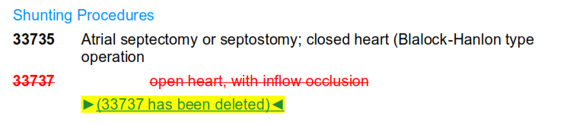
Cardiology & Interventional Cardiology – Deleted
33471 – Deleted
  Valvotomy, pulmonary valve, closed heart, via pulmonary artery
33737 – Deleted
Notes:
33471 – Deleted due to low utilization. If being done during a cardiopulmonary bypass use 33474
33737 – Deleted due to low utilization

Slide 54
Cardiology & Interventional Cardiology – Deleted & Revised
33813 – Deleted
  Obliteration of aortopulmonary septal defect; without cardiopulmonary bypass
33814 – Revised
  Obliteration of aortopulmonary septal defect; with cardiopulmonary bypass
Notes:
Removed 33813 and updated 33814 to add with cardiopulmonary bypass. The 33813 was deleted due to low utilization.

Slide 55
Cardiology & Interventional Cardiology – Category III Codes
New codes
  0893T Noninvasive PGE Analysis
  0897T Noninvasive Arrhythmia Analysis Services
  0899T and 0900T CMR AQMFB
  0913T and 0914T PCI by Therapeutic Drug Delivery
  0915T – 0931T CCM-D
  0933T and 0934T Transcatheter LA Pressure Sensor Services
  0937T – 0940T Continuous External ECG Monitoring
Notes:
0893T - • Multiple measurements simultaneously from a single test procedure .
• Clinical information needed for support of diagnosis, prognosis, and treatment of chronic and acute infection to respiratory system.
8097T - Code 0897T has been established to report arrhythmia analysis derived from quantitative computational cardiac arrhythmia simulations from a 12-lead ECG and uploaded clinical parameters. Uses a software system, the system processes the ECG and generates an output report.
0899T and 0900T – AQMFB Absolute quantitation of myocardial blood flow
New add on codes established to report noninvasive determination of AQMBF using augmentative and assistive algorithmic analysis. • Noninvasively provides AQMBF and analyzes it to stratify risk for patients that have acute chest pain and no known coronary artery disease (CAD).
0913T and 0914 T -
• Procedures differ from traditional coronary angioplasty, which centers around the mechanical dilation of an artery that may be accompanied by the insertion of a stent.
• The new codes focus on the antiproliferative drug delivery directly into the coronary vessels using the balloon as the delivery mechanism.
• Both codes include all the services within the code descriptors (ie, angioplasty or mechanical dilation, catheterization to access the vessel and lesion, drug delivery to maintain patency of the vessel, and all imaging to guide and perform the procedure).
• Code 0913T is reported for a single major coronary artery or branch of that artery.
• Add-on code 0914T is reported for a separately targeted lesion performed for a separate intervention (reported in conjunction with 92920, 92924, 92928, 92933, 92937, 92941, or 92943).
0915T – 0931T
A cardiac contractility modulation-defibrillation (CCM-D) system combines cardiac contractility modulation (CCM) for symptom relief from chronic heart failure with defibrillation protection against sudden cardiac arrhythmia into a single therapy. A CCM-D system consists of a pulse generator and two transvenous electrodes (leads): one defibrillation lead and one pacemaker lead. An implantable CCM -D system's electrodes (leads) are placed transvenously under fluoroscopic guidance. One right ventricular pacing lead is placed on the high septum and a second defibrillation lead is placed in the mid-septum. The pulse generator is implanted in a subcutaneous pocket in the pectoral region.
• Seventeen new codes have been established to report CCM-D services, housed in a new subsection with new guidelines within the Category III Codes section.
0933T – 0934T
• The service and the device are meant to be used for patients with persistent symptoms of heart failure.
• Continuous monitoring and interpretation of LA pressure data from an implanted monitoring system enables adjustments in treatment based on trends and changes in pressure readings.
0937T – 0940T • New codes have been established for reporting non-monitored external ECG recording services lasting more than 15 days and up to 30 days continuously.
• New codes fill a gap in coding because existing codes could only be reported for external ECG device recordings that last up to 15 days or less (eg, 93224-93227, 93241-93244, and 93245-93248).
• Other services (eg, 93228) may include more than ECG recording services, such as concurrent computerized real-time data analysis and remote attendance surveillance that may be patient- or ECG-triggered and would not be appropriate to report these non-monitored services.

Slide 56
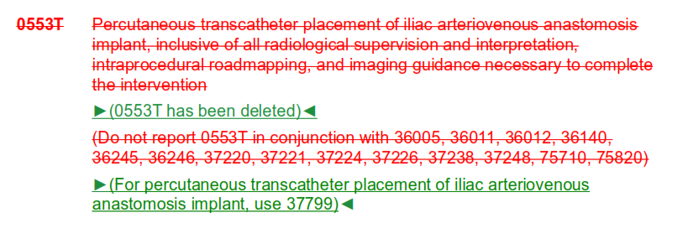
Cardiology & Interventional Cardiology – Category III Codes
Sundown
  0553T

Slide 57
Any Questions?
All information from AMA Symposium Live Session
Recommend purchasing yearly the CPT Changes book

