Slide 1

Coding for kidney and liver Transplant Procedures:
A CPT® and ICD-10-CM Guide
Presented by Dawson Ballard Jr, RHIA, CCS-P, CPC, CPC-P, CEMC, CUC, CPCD, CPMA, RCMS, CEMA, AAPC Fellow

Slide 2

About the Presenter
Experience: Over 20+ years in physician coding, auditing, and education
Current Specialties: E/M (inpatient/outpatient/office), Dermatology, Pulmonology, Behavioral Health, Urology, General Surgery (transplants, plastics, bariatric, GI), Risk Adjustment
Professional Affiliations: AAPC, AHIMA, KHIMA
Education: Bachelor of Science, Health Information Administration, Stephen’s College

Slide 3
Kidney/Liver Transplants: A Few Statistics
Transplants performed January - May 2025
Total | 20,481
Deceased Donor | 17,663
Living Donor | 2,818
Based on OPTN data as of 06/30/2025
Based on OPTN (Organ Procurement & Transplantation Network) data, as of 7/6/25, there are 91, 540 individuals on the waiting list for a kidney transplant and 8,939 individuals on the waiting list for a liver transplant

Slide 4
Kidney Transplants: A Few Facts
Common Diagnosis to Substantiate a Kidney Transplant:
  CKD (Stage 3b, Stage 4, or Stage 5);
  ESRD (usually on dialysis);
  Malignancy
On average, a kidney transplant from a living donor lasts about 15 to 20 years, and a kidney from a deceased donor lasts 8 to 12 years
Today, most people get a kidney transplant after being on dialysis for some amount of time, but that is not the only option. Getting a transplant before you need to start dialysis is called a preemptive transplant. Research shows that a preemptive or early transplant, with little or no time spent on dialysis, can lead to better long-term health. It may also allow you to keep working and have a better quality of life
SOURCE: https://www.kidney.org/kidney-topics/kidney-transplant

Slide 5
Liver Transplants: A Few Facts
Common Diagnosis to Substantiate a Liver Transplant *Not an All-Inclusive List:
  Alcoholic cirrhosis;
  Chronic active hepatitis with cirrhosis (hepatitis B or C);
  Malignancy
The average survival rate after liver transplant is 78% after five years and nearly 65% after 10 years. But your survival rate will depend on many factors, including your age, overall health status and the original liver disease that made a liver transplant necessary
SOURCES: https://my.clevelandclinic.org/health/procedures/8111-liver-transplantation
https://www.aetna.com/cpb/medical/data/500_599/0596.html

Slide 6
Kidney Transplants: Clinical Indicators
The following patients may be considered potential candidates for kidney transplantation:
Patients with End-Stage Kidney Disease on dialysis.
Patients with advanced chronic kidney disease (stage IV or V with calculated or estimated GFR <20ml/min.
Patients with chronic kidney disease (stage IV with GFR <30ml/min) that also need another organ transplant.
Patients with chronic kidney disease that have type 1 Diabetes that has not responded to medical treatment may also be considered for a combined kidney-pancreas transplant
*This criteria is from Cleveland Clinic and may not represent all payer's clinical policies for kidney transplants. Please refer to your specific payers' clinical policies
SOURCE: https://my.clevelandclinic.org/departments/transplant/programs/kidney/candidate

Slide 7
Liver Transplants: Clinical Criteria for Medical Necessity
*This criteria is from AETNA and is only a small segment of the payer's clinical policy for liver transplants. Please refer to your specific payers' clinical policies
Aetna considers liver transplantation medically necessary for the indications listed below in Section I.B. for the following:
Adolescents 12 years of age or older and adults with either:
  A Model of End-stage Liver Disease (MELD) score greater than 10; or
  Who are approved for transplant by the United Network for Organ Sharing (UNOS) Regional Review Board; or
  Who meet the transplant institution's selection criteria; and
Children less than 12 years of age who meet the transplanting institution's selection criteria.
In the absence of an institution's selection criteria, requests for liver transplantation are subject to medical necessity review for children, and for adolescents and adults with a MELD score of 10 or less who have not been approved by the UNOS Regional Review Board.
SOURCE: https://www.aetna.com/cpb/medical/data/500_599/0596.html

Slide 8

CPT® Code Selection for Kidney Transplants
CPT® codes for kidney transplants are categorized by the following:
  Type of donor (i.e., living or cadaver)
  Backbench work
  Type of transplant (i.e., autotransplantation or allotransplanation)

Slide 9
CPT® Code Selection for Kidney Transplants
Allotransplantation vs. Autotransplantation:
Allotransplantation: an organ or tissue is transferred between genetically different individuals of the same species (AAPC)
Usually involves three distinct components:
  Nephrectomy
  Backbench work
  Recipient allotransplanation
Autotransplantation: organs or tissues are excised from an individual and relocated into a new location in the same individual (AAPC)

Slide 10
CPT® Code Selection for Kidney Transplants
CPT® Code | Description
50300 | Donor nephrectomy from a cadaver donor, including cold preservation, unilateral or bilateral
50320 | Open, from living donor
50547 | Laparoscopic donor nephrectomy (including cold preservation), living donor
50340 | Recipient nephrectomy (separate procedure) *If performed bilaterally, append modifier 50 (Bilateral Procedure)
CPT® Codes for Donor/Cadaver Nephrectomy

Slide 11
CPT® Code Selection for Kidney Transplants
)
Backbench Work
In some cases, your urologist or transplant surgeon might use backbench standard preparation for the kidney transplant. A backbench is a sterile environment in the operating room (OR) but separate from the operating table where the transplant surgeon or a urologist prepares grafts before transplantation (AAPC).

Slide 12
CPT® Code Selection for Kidney Transplants
Backbench Work
Standard preparation of cadaver donor renal allograft prior to transplantation includes:
Dissection/removal of perinephric fat, diaphragmatic/retroperitoneal attachments;
Excision of adrenal gland;
Preparation of ureter(s), renal vein(s), renal artery(s), and ligating branches, as necessary
Standard preparation of living donor renal allograft (open or laparoscopic) prior to transplantation includes:
Dissection/removal of perinephric fat
Preparation of ureter(s), renal vein(s), renal artery(s), and ligating branches, as necessary

Slide 13
CPT® Code Selection for Kidney Transplants
CPT® Code | Description
50323 | Backbench standard preparation of cadaver donor renal allograft *Do not report in conjunction with codes 60540 ((Adrenalectomy, partial or complete, or exploration of adrenal gland with or without biopsy, transabdominal, lumbar or dorsal (separate procedure)) or 60545 ( (… with excision of adjacent retroperitoneal tumor))
50325 | Backbench standard preparation of living donor renal allograft (open or laparoscopic)
CPT® Codes for Backbench Work

Slide 14
CPT® Code Selection for Kidney Transplants
Backbench Reconstruction
“Backbench reconstruction of a cadaver or living donor renal allograft prior to transplantation, specifically focusing on the venous anastomosis. This procedure is essential in preparing the renal allograft for successful transplantation into a recipient. During this process, the renal vein of the donor kidney is reconstructed, which may involve the use of a section of the vena cava or a vein graft. The reconstruction is critical to ensure that the renal vein is adequately sized and configured to facilitate proper blood flow once the kidney is transplanted. The renal vein is meticulously trimmed to the appropriate dimensions, and the selected graft or vena cava section is fashioned to match these specifications. The anastomosis, or surgical connection, is then performed to join the graft to the renal vein. In cases where multiple branches of the renal vein are present, these branches can either be combined into a single vein or prepared individually for anastomosis” (“CPT® Code 50327”)

Slide 15
CPT® Code Selection for Kidney Transplants
CPT® Code | Description
50327 | Backbench reconstruction of cadaver or living donor renal allograft prior to transplantation; venous anastomosis, each
50328 | Arterial anastomosis, each
50329 | Ureteral anastomosis, each
CPT® Codes for Backbench Reconstruction

Slide 16
CPT® Code Selection for Kidney Transplants
CPT® Code | Description
50360 | Renal allotransplanation, implantation of graft; without recipient nephrectomy
50365 | With recipient nephrectomy *If performed bilaterally, append modifier 50 (Bilateral Procedure)
CPT® Codes for Renal Allotransplanation

Slide 17
CPT® Code Selection for Kidney Transplants
CPT® Code | Description
50380 | Renal autotransplantation, reimplantation of kidney
CPT® Code for Renal Autotransplantation
Report 50380 as the primary procedure, and report secondary procedures (i.e., partial nephrectomy) with modifier 51 (Multiple Procedures)

Slide 18
CPT® Code Selection for Kidney Transplants
Clinical Example
A 45-year-old patient with end-stage renal disease undergoes a deceased donor kidney transplant. The kidney is harvested from a cadaver, prepared on the backbench by removing perinephric fat and preparing the ureter, renal vein, and renal artery, and then transplanted into the recipient. Which set of CPT® codes should be reported?
Answer: 50300, 50323, 50360

Slide 19
ICD-10-CM Codes for Common Post Kidney Transplant Complications
T86.10 | Unspecified complication of kidney transplant
T86.11 | Kidney transplant rejection
T86.12 | Kidney transplant failure
T86.13 | Kidney transplant infection *Use additional code to specify infection
T86.19 | Other complication of kidney transplant

Slide 20
ICD-10-CM Coding for Common Post Kidney Transplant Complications
Code T86.1 should only be assigned for documented complications of a kidney transplant (.i.e., rejection, failure, infection)
Sequence a code from subcategory T86.1 as primary and then an additional code(s) for the complications(s)
Patients who have had a kidney transplant may still have some form of CKD as the transplant may not fully restore kidney function. The presence of CKD alone does not constitute a transplant complication. In these encounters, assign the appropriate code from the N18 category for the patient’s stage of CKD and code Z94.0 (kidney transplant status)

Slide 21
CPT® Coding for Common Post Kidney Transplant Complications
Report the ICD-10-CM code for the complication of the transplanted organ (T86-)
CPT® Code | Description
50370 | Removal of transplanted renal allograft

Slide 22
CPT® Code Selection for Liver Transplants
CPT® Codes for Liver Transplants are based the following:
Type of donor (i.e., living or cadaver)
Backbench work
Type of transplant (i.e., allotransplanation) *Autotransplantation does not apply to live transplants

Slide 23
CPT® Code Selection for Liver Transplants
Allotransplantation: an organ or tissue is transferred between genetically different individuals of the same species (AAPC)
Usually involves three distinct components:
Hepatectomy
Backbench work
Recipient allotransplanation

Slide 24
CPT® Code Selection for Liver Transplants
CPT® Code | Description
47133 | Donor hepatectomy (including cold preservation); cadaver
47140 | Donor hepatectomy (including cold preservation), living donor; left lateral segment only (segments II and III)
47141 | Total left lobectomy (segments II, III, IV)
47142 | Total right lobectomy (segments V, VI, VII, VIII)
CPT® Codes for Donor/Cadaver Hepatectomy

Slide 25
CPT® Code Selection for Liver Transplants
Backbench Work
Standard preparation of the whole liver graft prior to transplantation includes one of the following:
Preparation of the whole liver graft (including cholecystectomy, if necessary, dissection/removal of surrounding soft tissues to prepare the vena cava, portal vein, hepatic artery and common bile duct for implantation)
Preparation as described for whole liver graft, plus trisegment split into two partial grafts
Preparation as described for whole liver graft, plus lobe split into two partial grafts

Slide 26
CPT® Code Selection for Liver Transplants
CPT® Code | Description
47143 | Backbench standard preparation of whole liver graft; without trisegment or lobe split
47144 | With trisegment split of whole liver graft into 2 partial liver grafts (i.e., left lateral [segments II and III] and right trisegments [segments I and IV through VIII])
47145 | With lobe split of whole liver graft into 2 partial grafts (i.e., left lobe [segments II, III, and IV] and right lobe [segments I and V through VIII])
CPT® Codes for Backbench Work

Slide 27
CPT® Code Selection for Liver Transplants
CPT® Code | Description
47146 | Backbench reconstruction of cadaver or living donor liver graft prior to allotransplantation; venous anastomosis, each
47147 | Arterial anastomosis, each
CPT® Codes for Backbench Reconstruction

Slide 28
CPT® Code Selection for Liver Transplants
CPT® Code | Description
47135 | Liver allotransplanation, orthotopic, partial or whole, from cadaver or living donor, any age
CPT® Code for Liver Allotransplanation

Slide 29
ICD-10-CM Codes for Common Post Liver Transplant Complications
T86.40 | Unspecified complication of liver transplant
T86.41 | Liver transplant rejection
T86.42 | Liver transplant failure
T86.43 | Liver transplant infection *Use additional code to specify infection, such as Cytomegalovirus (CMV) infection B25-
T86.49 | Other complication of liver transplant

Slide 30
ICD-10-CM Coding for Common Post Liver Transplant Complications
Codes under category T86 (Complications of transplanted organs/tissues), are for use for both complications and rejection of transplanted organs. A transplant complication code is only assigned if the complication affects the function of the transplanted organ
Sequencing requires two codes…..the appropriate code from the T86 category and a secondary code to identify the complication
Pre-existing conditions or conditions that develop after the transplant are not coded as a complication unless they affect the function of the transplanted organ

Slide 31
Modifiers for Transplants
Modifier | Description
50 | Bilateral procedure
51 | Multiple procedures
62 | Co-surgeons
66 | Surgical team

Slide 32
Modifiers for Transplants
Modifier | Description
22 | Increased procedural services
78 | Unplanned return to the operating/procedure room by the same physician following initial procedure for a related procedure during the postoperative period
79 | Unrelated procedure or service by the same physician during the postoperative period

Slide 33
Modifiers for Transplants
Modifier | Description
80, 81, 82, AS | Assistant Surgeon Modifiers
LT | Left side
RT | Right side

Slide 34
Aftercare Z Codes
When the patient returns postop following a transplant, report ICD-10-CM codes from the Z48- category (Aftercare following organ transplant):
Z48.22 Aftercare following kidney transplant
Z48. 23 Aftercare following liver transplant

Slide 35
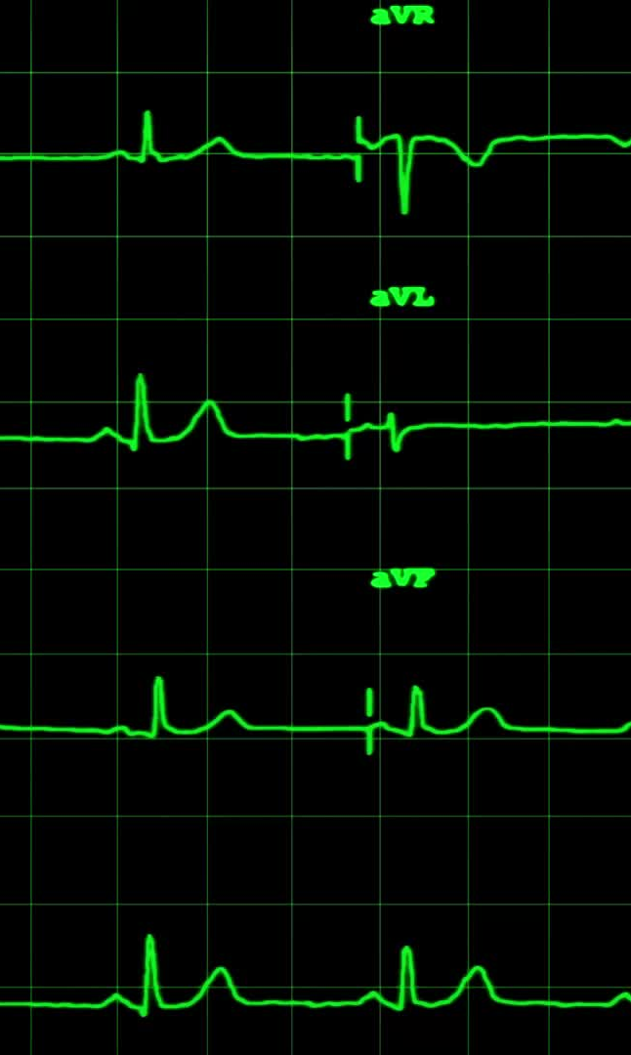
Transplant Status Z Codes
Transplants
Kidney transplant status Z94.0
Heart transplant status Z94.1
Lung transplant status Z94.2
Heart and lungs transplant status Z94.3
Liver transplant status Z94.4
Skin transplant status Z94.5
Bone transplant status Z94.6
Corneal transplant status Z94.7
Other transplanted organ and tissue Z94.8
Transplanted organ and tissue status, unspecified Z94.9
Awaiting organ transplant Z76.82
Transplanted organ removal status Z98.85

Slide 36
Q & A
For questions, please contact the presenter at:
dawsonrballard@gmail.com

Slide 37
References
..
ICD-10-CM Expert 2025
CPT® 2025 Professional Edition
ICD-10-CM Official Guidelines for Coding and Reporting FY 2025, I.C.19.g.3.b
ICD-10-CM Official Guidelines for Coding and Reporting FY 2025, I.C.19.g.3.a
ICD-10-CM Official Guidelines for Coding and Reporting FY 2025, I.C.14
AAPC. “CPT®: Demystify Kidney Transplant Coding with This Handy Guide.” Aapc.com, 12 Apr. 2022, www.aapc.com/codes/coding-newsletters/my-urology-coding-alert/ Accessed 5 July 2025
A2Z Medical. “Kidney Transplant CPT Code: A Comprehensive Guideline.” A2Z Medical Billing Services, 26 Sept. 2024, a2zmedicalbillingservices.com/cpt-codes/kidney-transplant-cpt-code/. Accessed 5 July 2025
“CPT® Code 50327.” Codingahead.com, 2025, case2code.codingahead.com/cpt/codes/50327. Accessed 6 July 2025.

Slide 38
References
..
.
.
Organ Procurement & Transplantation Network. “Data - OPTN.” Hrsa.gov, 2018, optn.transplant.hrsa.gov/data/. Accessed 6 July 2025.
National Kidney Foundation. “Kidney Transplant.” National Kidney Foundation, 13 Aug. 2024, www.kidney.org/kidney-topics/kidney-transplant. Accessed 6 July 2025.
“Liver Transplantation - Medical Clinical Policy Bulletins | Aetna.” Aetna.com, 2015, www.aetna.com/cpb/medical/data/500_599/0596.html. Accessed 6 July 2025
Clinic, Cleveland. “Liver Transplantation.” Cleveland Clinic, 7 Sept. 2023, my.clevelandclinic.org/health/procedures/8111-liver-transplantation. Accessed 6 July 2025
“Am I a Candidate for a Kidney Transplant?” Cleveland Clinic, my.clevelandclinic.org/departments/transplant/programs/kidney/candidate. Accessed 6 July 2025
.

