Slide 1
Overcoming Negative Self-talk

Slide 2


Slide 3
Negative Self-talk
-”Wished to have quit”
- “I’m hopeless”
- “I shouldn’t try”
- “There is no sense”
- “I’ve lost”
- “What’s the use?”
- “I’m annoying”
- “I’m too much”
- “Not good enough”
- “I’m worthless”
- “I’m a failure”
- “I can’t”

Slide 4



Slide 5
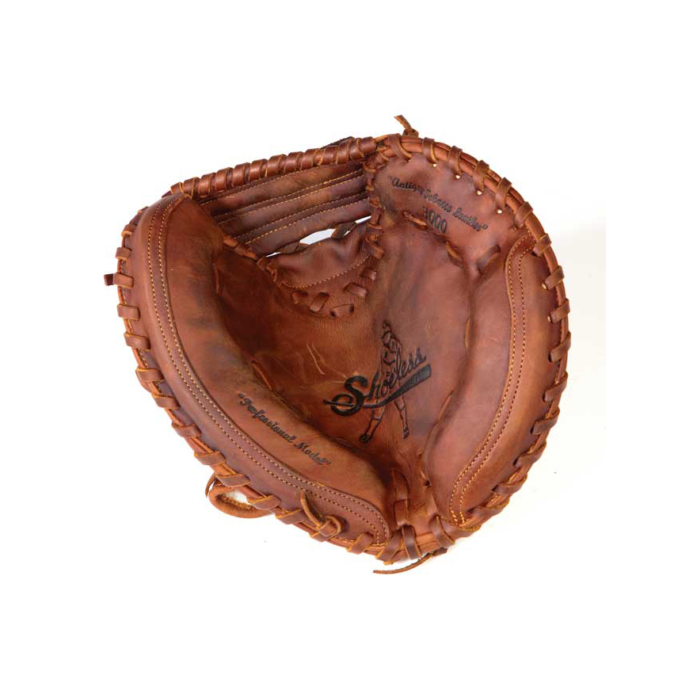


it
it
it

Slide 6
Three methods to help overcome Negative Self-talk
Keep Comparisons in check. Self vs. Others
Change the Narrative and Meaning. Acknowledge untold stories of accomplishment, achievement, perseverance, resiliency, commitment, determination.
Positive Affirmations

Slide 7
“Get up and win the race. You haven’t lost at all. For all you have to do to win, is rise each time you fall”

Slide 8
References
https://www.istockphoto.com/photos/determined-kid
https://theracquet.org/4705/letter-to-the-editor/letter-to-the-editor-combating-negative-self-talk/
https://theracquet.org/4705/letter-to-the-editor/letter-to-the-editor-combating-negative-self-talk/
https://www.linkedin.com/pulse/changing-your-narrative-john-pizzuro-ma-cfe
https://www.choosingtherapy.com/how-to-love-yourself/
http://holyjoe.org/poetry/anon3.htm

