Slide 1
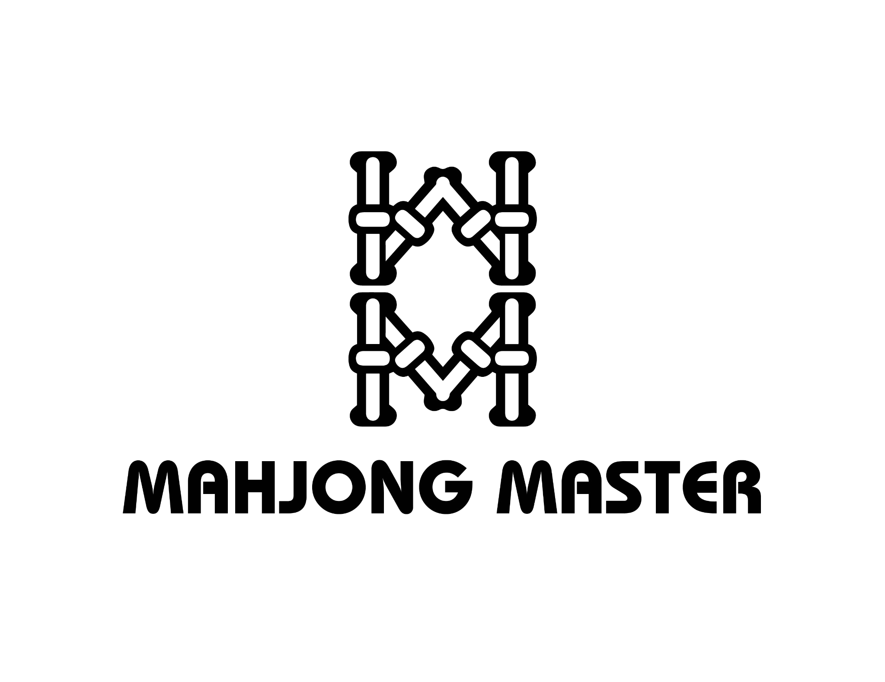
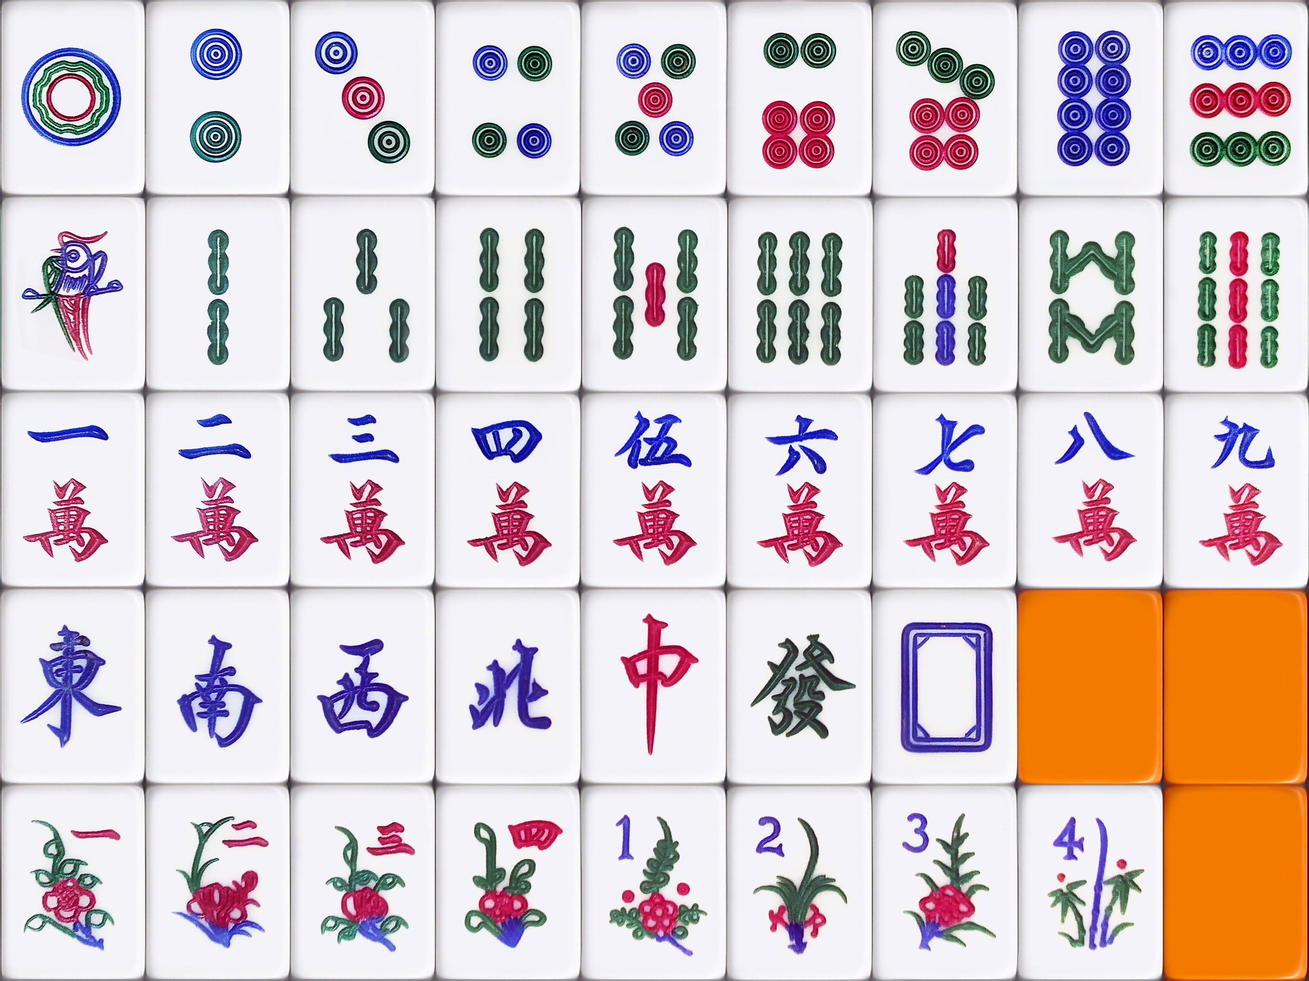
Mahjong tiles (There are 4 of each of the playing tiles and 8 flowers in total)
1 2 3 4 5 6 7 8 9
Circles
Bamboo
Characters
Honor Tiles
Winds & Dragons
East, South, West, North
Red, Green & White
Flowers & Seasons

