Slide 1
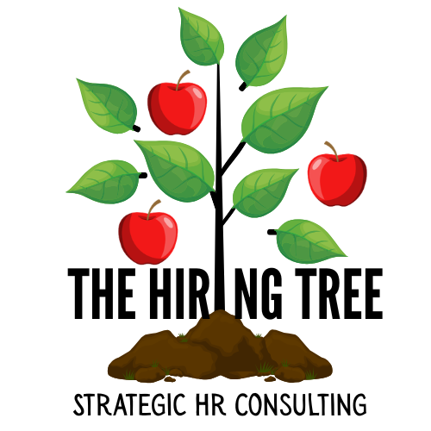

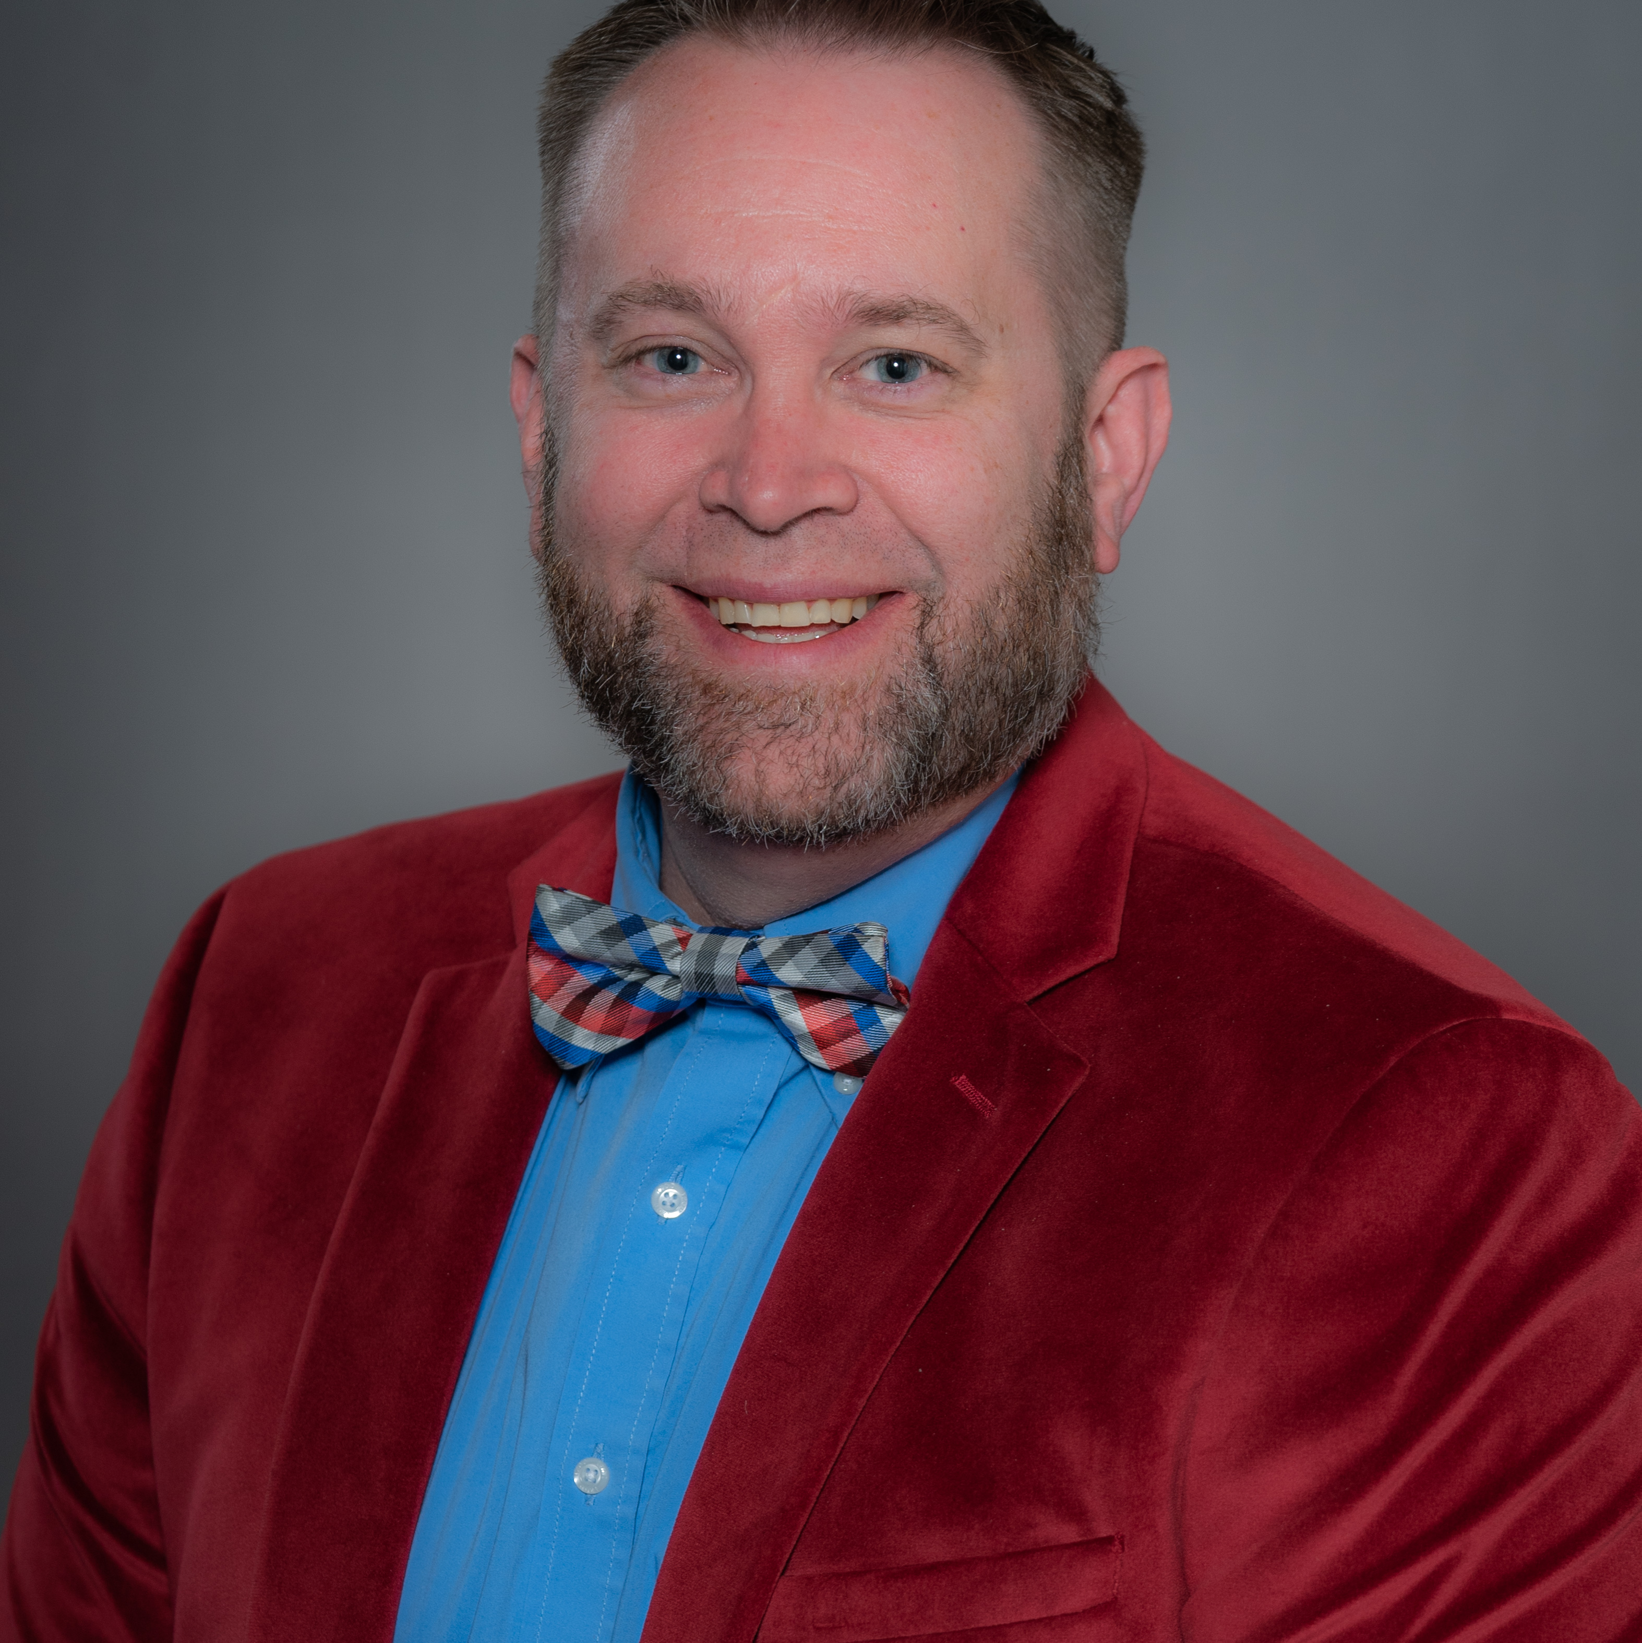

AI IN HR WORKSHOP
Beyond the Prompt
Using the IDEAL Framework to Apply AI in Human Resources
I
D
E
A
L
Identify
Dig Deeper
Enable
Apply
Launch
THE FRAMEWORK FOR TODAY
Steve Smith
Tony Benjamin
The Hiring Tree
The Grange
Utah Work Elevated Conference

Slide 2
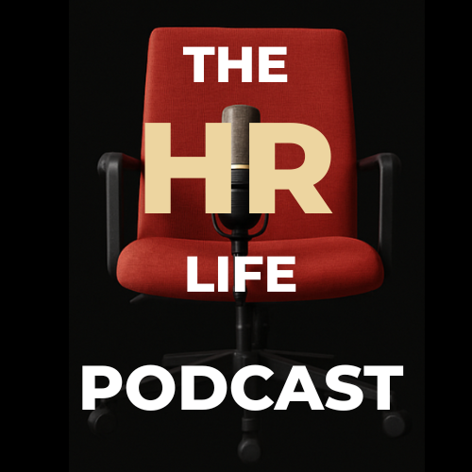
+
+
+
+
+
+
+
+
+
+
+
+
+
+
+
+
+
+
+
MEET YOUR HOSTS
+
+
+
+
+
+
+
+
+
+
+
Who's Presenting
STEVEN J SMITH
TONY BENJAMIN
The Hiring Tree
Strategic HR+AI Consulting
The Grange
Consultant on Talent Acquisition Strategy and AI in HR.
Author of The Hiring Tree: Laws of Applicant Attraction.
Co-Founder of ApplicantPro
Strategic HR consulting: compliance, performance management, and hands-on HR support.
Co-hosts of The HR Life Podcast, spotlighting HR professionals and real-world lessons from across the country.

Slide 3
+
+
+
+
+
+
+
+
+
+
+
+
+
+
+
+
+
+
+
THE PLAN
+
+
+
+
+
+
+
+
+
+
+
Today's Session
Two hours, two goals: think clearly about AI, then walk out with two ready-to-test bots.
HOUR ONE
HOUR TWO
Foundation + First Build
Job Ads, From the Book to the Bot
5 min
Why Clarity Beats Tools
8 min
Quick Teaching: Job Ad Basics
15 min
The IDEAL Framework
42 min
Building the Bot in Copilot
40 min
Tony's Build: Performance Review Bot
10 min
Launch and Learn, Wrap Up

Slide 4
+
+
+
+
+
+
+
+
+
+
+
+
+
+
+
5
SEGMENT 1
Why Clarity Beats Tools
MINUTES
1
Most business owners don't have an AI problem. They have a clarity problem.
2
AI is only as good as the thinking fed into it. Vague input produces vague, generic output.
3
Today isn't a tool tour. It's a repeatable way to think before you type.

Slide 5
THE AI MATURITY CURVE
+
+
+
+
+
+
+
+
+
+
From Prompt to Agent
+
+
+
+
+
Five stages of AI adoption at work, and where most people get stuck.
1
2
3
4
5
PROMPTING
PROJECTS
CUSTOM ASSISTANTS
CHATBOTS
AGENTS
Fast and ad hoc. Using AI on the fly, not repeatable.
Add context, templates, and files. Compounds over time. These are ideal for work settings in HR so that you do not have to keep repeating prompting steps
AI stores memory and follows repeatable instructions
A packaged, shareable assistant. Teammates use it, no rebuilding required.
Deployed for employees or customers to use directly.
Prompts still required and many cases, prompts are pre-built and provided
Fully autonomous. Triggered by events, no prompt needed.
MANUAL, ONE-OFF
AUTONOMOUS, ALWAYS-ON
Every platform has its own name for different stages: GPTs (ChatGPT), Gems (Gemini), Copilot Studio agents, or a shared Claude Project
Note for the room: OpenAI is retiring custom GPTs in favor of “Plugins” (Enterprise retirement set for Dec 11, 2026; personal accounts already can't create new GPTs).

Slide 6
+
+
+
+
+
SEGMENT 2
+
+
+
+
+
15
+
+
+
+
+
The IDEAL Framework™ (The Hiring Tree)
MINUTES
I
D
E
A
L
Identify
Dig Deeper
Enable
Apply
Launch
the core problem
Tell it who you want it to be. Define it thoroughly
by breaking it into smaller problems
Context is the most important
Provide examples
perspective by gathering differing views
Ask AI to what it needs to know
Ask AI how it can help
constraints to data input and output
These are the guardrails to control responses, content, data, output, etc.
and learn through iterative implementation
Observe, test, and see the results.
Adjust as needed
Write down one people problem you're facing right now. Just Identify and Dig deeper. Two minutes, no sharing.
PAUSE

Slide 7
+
+
+
+
+
SEGMENT 3, PART ONE · LED BY TONY BENJAMIN
+
+
+
+
+
40
+
+
+
+
+
Making Yourself More Efficient Using AI
MINUTES
Utilizing AI to accomplish more, starting with the tasks that eat your time.
1
Performance reviews are a task that takes real time, and a place AI can genuinely help.
2
There's a best process for doing this well, and it starts before you ever open a prompt.
3
There's also a worst implementation. We'll show you both, live.
Best process vs. worst implementation gets walked through live, this sets up why it matters.

Slide 8
SEGMENT 3, PART TWO
+
+
+
+
+
+
+
+
+
+
Creating a Bot to Implement
+
+
+
+
+
Ask AI How
Define What You Want
Provide Completed Examples
Coach the AI
APPROACH
APPROACH
APPROACH
APPROACH
Job Descriptions
Utilize Forms
Build and Create
Coach and Refine
INPUTS
INPUTS
INPUTS
INPUTS
DON’T FORGET COMPLIANCE:
Bias, privacy, and compliance checks in the review criteria, this is where responsible AI use gets taught in context.

Slide 9
+
+
+
+
+
SEGMENT 4
+
+
+
+
+
8
+
+
+
+
+
Quick Teaching: Job Ad Basics
MINUTES
JOB DESCRIPTION
JOB AD
An internal document.
Lists duties and requirements.
Written for HR and legal, not applicants.
An external pitch.
Sells the role and the why behind it.
Written for the applicant, not for HR.
Want the deep dive? Ask about a free one-on-one consult after the session.

Slide 10
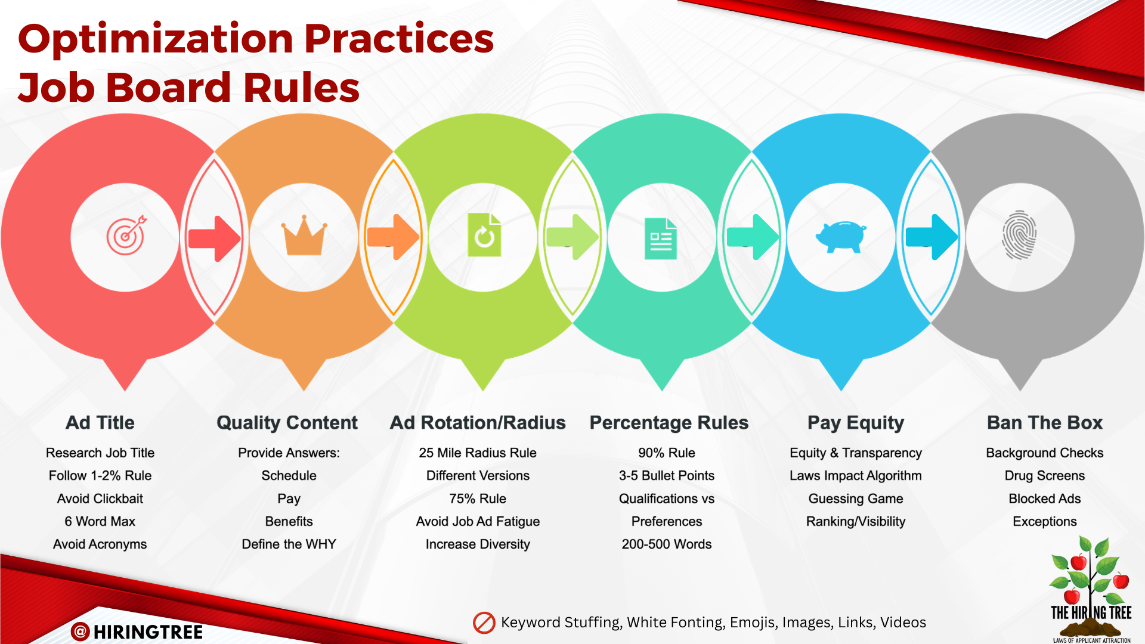

Slide 11
+
+
+
+
+
SEGMENT 5, PART ONE
+
+
+
+
+
42
+
+
+
+
+
Building the Bot in Copilot
MINUTES
Role and Purpose
Company Grounding
Job Ad Structure and Order
Tone and Voice
TAKE HOME
LIVE BUILD
LIVE BUILD
LIVE BUILD
Bias and Error Catching
Reposting and Algorithm Guardrails
Guardrails Against Hallucination
Output Format
TAKE HOME
TAKE HOME
TAKE HOME
TAKE HOME
Everyone leaves with all eight sections structured, three built live, five to finish on their own.

Slide 12
SEGMENT 5, PART TWO
+
+
+
+
+
+
+
+
+
+
Building the Bot in Copilot
+
+
+
+
+
1
2
3
Company Grounding
Job Ad Structure and Order
Tone and Voice
Without this the bot writes generic ads that could be for anyone. It is the foundation everything else depends on. This is where you can customize the tone and what your AI chatbot will use in creating your job ads.
This is where job description versus job ad gets applied. Ties Segment 4 directly to the build.
Fast to define and highly visible in the output. Attendees hear their own company in the result right away.
Paste in a real job description. Generate a job and use each time you need to post a new job.
PAUSE

Slide 13
+
+
+
+
+
+
+
+
+
+
+
+
+
+
+
10
SEGMENT 6, WRAP UP
Launch and Learn
MINUTES
This ties back to the fifth step of IDEAL: launch and learn through iterative implementation.
1
Add to your organization’s AI program and have coworkers test it and provide feedback.
2
Learn from what happens, make changes to your chatbot, and continue to test to perfection!
3

Slide 14
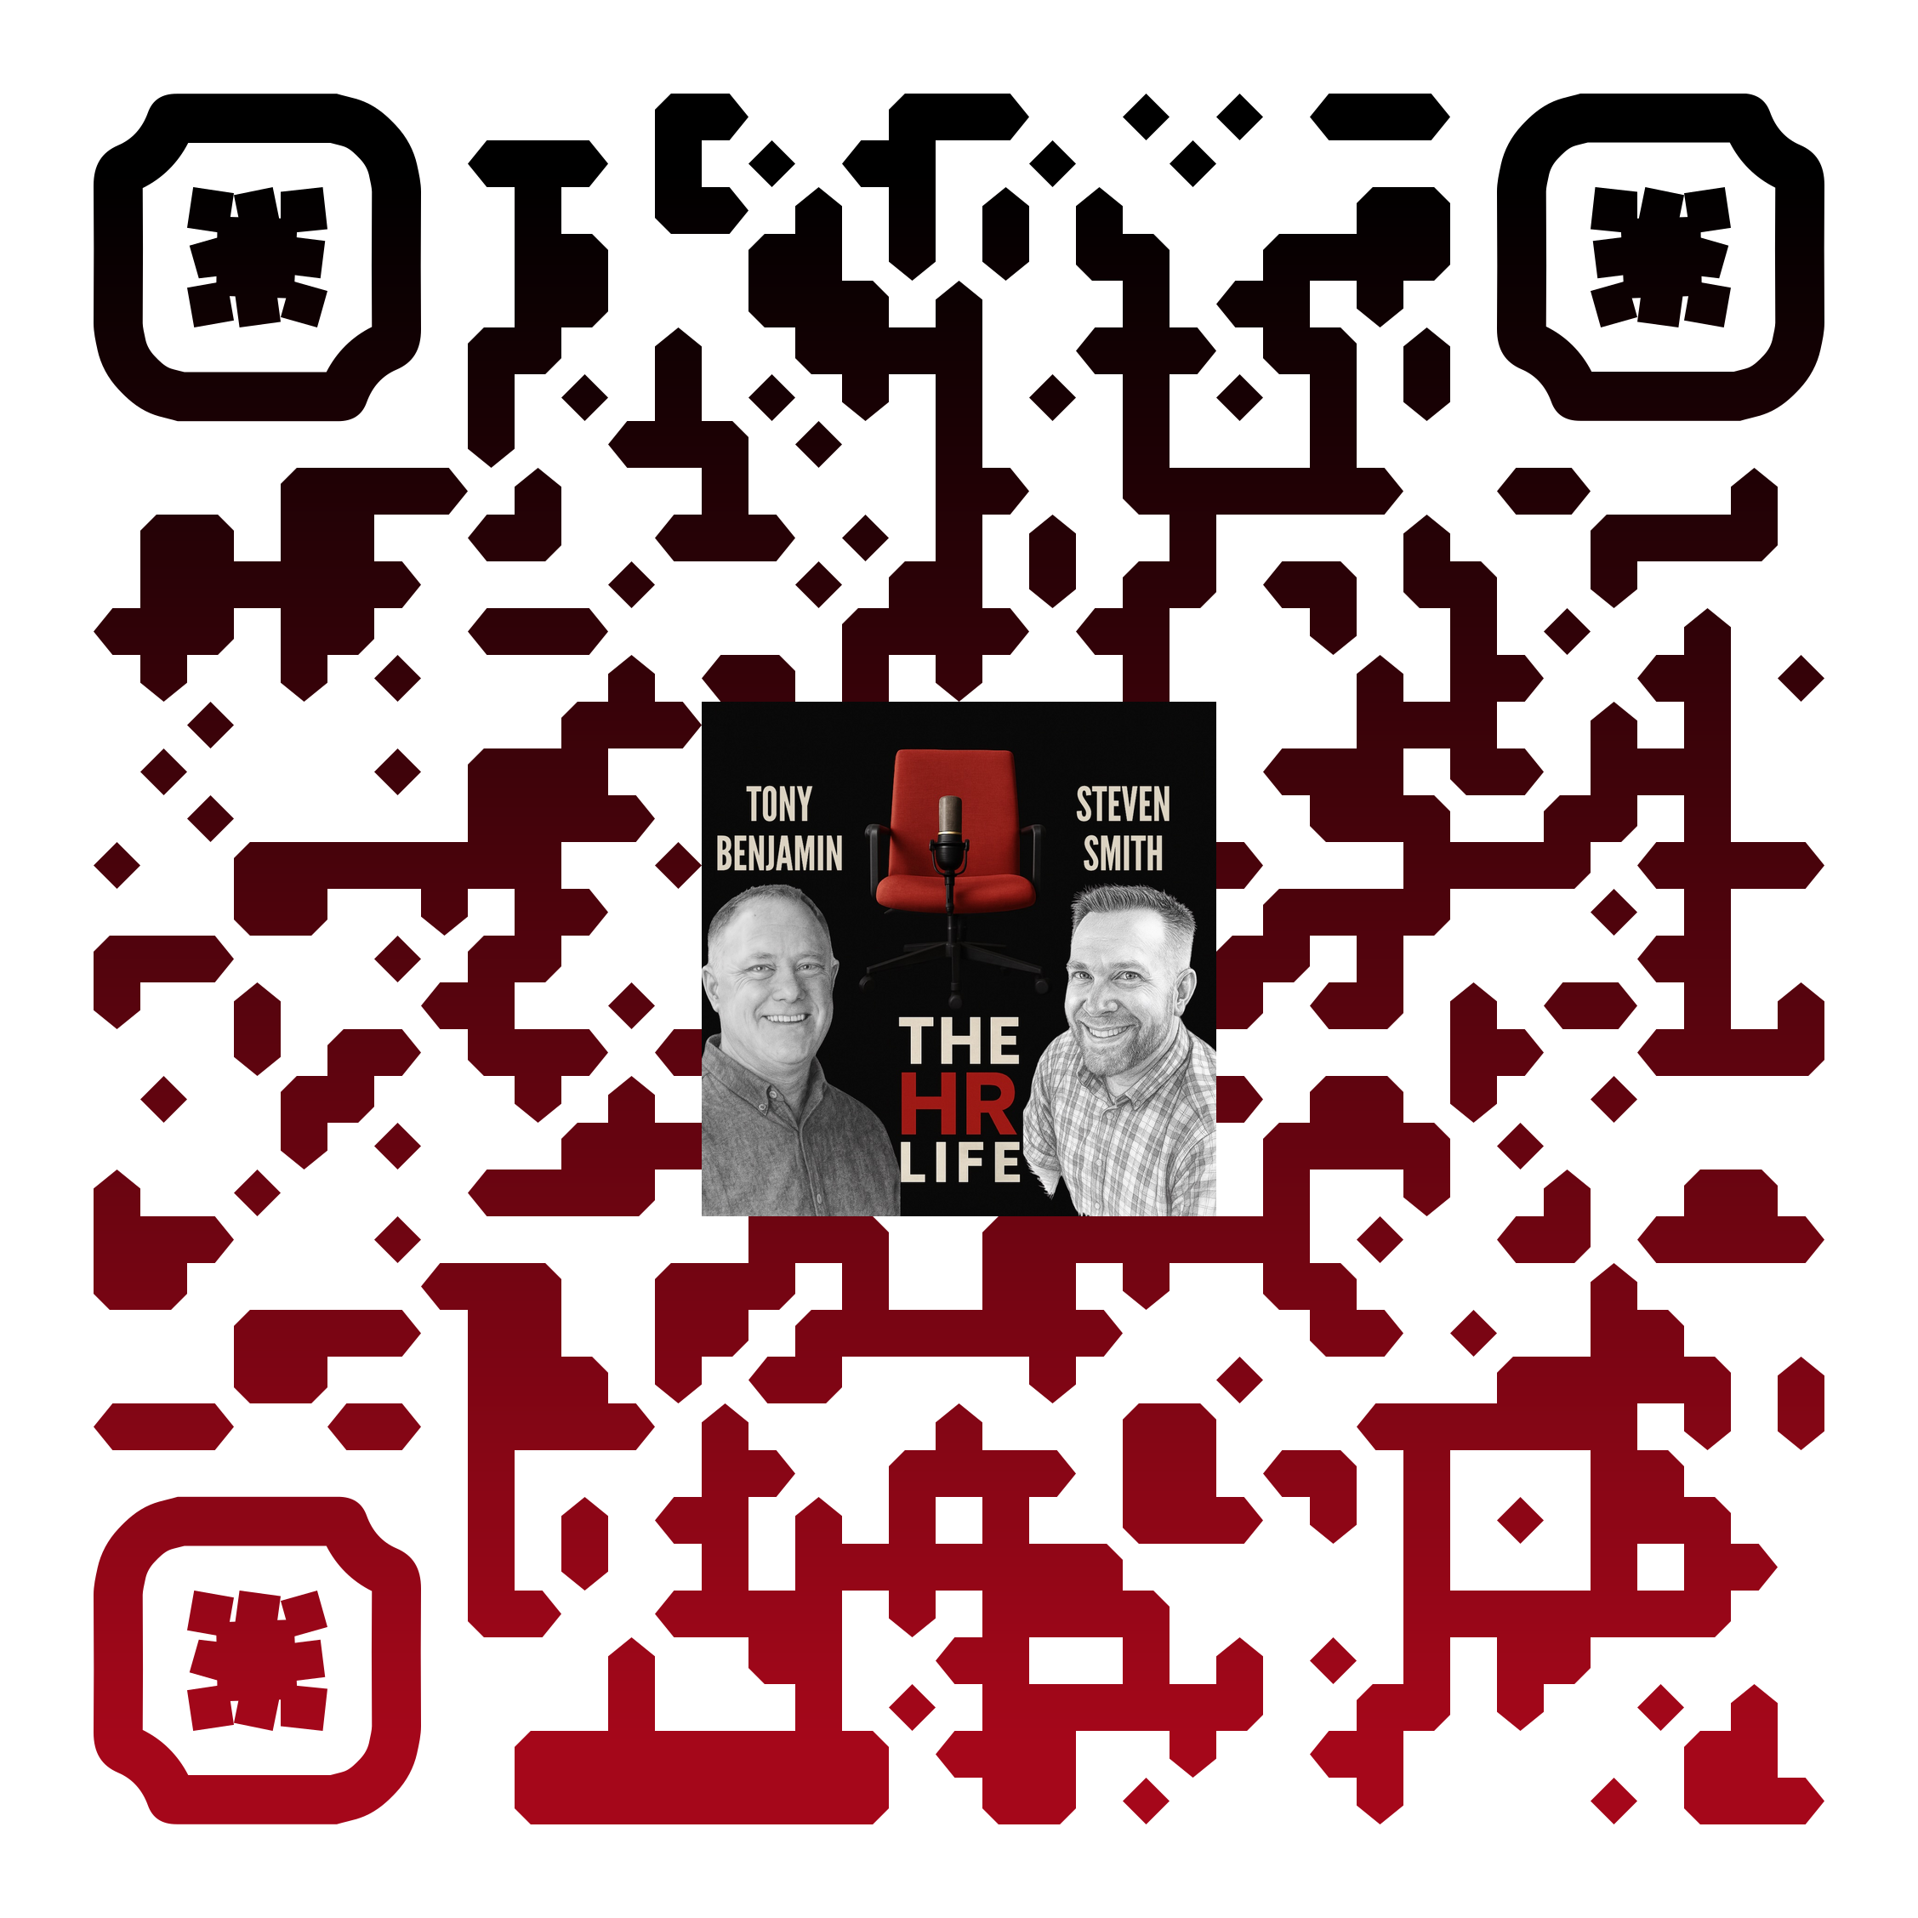

THANK YOU
Keep going after today
Steven J Smith, SHRM-CP, PHR, MSHRM
Tony Benjamin, MBA, PHR
The Hiring Tree: Strategic HR + AI Consulting
Steve@TheHiringTreeBook.com
(256) 419-4218
https://thehiringtreebook.com
The Grange
Tony@TheGrangeLLC.com
(435) 817-7695
https://TheGrangeLLC.com
Catch more conversations like this on The HR Life Podcast.

