Slide 1

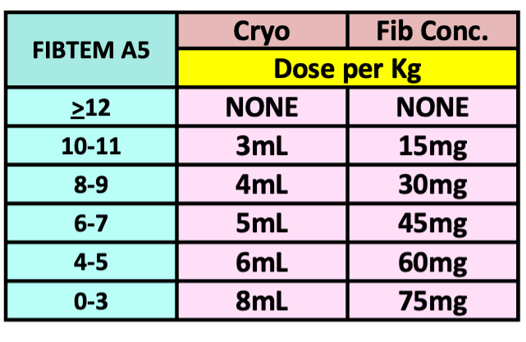

PAEDIATRIC
ROTEM TRANSFUSION ALGORITHM (2025)
Temp >36° C, pH >7.2, iCalcium >1.1 mmol/L, Platelets >70x10⁹/L, Hb >75 g/L
Repeat test 10 mins
After each intervention
IF BLEEDING CONTINUES
IS THERE CLINICALLY SIGNIFICANT BLEEDING?
YES
NO
ROTEM
Results in 10 min
Then
High risk of Fibrinolysis?
E.g. trauma, craniofacial, major ortho
Consider Tranexamic Acid now
Observe
Tranexamic Acid
15mg/kg
Consider repeat dose if patient has lost over one blood volume since initial dose
Adjust subsequent dose for renal dysfunction
Clot Instability
EARLY DIAGNOSIS:
IS EXTEM A5 < 35 mm?
Including flatline FIBTEM at 5min
YES
Hyperfibrinolysis
FIBRINOLYSIS
NO
PROCEED WITH ALGORITHM
Low Fibrinogen
Cryo or FibConc
If FIBTEM A5< 6 ensure platelets are also available
IS FIBTEM A5 < 12mm?
(Including flat line at 5 minutes)
Craniofacial cases, aim for higher FIBTEM target >15mm
YES
FIBRINOGEN
Clinician discretion for Fibrinogen Concentrate
Usually single dose
Only for severely low FIBTEM – e.g.. <6mm or earlier for craniofacial procedures
NO
RETEST
NORMAL FIBTEM A5 ≥ 12mm
AND
IS EXTEM A5 < 35mm?
YES
Poor Platelet Contribution
Pool Platelets
20mLs/kg
If chronic renal dysfunction also consider
Desmopressin / DDAVP
0.3microg/kg IV
Slow infusion over 30min
PLATELETS
NO
RETEST
NORMAL FIBTEM A5 ≥ 12mm
AND
IS EXTEM CT > 85 sec?
Ensure core temperature >36°C
And Fibrinogen corrected first
Low Coagulation Factors
Correct fibrinogen before
ELP* 20mLs/kg
OR
Beriplex
(If volume overloaded)
12.5 Units/kg IV
* FFP for Neonates
FACTORS
YES
RETEST
NO
Clot Instability
LATE DIAGNOSIS:
Leave test running for up to 60 min
IS FIBTEM ML ≥ 10%?
Clot should be stable for 1 hour, not tapering away
YES
Hyperfibrinolysis
Consider additional tranexamic acid
FIBRINOLYSIS
RETEST
STILL BLEEDING? Consider SURGICAL PROBLEM and discuss with surgeon and blood bank/haematologist
Make a stronger clot? Give Cryo to FIBTEM A5 > 14mm Give platelets to EXTEM A5 > 40 mm or consider Platelet Function testing (in hours) Consider ELP to shorten clotting time to EXTEM CT < 80 sec | Re check temperature, pH, iCalcium, platelets and haemoglobin Consider other contributors to bleeding Platelet inhibitors (do Multiplate Platelet Function test) Consider Von Willebrand’s Disease, warfarin (INR), enoxaparin etc.
NORMAL
When clinically possible always complete the algorithm in a stepwise manner and check the ROTEM between steps as indicated. This reduces unnecessary transfusion, especially of Platelets, ELP and Beriplex

