Slide 1

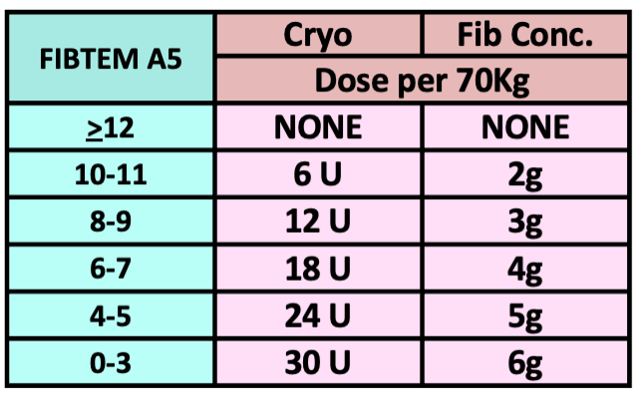
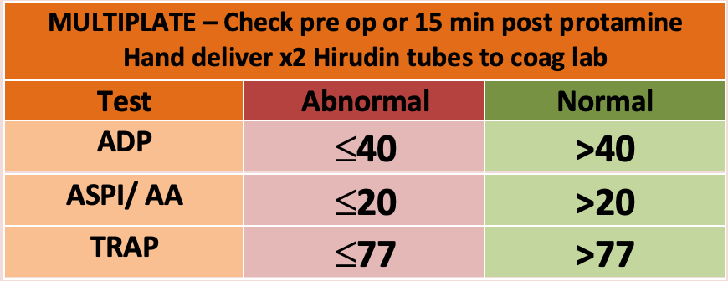

CARDIAC AND VASCULAR
ROTEM TRANSFUSION ALGORITHM (2025)
Temp >36° C, pH >7.2, iCalcium >1.1 mmol/L, Platelets >70x10⁹/L, Hb >75 g/L
Adjust dose of blood products for patients <50kg after consulting senior clinician
Repeat ROTEM test 10 mins
AFTER EACH INTERVENTION
IS THERE CLINICALLY SIGNIFICANT BLEEDING?
YES
NO
ROTEM
Results in 10 min
Then
High risk of Fibrinolysis? Give Tranexamic Acid initial 15mg/kg then check cardiac infusion schedule
Observe
INTEM CT | Ratio >1.25?
HEPTEM CT
YES
Any difference is Heparin Effect
Protamine IV
0.5-1 mg/kg
RETEST
NO
HEPARIN
ARE INTEM & HEPTEM CT
both >205 sec?
YES
Possible excess protamine inhibiting factor V
(or intrinsic factor deficiency or factor Xa inhibitor)
Wait >10min then re-test
If prolonged after re-test, consider coagulation factor deficiency
RETEST
NO
IF SEVERE BLEEEDING, PROCEED WITH ALGORITHM
Cryo or FibConc
If FIBTEM A5< 6 ensure platelets are also available
IS FIBTEM A5 < 12mm?
(Including flat line at 5 minutes)
YES
Low Fibrinogen
RETEST
FIBRINOGEN
Clinician discretion for Fibrinogen Concentrate
Usually single dose
Only for severely low FIBTEM – e.g.. <6mm
NO
NORMAL FIBTEM A5 ≥ 12mm
AND
IS EXTEM A5 < 35mm?
OR
Is MULTIPLATE abnormal?
Abnormal = any test in red zone
Platelet function test 0900-1600 M-F Call lab first
Note: ROTEM is not sensitive to antiplatelet drugs
YES
Poor Platelet Contribution
1 unit Pool Platelets
If chronic renal dysfunction also consider
Desmopressin / DDAVP
0.3microg/kg IV
Slow infusion over 30min
PLATELETS
RETEST
NO
NORMAL FIBTEM A5 ≥ 12mm
AND
IS EXTEM CT > 85 sec?
Ensure core temperature >36°C
and Fibrinogen corrected first
ELP* 4 units
OR
Beriplex
(If volume overloaded)
10-15 Units/kg IV
Use lower dose for high thromboembolic risk
* FFP for Neonates – see protocol
FACTORS
YES
Low Coagulation Factors or Oral anticoagulants (Warfarin or DOACs)
RETEST
NO
CLOT LYSIS INDEX after 30 minutes
IS FIBTEM ML ≥ 10 %?
Leave test running as long as possible
Clot should be stable for 1 hour, not tapering away
Hyperfibrinolysis
Consider Additional
Tranexamic Acid
Adjust subsequent dose for renal dysfunction and long bypass time
Max dose 80mg/kg per case
FIBRINOLYSIS
YES
RETEST
NO
STILL BLEEDING? Consider SURGICAL PROBLEM and discuss with surgeon and blood bank/haematologist
Make a stronger clot? Give Cryo to FIBTEM A5 > 14mm Give platelets to EXTEM A5 > 40 mm or consider Platelet Function testing (in hours) Consider ELP to shorten clotting time to EXTEM CT < 80 sec | Re check temperature, pH, iCalcium, platelets and haemoglobin Consider other contributors to bleeding Platelet inhibitors (do Multiplate Platelet Function test) Consider Von Willebrands Disease, warfarin (INR), clexane etc.
NORMAL
When clinically possible always complete the algorithm in a stepwise manner and check the ROTEM between steps as indicated. This reduces unnecessary transfusion especially of ELP.

