Slide 1
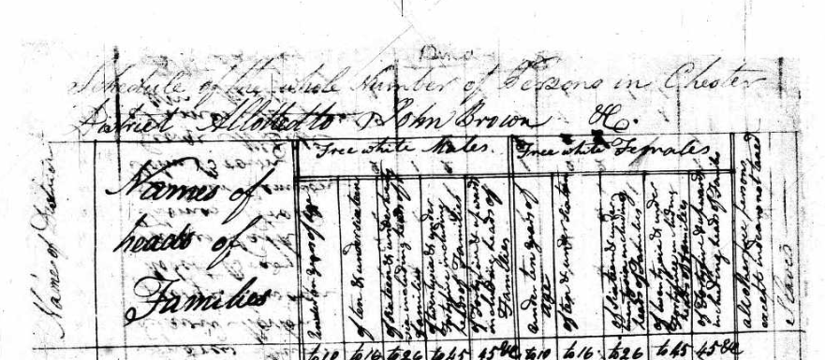
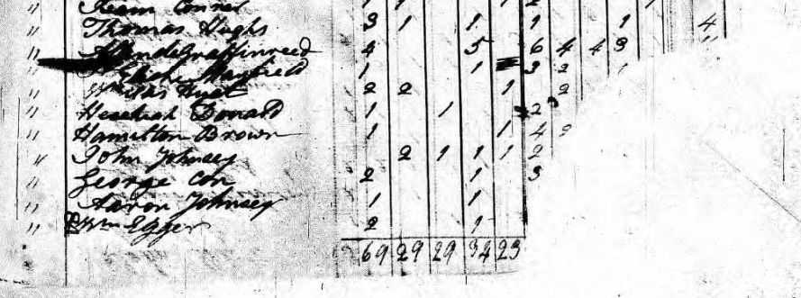
In 1800, In Hezekiah Donald’s household, there was 1 male under 10, 1 male between 16 and 26, and 2 females under 10. Unfortunately, the Census document was damaged and the rest of his family is unknown.

