Slide 1
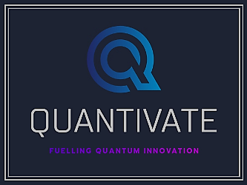
Hiring Reimagined: Cut Costs by 80% & Secure Top Talent 3X Faster with AI
Ditch costly agencies and outdated hiring—AI delivers pre-vetted, high-quality candidates before your competitors even know they exist
🔥 See AI Hiring in Action – Book a Demo Today!

Slide 2

Why Traditional Hiring is Failing You
❌ Slow Hiring → Competitors Secure Talent First
  Manual sourcing takes weeks / months, while competitors hire in days.
💸 Expensive → Agency Fees Are Unsustainable
  Agencies charge £40K per hire, LinkedIn licenses cost £11K+ per year.
⚠️ Low Efficiency → You’re Missing 85% of Top Talent
  Passive candidates never apply through job boards.
  Poor outreach = low response rates, wasted time.
🔥 See AI Hiring in Action – Get Early Access Today!

Slide 3
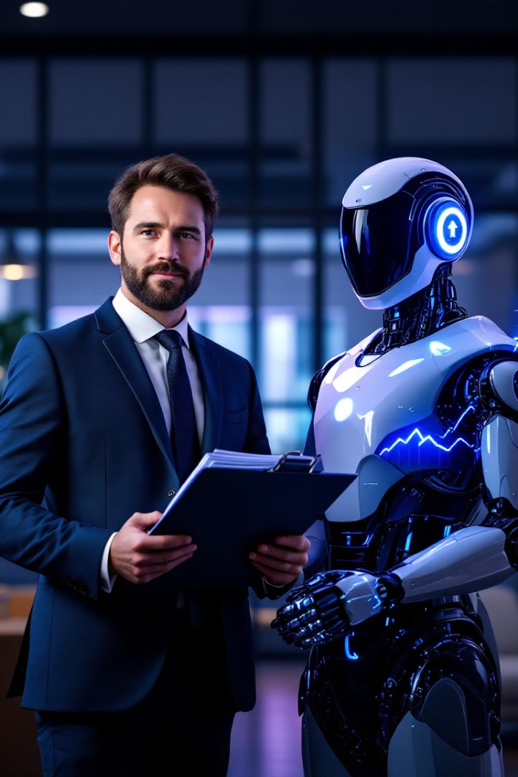
The AI Shift
💡 AI Is Transforming Recruitment – Are You Ready?
✅ AI analyzes 100+ data sources for precise candidate matches.
✅ AI automates sourcing, screening, and engagement – cutting hiring times by 50-75%.
✅ AI tracks candidate engagement in real-time, ensuring higher conversions.
🔥 Ditch Traditional Hiring – AI Finds You Top Talent Faster!
🚀 See AI in Action – Book Your Demo Now!

Slide 4

What is an AI Talent Partner?
💡 AI-Powered Recruitment, Designed for You.
🎯 AI Talent Partner is an AI-driven hiring model that helps companies source, engage, and hire the best candidates without expensive agencies.
🔥 The Best Teams Are Using AI—Don't Get Left Behind!
🚀 See AI in Action – Book Your Demo Today!

Slide 5
How Our AI Model Works
1️⃣ AI scans 100+ data sources to identify top talent.
2️⃣ AI scores & ranks candidates for relevance.
3️⃣ Automated multichannel outreach (Voice, Video, LinkedIn, Email).
4️⃣ Real-time analytics & dashboards track hiring success.
🔥 See AI Hiring in Action – Get Early Access Today!

Slide 6
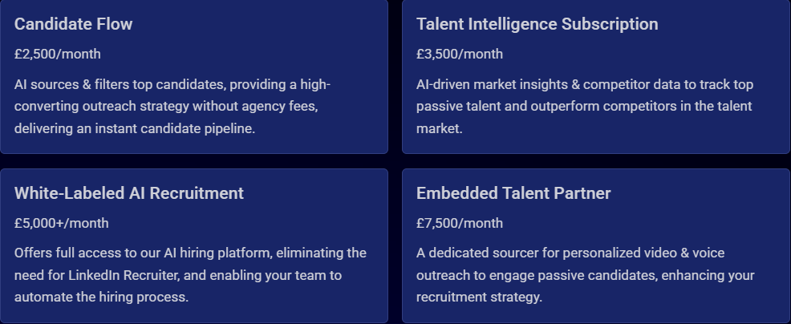
Service Offerings: Choose the Right AI Hiring Solution
AI hiring isn’t just about volume. It’s about precision. With real-time tracking, you can optimize every stage of hiring, boost conversion rates, and secure top talent before competitors do.

Slide 7
AI vs. Human Recruiter – The Perfect Model
🤖 AI Enhances Recruiters – It Doesn’t Replace Them
✅ AI handles sourcing, filtering, outreach.
✅ Your team focuses on relationship-building & final hiring decisions.
🔥 The Best Teams Are Using AI—Don't Get Left Behind!
🚀 See AI in Action – Book Your Demo Today!

Slide 8
The Data Advantage – Unmatched Insights
💡 AI Talent Partner Gives You Hiring Superpowers.
📊 100+ Data Sources – AI taps into global hiring data.
🔍 Passive Candidate Tracking – Find top talent before they start looking.
💰 Salary Benchmarking & Market Intelligence – Make competitive offers.
🔥 See AI Hiring in Action – Get Early Access Today!

Slide 9
Why Now? The AI First-Mover Advantage
🚀 The Best Companies Are Already Switching – Will You?
📈 50% of Leading Companies Are Adopting AI Hiring
⚡ First adopters outperform competitors in talent acquisition.
🔥 Ditch Traditional Hiring – AI Finds You Top Talent Faster!
🚀 See AI in Action – Book Your Demo Now!

Slide 10

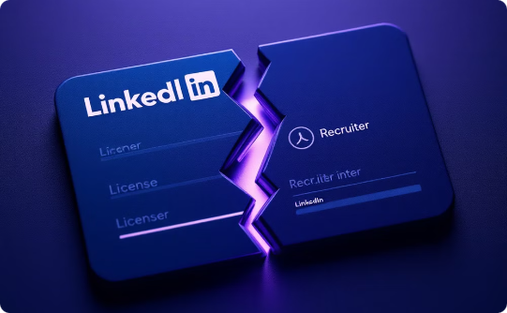
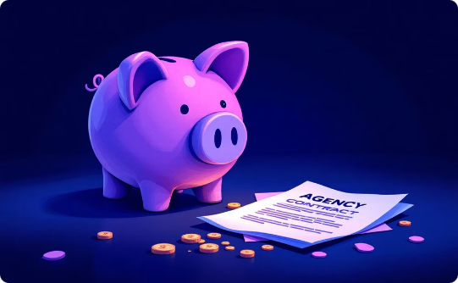
Why Clients Are Switching to AI Talent Partner
Recruitment costs are eating your budget. AI hiring eliminates overhead, recruiter fees & agency markups—without sacrificing quality
3X Faster Hiring
80% Cost Reduction
Competitive Advantage
No waiting for months, AI speeds up hiring.
Stop overpaying for recruitment agencies & LinkedIn licenses.
Get to top talent before your competition does.
🔥 You're Burning Money on Hiring — Stop the Waste Now!
🚀 See AI in Action → Save Thousands Instantly!

Slide 11
Your Next Step: Let’s Build Your AI Hiring System
📅 Book a free strategy call to see AI Talent Partner in action.
🎁 Exclusive Offer: Get started today with a personalized demo.
📞 Contact us: 07834 828550 or cgeorge@quantivate.co.uk
No sales pitch — just a quick walkthrough of how AI can supercharge your hiring!

