Slide 1

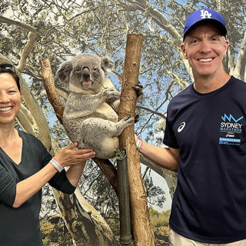
What Is Rain?
Discover how rain forms and why it's important

Slide 2

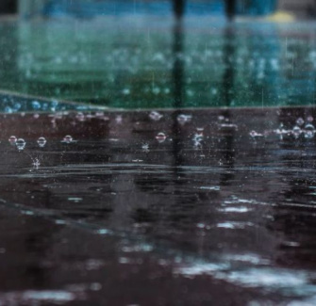
Rain Is Falling Water
What Does Rain Look Like?
Rain is water that falls from the sky in little drops. You can see it during cloudy or stormy weather.
Where Does It Come From?
It starts in clouds high above us. When clouds get too full of tiny water droplets, they let the water fall as rain.
Have you ever danced in the rain or jumped in a puddle?

Slide 3
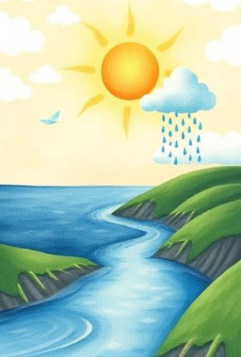
The Water Cycle Story
A Never-Ending Journey
Water doesn’t just appear — it travels in a big loop called the water cycle.
This cycle moves water from the ground to the sky and back again.
It includes evaporation, condensation, and rain — all working together!

Slide 4
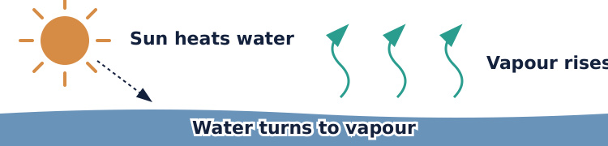
Step 1: Evaporation
Sun heats water, turning it into vapor that rises into the air.
This rising vapour is how water begins its journey into the sky. It’s called evaporation.

Slide 5
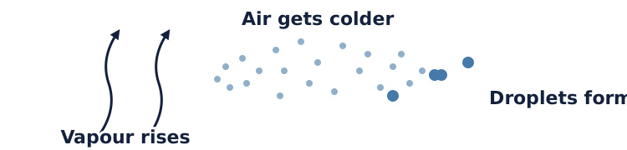
Step 2: Condensation
Warm water vapour rises, cools, and condenses into droplets, like a foggy mirror.
These droplets stick together to make clouds. This step is called condensation.

Slide 6
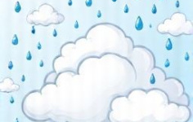
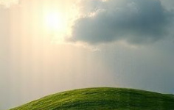
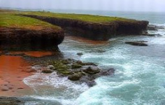
Step 3: Rain Falls
Clouds Fill Up
More and more droplets collect in the cloud until it becomes heavy.
Too Heavy!
When clouds are full, water falls as rain.
Back to Earth
Rain fills rivers, flows to ocean, repeats.

Slide 7
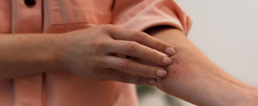
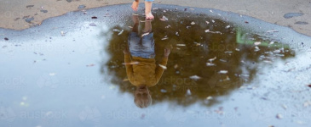
Where Do We See the Water Cycle?
On the Window
Cold morning breath mists glass—condensation!
In the Puddle
After rain, puddles dry up. That water is evaporating into the air!

Slide 8
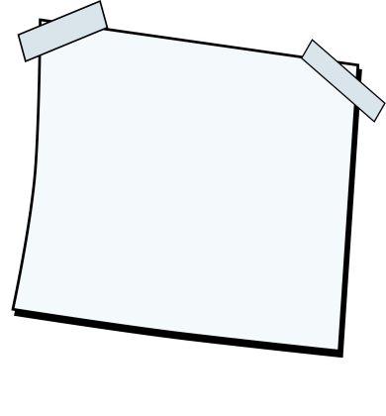
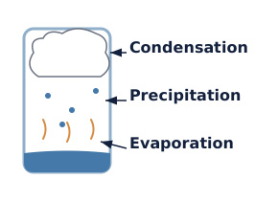
Get creative 🖼️​
Make Your Own Water Cycle Jar
Create a mini water cycle in a jar! Use cotton wool for the cloud and blue food colouring for rain. Label each part: evaporation, condensation, and precipitation to show how rain forms.
What you'll need: 🎨​ 🖌️​
Glass jar, Cotton wool, Water, Blue food colouring, Marker, Paper labels

Slide 9
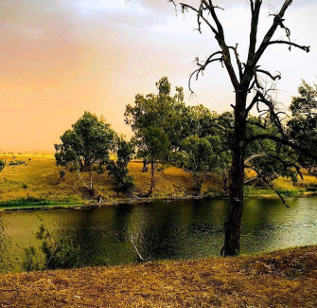
Why Is Rain Important?
For Nature
Plants need rain to grow. Trees, flowers, and crops all drink water from the rain.
For Animals and People
Rain fills rivers and dams so animals can drink and we can use water at home.
Without rain, the land can become dry and thirsty — like in a drought.

Slide 10
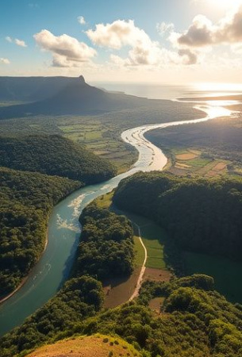
Rain Keeps the World Alive
Rain is part of a big, natural journey that keeps our planet full of life.
From the ocean to the sky, from clouds to puddles — water is always moving and helping everything grow.

