Slide 1

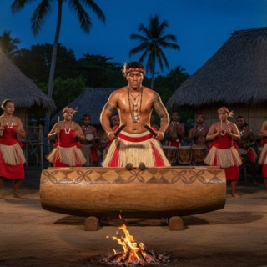
The Drums of Fiji
Exploring the History and Use of the Lali

Slide 2

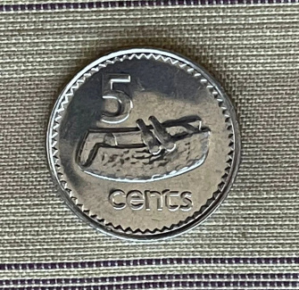
Lesson Goals
By the end of this lesson, you will be able to:
Describe what a Lali is and how it is constructed.
Explain the historical significance of the Lali in Fijian culture.
Identify the different occasions when the Lali is used today.
Understand the role of rhythm in communication.

Slide 3
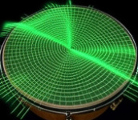

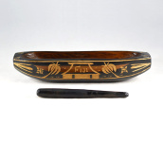
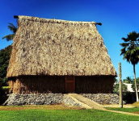
Key Vocabulary
Resonance
The deep, rich sound produced by the hollow chamber of the drum when struck.
Ritual
A solemn ceremony with prescribed actions.
Lali
Fijian slit drum: hollowed wood for communication and music.
Bure
Fijian communal house/meeting place where the Lali is kept.

Slide 4
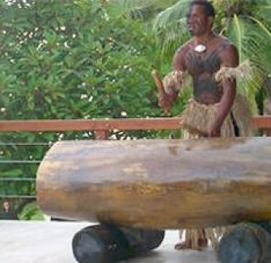
What is a Lali?
The Instrument
A Lali is a traditional Fijian drum, but it doesn't look like the drums you might see in a rock band. It is a slit drum made from a single, hollowed-out log of hardwood, usually Vesi or Iro trees.
The Design
A narrow slit is cut into the top of the log. The edges of this slit are often carved to different thicknesses, allowing the drum to produce two distinct notes when struck with wooden sticks called 'uvi'.

Slide 5
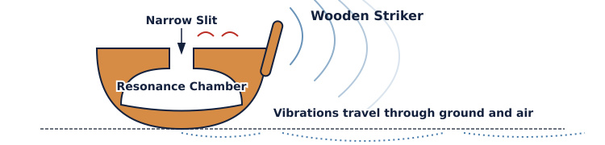
How Sound is Made
Because the drum is hollow, it acts as a resonance chamber. When the striker hits the lip of the slit, the wood vibrates.
The sound travels deep into the earth and can be heard for miles. This made it perfect for communicating across villages before phones existed.

Slide 6

True or False ✅​ ❌​
The Lali is made by stretching animal skin over a wooden frame, just like a standard snare drum.
👍​
👎​
TRUE
FALSE
Answers on the next slide...

Slide 7
True or False ✅​ ❌​
✅​
The Lali is made by stretching animal skin over a wooden frame, just like a standard snare drum.
👎​
FALSE
False! The Lali is a slit drum made from a hollowed-out log of wood. It relies on the wood vibrating to create sound, not a skin membrane.

Slide 8
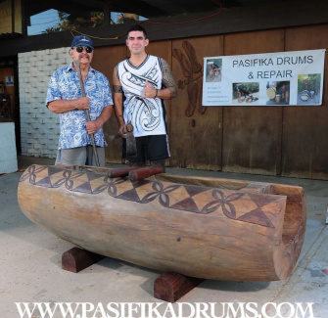
Origins and Materials
Choosing the Tree
Making a Lali starts with selecting the right tree. Traditional carvers look for specific hardwoods like the Vesi tree. These trees are dense, which gives the Lali its deep, booming tone that lasts for a long time.
Craftsmanship
The log is carefully hollowed out using traditional tools. This is skilled work that requires patience and strength to ensure the walls are the perfect thickness for the best sound.

Slide 9
History of the Lali
Traditional Era
Ceremonial Use
Became central to Meke (traditional dance) and religious ceremonies, marking the rhythm for performers.
Pre-19th Century
Ancient Times
Used primarily for long-distance communication between villages and to signal canoes returning from fishing or war.
Present Day
Modern Fiji
Today, the Lali is found in churches, schools, and hotels, serving as a proud symbol of Fijian identity.

Slide 10


Discuss! 🤷‍♀️​ 💁‍♂️​ 💬​
Think and Discuss
Imagine you lived in a Fijian village 200 years ago without phones or internet. What are three specific situations where you would need to use the Lali to send a message to your neighbours?

Slide 11
Discuss! 🤷‍♀️​ 💁‍♂️​ 💬​
✅​
You might have said...
Warning of an enemy attack or approaching storm.
Calling everyone to a communal feast or meeting.
Signalling the safe return of fishermen or warriors.

Slide 12
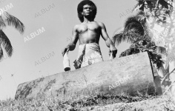
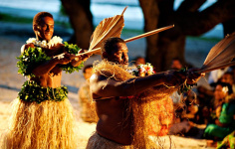

Uses of the Lali
Calling People
The deep sound calls villagers to meetings, church services, or meals. It acts as a community alarm clock.
Ceremonies
It provides the heartbeat for traditional dances (Meke) and important events like weddings and funerals.
Hospitality
In modern Fiji, hotels and resorts use the Lali to welcome guests, signalling a warm 'Bula!' greeting.

Slide 13
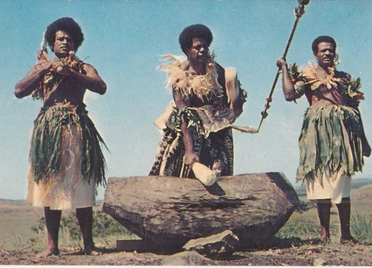
Lali come in various sizes. Small ones are portable, while large ones are stationary landmarks in a village.

Slide 14
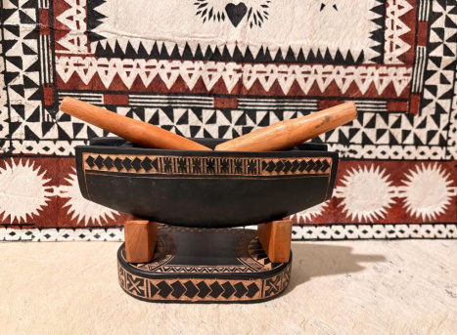
Lali come in various sizes. Small ones are portable, while large ones are stationary landmarks in a village.

Slide 15
Check Your Understanding
Answers on the next slide...
Why is the Lali considered an important part of Fijian identity today?
1.
It is used exclusively for pop music concerts.
2.
It connects modern Fijians to their ancestors and traditions.
3.
It is the only instrument allowed in Fijian schools.
4.
It is made from a metal found only in Fiji.

Slide 16
Check Your Understanding
✅​
Why is the Lali considered an important part of Fijian identity today?
1.
It is used exclusively for pop music concerts.
2.
It connects modern Fijians to their ancestors and traditions.
👍​
3.
It is the only instrument allowed in Fijian schools.
4.
It is made from a metal found only in Fiji.

Slide 17

Fill in the blanks 🧩​
The Lali is a traditional ____ drum made from hollowed ____. It produces sound through ____, creating deep notes that can travel over long ____.
Word bank 🏦​
slit, wood, vibration, distances, skin, metal, electricity, periods
Answers on the next slide...

Slide 18
Fill in the blanks 🧩​
✅​
The Lali is a traditional slit drum made from hollowed wood. It produces sound through vibration, creating deep notes that can travel over long distances.
Word bank 🏦​
slit, wood, vibration, distances, skin, metal, electricity, periods

Slide 19

Summary
The Heartbeat of Fiji
The Lali is more than just a musical instrument; it is a symbol of communication, community, and culture. From ancient times to the modern day, its distinctive rhythm has brought people together for work, worship, and celebration.
Understanding the Lali helps us appreciate how music and sound shape history and identity.

