Slide 1
Bunge Eliminates Cube Views & Report Clutter with Dashboards

Slide 2
Robin Morash, CPA, CGA
Techno-Functional OneStream Application Developer
✔ 6 years – OneStream Technical Services
✔10 years – Fortune 500 Financial Systems Manager
✔ 5 years – Hyperion & Cognos Implementations
✔ 5 years – Cognos Technical Support
Works For: EPMCPA® Consultants
Job Title: OneStream Independent Consultant
Location: Baton Rouge, Louisiana
Followers: 904
www.https://epmcpa.com/dashboards
www.linkedin.com/in/onestreamconsultant

Slide 3
Steve Cromwell
OneStream
Sr. Solutions Consultant, Global Alliances
Professional Experience
Joined OneStream in October 2021 to primarily support commercial partners in North America
12+ Years Solutions Consulting in Finance Software space (Performance Management, Procurement, Accounts Payable)

Slide 4
Brennan Penteluik
Bunge
Sr. Manager, Financial Reporting & Business Process
Professional Experience
10 years with Bunge, currently part of the OneStream Administration team focusing on Global Consolidations and FP&A solutions
Previously in Controlling, Audit and Finance roles in Bunge supporting Canada Grain, Global Trading and Distribution and Corporate FP&A
CPA with a Bachelors in Business Administration, Accounting Major, from the University of Regina

Slide 5
One Bunge Everywhere Across Value Chains
Bunge feeds and fuels the world with key ingredients, specialty oils and milled grains. From farm to consumer, we manage production, distribution flows, quality and risk and provide transparency across fully integrated end-to-end value chains.
Oilseed Processing
We buy oilseeds, such as soy, rapeseed, canola and sunflower seeds from farmers...
... process them by crushing and refining them into plant-based oils and proteins...
...to be used as ingredients to produce animal feed; to make cooking oils, margarine and shortening; and as feedstock for the biofuels industry.
...and transport them around the world...
Refining Specialty Fats and Oils (Lipids Ingredients)
We buy softseed and tropical oils, such as palm, coconut and shea...
...transform and refine them, partnering with customers to develop tailored solutions and create innovative plant-based oils and fats…
...and transport them around the world...
...to be used by food manufacturers, restaurants and foodservice.
…and source plant-based oils from our Oilseed Processing value chain…
Milling
We buy corn and wheat from farmers...
...transform and process them by milling...
…and transport them to customers...
...to be used in products we eat and cook with.
Distribution
We buy corn, wheat, rice, soy and softseeds from farmers...
...and transport them in their raw form...
...supplying high-quality commodity products to end-customers around the world — from entire nations to small livestock producers.
Notes:
Speaker notes:
Connecting farmers and consumers globally, Bunge brings food and feed products from where they are produced to where they are needed.
Our integrated value chain links origination, storage and transportation to activities further down the line, including processing, packaging and distribution.
We divide our value chain in four main groups: Oilseed Processing, Refining Specialty Oils and Fats, Milling and Distribution.
This helps farmers and communities prosper, puts better food on the shelf, increases sustainability, strengthens global food security and improves diets.
Bunge’s operations include buying grains, oilseeds and softseeds from farmers, then storing, transporting and selling them to domestic and export customers. We also provide financial, risk management and logistics services. From farm to consumer, we provide transparency across fully integrated end-to-end value chains, which you can see in this slide.

Slide 6
Cube Viewer Dashboard - Segment Portal
Bunge Objective
OneStream Solution
Improve end user experience for review of reporting segments
Optimally organize a collection of 50+ cube view reports
Replace static export to Excel and GetCell retrieves with user-friendly browser analysis
Ability to enter comments explaining variances to increase efficiency of review
Ensure uses have on-line access to current instructions and process updates
Flexibility to add or modify cube views to dashboard with changing business needs
Optimal report organization through dashboard portal
One screen with five pages provides access to 50+ cube views
Each page has a customized Entity hierarchy view
Integrate offline content - Embedded Excel Instruction books
Integrate on-line content - Direct links to external sites (Policies and Procedures)

Slide 7
Cube Viewer Dashboard - Segment Portal
Bunge Benefits
Reduce reliance on Excel exports
Manage cube view clutter through a single interface
Improve cube view analysis with drop-down pick list parameters
Improve end user acceptance with a simple one screen interface
Minimize training / level-of-effort to run reports
Reduce maintenance on OneStream Administrators
Grow OneStream user base by providing customized reporting
Establish Dashboard Reporting best practice for other segments

Slide 8
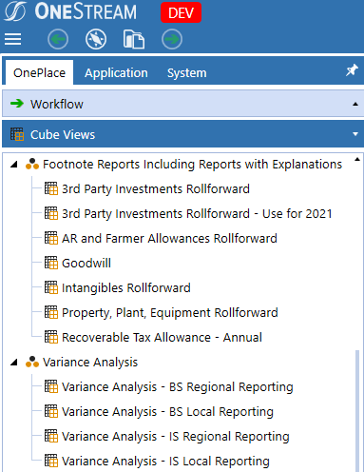
Cube Viewer Dashboard - Segment Portal
Before Cube Viewer Dashboard:
Cube views were stored in separate folders
Users had to open folders and scroll to select the cube view
Had to change the entity on the cube view with POV where selection can not be limited

Slide 9
Cube Viewer Dashboard - Segment Portal
Cube Viewer Dashboard
Buttons replace folders for quicker navigation with cube views moving to drop down lists
Entity tree selection is limited for button for entities valid to each report grouping

Slide 10
Demo

Slide 11
Report Viewer Dashboard - Account Reconciliation
Bunge Objective
OneStream Solution
Executive BI Report Viewer - Account Reconciliation Dashboard directly in OS
Ensure users are reporting accurate and real time data
Provide access to all data fields in the Account Reconciliation application
Improve analysis with access to all Account Reconciliation data including Item detail
Customize KPI calculations. E.g. Separate dues dates for Preparer and Approvers
Provide Tableau users with a comparable OneStream BI interface
Direct access to all Account Reconciliation data including Item detail
Segregate content into five pages: KPI charts, Reports & Analysis
Option to save pages as a multi-page PDF report book
User-friendly Excel-like auto filter analysis to change data selection

Slide 12
Report Viewer Dashboard - Account Reconciliation
Bunge Benefits
Mitigate Risk - Replace Tableau manual data import with OneStream data integration
Convenient access to Reconciliation Reports, grids & charts in OneStream
Provide access to all data fields available in the Account Reconciliation application
Improve analysis with supporting Reconciliation Item detail
Establish OneStream best practice for Enterprise Performance Management Reporting

Slide 13
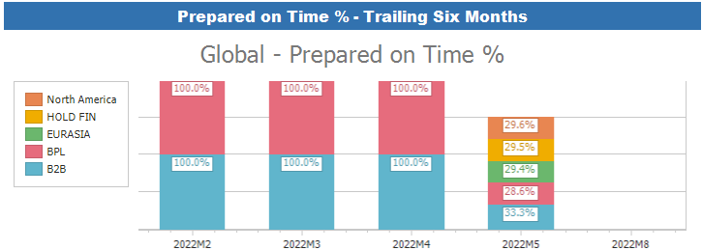
Report Viewer Dashboard - Account Reconciliation
Tableau Report
OneStream

Slide 14
Demo

